Slide 1
Advent Message 2021: Our Faith
Neil Cudden
12/05/2021

Slide 2
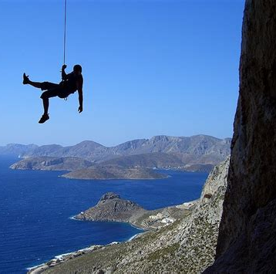
Secular Definition of Faith:
“Strong belief or trust in someone or something.”
- from Merriam-Webster dictionary

Slide 3
Hebrews 11:1 Biblical Definition of Faith:
“Now faith is the assurance of things hoped for, the conviction of things not seen.” (NASB & ESV)
“Now faith is the substance of things hoped for, the evidence of things not seen.” (NKJV)
“Now faith is being sure of what we hope for and certain of what we do not see.” (NIV)

Slide 4
Assurance, Substance, Being Sure: υποστασισ ”upostasis”
Strong’s Concordance #5287
“ essence” concrete definition
“assurance” abstract definition
“confidence”, “confident”, “person”, “substance” (obj. or subj.)

Slide 5
Conviction, Evidence, Certain: ελεγχοσ “elegchos”
Strong’s Concordance #1650
“ evidence”, “reproof”
“convict”, “convince” (from ελεγχω, #1651)

Slide 6
What does it mean:
Secular: The object of trust is pretty darn reliable
- it has a little wiggle-room
Biblical: The thing hoped for is absolutely substantive and real, the thing not seen is definitely there, no exceptions
- no wiggle-room whatsoever
- pretty close to what the NIV says
What faith gives us depends on the nature of the object we put our faith in
It goes without saying that putting our faith in the wrong thing can be very disappointing or get us into a lot of trouble……

Slide 7
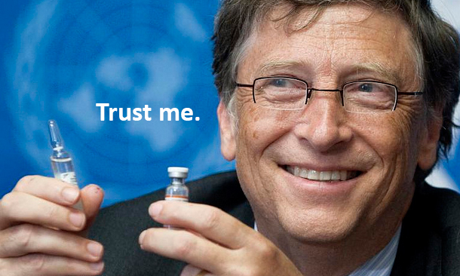
For example……

Slide 8
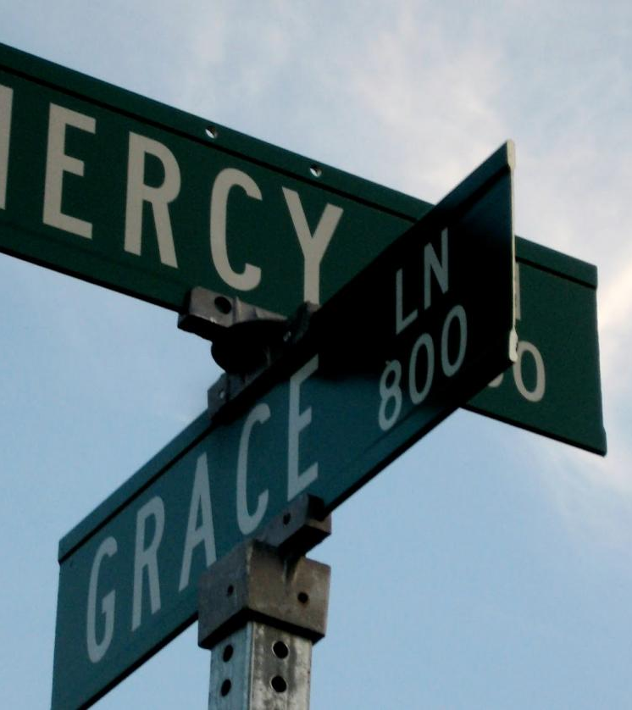
But our Biblical Faith is in God

Slide 9
1 John 5:4-5 (NASB):
“For whatever is born of God overcomes the world. And this is the victory that has overcome the world – our faith. Who is the one that overcomes the world, but he who believes that Jesus is the Son of God?”
- Jesus Christ is the absolutely substantive and real thing hoped for, the thing not seen that is definitely there, and the object of our faith
Habakkuk 2:4 (NASB):
“Behold, as for the proud one, his soul is not right within him; but the righteous will live by his faith.”
- We are to live focused on Jesus Christ and His “every word”
Ephesians 2:8,9 (NASB):
“For by grace you have been saved through faith; and that not of yourselves, it is the gift of God; not as the result of works, that no one should boast.”
- Faith is a gift

Slide 10
Faith is not of this world, but we are to live by faith while in this world
Living by faith in this world does not necessarily mean positive outcomes from this world’s perspective
John 16:33 (NASB)
“In the world you have tribulation, but take courage; I have overcome the world.”
Hebrews 12:7 & 12:10 (NASB)
“It is for discipline that you endure; God deals with you as with sons; for what son is there whom his father does not discipline?”
“…He disciplines us for our good, that we may share His holiness.”
But again, faith has overcome this world
Isaiah 55:11 (NASB)
“It (God’s word) shall not return to Me empty, without accomplishing what I desire, and without succeeding in the matter for which I sent it.”

Slide 11
We live in a world today where Biblical faith is completely misrepresented, even by some who claim to represent Jesus Christ.
Biblical faith is (mis)characterized as:
A thing anyone can have
A means for material gain
A magic substance whose quality is proportional to its quantity
Something God needs in order to be “released” to act
What does God’s word have to say about this?

Slide 12
Can anyone use faith?
James 1:5-8 (NASB):
“But if any of you lacks wisdom, let him ask of God, who gives to all men generously and without reproach, and it will be given to him. But let him ask in faith without any doubting, for the one who doubts is like the surf of the sea driven and tossed by the wind. For let not that man expect that he will see anything from the Lord, being a double-minded man, unstable in all his ways.”
What does James mean by “doubting”…doubting/not believing that the gift asked for will be given or doubting/not believing that the gift asked for can be given?
“’But if You can do anything, take pity on us and help us!’ And Jesus said to him, ‘”If You can!” All things are possible to him who believes.’ Immediately the boy’s father cried out and began saying, ‘I do believe, help my unbelief.’” (Mark 9:22-24 NASB)

Slide 13
Is faith meant to be a means for material gain?
What about Ecclesiastes 11:1? (NASB):
“Cast your bread on the surface of the waters, for you will find it after many days.”
See Galatians 6:8,9 (NASB):
“For the one who sows to his own flesh shall from the flesh reap corruption, but the one who sows to the Spirit shall from the Spirit reap eternal life. And let us not lose heart in doing good, for in due time we shall reap if we do not grow weary.”

Slide 14
Is faith’s “quality” dependent on its “quantity”?
Matthew 17:19,20 (NASB):
“Then the disciples came to Jesus privately and said, ‘Why could we not cast it out?’ And He said to them, ‘Because of the littleness of your faith; for truly I say to you, if you have faith as a mustard seed, you shall say to this mountain, “Move from here to there,” and it shall move; and nothing shall be impossible to you.”
Luke 7:6-9 (NASB):
“…the centurion sent friends, saying to Him, ‘Lord, do not trouble Yourself further, for I am not worthy for You to come under my roof; for this reason I did not even consider myself worthy to come to You, but just say the word and my servant will be healed. For I, too, am a man under authority, with soldiers under me; and I say to this one, “Go!” and he goes; and to another “Come!” and he comes, and to my slave “Do this!” and he does it.’ Now when Jesus heard this, He marveled at him, and turned to the multitude that was following Him, ‘I say to you, not even in Israel have I found such great faith.’”

Slide 15
Does God need us to have faith in Him for Him to be able to act?
What about Mark 6:5,6 (NASB)?:
“And He could do no miracle there except that He laid His hands upon a few sick people and healed them. And He wondered at their unbelief.”
Matthew 13:58 puts it this way
“And He did not do many miracles there because of their unbelief.”
It isn’t that He couldn’t do a miracle because He hadn’t been “released” to do so by human faith, it’s that He chose not to in the absence of faith; “the assurance of things hoped for, the conviction of things not seen.”
Genesis 1:1 (NASB)
“In the beginning God created the heavens and the earth.”

Slide 16
What Real Biblical Faith in Action Teaches Us
“For by it the men of old gained approval.”
- Hebrews 11:2

Slide 17
Abraham
Hebrews 11:17-19 (NASB)
“By faith Abraham, when he was tested, offered up Isaac; and he who had received the promises was offering up his only begotten son; it was he to whom it was said, ‘In Isaac your descendants shall be called.’ He considered that God is able to raise men even from the dead…..”
Genesis 22:10-12 (NASB)
“And Abraham stretched out his hand, and took the knife to slay his son. But the angel of the Lord called to him from heaven, and said, ‘Abraham, Abraham!’ And he said, ‘Here I am.’ And He said, ‘Do not stretch out your hand against the lad, and do nothing to him; for now I know that you fear God, since you have not withheld your son, your only son, from me.’”

Slide 18
Moses
Hebrews 11:29 (NASB)
“By faith they passed through the Red Sea as though they were passing through dry land; and the Egyptians, when they attempted it, were drowned.”
Exodus 14:12-16 (NASB)
“Is this not the word that we spoke to you in Egypt, saying, ‘Leave us alone that we may serve the Egyptians’? For it would have been better for us to serve the Egyptians than to die in the wilderness. But Moses said to the people, ‘Do not fear! Stand by and see the salvation of the Lord which He will accomplish for you today; for the Egyptians whom you have seen today, you will never see them again forever. The Lord will fight for you while you keep silent.’ Then the Lord said to Moses, ‘Why are you crying out to Me?...’”

Slide 19
Shadrach, Meshach, & Abednego
Daniel 3:15-18 (NASB)
“’Now if you are ready, at the moment you hear the sound of the horn, flute, lyre, trigon, psaltery, and bagpipe, and all kinds of music, to fall down and worship the image that I have made, very well. But if you will not worship, you will immediately be cast into the midst of a furnace of blazing fire; and what god is there who can deliver you out of my hands?’ Shadrach, Meshach and Abednego answered and said to the king, ‘Oh Nebuchadnezzar, we do not need to give you an answer concerning this matter. If it be so, our God whom we serve is able to deliver us from the furnace of blazing fire; and He will deliver us out of your hand, O king. But even if He does not, let it be known to you, O king, that we are not going to serve your gods or worship the golden image that you have set up.’”
Daniel 3:27 (NASB)
“…the fire had no effect on the bodies of these men nor was the hair of their head singed, nor were their trousers damaged, nor had the smell of fire even come upon them.”

Slide 20
Mordecai & Esther
Esther 4:13-16 (NASB)
“Then Mordecai told them to reply to Esther, ‘Do not imagine that you in the king’s palace can escape any more than all the Jews. For if you remain silent at this time, relief and deliverance will arise for the Jews from another place, and you and your father’s house will perish. And who knows whether you have not attained royalty for such a time as this?’ Then Esther told them to reply to Mordecai, ‘Go, assemble all the Jews who are found in Susa, and fast for me; do not eat or drink for three days, night or day. I and my maidens will also fast in the same way. And thus I will go in to the king, which is not according to the law; and if I perish, I perish.’”
Esther 8:1,2 (NASB)
“On that day King Ahasuerus gave the house of Haman, the enemy of the Jews, to Queen Esther; and Mordecai came before the king, for Esther had disclosed what he was to her. And the king took off his signet ring which he had taken away from Haman, and gave it to Mordecai.”

Slide 21
John the Baptist, Part I
Matthew 11:2-5 (NASB)
“Now when John in prison heard of the works of Christ, he sent word by his disciples, and said to Him, ‘Are You the Expected One, or shall we look for someone else?’ And Jesus answered and said to them, ‘Go and report to John what you hear and see: the blind receive sight and the lame walk, the lepers are cleansed and the deaf hear, and the dead are raised up, and the poor have the Gospel preached to them.’”
Matthew 11:11 (NASB)
“Truly, I say to you, among those born of women there has not arisen anyone greater than John the Baptist; yet he who is least in the kingdom of heaven is greater than he.”

Slide 22
John the Baptist, Part II
John 3:29,30 (NASB)
“He who has the bride is the bridegroom; but the friend of the bridegroom, who stands and hears him, rejoices greatly because of the bridegroom’s voice. And so this joy of mine has been made full. He must increase, but I must decrease.”
Mark 6:25-28 (NASB)
“And immediately she came in haste before the king and asked, saying, ‘I want you to give me right away the head of John the Baptist on a platter.’ And although the king was very sorry, yet because of his oaths and because of his dinner guests, he was unwilling to refuse her. And immediately the king sent an executioner and commanded him to bring back his head. And he went and had him beheaded in the prison, and brought his head on a platter, and gave it to the girl; and the girl gave it to her mother.”

Slide 23
22 My God, my God, why have You forsaken me? Far from my help are the words of my groaning. ² My God, I cry out by day, but You do not answer; And by night, but I have no rest. ³ Yet You are holy, You who are enthroned upon the praises of Israel. ⁴ In You our fathers trusted; They trusted and You rescued them. ⁵ To You they cried out and they fled to safety; In You they trusted and were not disappointed.
⁶ But I am a worm and not a person, A disgrace of mankind and despised by the people. ⁷ All who see me deride me; They sneer, they shake their heads, saying, ⁸ “Turn him over to the Lord; let Him save him; Let Him rescue him, because He delights in him.”
⁹ Yet You are He who brought me forth from the womb; You made me trust when upon my mother’s breasts. ¹⁰ I was cast upon You from birth; You have been my God from my mother’s womb.
¹¹ Do not be far from me, for trouble is near; For there is no one to help. ¹² Many bulls have surrounded me; Strong bulls of Bashan have encircled me. ¹³ They open their mouths wide at me, As a ravening and roaring lion. ¹⁴ I am poured out like water, And all my bones are out of joint; My heart is like wax; It is melted within me. ¹⁵ My strength is dried up like a piece of pottery, And my tongue clings to my jaws; And You lay me in the dust of death. ¹⁶ For dogs have surrounded me; A band of evildoers has encompassed me; They pierced my hands and my feet.
¹⁷ I can count all my bones. They look, they stare at me; ¹⁸ They divide my garments among them, And they cast lots for my clothing.
¹⁹ But You, Lord, do not be far away; You who are my help, hurry to my assistance. ²⁰ Save my soul from the sword, My only life from the power of the dog. ²¹ Save me from the lion’s mouth;
_________________________________________
From the horns of the wild oxen You answer me.
______________________________________
²² I will proclaim Your name to my brothers; In the midst of the assembly I will praise You. ²³ You who fear the Lord, praise Him; All you descendants of Jacob, glorify Him, And stand in awe of Him, all you descendants of Israel. ²⁴ For He has not despised nor scorned the suffering of the afflicted; Nor has He hidden His face from him; But when he cried to Him for help, He heard.
²⁵ From You comes my praise in the great assembly; I shall pay my vows before those who fear Him. ²⁶ The afflicted will eat and be satisfied; Those who seek Him will praise the Lord. May your heart live forever! ²⁷ All the ends of the earth will remember and turn to the Lord, And all the families of the nations will worship before You. ²⁸ For the kingdom is the Lord’s And He rules over the nations. ²⁹ All the prosperous of the earth will eat and worship, All those who go down to the dust will kneel before Him, Even he who cannot keep his soul alive. ³⁰ A posterity will serve Him; It will be told of the Lord to the coming generation. ³¹ They will come and will declare His righteousness To a people who will be born, that He has performed it.

Slide 24
So how can we describe faith?
It is a gift from God
It is how God brings us to Jesus and His atoning work
It is the means that God has provided to enable us to see beyond this evil world we know to the home we can’t yet imagine
It is our daily strength while in this world, regardless of our outcomes while in this world
The “greatness” of our faith isn’t a measure of quantity, but rather a statement to the degree of our confidence and trust in Jesus

Slide 25
Takeaway:
Having faith isn’t about controlling or even understanding your situation or knowing what God’s going to do; it’s about knowing and trusting God and what He can do
God gave us faith because we need it to see past this world and its deceptions to see Him and the more real eternal world we belong in with Him and through Him
Hebrews 11:6 (NASB):
“And without faith it is impossible to please Him, for he who comes to God must believe that He is, and that He is a rewarder of those who seek Him.”

