Slide 1
Isaiah
Only God is God
Chapter 22
Notes:
Growing up in the Midwest in the 60s/ 70s was different in most respects than now but one thing stands out was the sense of a neighborhood, community, family.
All the neighborhood kids did stuff together and all the parents were involved in parenting or at least chaperoning.
That was one thing I didn't understand about my Dad. I understood why he would scold me but there were many times whre he would scold the neighborhood kids.
For instance, I remember one time we thought it would be a good idea to play catch with horseshoes. As soon as we launched the 1st one, he sprinted over and caught it and them dressed us all down for not using our heads for anything beside a hat rack.
AS I had kids of my own and interacted with THEIR friends, there were times where I found myself injecting myself into their playtime just like my dad and I began to understand.
It wasn't because he didn't want us to have fun. It was because he wanted us to have fun today and live to have fun tomorrow.
In these last few chapters in Isaiah, God has been telling the surrounding nations (all while Judah is listening in) how they can 'have fun' How they can enjoy life, be at peace and relax. It is when they would decide to stop trusting men, political systems, armies, nations or alliances but when they would put their faith in God. He promised to be their protector and to keep them from being destroyed if they would only put their faith in him.
Now, this has been the warning and offer goiung out to the nations.
Warning of destruction for Not trusting in God
Offering of peace for putting faith in God
Judah has been listening to all these messages.
Now it comes time for God to address Judah themselves and not surprisingly, his message is very similar.

Slide 2
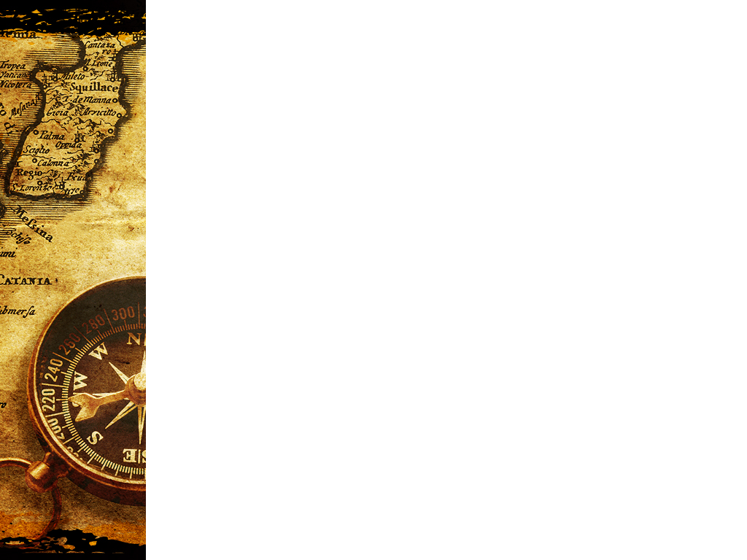
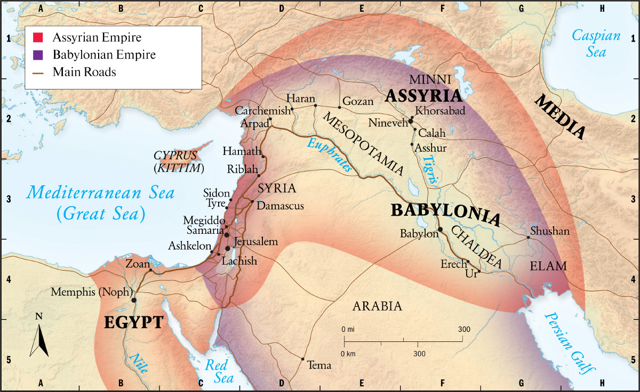
Notes:
The tiiming of this chapter is questionable. There are some who think that it was written prior to the Assyrian attempt to take Jerusalem and there are others who feel that it was written AFTER the Assyrian attempt but prior to the Babylonian invasion.
Remember Assyria came down from the north and was turned back literally at the gate of Jerusalem by God decimating the army with a plague. Although they were uable to destroy Jerusalem, they did make them a vassel state and forced continued tribute. Hezekiah becomes ill and fears for his life. He prays to God and is answered through Isaiah telling him his life will be spared for 15 additional years. In his sickness, the Babylonian King, (who has been engaging in battles with Assyria, sends Hezekiah a gift and wishes him well. Hezekiah, in return shows the babylonians all that he has in their treasuries (This sounds a little like Hezekiah is at least OPEN to the idea of aligning himself with Babylon to shrug off the yoke of Assyria.).
Isaiah tells Hezekiah that because he has opened the door to the babylonians, THEY will remove all the treasure and the people back to Babylon (whih kinda confirms the idea that Hezekiah was trusting more in Babylon than in God for relief from Assyria).
I think that this chapter is written some time AFTER the initial Assyrian defeat but prior to the Babylonian invasion. When Assyria still 'controls' Judah, has 'caged Hezekiah like a bird in a cage' in his palace but prior to the final destruction that babylon brings on judah and especially Jerusalem.

Slide 3
Isaiah 22
“The oracle concerning the valley of vision. What is the matter with you now, that you have all gone up to the housetops? You who were full of noise, You boisterous town, you exultant city; Your slain were not slain with the sword, Nor did they die in battle. All your rulers have fled together, And have been captured without the bow; All of you who were found were taken captive together, Though they had fled far away.” (Isaiah 22:1–3, NASB95)
Notes:
READ
The chapter begins describing who the orqacle is for...”The Valley of Vision” which seems to be an unusual name for Jerusalem, mostly because the city is on a hill and not in a valley but the title god gives the city may be a bit sarcastic. Instead of the top of the hill where there really WOULD BE a possibility of 'vision' he calls the city the 'valley of vision' because it cannot see anything.
This is a reminder of how God said Judah would react to Isaiah's ministry back in chapter 6 and Isaiah's commision as a prophet to the Jews.
“He said, “Go, and tell this people: ‘Keep on listening, but do not perceive; Keep on looking, but do not understand.’ “Render the hearts of this people insensitive, Their ears dull, And their eyes dim, Otherwise they might see with their eyes, Hear with their ears, Understand with their hearts, And return and be healed.” Then I said, “Lord, how long?” And He answered, “Until cities are devastated and without inhabitant, Houses are without people And the land is utterly desolate, “The LORD has removed men far away, And the forsaken places are many in the midst of the land.” (Isaiah 6:9–12, NASB95).
Isaiah goes on to describe HOW the city willl be taken...not by thew sword or in battle but they would be captured when they fled the city.
a prophecy that is fulfilled in the times of jeremiah and recorded in Jeremiah 39:4,5
“When Zedekiah the king of Judah and all the men of war saw them, they fled and went out of the city at night by way of the king’s garden through the gate between the two walls; and he went out toward the Arabah. But the army of the Chaldeans pursued them and overtook Zedekiah in the plains of Jericho; and they seized him and brought him up to Nebuchadnezzar king of Babylon at Riblah in the land of Hamath, and he passed sentence on him.” (Jeremiah 39:4–5, NASB95)

Slide 4
Isaiah 22
“Therefore I say, “Turn your eyes away from me, Let me weep bitterly, Do not try to comfort me concerning the destruction of the daughter of my people.” For the Lord GOD of hosts has a day of panic, subjugation and confusion In the valley of vision, A breaking down of walls And a crying to the mountain.” (Isaiah 22:4–5, NASB95)
Notes:
It continues; READ
Again, we have the heart of Isaiah exposed. Last week we read about his distress as he learded of the terrible defeat Babylon was going to run into at the hands of the Medes and Persians, this week we have him weeping over the distruction of Jerusalem and it;s inhabitants.
Although he weeps, he also recognizes that this...even this has come from the hand of God. The Lord GOD of Hosts has a day of panic. it is HE that has set this in motion and is directing the destruction in conformance with his plan. He is the one behind the breaking down of the walls. the removing of man-made defenses, a tearing apart of the things that Jerusalem has been putting their trust in...forcing them to 'cxry to the mountains' .
This may be a euphamism for their finally, in desperation turning to God as in Ps. 121
“I will lift up my eyes to the mountains; From where shall my help come? My help comes from the LORD, Who made heaven and earth.” (Psalm 121:1–2, NASB95)

Slide 5
Isaiah 22
“Elam took up the quiver With the chariots, infantry and horsemen; And Kir uncovered the shield. Then your choicest valleys were full of chariots, And the horsemen took up fixed positions at the gate. ” (Isaiah 22:6–8a, NASB95)
Notes:
READ
Although the coming destruction is spearheaded by Babylon, they are NOT alone in this military push, Elam and Kir are nations who will join babylon and participate in Judah's destruction.
This announcement seems to have been added to complete in the minds of the Jews hiding in Jerusalem, their inability to fend off this attack. The addition of these nations to Babylon's force is as if God were saying...If you even thingk you can oveerthrow babylon...it ISN't just Babylon. Itwill be a combined force, a united front that will bring about your sure destruction. they will fill your valleys with troops willl be guarding every gat ewith horsemen to capture any woul are thinking they may escape.

Slide 6
Isaiah 2
“In that day you depended on the weapons of the house of the forest, And you saw that the breaches In the wall of the city of David were many; And you collected the waters of the lower pool. Then you counted the houses of Jerusalem And tore down houses to fortify the wall. And you made a reservoir between the two walls For the waters of the old pool. But you did not depend on Him who made it, Nor did you take into consideration Him who planned it long ago.” (Isaiah 22:8b–11, NASB95)
Notes:
God continues on; READ
Judah will be putting their trust in their ability to defend themselves against the babylonians through the use of weapons that they have until then, hidden within the palace (Since it was made mostly of cedar from Lebanon, it was swometimes called the house of the forest.
They trusted in their ablity to repair the breaches in the wall by demolishing houses and using the rubble to fill the gaps and strengthen the wall.
They trusted in their ability to wait out any seige becausethey would have a certain water supply through the aquaducts that Hezekiah had developed to secure the waters flowing from natural springs outside the city.
But they were NOT trusting in the ONLY one able to save them. They were trusting in man made things, weapons, shield, walls and tunnels but they were NOT trusting in the God who made all things.

Slide 7
Isaiah 22
“Therefore in that day the Lord GOD of hosts called you to weeping, to wailing, To shaving the head and to wearing sackcloth. Instead, there is gaiety and gladness, Killing of cattle and slaughtering of sheep, Eating of meat and drinking of wine: “Let us eat and drink, for tomorrow we may die.” But the LORD of hosts revealed Himself to me, “Surely this iniquity shall not be forgiven you Until you die,” says the Lord GOD of hosts.” (Isaiah 22:12–14, NASB95)
Notes:
Because of their misplaced trust, Go will call them to repentance.
READ
He calls them to weep, wail, put on clothes of repentance and shave their heads in humiliation. He calls them to RECOGNIZE what they have done wrong but instead, their reaction in the face of the coming babylonian invasion will be; Partying, “gaeity and gladness'. instead of facing the truth and chosing to live in it's reality, they will chose to build a dream and live in that- temporary though it may be. They will construct a vehicle that says' instead of repenting, lets completely turn away and have one last HURRAH.
Isaiah says, this will NOT go unnoticed by God. instead of their repenting and being restored, their choice to shun God will be met with UNFORGIVENESS.
God DOES NOT FORGIVE those who do not trust in Him.
This is part of the arguemen Paul makes in Romans 4 talking about righteousness. Does it come by works (sacrifices, law obedience) or through faith Trusting in God for justification?
His answer is clear. righteosness- a right standing before God- comes through Faith. Abraham, Isreals Father made this apparent in his own life.
“For if Abraham was justified by works, he has something to boast about, but not before God. For what does the Scripture say? “ABRAHAM BELIEVED GOD, AND IT WAS CREDITED TO HIM AS RIGHTEOUSNESS.” Now to the one who works, his wage is not credited as a favor, but as what is due. But to the one who does not work, but believes in Him who justifies the ungodly, his faith is credited as righteousness, just as David also speaks of the blessing on the man to whom God credits righteousness apart from works: “BLESSED ARE THOSE WHOSE LAWLESS DEEDS HAVE BEEN FORGIVEN, AND WHOSE SINS HAVE BEEN COVERED. “BLESSED IS THE MAN WHOSE SIN THE LORD WILL NOT TAKE INTO ACCOUNT.”” (Romans 4:2–8, NASB95)
Righteousness for Jews OR Gentiles come only through faith.
How would any Jews be saved? By obeying their commands and the proper offering of sacrifices? no, by faith. How would any from Egypt, Edom, or Babylon be saved, by converting to Judiasm or by the same faith. well, we have been reading in the last few chapters that the remnant would be decided on because of their faith.
God is telling the inhabitants of Jerusalem, the City of David, the capitol of the Promised Land that their standing is NOT due to heritage, Lineage, or law =Obedience.It is ONLY because they have chosen to trust God

Slide 8
Isaiah 22
“Thus says the Lord GOD of hosts, “Come, go to this steward, To Shebna, who is in charge of the royal household, ‘What right do you have here, And whom do you have here, That you have hewn a tomb for yourself here, You who hew a tomb on the height, You who carve a resting place for yourself in the rock? ‘Behold, the LORD is about to hurl you headlong, O man. And He is about to grasp you firmly And roll you tightly like a ball, To be cast into a vast country; There you will die And there your splendid chariots will be, You shame of your master’s house.’ “I will depose you from your office, And I will pull you down from your station.” (Isaiah 22:15–19, NASB95)
Notes:
Now, God shift the vision. He moves from a 'national' vision to a practical application and he uses two very real people as examples. One bad, the other better.
READ
The first person he calls to Jerusalems mind is to Shebna, who was a scribe and was part of the entourage that met with the Assyrian army when they called out the inhabitants of Jerusalem to give up and surrender since no other nation and no other God had been able to stop Assyriaa's advance, what possibility did Israel or their God have?
Shebna, along with 2 other men, one was Eliakim who was over the house and the other was Joash, a recoder- took the message that was spoken over the wall of Jerusalem within earshot of the people and brought it to the King Hezekiah.
So far so good. Shebna is doing his job...an honorable official in the service of the king. But God takes us behind the scenes.
Shebna is busy taking care of himself. thinking that his death is immanent, he is NOT trusting in God at all. he is fatalistically preparing for his death and making sure people remember HIM after he is gone.
God's plans for him are significantly different.
Isaiah had started his book of telling us how God looked upon pride. Nothing has changed. not then, not now.
the Lord of hosts WILL have a reckoning;
“For the LORD of hosts will have a day of reckoning Against everyone who is proud and lofty And against everyone who is lifted up, That he may be abased. And it will be against all the cedars of Lebanon that are lofty and lifted up, Against all the oaks of Bashan, Against all the lofty mountains, Against all the hills that are lifted up, Against every high tower, Against every fortified wall, Against all the ships of Tarshish And against all the beautiful craft. The pride of man will be humbled And the loftiness of men will be abased; And the LORD alone will be exalted in that day,” (Isaiah 2:12–17, NASB95)
The pride of man will crumble before the Glory of the Lord. Proverbs 29:23 says A man’s pride will bring him low, But a humble spirit will obtain honor.
and Jesus has these words for those who hold onto pride in their hearts;
““For from within, out of the heart of men, proceed the evil thoughts, fornications, thefts, murders, adulteries, deeds of coveting and wickedness, as well as deceit, sensuality, envy, slander, pride and foolishness. “All these evil things proceed from within and defile the man.”” (Mark 7:21–23, NASB95)
“Defile' comes from the same root word an Koinonia and shares the idea of 'having a share in' or 'contributing to' but defile is having a share in the common, ordinary- not seperate or special. not holy or set apart.
Paul gives us a clearer word picture of what ir means in Rom. 9 talking about thee two types of people in the world. Those he choses and those left behind. “Or does not the potter have a right over the clay, to make from the same lump one vessel for honorable use and another for common use?” (Romans 9:21, NASB95)
He calls the chosen vessels 'honorable and the others he speaks of as being 'for common us'. Nothing special. disposable. not worthy to hold anything of value.
Shebna and his pride are looked at that way. they are less than special, consequently, he will be dealt with in ignomy and cast away in shame in a country that does not even know him.

Slide 9
Isaiah 22
““Then it will come about in that day, That I will summon My servant Eliakim the son of Hilkiah, And I will clothe him with your tunic And tie your sash securely about him. I will entrust him with your authority, And he will become a father to the inhabitants of Jerusalem and to the house of Judah. “Then I will set the key of the house of David on his shoulder, When he opens no one will shut, When he shuts no one will open.” (Isaiah 22:20–22, NASB95)
Notes:
Then we have a comparison being made.
READ
We had Shebna who in his pride will die in a foreign city as an unknown and now we have Eliakim, the ruler over the house that, along with Shebna and Joash, took the message of surrender to Hezekiah.
Eliakim though is different. God will honor him increasing his authority and status within the Jewish nation. he will have the the peoples intrests at heart and he will be able to mold and shape policy and decisions along with Hezekiah, having the keys of the house of David, his authority will be unmatched by anyone beside the king”.

Slide 10
Isaiah 22
““I will drive him like a peg in a firm place, And he will become a throne of glory to his father’s house. “So they will hang on him all the glory of his father’s house, offspring and issue, all the least of vessels, from bowls to all the jars. “In that day,” declares the LORD of hosts, “the peg driven in a firm place will give way; it will even break off and fall, and the load hanging on it will be cut off, for the LORD has spoken.”” (Isaiah 22:23–25, NASB95)
Notes:
God says
READ
He will drive him like a peg in a firm place.
When you are setting up a tent you know when you have set the tent peg in a firm place or if you have driven it into soft dirt that will give away in a wind storm or rain. Eliakim is like the peg driven firmly. the peg you can count on to hold your tent through adversity.
That is exactly what Jerusalem will do, they will 'hang on him all the glory of his fathers house articles and people. he will become responsible for EVERYTHING and under the strain of that much responsibility, the peg will NOT let go or pull up being uprooted, no Eliakim will actually carry the weight until he is sheared off. Broken in to.
Why?
becaus ehe was NEVER meant to carry that much weight. that much respinsibility. He is not able to manage, care fore, help, protect, advocate for, guard, pricvide for everyone. Under that amount of weight, he will fail.
Ther is NO man who is able to shoulder that responsiblity.
Eliakim, as great as a man as he was, was no match for that much.
OShebna, runs away, Eliakim stands until he is destroyed. God iis the ONLY one who will NEVER run away. He will NEVER fail under ANY amount of weigh.
AS a matter of fact, he is the one, the ONLY one able and willing to handle EVERYTHING in your life. He ASKS to shoulder any burden you have.
Fear of the future?
Fear of the past?
Anxiety?
Failing faith?
Peter tells us to;
“Therefore humble yourselves under the mighty hand of God, that He may exalt you at the proper time, casting all your anxiety on Him, because He cares for you.” (1 Peter 5:6–7, NASB95)..
Jerusalem was facing a bleak future...bleak getting bleaker.
Ezekiel (who was a latter contemporary of Isaiah had these words to say to them and to us in Ez. 34. 12-16
Living in uncertain times. he offers this timeless encouragement.
As a shepherd cares for his herd in the day when he is among his scattered sheep, so I will bcare for My sheep and will deliver them from all the places to which they were scattered on a cloudy and gloomy day. I will bring them out from the peoples and gather them from the countries and bring them to their own land; and I will feed them on the mountains of Israel, by the streams, and in all the inhabited places of the land. I will feed them in a good pasture, and their grazing ground will be on the mountain heights of Israel. There they will lie down on good grazing ground and feed in brich pasture on the mountains of Israel. I will feed My flock and I will lead them to rest,” declares the Lord GOD. will seek the lost, bring back the scattered, bind up the broken and strengthen the sick;

