Slide 1
Isaiah
Only God is God
Chapter 24
Notes:
One of the things we need to remember when reading Isaiah is that it is a book written to Israel about them and their time but ALSO a book written to God's people throughout the ages.
-Many times the message is the same for them and us,
-Many times the timeline grows and the mission expands in scope increasing in magnitude the further away from Isaiah's time we get.
As we look at this next chapter (24) we will quickly see that the message that had been pronounced on individual nations was overflowing- spilling over.
Chapter 22 had us look at Israel...a nation failing to fulfill it's call to make God's glory known throught the world and the destruction it would face because it did NOT honor God and reflect His Glory to the world.
Then 23 brought us face to face with the city of Tyre (which represented the unbelieving world) and it's obsession with things, wealth and power. God's wrath was to be poured out on that city time and time again until it was thoroughly destroyed.
This left us with the realization that Israel had failed in it's mission and the world was conscripted for judgement because of its sinful appetites and dismissal of the God of all creation and they were BOTH facing God's judgment

Slide 2
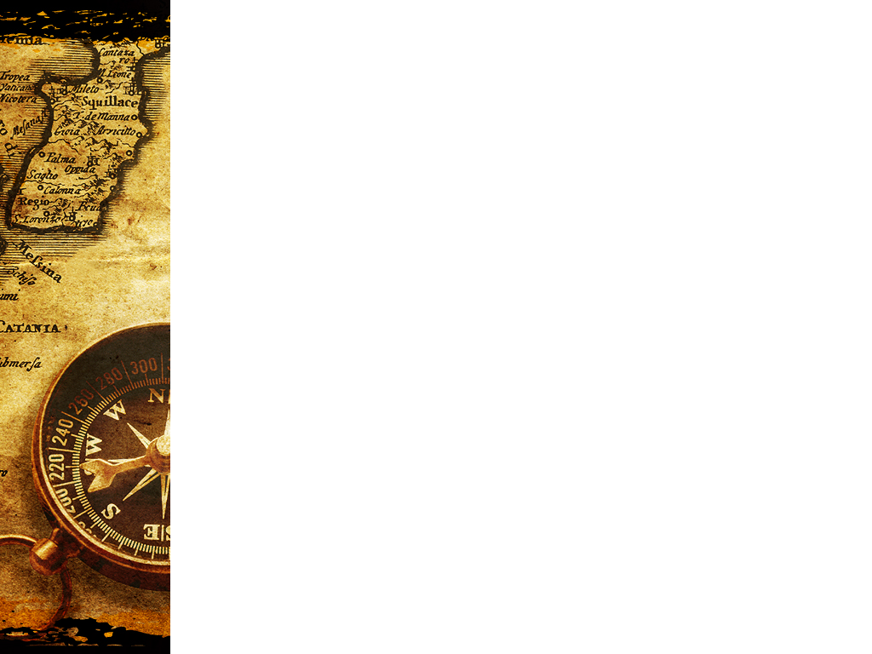
God's
Command
“Be fruitful and multiply”
Adam
Noah
Israel
Jesus
Church
Gen. 1:22
Gen.
9:1
Gen. 35:11
Matt. 28:19
Garden of Eden-Tree of Life- Genesis
City of God-Tree of Life- Revelation
Notes:
This chapter weaves failure and judgment through it pulling from Creation, the Flood the history of nations and the nation of Israel.
In each picture, historically we see a failure to accomplish what God had commanded.
Adam was the first example- falling in the Garden of Eden. Eden is the starting point for historical redemption with the plan culminating in Revelation- the return of Christ and a subtle but real 'return to a NEW Eden', the City of God.
Then we have Noah, the entire earth is destroyed but Noah is saved with his family. The command remains and he fails as well, sleeping with and proceating with his daughters.
Abraham and Israel through him have been given the same command which they fail at- breaking the covenant and never being the witness to the wold of the Glory of God that they were supposed.
to be,
Then we have Jesus who fulfills the command that Adam, Noah, Abraham and Israel fail at; by exhalting God and delivering the message of salvation not only to the Jews but also to neighboring Gentile cities and through his death literally fulfilling his promise to draw all men to himself. In Jesus the Messiah, we have the command made concrete. Fruitful and multiply doesn't necessarily just mean procreation but to reproduce people for God's family, His Kingdom. His Glory.
People who will inherit his new creation and enter into the new Eden- the city of God, introduced in Rev. 21
Lastly we have the chuch and their job is not any different, just more defined. Their fruitfulness and multiplication comes from expanding the Glory of God in the World through the revelation of Jesus Christ by their words and by their actions- their witness and propigating the gospel - delivering the message of redemption through God's son leading to a multiplication of Kingdom inhabitants; more residents in the New Jerusalem- the city of God.

Slide 3
Isaiah 24
“Behold, the LORD lays the earth waste, devastates it, distorts its surface and scatters its inhabitants. And the people will be like the priest, the servant like his master, the maid like her mistress, the buyer like the seller, the lender like the borrower, the creditor like the debtor. The earth will be completely laid waste and completely despoiled, for the LORD has spoken this word. The earth mourns and withers, the world fades and withers, the exalted of the people of the earth fade away.” (Isaiah 24:1–4, NASB95)
Notes:
READ-
So we come to this chapter- It Begins by laying out a world-wide destruction.
Not Assyria, Babylon or Egypt. It is The LORD who will bring this upon the world. It may be that he uses Assyria, Babylon, Persia, Greece , or Rome but it is God who is the judge- issuing judgment through these nation-tools.
Notice that the destruction is NOT JUST removing of people because of their sin but the sin of the people actually has infected the world.
The infection began in the Garden with the curse that caused a once fruitful ground to give up things sparingly...by the sweat of man's brow would he be rewarded.
Yet even through extra effort the infection of creation went beyong an increase in effort. It included weeds, thorns and thistles. Man would plant good grain but because of the curse, gardens would be infested with invasive weeds along side good grain...stealing nutrition and exposure..
Weeds, beginning then from Eden, hold a place in scripture representing sin and sins influence.
When God judges, his judgment falls on mankind but extends into creation- Paul tells us all of creation groans under the burden of corruption in Rom. 8:20-22. Our sin destroys ourselve but ALSO damages creation as well.
Isaiah writes that there is no one safe from this. Every person will be affected as well as all of creation. There is no amount of human wisdom, power, authority, money or worldly influence that can shield sinful man from the righteous judgment of God

Slide 4
Isaiah 24
“The earth is also polluted by its inhabitants, for they transgressed laws, violated statutes, broke the everlasting covenant. Therefore, a curse devours the earth, and those who live in it are held guilty. Therefore, the inhabitants of the earth are burned, and few men are left.” (Isaiah 24:5–6, NASB95)
Notes:
READ-
We are told Why mankind is facing judgment. three reasons;
1. Transgressed laws- the laws that were transgressed were not laws written on the stone tablets. these are the 'laws of nature'. People were not living by the natural laws of revelation.
Laws of conduct as well as laws created that would point to God; recognizing and uncovering who God is (Romans 1 creation reveals the reality and power of God)
2. Violated statutes- literally altering or replacing one with another. in other words, they were innovative in their immorality
3. Broke the everlasting covenant- This idea of an 'everlasting covenant starts with Noah (although THAT is a one sided covenant and mankind holds no responsibility for anything). It's foundation must be broader than that to include the everlasting covenant of Noah AND Abraham, The Sianiac covenant, Covenant with Israel and David's“everlasting covenant.
The foundation really is to include ANY covenant that God had made that created a way to live in fellowship with Himself. They denied themselves of the opportunity to relate with God
because of this threefold failure, God's just judgment would come down on the entire world burning everything up (ref. 2 Peter 3:10-12) “But the day of the Lord will come like a thief, in which the heavens will pass away with a roar and the elements will be destroyed with intense heat, and the earth and its works will be burned up. Since all these things are to be destroyed in this way, what sort of people ought you to be in holy conduct and godliness, looking for and hastening the coming of the day of God, because of which the heavens will be destroyed by burning, and the elements will melt with intense heat!”
Yet there will remain, a remnant-”a few men are left”

Slide 5
Isaiah 24
“The new wine mourns, The vine decays, All the merry-hearted sigh. The gaiety of tambourines ceases, The noise of revelers stops, The gaiety of the harp ceases. They do not drink wine with song; Strong drink is bitter to those who drink it. The city of chaos is broken down; Every house is shut up so that none may enter. There is an outcry in the streets concerning the wine; All joy turns to gloom. The gaiety of the earth is banished. Desolation is left in the city And the gate is battered to ruins.” (Isaiah 24:7–12, NASB95)
Notes:
If you look in your bible, this section (7-12) is set out as a poem
Documenting the failed attempts of mankind to make merry apart from God.
READ-
The normal distractions for people will fail. People will depend on alcohol and alcohol will not give them what they need. There will be no escape- real or imagined.
The new wine mourns- the vine decays- Wine and spirits fail in production AND fail in providing the sense of frivolity the world looks for as even the earth fails under the burden of a continual increase of sin and neglect of God and his laws.
The party is over and all that the world hopes in for good times is useless.
The city of chaos is broken down.
City= organized, yet this is a city of chaos
Chaos is the same word used in the very opening chaper of scripture, describing the time before Gods creation “The earth was formless and void”. The earth is being made useless, without form or structure.
It correlates to the city made by the hand of man that was built around the tower of babel. it was all about mankind; God stepped in and stopped it. Here again, we have the entire earth as the city and God again- stepping in to the city of mans own making- a city of chaos- to destroy it- make it desolate and those that remain are shut up in their hoses, afraid to come out and afraid to be in the streets

Slide 6
Isaiah 24
“For thus it will be in the midst of the earth among the peoples, As the shaking of an olive tree, As the gleanings when the grape harvest is over. They raise their voices, they shout for joy; They cry out from the west concerning the majesty of the LORD.” (Isaiah 24:13–14, NASB95)
Notes:
READ
God will be saving and keeping safe His people in the midst of the destruction. He will shake the entire olive tree- the city of Chaos- the earth- but will keep some; the gleanings he will keep for Himself. he will allow the gleanings-remant to remain and not just remain but to remain and shout for Joy.
God's remnant will be singing for joy in the middle of the holocaust- the collapse- Honoring and glorifying God singing about the “Majesty of the Lord”

Slide 7
Isaiah 24
“Therefore glorify the LORD in the east, The name of the LORD, the God of Israel, In the coastlands of the sea. From the ends of the earth we hear songs, “Glory to the Righteous One,” But I say, “Woe to me! Woe to me! Alas for me! The treacherous deal treacherously, And the treacherous deal very treacherously.” Terror and pit and snare Confront you, O inhabitant of the earth. Then it will be that he who flees the report of disaster will fall into the pit, And he who climbs out of the pit will be caught in the snare; For the windows above are opened, and the foundations of the earth shake.” (Isaiah 24:15–18, NASB95)
Notes:
The praise will continue surrounded by the backdrop of terror
READ
Isaiah exposes his heart once again. He calls for the gleanings to 'glorify God in the East, the name of Lord, the God of Israel, in the coastland. Even to the very ends of the earth there will be praise and songs of Joy. Gods remnant will be from all over. From every tribe, nation and tongue. His 'kept ones' will rejoice in God even as the world around them is destroyed. Isaiah's heart reflects the very heart of God who “is patient toward you, not willing that ANY should perish”.
How could this be? God takes no delight in the destruction of the wicked, yet in his righteousness, judgment is necessary. As children of the king, we will find no joy in the destruction of the city of Chaos BUT we will find joy in two things;
1. Gods righteousness will be fully displayed (Rev. 6:10, 11- the saints under the alter- and they cried out with a loud voice, saying, “How long, O bLord, holy and true, will You refrain from judging and avenging our blood on those who dwell on the earth?” And there was given to each of them a white robe; and they were told that they should rest for a little while longer, until the number of their fellow servants and their brethren who were to be killed even as they had been, would be completed also.
2 That God does ALL things well. God IS GOOD. He is not some mischevious kid that teases or tempts or tries us “because he can”
His ways are not our ways, his thoughts are not ours so we may not see 'the good' in everything that befalls us. Because we don't understand does not mean it isn't true. Because we can't see it doesn't mean it isn't there.
What the original readers AND we are supposed to trust in are God's promises based in his unchanging character in that it is impossible for God to lie
We have all read Ps. 73. It is Asaph's confession of temporary jealousy concerning the apparent easy life the ungodly have here on earth BUT listen to how he bookends the story.
“Surely God is good to Israel, To those who are pure in heart!” (Psalm 73:1, NASB95) He begins telling the readers of the goodness of God before he tells them of his temporary lapse from reality and he closes with still stronger words of affirmation and joy from his position with God;
“Whom have I in heaven but You? And besides You, I desire nothing on earth. My flesh and my heart may fail, But God is the strength of my heart and my portion forever. For, behold, those who are far from You will perish; You have destroyed all those who are unfaithful to You. But as for me, the nearness of God is my good; I have made the Lord GOD my refuge, That I may tell of all Your works.” (Psalm 73:25–28, NASB95)
Asaph realizes that God is at His foundadtion' good and it is good to be near Him. trusting in Him as a refuge and not chasing the sparkle, glitz or distraction the world offers.
Isaiah is stuck in this conundrum- While he recognzes and encourages the songs of joy, his heart is moved as he see the continual self destruction of the ungodly.
The treacherous deal treacherously and the very treacherous deal very treacherously with the very treacherous.
If any of the ungodly think that they may have escaped the coming; the destruction they have escaped they fall into a pit. They rise out of the pit to be caught in a snare. They escape the lion to run into a bear.
These are the words Amos uses to describe those who 'long for the day of the Lord when all they have done is dishonor him.
The world will cry out to God but the time fo mercy will have passed

Slide 8
Isaiah 24
“The earth is broken asunder, The earth is split through, The earth is shaken violently. The earth reels to and fro like a drunkard And it totters like a shack, For its transgression is heavy upon it, And it will fall, never to rise again. So it will happen in that day, That the LORD will punish the host of heaven on high, And the kings of the earth on earth. They will be gathered together Like prisoners in the dungeon, And will be confined in prison; And after many days they will be punished.” (Isaiah 24:19–22, NASB95)
Notes:
Isaiah continues on expanding the judgement
READ
The earth is broken, split through Possibly helping John put words to the revelation he had of the earth's demise when he says in Rev. 6:14 The sky was split apart like a scroll when it is rolled up, and every mountain and island were moved out of their places.
Then he adds one final straw to the camels back concerning the fruitlessness of trusting in the world and powers of men;
He characterizes it as a drunken man-tottering- unstable and untrustworthy
He characterizes it as a shack- erected in a storm- unstable- on the brink of being blown away. with no strenght for support.
This end is due to the sin of mankind. polluting mankind and infecting all of creation “transgression is heavy upon it' it WILL fall because it cannot bear up under the burden of it's self inflicted wounds
Isaiah broadens the scope now including the host of heaven- literally meaning 'those who wage war'. The messengers of Satan; He will gather them together for punishment. Jude 6 says something similar;
“And angels who did not keep their own domain, but abandoned their proper abode, He has kept in eternal bonds under darkness for the judgment of the great day,” (Jude 6, NASB95)
So this sounds a little like premillenialism and the binding of Satan but I think what we have is a perfect picture of reality...Sanan and his workers ARE BOUND. They DO have limits. God in his mercy tells us that the powers of Satan, at the present time are 'restrained' in 2 Thes. 2:26,27.
The “Man of lawlessness has not been released and until that happens, the demons are 'confined' until the coming Day of the Lord when they will be punished..

Slide 9
Isaiah 24
“Then the moon will be abashed and the sun ashamed, For the LORD of hosts will reign on Mount Zion and in Jerusalem, And His glory will be before His elders.” (Isaiah 24:23, NASB95)
Notes:
READ
After that day- the day of judgment, Even the sun and moon will pale in comparison to the glory of God.
1 Cor. 15:25-28 complete the picture;
“For He must reign until He has put all His enemies under His feet. The last enemy that will be abolished is death. For HE HAS PUT ALL THINGS IN SUBJECTION UNDER HIS FEET. But when He says, “All things are put in subjection,” it is evident that He is excepted who put all things in subjection to Him. When all things are subjected to Him, then the Son Himself also will be subjected to the One who subjected all things to Him, so that God may be all in all.”
ALL things will finally be put under His feet including death. Jesus work will have been made manifest in the abolishion of death and His subjecting it to the Father and last of all the Son will put himself volutarily at the feet of the Father.
Isaiah closes with a glimpse of the throne room of Revelation. the Elders surround the very throne of God- worshiping and singing praises.
The 24th Chapter of Isaiah begins a new section that requires that the readers look at God from a more Universal perspective. He is not a 'local' God or the God of ONLY Israel. He is the God with whom EVERYONE has to do!
This coming day of destruction is surely...certainly coming and preparation MUST be made. Changes must happen for many to escape this coming Judgment.
On a personal note; I have always thought that the return of Christ must follow an unusual apostacy and the coming of the 'man of Lawlessness'. So I have felt (rightly or wrongly) that there is still time but I am not so sure anymore. Could recent events have been the impetus for the necessary mass exodus?
Look at our own small church. We had a wholesale change in attendees due to the things taking place in the world. There are reports that as many as 1/3 of all those attending services have stopped due to current events. FEar has replaced or overcome or unraveled or exposed faith.
Despite Gods clear injunction to not forsake the gathering together, many who name the name of Christ have stopped for various reasons and phobias. What does that say?
What does that say to US about the necessity for urgency- for seriousness- for soberness in our walk. We may be very close to the return of Jesus Christ and even closer to the release of more wickedness including the Man of lawlessness.....

