Slide 1
Isaiah
Only God is God
Chapter 61
Notes:
Isaiah has clearly shown that there is NO OTHER God beside our God.
Politics, military might, human will or wisdom stand no chance before our God.
Since He and He alone IS God. That means we aren't!
This leaves only one job description open;
God's servant.
What does it mean to be the servant of God?
What can we learn from other servant's of God?

Slide 2
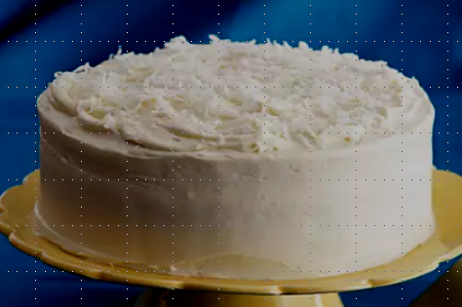
Isaiah 61

Slide 3
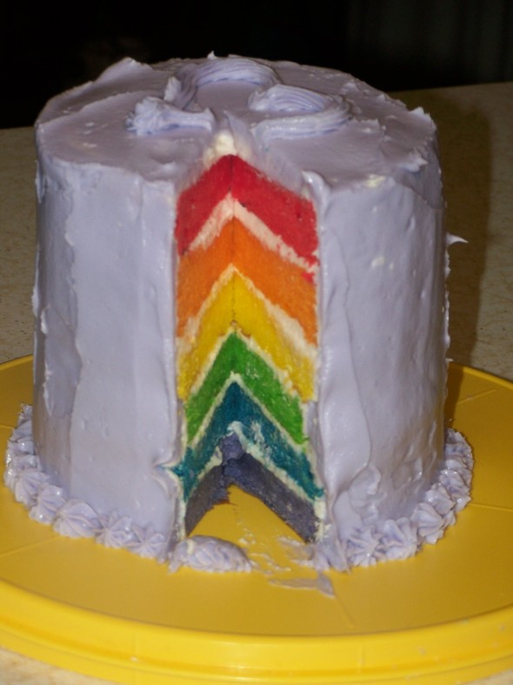
Isaiah 61
Church
Jesus
Isaiah
Cyrus
Remnant
Israel

Slide 4
Isaiah 61
Isaiah 61:1–3
The Spirit of the Lord GOD is upon me, Because the LORD has anointed me To bring good news to the afflicted; He has sent me to bind up the brokenhearted, To proclaim liberty to captives And freedom to prisoners; To proclaim the favorable year of the LORD And the day of vengeance of our God; To comfort all who mourn, To grant those who mourn in Zion, Giving them a garland instead of ashes, The oil of gladness instead of mourning, The mantle of praise instead of a spirit of fainting. So they will be called oaks of righteousness, The planting of the LORD, that He may be glorified.” (NASB95)
Notes:
READ
The chapter begins with Isaiah speaking.
He writes that He has been annointed by God to deliver a message
Isaiah6:6 Then one of the seraphim flew to me with a burning coal in his hand, which he had taken from the altar with tongs.
7 He touched my mouth with it and said, “Behold, this has touched your lips; and your iniquity is taken away and your sin is forgiven.”
8 Then I heard the voice of the Lord, saying, “Whom shall I send, and who will go for Us?” Then I said, “Here am I. Send me!”
9 He said, “Go, and tell this people:
Isaiah, God's servant is to declare that there is life after exile.
There is freedom for God's followers. Joy can be restored the oil of gladness is available and a mantle or garment of praise is awaiting those who are righteous.
What we know, though, is that from the very beginning, Isaiah, God's servant, brings this message to israel. Israel, as Gods unfaithful servant, ll choosees to remain in their rebellionn and rejects God as their God.
Isaiah 6:9 He said, “Go, and tell this people:
‘Keep on listening, but do not perceive;
Keep on looking, but do not understand.’
10 “Render the hearts of this people insensitive,
Their ears dull,
And their eyes dim,
Otherwise they might see with their eyes,
Hear with their ears,
Understand with their hearts,
And return and be healed.”:
We know that when they WERE freed from Babylon, their return to Jerusalem was not full of praise (although there was praise given) but mostly their days were full of work and effort that did nothing to remove the rock of stumbling between God and themselves.
Isaiah is declaring that their return can mark a favorable year of the Lord. He is declaring a celebration, their return could be called a year of jubilee. a forgiveness of debts and restoration.
What we have on record is just the opposite. They return to Jerusalem and very quickly need to put themselve into debt to their own countrymen.
Nehemiah 5:1–3
Now there was a great outcry of the people and of their wives against their Jewish brothers. For there were those who said, “We, our sons and our daughters are many; therefore let us get grain that we may eat and live.” There were others who said, “We are mortgaging our fields, our vineyards and our houses that we might get grain because of the famine.”” (NASB95)
So although we have these blessings that were available to the remnant, as God's servants who returned to Jerusalem, They failed to take hold of them because they would not take hold of God.
The remnant of Israel were unwilling AND unable to claim these promises.
But, if we again, accordion time, We have these same promises reiterated by ANOTHER servant of God.
Luke 4:16–19
And He came to Nazareth, where He had been brought up; and as was His custom, He entered the synagogue on the Sabbath, and stood up to read. And the book of the prophet Isaiah was handed to Him. And He opened the book and found the place where it was written, “THE SPIRIT OF THE LORD IS UPON ME, BECAUSE HE ANOINTED ME TO PREACH THE GOSPEL TO THE POOR. HE HAS SENT ME TO PROCLAIM RELEASE TO THE CAPTIVES, AND RECOVERY OF SIGHT TO THE BLIND, TO SET FREE THOSE WHO ARE OPPRESSED, TO PROCLAIM THE FAVORABLE YEAR OF THE LORD.”” (NASB95).
Now we have Jesus, God's sucessful, faithful servant proclaiming these self same blessings .
But where the nation ofIsrael fails to inherit these promises, God's church, made of Jews and Gentiles, are able to because it is based on the person and work of Gods faithful servant. Not on self generated works. He is the one that will make them righteous.
Jesus proclaims freedom from captivity to sin. A celebration, a year of jubilee because HE is able to cancel the debt of sin that has alienated mankind from God.
Jesus used many of the same promises found in this chapter of Isaia in his sermon on the mount; again, installing his kingdom on earth and proclaiming these new kingdom principles.
Matthew 5:2–12
He opened His mouth and began to teach them, saying, “Blessed are the poor in spirit, for theirs is the kingdom of heaven. “Blessed are those who mourn, for they shall be comforted. “Blessed are the gentle, for they shall inherit the earth. “Blessed are those who hunger and thirst for righteousness, for they shall be satisfied. “Blessed are the merciful, for they shall receive mercy. “Blessed are the pure in heart, for they shall see God. “Blessed are the peacemakers, for they shall be called sons of God. “Blessed are those who have been persecuted for the sake of righteousness, for theirs is the kingdom of heaven. “Blessed are you when people insult you and persecute you, and falsely say all kinds of evil against you because of Me. “Rejoice and be glad, for your reward in heaven is great; for in the same way they persecuted the prophets who were before you.” (NASB95)
The Servant of God,Jesus Christ, is setting the stage for His servants todo their job, fulfill his commission by obediebntly representing God, declaring Him to the nations and glorifying His name.
His first step is to purchase their righteousness.
His people will be recognized by their righteousness. They will be His plantings, the new beginning from the oak.
Going back to Isaiah 6, we have seen this picture before as God declares his coming day of vengeance.
Isaiah 6:12–13
“The LORD has removed men far away, And the forsaken places are many in the midst of the land. “Yet there will be a tenth portion in it, And it will again be subject to burning, Like a terebinth or an oak Whose stump remains when it is felled. The holy seed is its stump.”” (NASB95)
The church is this holy seed, the stump, the planting.

Slide 5
Isaiah 61
Isaiah 61:4–5
Then they will rebuild the ancient ruins, They will raise up the former devastations; And they will repair the ruined cities, The desolations of many generations. Strangers will stand and pasture your flocks, And foreigners will be your farmers and your vinedressers.” (NASB95)
Notes:
These next verses paint pictures of restoration and rebuilding
READ
They begin with the rebuilding of ancient ruins.
The rebuilding effort to restore physical Jerusalem is carried out by Cyrus as God's servant.but the rebuilding that is being looked forward to is launched, funded and headed up by the servant of God. Not Cyrus but Jesus.
Isaiah 44:26–28
Confirming the word of His servant And performing the purpose of His messengers. It is I who says of Jerusalem, ‘She shall be inhabited!’ And of the cities of Judah, ‘They shall be built.’ And I will raise up her ruins again. “It is I who says to the depth of the sea, ‘Be dried up!’ And I will make your rivers dry. “It is I who says of Cyrus, ‘He is My shepherd! And he will perform all My desire.’ And he declares of Jerusalem, ‘She will be built,’ And of the temple, ‘Your foundation will be laid.’ ”” (NASB95).
Jesus Christ, operating as God's faithful servant, moves Cyrus to rebuild the temple and the walls but the rebuilding that is pictured here is a city that was being searched for as far back as Abraham.
Hebrews 11:9–10
By faith he lived as an alien in the land of promise, as in a foreign land, dwelling in tents with Isaac and Jacob, fellow heirs of the same promise; for he was looking for the city which has foundations, whose architect and builder is God.” (NASB95).
THIS city is a city where Jews and gentile will live and prosper. There will be an absence of fear. Gentiles will no longer rule over Jew BUT Jews will not lord it over gentiles either. This was discussed in Isaiah 56:3.
Isaiah 56:3
Let not the foreigner who has joined himself to the LORD say, “The LORD will surely separate me from His people.” Nor let the eunuch say, “Behold, I am a dry tree.”” (NASB95)
They will work as one and the abundance of the nations will be made available.

Slide 6
Isaiah 61
Isaiah 61:6–7
But you will be called the priests of the LORD; You will be spoken of as ministers of our God. You will eat the wealth of nations, And in their riches you will boast. Instead of your shame you will have a double portion, And instead of humiliation they will shout for joy over their portion. Therefore they will possess a double portion in their land, Everlasting joy will be theirs.” (NASB95)
Notes:
These people of God are not slated to RULE the world but to be priests in it. To be God's mouthpiece in it.
READ
The gods of the nations are not discredited so that the followers of God rule over the nations but the gods of the nations are discredited so that the nations of the world come to the knowledge of the TRUE God through the actions of the servant, Jesus Christ and the ones he purchased and made righteous. It is a position of responsibility and not power.
This new kingdom of priests will be worthy of 'double honor' or a double portion.
We are not talking about land or wealth though, Isaiah is describing a role a position of honor.
We are talking about the casting away of shame or reproach and replacing it with honor upon honor.
1 Corinthians 1:26–28
For consider your calling, brethren, that there were not many wise according to the flesh, not many mighty, not many noble; but God has chosen the foolish things of the world to shame the wise, and God has chosen the weak things of the world to shame the things which are strong, and the base things of the world and the despised God has chosen, the things that are not, so that He may nullify the things that are,” (NASB95)
(Read an article about a young woman who was voted in as Prom Queen)
The double portion was reserved for the 1st born in a jewish family. A position of honor BUT ALSO a position of responsibility.
If anything were to happen to a sibling, the 1st born is to be the advocate, the helper.
The position of Firstborn is found completed in Jesus Christ who is the “Firstborne of all creation” and as His followers, we are included being joint or fellow heirs with Christ.
Romans 8:15–17
For you have not received a spirit of slavery leading to fear again, but you have received a spirit of adoption as sons by which we cry out, “Abba! Father!” The Spirit Himself testifies with our spirit that we are children of God, and if children, heirs also, heirs of God and fellow heirs with Christ, if indeed we suffer with Him so that we may also be glorified with Him.” (NASB95)
But the key to this is that it is NOT to make us proud, arrogant but it has been accomplished to bring glory to God THRU Jesus Christ.

Slide 7
Isaiah 61
Isaiah 61:8–9
For I, the LORD, love justice, I hate robbery in the burnt offering; And I will faithfully give them their recompense And make an everlasting covenant with them. Then their offspring will be known among the nations, And their descendants in the midst of the peoples. All who see them will recognize them Because they are the offspring whom the LORD has blessed.” (NASB95)
Notes:
Now we have a change in voice.
It moves from Isaiah being the mouthpiece and declaring to God's servant declaring and the 1st thing he does is introduce himself NOT as the Servant but that HE IS GOD.
READ
The Servant, God, loves justice.
Isaiah 42:3–4
“A bruised reed He will not break And a dimly burning wick He will not extinguish; He will faithfully bring forth justice. “He will not be disheartened or crushed Until He has established justice in the earth; And the coastlands will wait expectantly for His law.”” (NASB95)
Isaiah 51, describes God's ARM as the one that brings justice but we know that God's arm is also another title for His Servant.
The Servant will come and execute justice...giving all their due BUT also confirming again the covenant he has made with His people as an everlasting covenant. A covenant that spans the generations.
The covenant people will be recognized by all as 'blessed by God.'
This sentiment is expressed more fully in Ezekiel 34
Ezekiel 34:28–29
“They will no longer be a prey to the nations, and the beasts of the earth will not devour them; but they will live securely, and no one will make them afraid. “I will establish for them a renowned planting place, and they will not again be victims of famine in the land, and they will not endure the insults of the nations anymore.” (NASB95)

Slide 8
Isaiah 61
Isaiah 61:10–11
I will rejoice greatly in the LORD, My soul will exult in my God; For He has clothed me with garments of salvation, He has wrapped me with a robe of righteousness, As a bridegroom decks himself with a garland, And as a bride adorns herself with her jewels. For as the earth brings forth its sprouts, And as a garden causes the things sown in it to spring up, So the Lord GOD will cause righteousness and praise To spring up before all the nations.” (NASB95)
Notes:
The Servant of God continues by offering praise.
READ
Earlier, the servant had been clothed with garments of battle;
Isaiah 59:17
He put on righteousness like a breastplate, And a helmet of salvation on His head; And He put on garments of vengeance for clothing And wrapped Himself with zeal as a mantle.” (NASB95)
Now we have the same servant but he is clothed differently. He is clothed in salvation and wrapped up in righteousness.
He was the bringer of God's vengence in Isaiah 59 but now he is represented as the one that brings salvation.
He IS righteousness incarnate.
Righteousness and praise spring up from ALL nations because within all nations, The servant has chosen his people and wrapped them in these same garments.
Galatians 3:26–28
For you are all sons of God through faith in Christ Jesus. For all of you who were baptized into Christ have clothed yourselves with Christ. There is neither Jew nor Greek, there is neither slave nor free man, there is neither male nor female; for you are all one in Christ Jesus.” (NASB95)
As a garden causes things to grow, God, clothing his people in righteousness, naturally brings out Praise from His people.
Just like a garden naturally grows food, God's righteousness covering us 'grows praise, glory and honor from His people and also results in evident fruit. Something disobedient israel could not produce.
Psalm 132:7–9
Let us go into His dwelling place; Let us worship at His footstool. Arise, O LORD, to Your resting place, You and the ark of Your strength. Let Your priests be clothed with righteousness, And let Your godly ones sing for joy.” (NASB95)

Slide 9
Isaiah 60:22
Notes:
I

