Slide 1
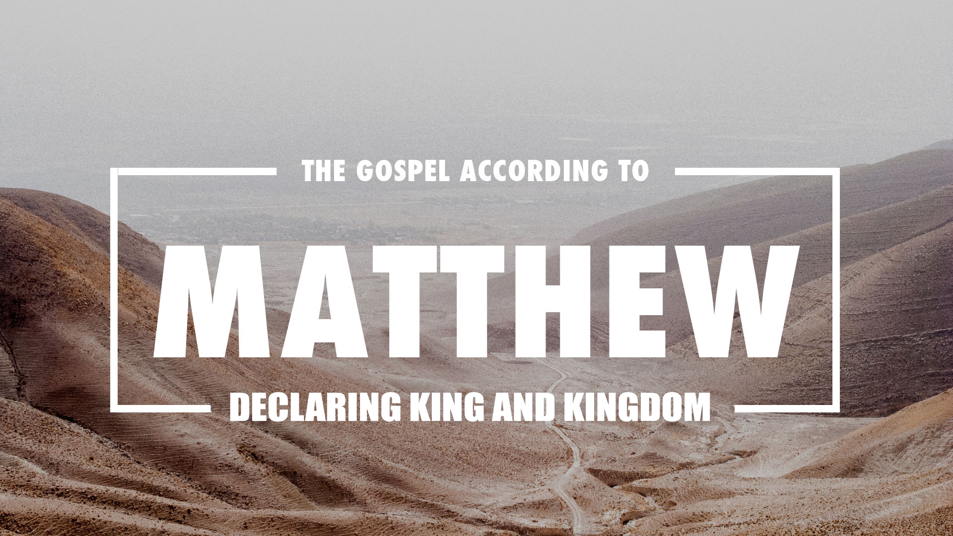
Notes:
This week. Matt. 1;1-17
Got slapped in the face this week by Matthew as I tried to wade through the geneology.
What I had hopped and what actaully happened were 2 different things.
What I hoped would be exciting and sncouraging ended up in a walk 'by faith'
In order to get through the geneology with any degree of honesty and accuracy, We need to review and highlight a couple things about this gospel.
The geneology IS put in scripture s for a reason. God has a purpose for the geneology and for why it is recorded the way it is.
it is our duty and our priveledge, for His glory and even for our encouragement to dive into it.
1 The record of the genealogy of Jesus the Messiah, the son of David, the son of Abraham:
2 Abraham was the father of Isaac(ee-sa-AK), Isaac the father of Jacob(ya-COB), and Jacob the father of Judah(YOO-das) and his brothers.
3 Judah was the father of Perez and Zerah by Tamar, Perez was the father of Hezron(hez-RONE), and Hezron the father of Ram.
4 Ram was the father of Amminadab, Amminadab the father of Nahshon9na-ha-SONE), and Nahshon the father of Salmon.
5 Salmon was the father of Boaz by Rahab, Boaz was the father of Obed(yo-BAID) by Ruth, and Obed the father of Jesse(ye-sa-EE).
6 Jesse was the father of David(dow-WEED) the king.
David was the father of Solomon(so-low-MOAN) by Bathsheba who had been the wife of Uriah (oo-ree-AS).
7 Solomon was the father of Rehoboam(re-bow-AM), Rehoboam the father of Abijah (ah-be-AH) and Abijah the father of Asa (a-SA).
8 Asa was the father of Jehoshaphat(yo-so PHAT), Jehoshaphat the father of Joram(yo-RAM), and Joram the father of Uzziah (oo-ZEE-as).
9 Uzziah was the father of, Jotham(yo-a THAM) the father of Ahaz(a-HAZ), and Ahaz the father of Hezekiah(he-ZEE key-ah).
10 Hezekiah was the father of Manasseh(man-a SES), Manasseh the father of Amon(a-MOS), and Amon the father of Josiah (yo-SEE-as).
11 Josiah became the father of Jeconiah(ye-co-NEE-as) and his brothers, at the time of the deportation to Babylon.
12 After the deportation to Babylon: Jeconiah became the father of Shealtiel(sa-lathee-AIL), and Shealtiel the father of Zerubbabel (ze-ru-ba-BEL).
13 Zerubbabel was the father of Abihud(a-ba-OOD), Abihud the father of Eliakim (el-ee-ah-KEEM), and Eliakim the father of Azor.
14 Azor was the father of Zadok(sa-DOK), Zadok the father of Achim, and Achim the father of Eliud(el-ee-UD).
15 Eliud was the father of Eleazar(el-ee-a-ZAR), Eleazar the father of Matthan, and Matthan the father of Jacob.
16 Jacob was the father of Joseph the husband of Mary, by whom Jesus was born, who is called the Messiah.
17 So all the generations from Abraham to David are fourteen generations; from David to the deportation to Babylon, fourteen generations; and from the deportation to Babylon to the Messiah, fourteen generations.

Slide 2
Eusebius preserved this excerpt from Papias of Hierapolis (70-130 AD): "Matthew put “the logia” in an ordered arrangement in the Hebrew language, but each translated it as best he could."
Lukes “Logia”
Mark's Gospel
Matthew's “Logia”
PETER
Matthew's Gospel
MATTHEW
Notes:
Matthew is assumed to have written the gospel and assembled the geneology. but he did not write it 'directly'. He used his own experiences but he also seems to have kept a notebook or scrap book during this time and very quickly after Jesus death he compiled them and the were recognised as 'the logia' or the words. This compilation is NOT thought to have been his gospel but a body of work that he created that both he and Mark used as they later compiled their gospels
Mark ALSO got much of his information from Peter and it is ALSO assumed that Peter's info was possibly shared with Matthew when he wrote.
Luke mentions in his opening that his writings are based on His careful inestigation as well as eyewitness accounts and accounts from others.

Slide 3
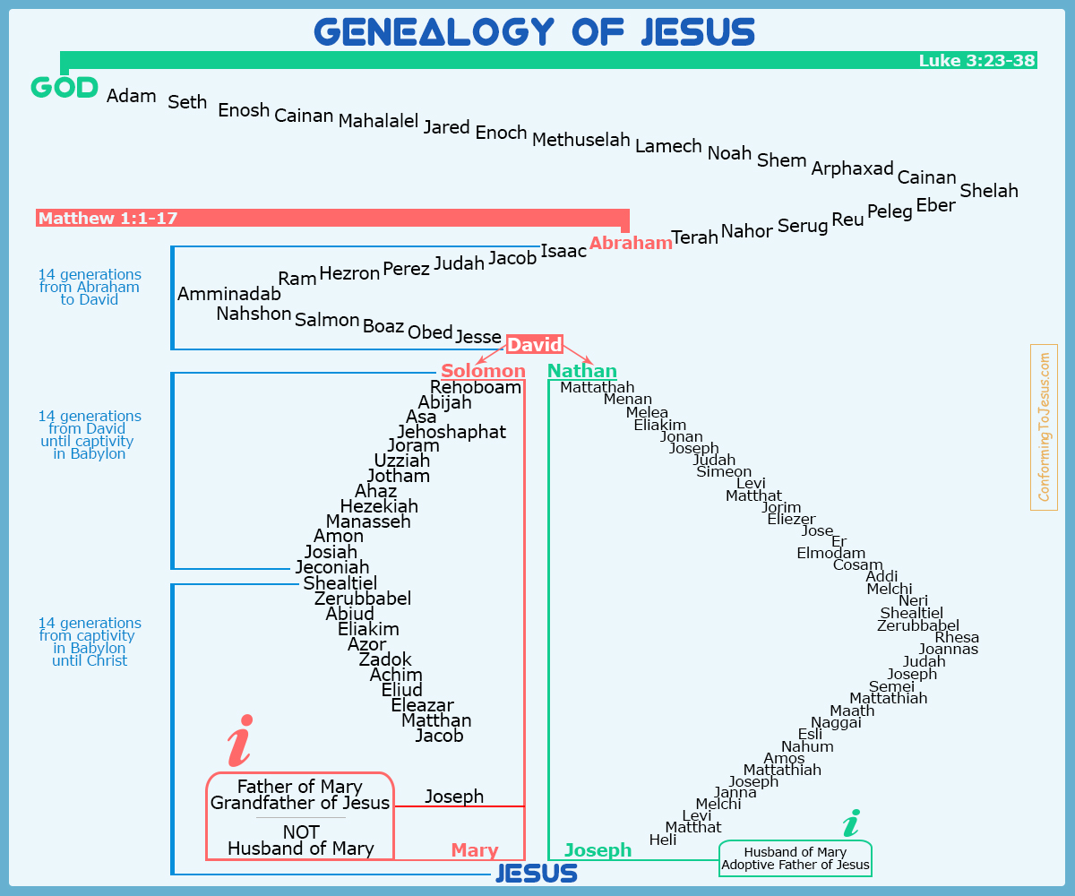
ἀνήρ anēr; a prim. word;
a man: brethern, husband
Notes:
When we get to His geneolgy, It reads alright UNTIL you compare it with Lukes.
We need to do some investigation of our own to try to find out why.
There are an abundance of reasonable answers to the discrepancies found in the geneologies.
It is not my intention to offer a dogmatic solution to this problem, but only to point out that there is a discrepancy in the two genealogies, and that sound, evangelical scholars have posed some reasonable solutions. My purpose is to show that both genealogies are very carefully crafted to teach us some very important truths, truths which are foundational to the gospel of Jesus Christ, and thus to our lives.
We Do need to know two things up front.
a. A geneology is for a reason so it need carry only the information it necessary to make the point
b. Geneologies do, in fact sometimes skip over people. In some cases it was because they brought shame, in some cases a leverite marriage may have erased them. In some cases they were not necessary
Remember the earlier work of Matthew? His “Logia”
The original Hebrew “Logia” was translated into Aramaic and Aramaic writers chose to translate the Hebrew word ANER as father while Greek chose Husband
The Luke chart showed David's lineage through Nathan, Solomons older brother. This could be a problem depending on how you read 2 Sam. 7:12-14.
2 Samuel 7:12–13
“When your days are complete and you lie down with your fathers, I will raise up your descendant after you, who will come forth from you, and I will establish his kingdom. “He shall build a house for My name, and I will establish the throne of his kingdom forever.” (NASB95)
Literally it demands the line flow through Solomon, If Solomon is a placeholder, then either line will work.

Slide 4
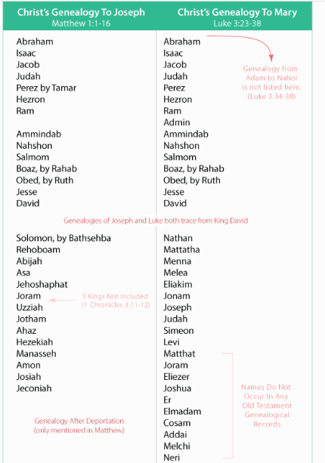
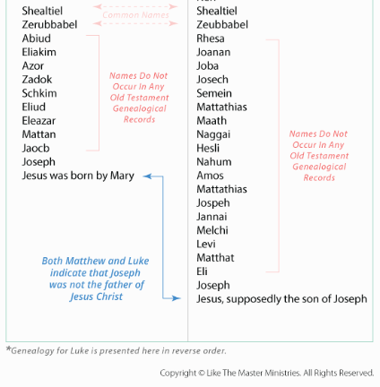
Notes:
J Gresham Mecham says this:”Reconciliation might conceivably be effected in a number of different ways. But on the whole we are inclined to think that the true key to a solution to the problem … is to be found in the fact that Matthew, in an intentionally incomplete way, gives a list of incumbents (actual or potential) of the kingly David throne, whereas Luke traces the descent of Joseph back through Nathan to David. Thus the genealogies cannot properly be used to exhibit contradiction between the Matthean and the Lukan accounts of the birth and infancy of our Lord.”
In other words He says that Matthew is tracing Jesus through the Royal Line while Luke traces him through the Legal line
James Montgomery Boice has this explaination; In my judgment, a better solution involves viewing the two lines as the lines of Joseph and Mary respectively, each thereby identified as a descendant of King David… . According to this view, the distinction between the two lines of descent is not between the ‘legal’ line and the ‘paternal’ line, as Machen suggests, but between the ‘royal’ line of those who actually sat on the throne and the ‘legal’ line of descent from the one oldest son to the next, even though these did not actually rule as kings.
Boice is saying the difference is NOT royal and legal but it is tracing the line through each parent Mary's lineage being opened up in Luke while Joseph's is unraveled in Matthew
Matthew and Luke both tell us that Joseph was not the physical father of Jesus (Matthew 1:16 and Luke 3:23).
Both Matthew and Luke tell us the Holy Spirit caused the birth of Jesus (Matthew 1:20 and Luke 1:34-35).
Matthew's geneology prove Jesus IS a Jew...from the tribe of Judah and as such He can fulfill the promises made to Abraham about his offspring being a blessing to ALL nations as well as the scepter never departing from the tribe of judah.
Matthews' geneology also proves Jesus lineage can be traced back to David (in fulfilment of the promise made to him for a eternal kingdom and someone from his line ruling continually

Slide 5
Matthew
The record of the genealogy of Jesus the Messiah.....
The Rule of 3 fourteens?
Nope the rule of 42 (or 6 sevens)
42 is a placeholder John uses by Inspriation of the Holy Spirit as the time 'left' for Satan. It is the time Satan has left before Jesus returns.
But do not measure the outer courtyard, for it has been turned over to the nations. They will trample the holy city for 42 months. —Revelation 11:2 (NLT)
Then the beast was allowed to speak great blasphemies against God. And he was given authority to do whatever he wanted for forty-two months. —Revelation 13:5 (NLT)
Notes:
Matthew makes special efforts for us to see 14 in the geneology.
the number 14 doesn't have any specific meaning (outside of 2X7)
But if you take the fourteens together, there are a few observations that can be considered.
First of all 6 is the number of man
7 is the number for perfection
6X7 = 42 and that number holds a place in God's economy. recognizing it as a section of time or an allotment- an 'allowment'.
Not for good but for evil.

Slide 6
Matthew
The record of the genealogy of Jesus the Messiah.....
The Rule of 3 fourteens?
Nope the rule of 42 (or 6 sevens)
Jesus comes on the scene as the 7th of the sevens.
He is the Sabbath rest (7th day)
He is the 49th (last) year that culminates in the year of Jubilee (50th year)
L
Notes:
With Jesus coming in after the 3 14s or beginning the seventh 7
We can see in him 7squared perfection. We can identify him ushering in the sabbath day sabbath rest .
rest but we can ALSO see him as the final efforts (49th year) that is in preparation for the year of Jubilee.

Slide 7
Matthew-
Leviticus 25:3–10
‘Six years you shall sow your field, and six years you shall prune your vineyard and gather in its crop, but during the seventh year the land shall have a sabbath rest, a sabbath to the LORD; you shall not sow your field nor prune your vineyard. ‘Your harvest’s aftergrowth you shall not reap, and your grapes of untrimmed vines you shall not gather; the land shall have a sabbatical year. ‘All of you shall have the sabbath products of the land for food; yourself, and your male and female slaves, and your hired man and your foreign resident, those who live as aliens with you. ‘Even your cattle and the animals that are in your land shall have all its crops to eat. ‘You are also to count off seven sabbaths of years for yourself, seven times seven years, so that you have the time of the seven sabbaths of years, namely, forty-nine years. ‘You shall then sound a ram’s horn abroad on the tenth day of the seventh month; on the day of atonement you shall sound a horn all through your land. ‘You shall thus consecrate the fiftieth year and proclaim a release through the land to all its inhabitants. It shall be a jubilee for you, and each of you shall return to his own property, and each of you shall return to his family.” (NASB95)
Notes:
With Jesus coming in after the 3 14s or beginning the seventh 7
We can see in him ushering in the sabbath rest but we can ALSO see him as the final efforts (49th year) that is in preparation for the year of Jubilee.

Slide 8
Matthew-
The record of the genealogy of Jesus the Messiah...
Geneologies are records of ....deaths
Matthew introduces his Gospel with the first genealogy of the New Testament. Not only are we reminded that everyone in this genealogy died, just like in all the rest.
Matthew’s words seem to hint that in Jesus there begins a whole new race of people who will never die. It begins a new line, the line of all who are “in Christ” by faith, who thereby possess the gift of eternal life. Here is an exciting genealogy indeed! Who would not want to be included in our Lord’s lineage?
Notes:
What can we learn for Tis geneology of Jesus?
1st...That in his jeneology, everyone dies. Then Jesus comes on the scene....perfection.
Matthew seems to be unpacking the beginning of a NEW geneology- a geneology filled with names of people who NEVER die.
The rich young ruler asks about entrance into 'eternal life'. Jesus promises the righteouse in Ch. 25 that they will enter eternal life.

Slide 9
Matthew-
The record of the genealogy of Jesus the Messiah, the son of David...
Jesus geneology is riddled with 'sinners'
Jacob-deceiver Judah-incest
Rahab- prostitute David- adultery
Solomon-swayed by wives Rehoboam-rebellion
Matthew 9:13
“But go and learn what this means: ‘I DESIRE COMPASSION, AND NOT SACRIFICE,’ for I did not come to call the righteous, but sinners.”” (NASB95)
Notes:
Jesus lineage is filled with sinners. “He came to save sinners Of whom I am chief”- Paul
Hebrews 1:11 says: For both He who sanctifies and those who are sanctified are all from one Father; for which reason He is not ashamed to call them brethren,” (NASB95)
He does not come from sort of aristocratic line. His heredity is filled will bad eggs, the same asyou or I. Yet because of this. what he does on the cross for us, unites us with him in erernity.

Slide 10
Matthew-
The record of the genealogy of Jesus the Messiah, the son of David...
Jesus geneology has gentile representation
Rahab- Caananite
Ruth Moabitess
Jesus geneology testifies to divine election
Judah
Boaz
David
Solomon
None of these were in the 'logical order' of a geneological progression
Notes:
Jesus is born a jew. Has a jewish lineage but his mission of salvation is for all the world.
Salvation knows no boundaries.
it knows no lineage or pedigree.
It does not come on the logical or worthy. Paul says;
1 Corinthians 1:26–29
For consider your calling, brethren, that there were not many wise according to the flesh, not many mighty, not many noble; but God has chosen the foolish things of the world to shame the wise, and God has chosen the weak things of the world to shame the things which are strong, and the base things of the world and the despised God has chosen, the things that are not, so that He may nullify the things that are, so that no man may boast before God.” (NASB95)
Jesus is NOT the savior of the Jews but the savior of the world. Again paul in his letter to the Ephesians...Ephesians 3:6
to be specific, that the Gentiles are fellow heirs and fellow members of the body, and fellow partakers of the promise in Christ Jesus through the gospel,” (NASB95)

Slide 11
Matthew-
The record of the genealogy of Jesus the Messiah, the son of David, the son of Abraham
Matthew’s genealogy covers the entire history of Israel, from Abraham to Christ and emphasizes the fulfillment of Old Testament prophecies and Jesus authority as king over his kingdom.
The genealogies combined confirm to us that Jesus Christ is the fulfillment of the entire Old Testament. The history of humankind. No matter where we turn in the Old Testament, Christ is there.

Slide 12
Matthew-
The record of the genealogy of Jesus the Messiah, the son of David, the son of Abraham
Matthew’s genealogy covers the entire history of Israel, from Abraham to Christ and emphasizes the fulfillment of Old Testament prophecies and Jesus authority as king over his kingdom.
The genealogies combined confirm to us that Jesus Christ is the fulfillment of the entire Old Testament. The history of humankind. No matter where we turn in the Old Testament, Christ is there.

