Slide 1
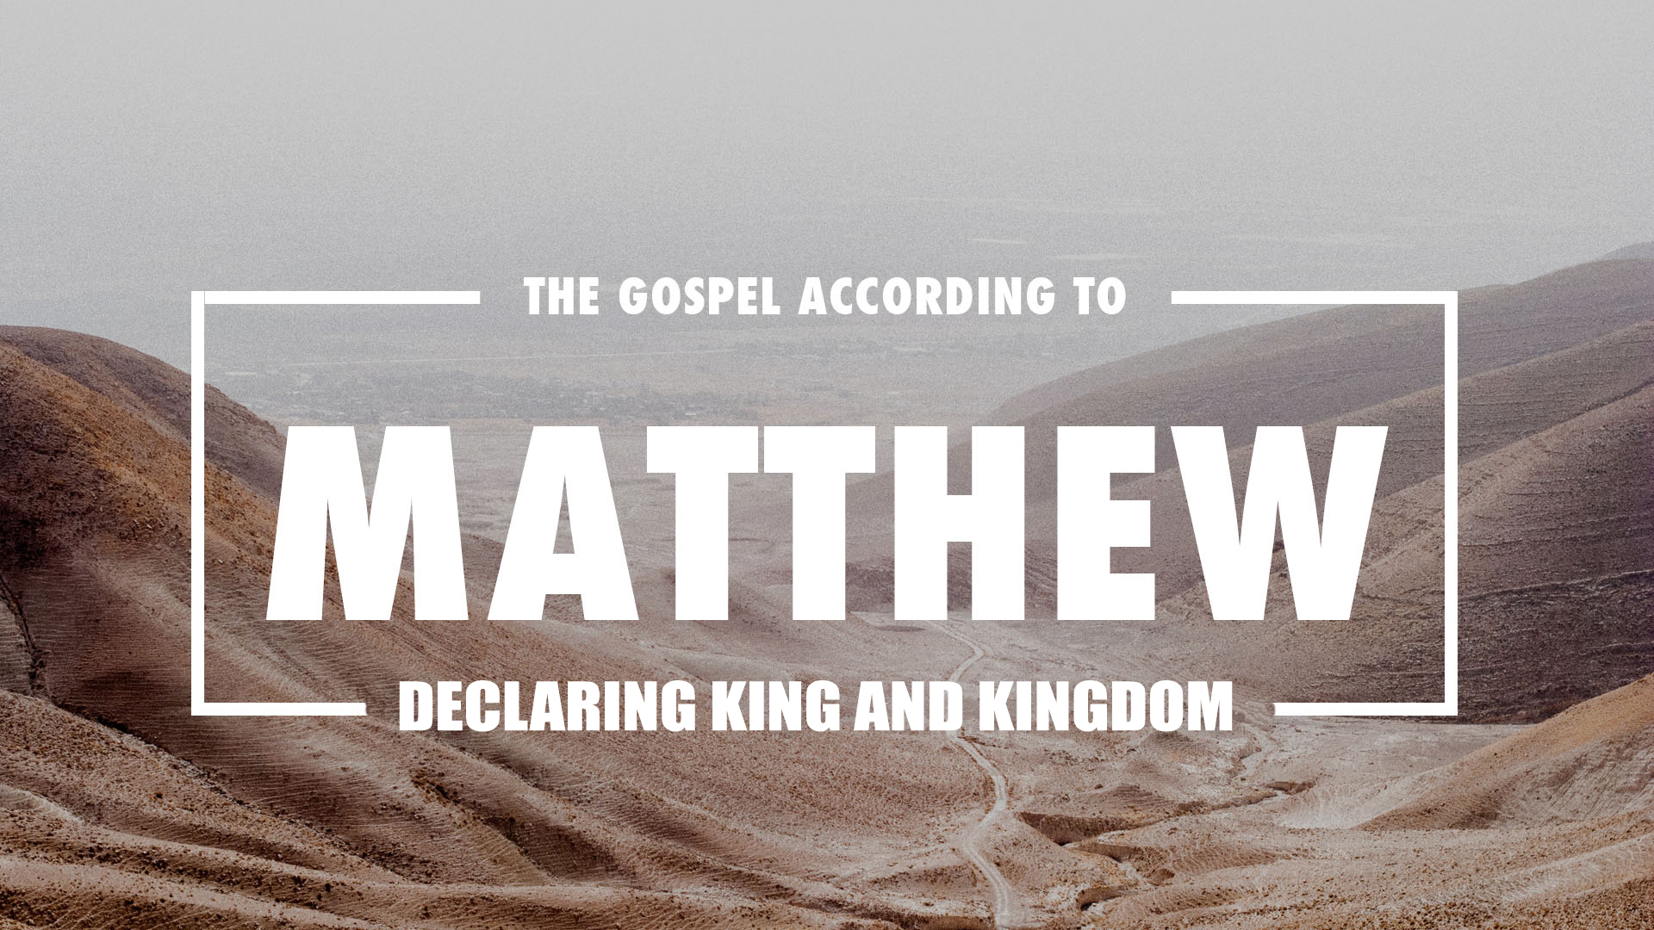
Notes:
“You need a Savior”
“You need to find salvation”
It sounds like this is something you get to choose from. There are a bunch of different OPTIONS for 'savior'. Salvation is a formula with interchangeable pieces like 1+3 or 2+2 or 1+1+1+1. The result for all these equations is the same.......4
Satan has the world thinking that there is a shelf with saviors and you can pick the one you most agree with or like or looks good to you.
Matthew's gospel is all about a savior and all about salvation
BUT it is all about THE Savior.
His opening genealogy has proven to us Jesus historicity and heritage. He is 'suitable'. He fits the bill from a historical/ genealogical perspective.
In this section of scripture, Matthew tunes this description and at the end, displays Jesus as the ONLY savior. The only REAL savior, The only POSSIBLE savior.
Acts 4:12
“And there is salvation in no one else; for there is no other name under heaven that has been given among men by which we must be saved.”” (NASB95)
THIS is Matthew's goal. Jesus isn't 'only one among many' He is the ONLY one.

Slide 2
Matthew 1:18-25
Matthew 1:18–25
Now the birth of Jesus Christ was as follows: when His mother Mary had been betrothed to Joseph, before they came together she was found to be with child by the Holy Spirit. And Joseph her husband, being a righteous man and not wanting to disgrace her, planned to send her away secretly. But when he had considered this, behold, an angel of the Lord appeared to him in a dream, saying, “Joseph, son of David, do not be afraid to take Mary as your wife; for the Child who has been conceived in her is of the Holy Spirit. “She will bear a Son; and you shall call His name Jesus, for He will save His people from their sins.” Now all this took place to fulfill what was spoken by the Lord through the prophet: “BEHOLD, THE VIRGIN SHALL BE WITH CHILD AND SHALL BEAR A SON, AND THEY SHALL CALL HIS NAME IMMANUEL,” which translated means, “GOD WITH US.” And Joseph awoke from his sleep and did as the angel of the Lord commanded him, and took Mary as his wife, but kept her a virgin until she gave birth to a Son; and he called His name Jesus.” (NASB95)
Notes:
Having gone through Ancestry.com for Jesus, We now come to the section in Matthew that unveils Jesus own birth and it is complex.
It is encouraging but complex.
Matthew wastes NO TIME using quotes from The Prophets to confirm Jesus as King....and much more.
READ

Slide 3
Matthew 1:18-25
The virgin birth-
Confirms the origin of the HUMANITY of Jesus
Joseph was NOT his father
Luke 3:23
When He began His ministry, Jesus Himself was about thirty years of age, being, as was supposed, the son of Joseph, the son of Eli,” (NASB95)
Does NOT confirm that Jesus is divine but that his human origin is supernatural
Supernatural births may confirm a degree of 'specialness' but not NECESSARILY divinity
Adam, Eve, Isaac, John
Notes:
First thing is to deal with this amazing birth story.
The virgin birth....Let's get it in proper perspective
The Virgin birth confirms the humanity of Jesus- Important.
For him to be our Representative.
For him to be our Advocate He needs to be Like us...humans.
Hebrews 2:17–18
Therefore, He had to be made like His brethren in all things, so that He might become a merciful and faithful high priest in things pertaining to God, to make propitiation for the sins of the people. For since He Himself was tempted in that which He has suffered, He is able to come to the aid of those who are tempted.” (NASB95)
The virgin birth confirms for us that he is human AND that Joseph was NOT his father
AS was supposed- lit.= As was assigned
Yet, That does NOT make Jesus illegitimate
Joseph being a righteous man, is persuaded by the message to marry Mary despite the strict demand of the Law.
What the virgin birth does NOT do is confirm for us that Jesus is Divine.
We cannot ASSUME that Jesus being born of a virgin MUST make him God.

Slide 4
Matthew 1:18-25
The virgin birth-
Is NOT required for Jesus 'sinlessness'
Representation v biology v 'mediate imputation'
Romans 5:18–19
So then as through one transgression there resulted condemnation to all men, even so through one act of righteousness there resulted justification of life to all men. For as through the one man’s disobedience the many were made sinners, even so through the obedience of the One the many will be made righteous.” (NASB95)
Notes:
Original Sin- what we inherit from Adam our sinful NATURE.
Actual sin- what we do in acting OUT that nature
Representation- Federal Headship- His acts are accounted to us. Government- Arizona is a RED state.
This was even the case with Adam and Eve as it was Adam's sin that brought this upon us although Eve is the first to have recorded sinning.
Biology- Adam's sin is translated to humankind through chromosomes. It is beieved The male (usually) is the culprit hence the need to et rid of Joseph.
. If it were tied to biology, the above analogy would fall apart since we are all not biologically related to Christ although we ARE all biologically related to Adam. This argument also fails in that Mary confirms that she herself is a sinner in Luke 1.
Luke 1:46–47
And Mary said: “My soul exalts the Lord, And my spirit has rejoiced in God my Savior.” (NASB95)
Mediate imputation=all mankind have become sinners THROUGH the influence of Adam's sin. Guilt is imputed to us NOT based on Adam's original sin but on the sinfulness developed within us. (innocent babies)

Slide 5
Matthew 1:18-25
JESUS virgin birth-
was absolutely necessary
To fulfill the prophetic vision
Isaiah 7:13–16
Then he said, “Listen now, O house of David! Is it too slight a thing for you to try the patience of men, that you will try the patience of my God as well? “Therefore the Lord Himself will give you a sign: Behold, a virgin will be with child and bear a son, and she will call His name Immanuel. “He will eat curds and honey at the time He knows enough to refuse evil and choose good. “For before the boy will know enough to refuse evil and choose good, the land whose two kings you dread will be forsaken.” (NASB95)
Notes:
The Story...Ahaz is king of Judah.
Rezin, the king of Aram and Pekah, the king of Israel
are gathering their forces to unite in a strike to overthrow Judah.
God sends Isaiah out to Ahaz to deliver this message;
‘Take care and be calm, have no fear and do not be fainthearted because of these two stubs of smoldering firebrands, on account of the fierce anger of Rezin and Aram and the son of Remaliah.
5 ‘Because Aram, with Ephraim and the son of Remaliah, has planned evil against you, saying,
6 “Let us go up against Judah and terrorize it, and make for ourselves a breach in its walls and set up the son of Tabeel as king in the midst of it,”
7 thus says the Lord GOD: “It shall not stand nor shall it come to pass.
8 “For the head of Aram is Damascus and the head of Damascus is Rezin (now within another 65 years Ephraim will be shattered, so that it is no longer a people),
9 and the head of Ephraim is Samaria and the head of Samaria is the son of Remaliah. If you will not believe, you surely shall not last.” who”
Ahaz (for whatever reason) declines saying he doesn't want to “test” God (although it was God wh told him to ask)
God then declares that HE will define the sign and here it is... a virgin will be with child and bear a son, and she will call His name Immanuel. “He will eat curds and honey at the time He knows enough to refuse evil and choose good. “For before the boy will know enough to refuse evil and choose good, the land whose two kings you dread will be forsaken.”
What God did NOT provide was a time frame!...except that when this sign happens, neither Israel or Aram will be of any concern to Ahaz OR to the entire hose/ dynasty of David.
When we went through this, I went back to look at my notes) I said;
So then we come to what could it mean?
Could it mean;
1 a virgin in Ahaz's/ Isaiah's time-frame?
2 maybe a young girl (Ahaz's concubine)
3 Isaiah's wife?
4 The land itself (see 8:8)
5 a foretelling of Jesus Christ
6 a combination of any two
If it was SOLELY about Jesus, what kind of sign could it be for Ahaz who died 700 years before Jesus advent. Also, this Immanuel seems to be alive after the fall fall of 2 nations.
There are arguments for all of these positions.
I don't have an answer but what do have is this.
1. Whatever it was, it was amazing. If God had offered ANYTHING in or under heaven as a sign, do you think he would have settled for something that had happened or was duplicatable? ...a NORMAL birth of a boy named Immanuel
2. This same Immanuel is called out later in chapter 9 and there is nothing uncertain about who THAT Immanuel is referencing.
3. This name Immanuel meant something ENTIRELY different for Isaiah as a believer than it did for Ahaz who was coming under God's anger!
4. the repeated reference to Ahaz and Israel as the House of David sets up the birth of Immanuel in the lineage if the house of David! in other words the Immanuel child would come from the Line of David.
There may have been a near time fulfillment (maybe Hezekiah or Isaiahs's children).
But...It was a sign NOT just to Ahaz but to the entire house and lineage of David. To his dynasty and rule.
There was ONLY 1 complete fulfillment...here it is in Matthew's own words...to confirm what was written.
BUT the writing DOESN'T just confirm the virgin birth.
It confirms the NAME...God with us.
This birth is MORE that just a virgin birth of a normal child this sign is the sign God chose to confirm the birth of Immanuel...God with us.
This theme of God with us sticks around in Isaiah.
In the next chapter (Ch. 8) Isaiah calls all the remnant to:...
Be broken, O peoples, and be shattered;
And give ear, all remote places of the earth.
Gird yourselves, yet be shattered;
Gird yourselves, yet be shattered.
Devise a plan, but it will be thwarted;
State a proposal, but it will not stand,
For God is with us.
The believers were to repent, turn, trust in God and not in their plans because...God IS with us.
Then in the very next chapter, we have the definition for the coming Immanuel that leaves little to the imagination.
Isaiah 9:6–7
For a child will be born to us, a son will be given to us; And the government will rest on His shoulders; And His name will be called Wonderful Counselor, Mighty God, Eternal Father, Prince of Peace. There will be no end to the increase of His government or of peace, On the throne of David and over his kingdom, To establish it and to uphold it with justice and righteousness From then on and forevermore. The zeal of the LORD of hosts will accomplish this.” (NASB95)
Immanuel is NOT the sign the birth is the sign. Immanuel is the reality

Slide 6
Matthew 1:18-25
The incarnation concerns the DIETY of Christ- God became man
The Incarnation would have been supernatural and miraculous even if the incarnate one had had an otherwise normal birth
The Arian Controversy (4th century) centers on the incarnation.
homoousios (“of the same substance” or “of the same essence”)
homoiousios (“of like essence”).
Nicene Creed...eternally begotten of the Father, God from God, Light from Light, true God from true God,begotten, not made, one in Being with the Father.
Notes:
Arius= His basic notion was that the Son came into being through the will of the Father; the Son, therefore, had a beginning. Although the Son was before all eternity, he was not eternal, and Father and Son were not of the same essence.
According to Athanasius, God had to become human so that humans could become divine. Thus, at the heart of Athanasius’s Christology was a religious rather than a speculative concern. That led him to conclude that the divine nature in Jesus was identical to that of the Father and that Father and Son have the same substance.
Council of Chalcedon in 451; perfect in Godhead and also perfect in humanity; truly God and truly man, of a reasonable soul and body; consubstantial with the Father according to the Godhead, and consubstantial with us according to humanity; in all things like unto us, without sin; begotten before all ages according to the Godhead.
We apprehend this one and only Christ—Son, Lord, only-begotten—in two natures; without confusing the two natures, without transmuting one nature into the other; without dividing them into two separate categories; without contrasting them according to area or function. The union does not nullify the distinctiveness of each nature. Instead, the properties of each nature are conserved and both natures concur in one person.

Slide 7
Matthew 1:18-25
The incarnation concerns the DIETY of Christ- God became man
Incarnation involves emptying and taking on
Phil. 2:6-8
Who , although He existed in the form of God, did not regard equality with God a thing to be grasped, but emptied Himself, taking the form of a bond-servant, and being made in the likeness of men. Being found in appearance as a man, He humbled Himself by becoming obedient to the point of death, even death on a cross.” (NASB95)

Slide 8
Matthew 1:18-25
The incarnation concerns the DIETY of Christ- God became man
Incarnation involves emptying....
Did he...
1. Not hold onto what he already possessed?
2. Not grasp for what he did not yet possess?
And taking on...
...the form (GK=morphe; image) more than representation but actual presence)
Matthew 20:28
just as the Son of Man did not come to be served, but to serve, and to give His life a ransom for many.”” (NASB95)
Notes:
If #1, we run into a problem of Jesus not being God and his incarnate life has been stripped of actual meaning or effect.
If #2, and we understand his role as 'savior' as what he was yet to possess, it makes sense and adds power to Jesus temptation in the wilderness
Matthew 4:1–11
Then Jesus was led up by the Spirit into the wilderness to be tempted by the devil. And after He had fasted forty days and forty nights, He then became hungry. And the tempter came and said to Him, “If You are the Son of God, command that these stones become bread.” But He answered and said, “It is written, ‘MAN SHALL NOT LIVE ON BREAD ALONE, BUT ON EVERY WORD THAT PROCEEDS OUT OF THE MOUTH OF GOD.mankind” Then the devil took Him into the holy city and had Him stand on the pinnacle of the temple, and said to Him, “If You are the Son of God, throw Yourself down; for it is written, ‘HE WILL COMMAND HIS ANGELS CONCERNING YOU’; and ‘ON their HANDS THEY WILL BEAR YOU UP, SO THAT YOU WILL NOT STRIKE YOUR FOOT AGAINST A STONE.’ ” Jesus said to him, “On the other hand, it is written, ‘YOU SHALL NOT PUT THE LORD YOUR GOD TO THE TEST.’ ” Again, the devil took Him to a very high mountain and showed Him all the kingdoms of the world and their glory; and he said to Him, “All these things I will give You, if You fall down and worship me.” Then Jesus said to him, “Go, Satan! For it is written, ‘YOU SHALL WORSHIP THE LORD YOUR GOD, AND SERVE HIM ONLY.” Then the devil left Him; and behold, angels came and began to minister to Him.” (NASB95)
The incarnation is about Christ Him taking on human form. Entering into the Human condition. Experiencing life from a human perspective but not just ANY type of human. Jesus became man to be mankind= servant. Giving His life as a ransom for many

Slide 9
Matthew 1:18-25
Colossians 2:9; For in Him all the fullness of Deity dwells in bodily form,” (NASB95)
Hebrews 1:2–3; In these last days has spoken to us in His Son, whom He appointed heir of all things, through whom also He made the world. And He is the radiance of His glory and the exact representation of His nature, and upholds all things by the word of His power. When He had made purification of sins, He sat down at the right hand of the Majesty on high,” (NASB95)
Hebrews 2:9–10;But we do see Him who was made for a little while lower than the angels, namely, Jesus, because of the suffering of death crowned with glory and honor, so that by the grace of God He might taste death for everyone. For it was fitting for Him, for whom are all things, and through whom are all things, in bringing many sons to glory, to perfect the author of their salvation through sufferings.” (NASB95)
Notes:
John 1;1-3
In the beginning was the Word, and the Word was with God, and the Word was God. He was in the beginning with God. All things came into being through Him, and apart from Him nothing came into being that has come into being.” (NASB95)
John 8:42
Jesus said to them, “If God were your Father, you would love Me, for I proceeded forth and have come from God, for I have not even come on My own initiative, but He sent Me.” (NASB95)

Slide 10
Matthew 1:18-25
The incarnation- it's WONDER
Not a “fairy tale”
Alien with Super Powers comes to save mankind
Alien's enemy want to thwart him and rule in his place
Alien appears defeated but rises in triumph vanquishing foe
Alien makes good and there is joy and peace
BUT...This story is real. documented. historical.
Notes:
Could the draw that fairy tales seem to have come from humankinds yearning to experience this in real life. The attempt to fill the 'God-Shaped Hole”?

Slide 11
Matthew 1:18-25
The incarnation- it's WONDER
Unique to Christianity
Wonderful Counselor
Mighty God
Eternal Father
Prince of Peace...was BORN
There is no place in this definition for 'liking' Jesus or accepting him as a teacher only.
Notes:
“Truth must necessarily be stranger than fiction; for fiction is the creation of the human mind and therefore congenial to it.” G. K. Chesterton
That the incarnation is unique is a stamp of it's 'otherworldly-ness'. It was not invented by man but was given to them as a truth from the source of all truth. The only one able to conceive of the incarnation
C.S Lewis: The Central Miracle asserted by Christians is the Incarnation…. Every other miracle prepares for this, or exhibits this, or results from this…. The fitness, and therefore credibility, of the particular miracles depends on their relation to the Grand Miracle; all discussion of them in isolation from it is futile.
Luther is recorded as saying this; He [Jesus Christ] condescends to assume my flesh and blood, my body and soul. He does not become an angel or another magnificent creature; He becomes man. This is a token of God’s mercy to wretched human beings; the human heart cannot grasp or understand, let alone express it.[

Slide 12
Matthew 1:18-25
The incarnation- it's WONDER
Some have argued that the supreme miracle of Christianity is not the resurrection of Christ from the dead but the incarnation. The beginningless, omnipotent creator of the universe took on a human nature without the loss of His deity,so that Jesus, the son of Joseph of Nazareth, was both fully divine and fully human. Of all the things that Christianity proclaims, this is the most staggering- Tim Keller
“God became man; The divine Son became a Jew; the Almighty appeared on earth as a helpless human baby,unable to do more than lie and stare and wiggle and make noises, needing to be fed and changed and taught to talk like another child...The babyhood of the Son of God was a reality. The more you think about it the more staggering it gets. Nothing in fiction is so fantastic as is the truth of the incarnation.”- J.I Packer
Notes:
Packer goes on to say that difficulties with the reality of the incarnation of Jesus Christ will foster difficulties with other points in the gospel story.
]If there IS a God and he HAS become human, why would you find it incredible that he would do miracles and be hungry? Why would you struggle with his ability to pay for our sins but have to fish for is lunch AND to pay his taxes?
If you understand and believe the truth of the incarnation, The resurrection becomes not just believable but understandably necessary

Slide 13
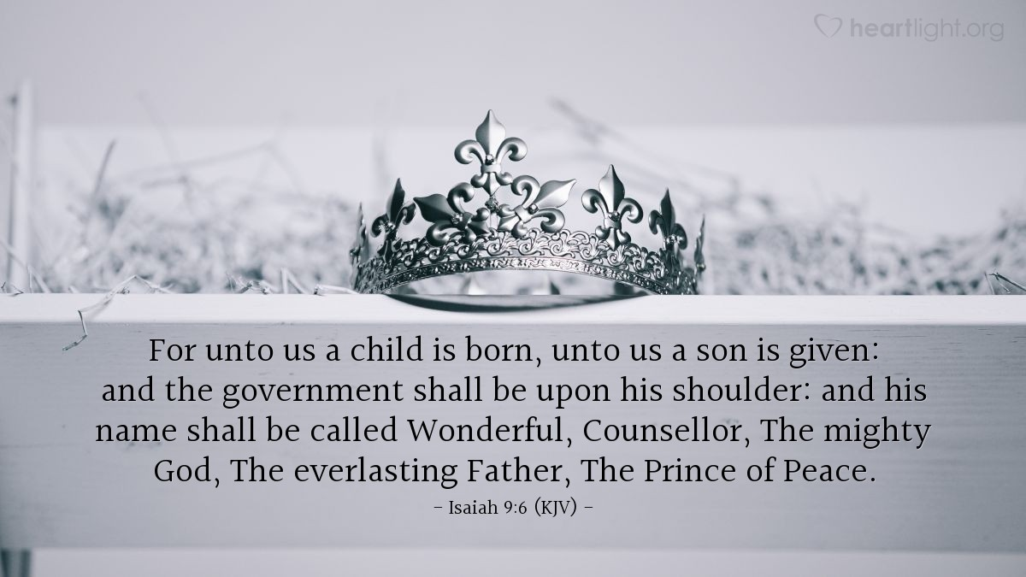
Notes:
Packer goes on to say that difficulties with the reality of the incarnation of Jesus Christ will foster difficulties with other points in the gospel story.
]If there IS a God and he HAS become human, why would you find it incredible that he would do miracles and be hungry? Why would you struggle with his ability to pay for our sins but have to fish for is lunch AND to pay his taxes?
If you understand and believe the truth of the incarnation, The resurrection becomes not just believable but understandably necessary

