Slide 1
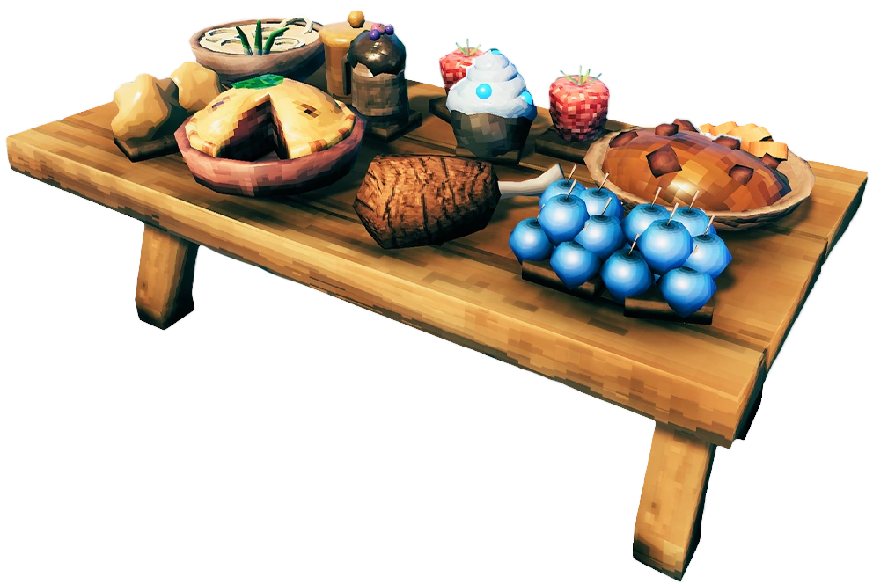
Notes:
Drinking from a hose outside?
Have you ever had your mouth over the end when your friend turned it on?
Result?
This section, as familiar as water…read it many in our times… get used to it and maybe overlook it and it’s power.
It still hits us like we have our mouths over the end of a hose. It quickly fills us to overflowing with practicality.

Slide 2
Matthew 6:25–34
“For this reason I say to you, do not be worried about your life, as to what you will eat or what you will drink; nor for your body, as to what you will put on. Is not life more than food, and the body more than clothing? “Look at the birds of the air, that they do not sow, nor reap nor gather into barns, and yet your heavenly Father feeds them. Are you not worth much more than they?
Notes:
READ

Slide 3
“And who of you by being worried can add a single hour to his life? “And why are you worried about clothing? Observe how the lilies of the field grow; they do not toil nor do they spin, yet I say to you that not even Solomon in all his glory clothed himself like one of these. “But if God so clothes the grass of the field, which is alive today and tomorrow is thrown into the furnace, will He not much more clothe you? You of little faith!
Notes:
READ

Slide 4
“Do not worry then, saying, ‘What will we eat?’ or ‘What will we drink?’ or ‘What will we wear for clothing?’ “For the Gentiles eagerly seek all these things; for your heavenly Father knows that you need all these things. “But seek first His kingdom and His righteousness, and all these things will be added to you. “So do not worry about tomorrow; for tomorrow will care for itself. Each day has enough trouble of its own.” (NASB95)
Notes:
READ

Slide 5
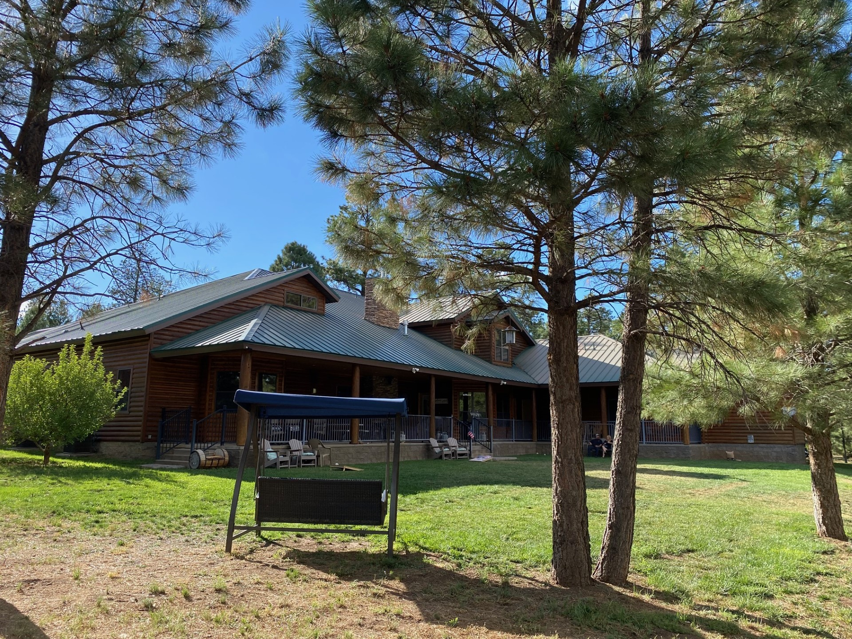
“For This Reason”…
“What’s it gonna’ be?
Notes:
Treasures in this world are like pictures or illustrations of the real thing.
They look truly good on their own. They provide a taste of happiness and even provide a glimpse of real enjoyment for a moment.
They are like reading a book about something instead of actually experiencing it.
On this side of heaven, we are still on the sidelines...still reading the book when it comes to actually experiencing what we, long for. What we were built for
When worldly treasure are compared to those in heaven, they provide a shell without the deep experience.
I can read about the North Country but when I am in it and see the trees, experience the breeze and wind. Get wet in the rain and enjoy the majesty of a night sky, I can then only relate. I can interact and experience it personally. Even my descriptions of it do not provide for the hearers the actual experience.
Such is worldly wealth.
That is why Christ, in the last section
Warned against holding onto things of the world.
He told us that the world and it’s treasures as things that, if they captivate your heart, blacken it…skew it . Things that twists your thinking until everything you think do or say is filtered through the lens of worldly treasure.
But if we hold onto the Light that is the gospel, we will not only have the glory of the gospel truth but our hearts will recognize and respond correctly as eyes do to light.
Jesus follows it with a warning against TRYING to hold onto both.
In trying to hold onto both we can really hold onto neither.
So he began this section with the phrase; “For this reason”.
His assumption moving forward is that further pursuit of money and treasures of this world is not even an option.
His kingdom subjects should no longer have an unhealthy fixation on things like money or power or influence.
Their (and our) new king has saved them from cardboard treasures and invited them (and us) to a life filled with eternal wealth.
Entering into His kingdom grants us free access to God and we become joint heirs with Jesus and all the weight of glory that that carries.
For this reason…

Slide 6
Notes:
We should live more like this.
Recognize the riches we have in Christ and enjoying all the good things he has promised to us.
Scrooge spared no expense in enjoying the riches himself. What he often got wrong is that even these riches become MORE precious when they are given away
CLICK.
When he hoarded his stuff, he became twisted. I would dare say that even as Believers, hoarding the riches we have, both heavenly and earthly, Christ does us damage as well and deprives us of an even greater amount of joy we would have in sharing it.
So Jesus takes all the cares of the world off of the table.
He does it not just by promising…
His WORD should be enough, but he goes BEYOND words doesn’t he?
We can see, Even in communicating his truth he does it so that it has the most effect.
He uses two examples.
Birds. They do not sow nor reap…but they DO work. Worms do not hop into their nests. Birds do what God gave them to do for the day.. They build a nest, they pick up worms (after waking up early to get ‘em!)
They never worry about a worm shortage or what the world conditions may do to available worms. God gives them DAILY the food that they need.
This is the example we are to see in the Manna provided to Israel.
They were to pick up manna daily. If they picked up more than they needed for the day, it turned rotten and useless.
Lilies. Very beautiful flower. I killed more than my fair share!
God knows a lily in my house won’t last long but it looks just as beautiful as one in Hawaii.
Jesus says if he beautifies the lily in spite of it’s lifespan.
As a realist, I would have not spent much time on lilies BECAUSE they are so temperamental . No bang for the buck.
But God treats his children exactly the opposite.
Listen.
1 Corinthians 12:22–24
On the contrary, it is much truer that the members of the body which seem to be weaker are necessary; and those members of the body which we deem less honorable, on these we bestow more abundant honor, and our less presentable members become much more presentable, whereas our more presentable members have no need of it. But God has so composed the body, giving more abundant honor to that member which lacked,” (NASB95)
Jesus actually says He AND WE are to take the fragile among us, those who may not be as strong or able and cloth them…shelter them with special honor.
In Jesus economy, he calls us to take special notice of those in need and OVERCOMPENSATE for them.

Slide 7
Who, by worrying, can improve their lives at all?
Psalm 118:5–6
From my distress I called upon the Lord; The Lord answered me and set me in a large place. The Lord is for me; I will not fear; What can man do to me?” (NASB95)who did not spare His own Son, but delivered Him over for us all, how will He not also with Him freely give us all things?” (NASB95)
8:32 Romans 8:32
He who did not spare His own Son, but delivered Him over for us all, how will He not also with Him freely give us all
Notes:
Does the lily sew it’s own leaves or petals?
Is it concerned about it’s color or have any of them said “If only I was THIS color or had 1 more leaf”.
Lilys do what lilies do. And that is exactly and only what God wants and what pleases Him.
jUST AS THEY ARE, THEY are amazing to God and frankly to anyone who has looked at one for any length of time.
The thing Both of these examples have in common is….
GOD feeds the bird DESPITE what it looks like and because they are his.
GOD clothes the flowers despite what it looks like...even if they only last a short time.
If he cares in such minute detail for these things…in ALL their diversity, How much more WILL HE care for the people he has ALREADY invested his Sons blood in?
If you want something closer to home, look at the life of David.
One example among many but listen to how HE sees his situation.
READ
He recognizes this is real distress. He does not NOT see concerns
He Calls on the Lord- He does not call his advisors, his treasurer or his army. He knows his surest and ONLY hope is His God.
He sees God answer and provide. (we know it does not Always go this easily for David (he lost his first son from Bathsheba. His prayers for Absolom don’t go his way) but in all of David’s life, his trust is firmly in the Lord.

Slide 8
If God cares so much for short lived things…..
Romans 8:32
He who did not spare His own Son, but delivered Him over for us all, how will He not also with Him freely give us all things?” (NASB95)
Notes:
Paul sets us on the right track in Romans 8:32.
Arguing from the greater to the lessor.
Read
Notice that Paul doesn’t fence God in at all in this declaration.
He say that God will FREELY…no cost
Give us ALL THINGS…
He just got done telling us in vs. 28 that ALL things work together for the good of those who are the called in Christ Jesus. Now he says that God will FREELY provide to us ANYTHING (without obligation or limit) anything that will be good for us.
1 Corinthians 7:21
Were you called while a slave? Do not worry about it; but if you are able also to become free, rather do that.” (NASB95)

Slide 9
Worry is the lifestyle of the (not so) rich and faithless
Psalm 94:19
When my anxious thoughts multiply within me, Your consolations delight my soul.” (NASB95)
Notes:
The bible tells it’s reader, listener over 80 times; Do Not Fear/ Don’t be worried. Here are a few examples but these are all similar.
Abram- After these things the word of the LORD came to Abram in a vision, saying, “Do not fear, Abram, I am a shield to you; Your reward shall be very great.”
Jacob- Do not fear, for I am with you.
I will bless you, and multiply your descendants,
For the sake of My servant Abraham.”
Israel- But Moses said to the people, “Do not fear! Stand by and see the salvation of the LORD which He will accomplish for you today
Israel- See, the LORD your God has placed the land before you; go up, take possession, as the LORD, the God of your fathers, has spoken to you. Do not fear or be dismayed.
Joshua- Now the LORD said to Joshua, “Do not fear or be dismayed. Take all the people of war with you and arise, go up to Ai; see, I have given into your hand the king of Ai, his people, his city, and his land.
David- I will not be afraid of ten thousands of people
Who have set themselves against me round about.
Arise, O LORD; save me, O my God!
For You have smitten all my enemies on the cheek;
You have shattered the teeth of the wicked.
Jeremiah- reminding the Lord of his own words-
You drew near when I called on You;
You said, “Do not fear!”
O Lord, You have pleaded my soul’s cause;
You have redeemed my life.
Us- Peace I leave with you; My peace I give to you; not as the world gives do I give to you. Do not let your heart be troubled, nor let it be fearful.
…. just as Sarah obeyed Abraham, calling him lord, and you have become her children if you do what is right without being frightened by any fear.
The antidote for fear or worry is found in our Lord.
Ps. 94 steers us in the way. The writer using himself as an example.
He finds himself surrounded by enemies and he is seeing them prosper.
In the midst of the calamity he is witnessing all around him, he starts seeing the broader picture.
In vs. 14 he says; For the LORD will not abandon His people, Nor will He forsake His inheritance.
Later on in the same Psalm he is convinced of God’s care and finds his consolation in him.
READ
Isaiah speaking for God in Isaiah 41:10 says;
Isaiah 41:10
‘Do not fear, for I am with you; Do not anxiously look about you, for I am your God. I will strengthen you, surely I will help you, Surely I will uphold you with My righteous right hand.’” (NASB95)
Notice the confidence he is providing…Surely….
Because I am God, I WILL SURELY help. I will SURELY uphold.
What does it mean for God to UPHOLD us? Literally to grasp hold of us and support us.
We can go BACK to David.
Ps. 63. Written while he was in the wilderness.
Psalm 63:8–11
My soul clings to You; Your right hand upholds me. But those who seek my life to destroy it, Will go into the depths of the earth. They will be delivered over to the power of the sword; They will be a prey for foxes. But the king will rejoice in God; Everyone who swears by Him will glory, For the mouths of those who speak lies will be stopped.” (NASB95).
David finds his support coming from God’s word and His proven track record.
Paul takes this and builds on it when he discusses anxiety in his letter to the Philippians who themselves were facing dire straits.

Slide 10
Worry is the lifestyle of the (not so) rich and faithless
Philippians 4:6–7
Be anxious for nothing, but in everything by prayer and supplication with thanksgiving let your requests be made known to God. And the peace of God, which surpasses all comprehension, will guard your hearts and your minds in Christ Jesus.” (NASB95)
Notes:
Philippians 4:6, 7
Be anxious for nothing, but in everything by prayer and supplication with thanksgiving let your requests be made known to God. And the peace of God, which surpasses all comprehension, will guard your hearts and your minds in Christ Jesus.
Many of us, if we are honest, would say I believe this because it is God’s word but when I tried to practice leaving my anxiety at the alter, it kept on following me home.
I believe that is because we do not read on…
“Finally, brethren, whatever is true, whatever is honorable, whatever is right, whatever is pure, whatever is lovely, whatever is of good repute, if there is any excellence and if anything worthy of praise, dwell on these things.” (NASB95
We pray about it but we do not find our consolation because we do not fill our minds with the things Paul tells us to. Instead our mind, being swept clean of the anxiety, and having nothing good to replace it with, runs BACK to the original concern and like Matt. 12:124, it multiplies in it’s strength bringing 7 more related friends with it!

Slide 11
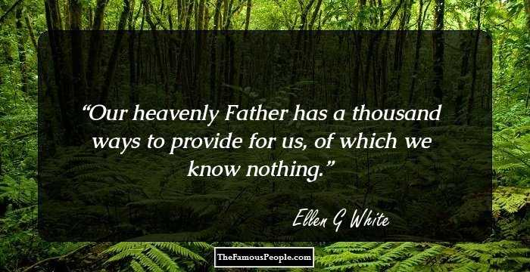
Each day is its own trial…I mean adventure
Notes:
Where does worry come from? The unknown future.
No one worries about the past.
BUT, We have a friend who sticks closer than a Brother who KNOWS what tomorrow will bring.
Jesus says we are NOT to forecast trouble but instead James tells us that EVERYTHING is being orchestrated by God. We will do this and such IF GOD WILLS.
If we look at the things that cause us to worry, We MUST look at them through the lens that Jesus has provided.
He gave us examples of his fastidious care in creation.
He told us we were worth MUCH more than these things.
He called us into his kingdom at the cost of His Son
He will certainly not leave us to our own devices now. He has today AND tomorrow covered.
We all know this…intellectually. What we need to do is know it in the moment.
We, as servants of Christ Do have a job to do. We DO have obligations to Him and those around us.
Every day we face an uncertain future.
What I try to remind myself about Him is that he is the God of option C
I look at any situation, no matter how desperate and I can see a couple of paths. One or both maybe not particularly pleasing.
More often than not, God has intervened and done something totally unexpected. Part of our job is to relish the uncertainty in our lives because it only APPEARS uncertain.
We are in God’s hands.
He has promised that won’t change.
He promises to care for us. HOW he does it is the adventure.

