Slide 1
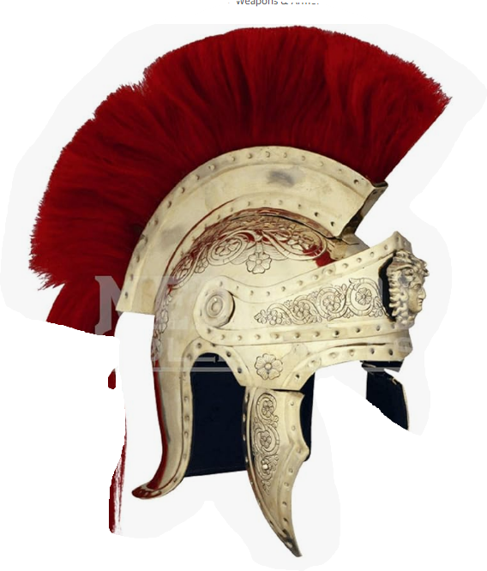
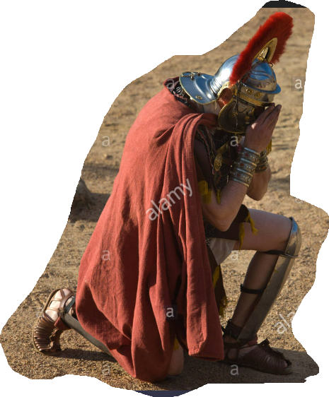
Notes:
Last week we were discussing Jesus healing the leper outcast and we used Miriam as an object lesson. She was punished with lerrosy for challenging God by speaking against Moses who as far as God was concerned was even more than a prophet Wow! what an honor. Moses is MORE than vindicated by GOD!
What we didn't mention last week was what scripture mentions about Moses in this same section.
Before God dresses down Miriam and Aaron, He puts this little note in the record.
(Now the man Moses was very humble, more than any man who was on the face of the earth.)
This is the same Moses who was leading an entire nation through uncharted lands. This was the same Moses who went toe to toe with Pharoah. The same Moses who was invited to the top of Mt. Sinai to retrieve the tablets of stone and who's face shone with the reflected glory of God after meeting with him.
This is the most humble man on the face of the earth.
What we saw last week was that Jesus kingdom, in fact jesus the King, did not govern by the normal standards or by Jewish regulations.
Jesus kingdom was not about outward uncleanness but a change in the inner heart.
A change in the innerman results in necessary change in the outer man.
One of these changes is found in Moses' example.
His humility.
Humility is a necessity of Chris't's kingdom. A rightful understanding of who one is in relation to Jesus, the King.
Humility and Authority can exist together. For us, Jesus is our prime example but for those surrounding Jesus at the time, we have another example of it in this section of Matthew 8 as Jesus interacts with a member of the occupying Roman government in Capernaum.

Slide 2
Matthew 8:5–13
And when Jesus entered Capernaum, a centurion came to Him, imploring Him, and saying, “Lord, my servant is lying paralyzed at home, fearfully tormented.” Jesus said to him, “I will come and heal him.” But the centurion said, “Lord, I am not worthy for You to come under my roof, but just say the word, and my servant will be healed. “For I also am a man under authority, with soldiers under me; and I say to this one, ‘Go!’ and he goes, and to another, ‘Come!’ and he comes, and to my slave, ‘Do this!’ and he does it.” Now when Jesus heard this, He marveled and said to those who were following,

Slide 3
“Truly I say to you, I have not found such great faith with anyone in Israel. “I say to you that many will come from east and west, and recline at the table with Abraham, Isaac and Jacob in the kingdom of heaven; but the sons of the kingdom will be cast out into the outer darkness; in that place there will be weeping and gnashing of teeth.” And Jesus said to the centurion, “Go; it shall be done for you as you have believed.” And the servant was healed that very moment.” (NASB95)
Notes:
Here is a real life opportunity for Jesus to 'practice what he preached...”Love your enemies and pray for those that persecute you”

Slide 4
Authority of the Centurion
Authority under Caesar- His word was Caesars’ word
Authority over the city / over 100 soldiers
Authority for his slave
Notes:
Centurions were in charge of a group of about 100 men and depending on the size of the city, sat in on the affairs of the city
They were usually men of valor among the troops and most often promoted from within.
They were responsible for the day-to-day operations including discipline. Some of them were notorious for their tortuous disciplinary treatment of those under them to gain obedience.
They also were the leader into battle so most gained the respect of their soldiers through their acts of bravery. (Think of David’s Mighty Men)
This centurion was able to lead his men well but ALSO develop relationships among the Jews. ( no small feat)
Luke’s account of this encounter tells it as the Centurion sending ’friends’ to contact Jesus on his behalf initially.
This speaks a lot about the character of the centurion.
(I think Matthew leaves this out to highlight the awkwardness of this incident.
The Romans, living in Israel were a daily reminder of their subjection and their own slavery to Rome.
For Jesus to have any discussion with a Roman soldier would, of itself, be offensive to the Jews).
Here we find Jesus, recently finished up with a leper and now moving on to another rejected person.
This one is different though;
Unlike the leper, the centurion separates himself from others by reminding them that He is UNDER authority…What does that mean?
He is under the authority of Caesar.
What he says get’s done because he is Caesar’s representative. He is, for all intent and purpose, Caesar in Capernaum. He carries all the authority of Caesar in most things
He wields his power on behalf of Caesar and for the good of the Roman nation.
He knows what it is like to be UNDER authority. To have it…to use it…to represent someone as important as Caesar
He knows what it is like to communicate in power BUT he also knows what it is like to CARE for those under His power.
Here we have this hardened soldier- caring about his young servant literally his ’boy’.
He sees him almost like a son. And his boy is in trouble.
I very much see the love of Christ reflected in this relationship.

Slide 5
Authority of Jesus
Authority of God- His word is God’s word
Authority over all creation
Authority over His kingdom
Invites whomever he desires
Denies whomever does not honor HIM as God.
Notes:
Then we have Jesus…
The centurion comes to Him.
ALWAYS the weaker comes to the Stronger.
The centurion knows who Jesus is. He recognizes Jesus SUPERIOR AUTHORITY.
If he were a student of the land he lived in (and My guess is he is for him to have Jewish friends plead his case), He would have at least studied the writings of Israels greatest king AND warrior, David.
He surely would have come across a few of David's confessions of dependance;
Psalm 103:1–5
Bless the Lord, O my soul, And all that is within me, bless His holy name. Bless the Lord, O my soul, And forget none of His benefits; Who pardons all your iniquities, Who heals all your diseases; Who redeems your life from the pit, Who crowns you with lovingkindness and compassion; Who satisfies your years with good things, So that your youth is renewed like the eagle.” (NASB95)
OR;
Psalm 30:2
O LORD my God, I cried to You for help, and You healed me.” (NASB95)
OR;
Psalm 33:8–9
Let all the earth fear the LORD; Let all the inhabitants of the world stand in awe of Him. For He spoke, and it was done; He commanded, and it stood fast.” (NASB95)
OR;
Isaiah 35:4–6
speaking about the servant of the Lord;
Say to those with anxious heart, “Take courage, fear not. Behold, your God will come with vengeance; The recompense of God will come, But He will save you.” Then the eyes of the blind will be opened And the ears of the deaf will be unstopped. Then the lame will leap like a deer, And the tongue of the mute will shout for joy. For waters will break forth in the wilderness And streams in the Arabah.” (NASB95)
He would have seen in Jesus, the reality of the Servant of God and the one David depended on 'in the flesh'.
Unlike Jews who have had their hearts hardened through the false teaching of the Pharisees, The Roman Centurion can see Jesus for who he is. God’s representative here on earth.
Carrying ALL the authority of God with Him.
His kingdom, unlike Caesars, has no boundaries as Jesus rules over all creation. Proving it by His miracles.
Caesar has authority over Rome
Jesus has ALL authority.
The centurion ALSO knew the benefits of citizenship. Only Roman citizens could experience the full blessing of the Roman government. It’s protection and it’s offerings.
The centurion, understanding he IS not a citizen of Israel, appeals to Him not on the basis of Jewishness but on the basis of faith.
Even the Jewish leaders did not understand that.
The sermon on the mount was delivered to identify the proper way to enter into Christ’s kingdom and it is NOT through what is done or even who is in your lineage. Entrance into the kingdom of Christ is expressed through faith in the SON OF GOD.
The centurion, I believe, understood this better than most. His faith goes beyond just believing that Jesus can heal.
He sees Jesus as His superior and AS the superior over ALL creation as evidenced in his work of healing..
Jesus never commends the leper for his faith because he comes to be healed but there is something in the faith of the centurion that goes BEYOND that. It goes BEYOND believing Jesus can heal. Multitudes were coming to Jesus to be healed but the faith of the centurion was a faith that had not been evidenced even in theJews...the supposed'children of God.”

Slide 6
Humility of the Centurion
My slave is sick
I am not worthy- Jesus kingdom superior to Rome
Just say the word
Notes:
How is the faith and humility of the centurion expressed?
By coming to Christ….expressing his need and knowing Jesus was the only one able to satisfy it.
By knowing Jesus has a heart for the lowly. The centurion does not come on his own behalf but comes seeking relief for his servant… easily replaceable by mos standards but this boy is special to him so he takes this special boy to Jesus
By knowing AND confessing his position. Although he is overseeing 100 roman soldiers He goes to Christ (couldn’t he have brought Christ to him?).
The queen of Sheba, as powerful as she was, came to Solomon to see for herself the wonders of the kingdom God had entrusted to Solomon.
1 Kings 10:1–7
Now when the queen of Sheba heard about the fame of Solomon concerning the name of the Lord, she came to test him with difficult questions. So she came to Jerusalem with a very large retinue, with camels carrying spices and very much gold and precious stones. When she came to Solomon, she spoke with him about all that was in her heart. Solomon answered all her questions; nothing was hidden from the king which he did not explain to her. When the queen of Sheba perceived all the wisdom of Solomon, the house that he had built, the food of his table, the seating of his servants, the attendance of his waiters and their attire, his cupbearers, and his stairway by which he went up to the house of the Lord, there was no more spirit in her. Then she said to the king, “It was a true report which I heard in my own land about your words and your wisdom. “Nevertheless I did not believe the reports, until I came and my eyes had seen it. And behold, the half was not told me. You exceed in wisdom and prosperity the report which I heard.” (NASB95)
Or take as another example; Melchizedek, who blesses Abraham and Abraham pays a tithe to Him.
In describing Melchizidek and this relationship, the book of Hebrews says;
Hebrews 7:3–7
Without father, without mother, without genealogy, having neither beginning of days nor end of life, but made like the Son of God, he remains a priest perpetually. Now observe how great this man was to whom Abraham, the patriarch, gave a tenth of the choicest spoils. And those indeed of the sons of Levi who receive the priest’s office have commandment in the Law to collect a tenth from the people, that is, from their brethren, although these are descended from Abraham. But the one whose genealogy is not traced from them collected a tenth from Abraham and blessed the one who had the promises. But without any dispute the lesser is blessed by the greater.” (NASB95).
4. The centurion, voluntarily submits to Jesus and his authority even to the degree that he recognizes Jesus does not need to physically be there. All he need do is just say the word.
The centurion believed in the power of Christ's word and the authority of Christ and his promises.
If Jesus said it...it is true!
Many times we think God needs to work within our parameters and we do not appreciate or see his hand if his answer comes in a different fashion.
Last week we talked a bit about Naaman and the leprosy he had. As an Aramean officer, the Aramean king sent him to Judah for cleansing. After consternation by the Judean king, he is sent to Elisha to be cured. When Elisha gave his the requirements for a cure what did Hamaan do?
But Naaman was furious and went away and said, “Behold, I thought, ‘He will surely come out to me and stand and call on the name of the Lord his God, and wave his hand over the place and cure the leper.’
He had to be convinced by his servant to do what he was told.
We put God in a box but the centurion sees Jesus as able to work however He pleases. He doesn’t even need to show up!

Slide 7
Humility of Jesus
Condescension into humanity
Willing to heal
Engages even a Gentile
Exposes truth to His followers
Notes:
Lastly, Let’s extend this topic of humility to Jesus himself. How does HE express humility.
He expresses it by coming to earth. Roman god’s, for the most part, were unconcerned about the daily life of the people and chose to reign from ‘on high’ (Mt. Olympus in many cases)
Here we have God, in the flesh interacting with His creation and stepping into individual lives…what a difference.
Jesus came NOT to do as HE saw fit but He came to do His Father’s will. To act in accordance to the desires of His Father’s heart. Jesus freely heals because that is what God wanted him to do. Jesus came to spend himself and be spent for his creation. For those who labor under the slavery of sin, Jesus came to set them free. This then MUST include more than physical healing but to deal with the real issue and that is the healing of a broken relationship.
Just like the centurion who was under the authority of Caesar, to do His will, Jesus comes, under the authority of God...carying all the authority of God. To do the will of His Father
2 Corinthians 5:21
He made Him who knew no sin to be sin on our behalf, so that we might become the righteousness of God in Him.” (NASB95)
How much of THIS did the centurion know? I am not sure; but he had a faith unlike anyone else in Israel.
3. Jesus came to the Lost sheep of Israel but NOT just for them.
Simeon, when Jesus was presented in the temple as just an infant prophesied;
Luke 2:30–32
For my eyes have seen Your salvation, Which You have prepared in the presence of all peoples, A Light of revelation to the Gentiles, And the glory of Your people Israel.”” (NASB95)
And in the book of Isaiah, God declares through Isaiah the prophet,
Isaiah 56:8
The Lord God, who gathers the dispersed of Israel, declares, “Yet others I will gather to them, to those already gathered.”” (NASB95)
Jesus came NOT just for the Jews but to draw ALL people to Him. Jew and Gentile.
John 1:11–13
He came to His own, and those who were His own did not receive Him. But as many as received Him, to them He gave the right to become children of God, even to those who believe in His name, who were born, not of blood nor of the will of the flesh nor of the will of man, but of God.” (NASB95)
Being rejected by the Jews was not a big surprise to Jesus, The Gentiles were not some sort of ‘plan B’.
Jesus had his own in every country set apart before the beginnings of time itself.
This was a truth both the Jew and Gentile had to wrestle with.
The Gentile- Access to the ONE TRUE God was available to anyone who had god given faith.
The Jew- Access to the one true God was available to ANYONE who had a God-given faith.
Jesus is the great dividing line. Not Jewishness… and it appears the Roman Centurion understood that better than those who spent their lives in study..
As the exchange closes, Jesus WARNS the jews believing in their self-made righteousness or in their Jewish heritage that their understanding of being God’s people…sons of God was sorely misplaced. Their insistance in following their self made ideas of God, His righteousness would end in their eternal destruction and He uses a Roman Centurion as an object lesson.

