Slide 1
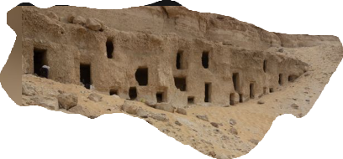
Notes:
Charles Blondin; famous for tight-rope walking across the Niagara falls.
His first crossing was done in 1858 and he promised that each crossing he did after that would be more spectacular.
He crossed walking backward, He crossed with a big camera so he could take pictures of the spectators
He carried a chair and stool and sat on the chair, propping his feet on the stool in the middle.
He crossed with a wheelbarrow.
He crossed blindfolded.
He crossed with someone on his back.
His most famous crossing is where he crossed to the middle, pulled out a small stove and frying pan, made breakfast and lowered it to a boat waiting for it under him.
Later he crossed with his son AND another person on his back, making another omelet for the crowd.
He completed every challenge he was given.
When I heard of Mr. Blondin, it caused me to think of where we are in Matthew.
Jesus has made some amazing claims and claimed authority for Himself that only God would reasonably claim.
No one challenges Jesus’ word so he goes on to prove He is all that he has been intimating.
He does these things to SHOW- make visible- confirm for our senses... to understand- that his claims are not false. He is a king and His kingdom Is at hand.
He begins by healing the marginalized and outcast in the leper.
He assists the outright Enemy of Israel healing a centurion's daughter but in the healing, He deconstructs the borders that many had wanted to maintain concerning God’s kingdom and Jesus’.
His healing of the Centurion’s daughter opens the eyes of the Israelites to the reality that Jesus’ kingdom is NOT about earthly borders, earthly powers or authorities.
Then he heals Peter’s mother-in-law. A reminder that His kingdom is not about lineage but family is not ignored. (He makes it even plainer when he later confronts the Pharisees about their giving their excess money as Corban to the temple instead of caring for their parents.)
Then, like Blondin, he ups his game again. He has shown his ability to heal disease, next he heals nature by calming a storm which rightfully so, causes the disciples to second guess who this Jesus really is.
Jesus, like Blondin, Has been slowly expanding his limits. Jesus is revealing the true nature of His authority and the extent of His kingdom. It has nothing to do with flesh and blood and conquering nations. ‘Render unto Caesar what is Caesar but unto God what is God’s.’
Now we come to the close of chapter 8 and Jesus is set to reveal the full extent of His authority and to answer any remaining questions swirling around concerning who He is. He is God…in the flesh.

Slide 2
Matthew 8:28–34
When He came to the other side into the country of the Gadarenes, two men who were demon-possessed met Him as they were coming out of the tombs. They were so extremely violent that no one could pass by that way. And they cried out, saying, “What business do we have with each other, Son of God? Have You come here to torment us before the time?” Now there was a herd of many swine feeding at a distance from them. The demons began to entreat Him, saying, “If You are going to cast us out, send us into the herd of swine.”
Notes:
READ

Slide 3
And He said to them, “Go!” And they came out and went into the swine, and the whole herd rushed down the steep bank into the sea and perished in the waters. The herdsmen ran away, and went to the city and reported everything, including what had happened to the demoniacs. And behold, the whole city came out to meet Jesus; and when they saw Him, they implored Him to leave their region.” (NASB95)
Notes:
READ

Slide 4
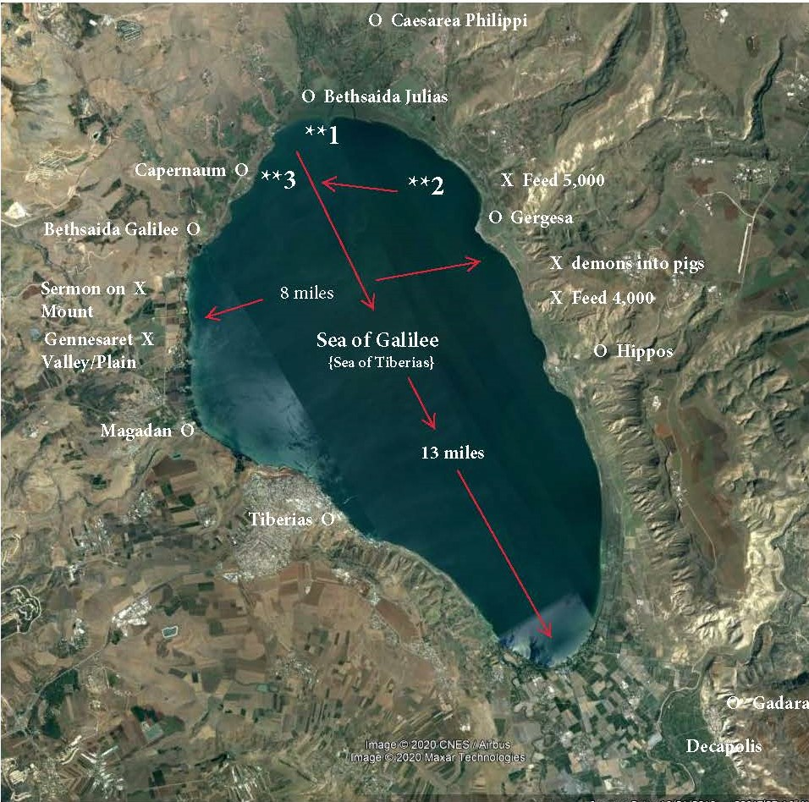
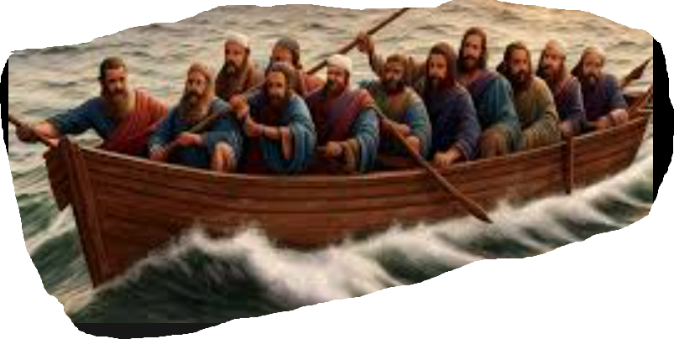
Notes:
We went along with Jesus getting into a boat with his disciples and crossing the lake.
The route was probably similar to this;
CLICK.
I had a couple of interesting thoughts;
1. How many people were actually in the boat. The sides of these boats were actually pretty low to allow the workers to pull nets over the sides. Good for fishing...back for rough weather.
2. Depending on exactly where the storm overtook them, they could have been up to 4 miles from shore but with the wind blowing as it was, and the rain and clouds covering any stars or identifying landscape, they would have no idea what shore they were closest too.
Both of these would have added drama to the situation we discussed earlier.
Moving forward;
Matthew's story doesn't line up perfectly with Lukes and Marks.
Most notable differences;
1. Number of demoniacs; 2 for Matthew, 1 in Luke or Mark. The most reasonable explaination is that there were 2 men there. One was probably the spokesperson. Matthew records the interaction with BOTH the men because Matthew is concerned about what Jesus says as King as he addresses his audience
His focus is on God's son and unfolding/ extending His kingdom.
Matthew's primary goal is explaining Jesus as KING, his authority and his mission to bring his Kingdom through others.
Luke and Mark have a different reason for writing their accounts, so they include only the spokesperson to further their narrative. None of them are innaccurate, they are just recalling for us what is important for us to know from their perspective.
Matthew is interested in recounting the discussion between the king....... and the audience that heard the words of the King so his recollection is on EVERYONE being spoken to.
2. Where it took place; Again, Matthew says it took place at a location known as the Gadarenes while Luke and Mark identify the location as the Gerasenes. historically, Gerasa was the dominant town in the area so people who lived within or close to a town were called Gerasenes. Gadara was the gentile area that included Geresa and extended as far south as the south end of the sea.
Growing up, I lived in a town of Summit but when we wrote a letter or paid a bill our mailing address was in the closest city of Delafield. On top of that, when I went to school I went to school in a different city of Oconomowoc. Depending on who I was talking to and what I was talking about I was from Summit, or Delafield, or Oconomowoc.
Beyond these details, the stories line up well and compliment each other giving us a more 3D picture of Christ. And what do we see?

Slide 5
Jesus’ kingdom and his authority
Conquering sin by healing Bodily infirmities
The Leper…outcast
The daughter of the Roman Centurion…enemy
Peter's Mother-in Law….familial love
Conquering sin by healing the Natural world
The calming of the storm and transporting the boat
Who ELSE showcased these powers for Israel?
Notes:
Prior to Advent, we had gone through the Beatitudes and followed it up with the Sermon on the Mount which was Jesus describing His Kingdom and attributes, laying out ITS laws attributes of those who would be participating as citizens. Those who find and follow the ‘narrow way’.
Through these acts of healing, both physical and natural, the disciples are catching glimpses of the extent of Christ's power, authorityand reign.
They are getting a front row seat to the development of His kingdom and Matthew takes us along on the journey of revelation.
Last time we saw that even the winds and waves obey his command. Nature operated in obedience to His will.
From a Jew's perspective, Where had the disciples heard of such a thing as what they had witnessed?
How about Exodus 14:21–22
Then Moses stretched out his hand over the sea; and the LORD swept the sea back by a strong east wind all night and turned the sea into dry land, so the waters were divided. The sons of Israel went through the midst of the sea on the dry land, and the waters were like a wall to them on their right hand and on their left.” (NASB95)
Even with this, their response is less than ideal.
Matthew 8:27
The men were amazed, and said, “What kind of a man is this, that even the winds and the sea obey Him?”” (NASB95)
Someone said;
Principalities and powers were made subject to him, even while he was in his estate of humiliation, as an earnest of what should be at his entrance into his glory.
The mystery of God in the flesh...God with us...Emmanuel evidenced for us clearly in his authority over nature.

Slide 6
Jesus’ kingdom and his authority extended...
over the Spiritual Realm
Notes:
They land the boat and we are told 'two men who were demon possed met Him as they were coming out of the tombs'.
Notice this first; The demons come to Christ.
Mark records that at least one man had many times broken out of leg irons or shackles, yet the man comes to Jesus?
Is this because Jesus drew them or the demons wanted a controntation?
We don't know the answer but what we DO know is that there is a battle line being drawn and the men seem to be the battlefield.
Have you ever stopped to wonder how these men felt? Did they have ANY understanding of what they had become?
Did they even have a vote on whether to run away or meet Him?
Romans 3:10–12
as it is written, “THERE IS NONE RIGHTEOUS, NOT EVEN ONE; THERE IS NONE WHO UNDERSTANDS, THERE IS NONE WHO SEEKS FOR GOD; ALL HAVE TURNED ASIDE, TOGETHER THEY HAVE BECOME USELESS; THERE IS NONE WHO DOES GOOD, THERE IS NOT EVEN ONE.””
These men did NOT come to Jesus. Jesus drew them even while under the control of the enemy...He DREW THEM!
The men are the helpless ones.
It seems that the ONLY reason Jesus made that trip in the boat was to heal the men and confron the villagers. He left back across the water directly after this scene.
What a clear picture of the spiritual battle that takes place every person comes to faith in Christ.
There is a time where in each one of our lives there was this same confrontation. We were the battlefield and the spectator at the same time.
Secondly, Has it occurred to you that Jesus has never backed away from a confrontation with Satan or His demons?
Do you think that Jesus had no knowledge of what or who was waiting for Him here?
He was out for a Sunday boat ride and happened to land there?
He couldn’t blame the weather…that is for sure!
His mission was to 'bind the strong man' on our behalf!
We are told to RESIST the Devil and FLEE temptation but Christ walks INTO the strong man's house to tie him up. He ties Him up for the sake of OUR diseases, the daughter, the disciples, and the demoniac…all representatives of us…Our helplessness to effect a cure for ourselves. It also pictures the degree of slavery we were under.
How bad was it?
In in these two demon-possessed men we have some of the most terrible and heart-humbling revelations that we have in all the Bible. Look at evil personified in these wholly-possessed ones.
I. These men were “possessed”. Evil takes possession of the sinner, controls his actions and thoughts, and completely masters his whole life. Sin is an awful tyrant and warps every power and faculty of the being.
II. Evil is Allied with Death. Notice WHERE Jesus met them. “They dwelt among the tombs. A visible picture of their spiritual reality.
John Calvin writes; These wretched men were kept among the graves by an unclean spirit, that he (The demons) might have an opportunity of terrifying them continually with the mournful spectacle of death, as if they were cut off from the society of men, and already dwelt among the dead. Their abode was a daily reminder...a deception by Satan to increase their feelings of helplessness and yet they were there by choice. Sin, left unrestrained leads to death.
III. Its Power is too Great for Man. Those possessed ones had no power of resistance whatever. They could do nothing to save themselves. Sin, like a poison, becomes an integral part of the person.... affecting and infecting every part of our bodies and lives. As the men are face to face with Jesus it is the Demon who speaks How does someone GET that way?
Romans 1:21–23
For even though they knew God, they did not honor Him as God or give thanks, but they became futile in their speculations, and their foolish heart was darkened. Professing to be wise, they became fools, and exchanged the glory of the incorruptible God for an image in the form of corruptible man and of birds and four-footed animals and crawling creatures.” (NASB95)
This encounter reminds me of Jesus last recorded confrontation in the wildermess with Satan. Jesus walked into the wilderness...into the location he knew Satan would confront him. Here we have again, Jesus going TO the confrontation to disassemble sin and destroy it's power.
He disassembled Satan's arguements in the wilderness.
Here he destroys sin that has completely taken over the lives of 2 who have been enslaved by Satan.
He in like fashion has disassembled Satan's power over us at the cross. Going THERE willingly as well.
We have been set free exactly like the demoniacs

Slide 7
Jesus’ kingdom and his authority extend...
Notes:
The demoniac says;“What business do we have with each other, Son of God? Have You come here to torment us before the time?””
John Calvin- “What have we to do with thee? Willingly would they, by this word, drive him far from them. But when they see that they are held under restraint, and that it is in vain for them to decline his authority, they complain that they are tormented before the time, and likewise mingle entreaty”
Jesus presence stopps them from further evil. Their being STOPPED from doing harm is a more fearful thing.
Matthew Henry- “To be turned out, and tied up, from doing mischief, is a torment to the devil, all whose comfort and satisfaction are man’s misery and destruction. The devils fear the TORMENT of God more than that of Satan. There is a time in which devils will be more tormented than they are, and they know it.”
Some one once said; “It is fascinating that these demons had never before seen Jesus in the form of a Man, and yet they instantly recognized Him as the Son of God!”
Note the striking contrast in reactions to Jesus between the Disciples - Mt 8:27 “What kind of a man is this" and the Demons - Mt 8:29 "Son of God."
The demons clearly know Jesus has all the authority.
They stand in direct opposition to all He is and all He comes to accomplish. They stand in open rebellion to Jesus authority and kingdom.
Yet, they ALSO recognize that their position is fixed. The reality is that Jesus IS their king AND their judge regardless of what THEY want. At some level, they know that they are already bound and chained.
Proverbs 14:19
The evil will bow down before the good, And the wicked at the gates of the righteous.” (NASB95)
Jesus is MUCH MORE than a ‘good man’ though.
And WE...because of Christ are 'The righteous'.
Back to the event;
Isaiah 45:22–24
“Turn to Me and be saved, all the ends of the earth; For I am God, and there is no other. “I have sworn by Myself, The word has gone forth from My mouth in righteousness And will not turn back, That to Me every knee will bow, every tongue will swear allegiance. “They will say of Me, ‘Only in the LORD are righteousness and strength.’ Men will come to Him, And all who were angry at Him will be put to shame.” (NASB95)
Those who find themselves at opposition with Jesus will meet their end at His feet. They will NOT overthrow God's reign. they will not overthrow God's Son.
The demons believe that even they can somehow outwit Jesus but they will be put to shame.
Philipians says that EVERY knee shall bow . Of those who are in heaven, roaming on the earth...even those UNDER the earth. There is NO escape. Despite their hatred, they come to Jesus when he appears and bow their knee to Jesus Christ.
Now here, whether it is the demons or the men speaking on behalf of the demons, I don't know but what I DO know is that Jesus is not going to allow the demons to reside in these men any longer. This ALSO should come to us as relief and sweetness to the souls of God's children. That he comes to save even when we have no desire of it.
Jesus travels across the lake to free two souls.
His love for us is evidenced even greater as Hisjourney for us included a trip to the cross.
As Peter mentioned a couple of weeks ago...He hung on the cross while we were hammering in the nails that held Him there. All the while we hammer in hatred and rebellion, He watches... knowing us and still loving that we are included in the purchase.

Slide 8
Jesus’ kingdom and his authority extend...
Notes:
The demons entreat Jesus. Entreat has the root of paraclete…to come along side…to be understanding.
Matthew Henry-They own Christ’s power over them; that, without his sufferance and permission, they could not so much as hurt a swine. This is comfortable to all the Lord’s people, that, though the devil’s power be very great, yet it is limited, and not equal to his malice (what would become of us, if it were?) especially that it is under the control of our Lord Jesus, our most faithful, powerful friend and Saviour; that Satan and his instruments can go no further than he is pleased to permit.
The demons have a request… (I can’t even believe that they do but it speaks to their boldness and hatred of mankind.)
If they cannot destroy the lives of the men, they ask if they can stay OUT of the Abyss by continuing to wreak havoc through the bodies of the pigs.
Rev. 9:1-6 references the Abyss as a type of ‘holding or dwelling place’ for the demons until they are released to cause damage to those who are NOT protected by the Blood of the Lamb. John sees them as a cross between locusts and scorpions...combining a limitless appetite for evil as well as the ability to inflict pain.
But they need Jesus’ authorization to move.
They cannot inhabit ANYTHING or anyone unless it be allowed by Jesus.
The desire of the demons is to stay OUT of the abyss by inhabiting the bodies of the pigs and so it seems that Jesus grants that desire. The demons rush out of the pigs and enter the bodies of the pigs.
This is not a herd of 20 or 30 pigs though. Mark record this as a heard ~2000 pigs.
Here is where it is interesting though.
Jesus send the pigs ALL into the sea. The pigs die and the demons are literally and spiritually…sunk.
They have no where left to go except the Abyss anyway!
The demons think that they can bargain with Jesus but what happens is that they do EXACTLY what Jesus wants.
They free two men and deprive the region of a source of income which drives them out to their own confrontation with Jesus!

Slide 9
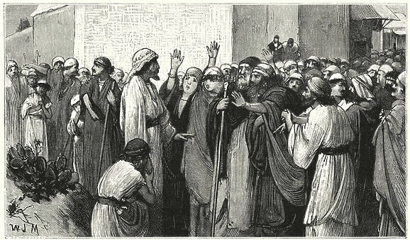
Jesus’ kingdom and his authority extend...
Notes:
The demons map out their own destruction and along with it, free two men and FORCE the entire city to examine their heart in front of the King.
This reminds me of Joseph confronting his Brothers after them see him in his place of authority in Egypt. “What you intended for evil, God used for Good”.
The demons wanted to continue to carry out mischief on the earth but Jesus, after clearing them out of the men, sends their new hosts to the bottom of the sea.
The pig owners and citizens of the neighbotring town arey are faced with a choice.
Embrace Jesus for who he is or…
Bob Utley says "This is one of the saddest verses in all of the Bible. In the presence of the greatest man of history, these villagers were more concerned about the death of a few hogs than they were over the redemption and reclamation of two demonized persons and the spiritual potential of the gospel for their area.“
The city comes out to Jesus and IMPLORES him to leave!
We don’t use the word implore much but it has andurgent-ness in it. It is an appealing or pleading.
They came out as a city and begged Jesus to leave… Why?
Mark says that they were frightened. They saw the results of the power of God and instead of giving thanks for the salvation of two men, They were afraid of Jesus. He took away their prosperity…their wealth.
They did not see Jesus as the Savior of mankind, but they saw Jesus as an obstacle to worldly prosperity. Their covetousness made them willing to be rid of him. Instead of inviting him into their city, or bringing their sick to him to be healed, they begged him to depart and leave their coasts. It is as if they had borrowed the words of the devils, What have we to do with you, Jesus, Son of God? The grace of God in the lives of the men has completely escaped them.
Spurgeon says this about the encounter with the citizens and their request;
Surely, this legion of demons must have had the same effect on them as on the poor man when Christ first came to him. These foolish people took up the same cry as the poor demoniac: “The whole multitude besought him to depart from them? Christ sometimes hears this kind of prayer. There is many a man who has entreated that his conscience might not be troubled any more, and it never has been troubled again. But what an awful prayer for any people to pray! “The whole multitude of the country of the Gadarenes round about besought him to depart from them.”
Look at Mark’s account to close this chapter
Mark makes this even clearer in His account,
Mark 5:16–20
Those who had seen it described to them how it had happened to the demon-possessed man, and all about the swine. And they began to implore Him to leave their region. As He was getting into the boat, the man who had been demon-possessed was imploring Him that he might accompany Him. And He did not let him, but He said to him, “Go home to your people and report to them what great things the Lord has done for you, and how He had mercy on you.” And he went away and began to proclaim in Decapolis what great things Jesus had done for him; and everyone was amazed.” (NASB95)
Through Jesus healing of the demoniac, we are faced with multiple truths.
We see Jesus extend his authority kingdom from the seen to the unseen realms.
This has ramifications to all those who follow him.
The result of a confrontation with Jesus is 1 of two responses.
There is a response similar to the citizens of the city (that echoes the words of the demons themselves) . They want NOTHING to do with Jesus and see no benefit to his presence. They completely miss seeing God’s mercy and grace poured out to them through Jesus but instead they see only Jesus as an OBSTACLE to their lives.
The abundant life that Jesus came to bring is of NO interest to them and they cannot close the door quick enough on the opportunity.
Then you have the demoniac.
2. Jesus FORCES himself into his life and forcibly extricates him from his sin.
The man wants nothing to do with the citizens but wants everything to do with Jesus and asks to follow Him and be His disciple.
He KNOWS what it is like to live a life outside of Christ and wants NOTHING to do with it.
He has been re-made. He is completely new. His heart has been changed and he sees Jesus AND everyone else completely differently
Sin has NO hold on him.
His gratitude toward Jesus goes BEYOND becoming a follower of Jesus though. He is enlisted as Jesus’ ambassador.
He is now called to do what Jesus was not able to do.
He was to witness the love of God expressed in Jesus Christ to those who have rejected him earlier.

Slide 10
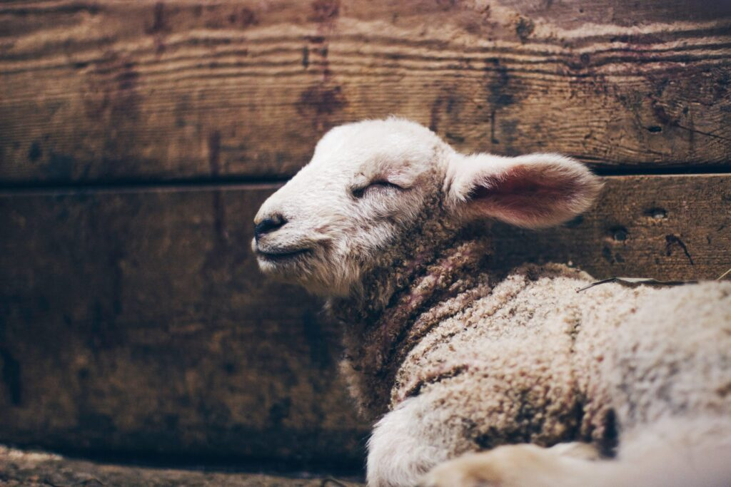
2 Corinthians 5:16-17 NLT
So we have stopped evaluating others from a human point of view. At one time we thought of Christ merely from a human point of view. How differently we know him now! This means that anyone who belongs to Christ has become a new person. The old life is gone; a new life has begun!
Notes:
Peter paints a picture of Satan as a roaring lions...seeking whom he may devour and let's not kid ouselves, He is all that and more. His aim in this life is to keep us far from Christ and should Christ's Holy Spirit confirm us into God's family, the sole desire of Satan becomes to make us ineffective and unproductive for the kingdom of God and the glory of the king.
At the root of all Satan's attackes is to usurp Jesus’ authority on earth and build his own kingdom until Jesus' return.
We, like the demoniac, have the truth and regard Jesus differently, now. He is NOT just a good moral example or a nice guy. He is NOT a kindly grandfather or a super-powered slot machine.
He calmed the waves of the sea and destroyed 2000 pigs.
He is ALSO not some lunatic...some guy with deliusions of greatness. He removed the lunacy from the demoniac and heals lives and families as part of his mission.
He is for us;
The Power of God AND He is the wisdom of God (1 Cor. 1:24)
HE is the mercy of God (2 Cor. 8:9)
He is the peace with God. (Rom. 5:1)
He is the reconciliation with God (John 14:6)
He is ALL the promises of God (2 Cor. 1:20)
He IS the lamb of God and OUR substitutionary sacrifice.
DAILY we make the choice to follow as the cured demoniac or push him away like the citizens of the city.

