Slide 1
The Book of James
Lesson 11
Chapter 2 vss. 1-7

Slide 2
James 2:1–7 (NASB95)
My brethren, do not hold your faith in our glorious Lord Jesus Christ with an attitude of personal favoritism. For if a man comes into your assembly with a gold ring and dressed in fine clothes, and there also comes in a poor man in dirty clothes, and you pay special attention to the one who is wearing the fine clothes, and say, “You sit here in a good place,” and you say to the poor man, “You stand over there, or sit down by my footstool,” have you not made distinctions among yourselves, and become judges with evil motives?
Listen, my beloved brethren: did not God choose the poor of this world to be rich in faith and heirs of the kingdom which He promised to those who love Him? But you have dishonored the poor man. Is it not the rich who oppress you and personally drag you into court? Do they not blaspheme the fair name by which you have been called?
.

Slide 3
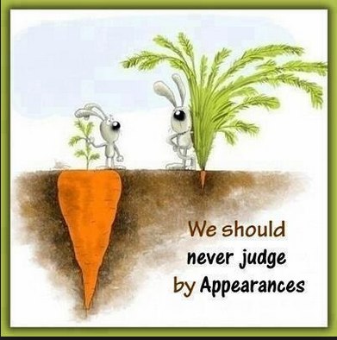
KNOW THIS:

Slide 4
Worldly Standing Means Nothing in God’s Kingdom
A Measure of Our Heart- Usurp God’s Glory
“My brethren, do not hold your faith in our glorious Lord Jesus Christ with an attitude of personal favoritism”
1 Samuel 16:6–7 (NASB95)
When they entered, he looked at Eliab and thought, “Surely the Lord’s anointed is before Him.”
But the Lord said to Samuel, “Do not look at his appearance or at the height of his stature, because I have rejected him; for God sees not as man sees, for man looks at the outward appearance, but the Lord looks at the heart.”

Slide 5
Worldly Standing Means Nothing in God’s Kingdom
A Measure of Our Heart- Usurp God’s Glory
“My brethren, do not hold your faith in our glorious Lord Jesus Christ with an attitude of personal favoritism”
John 9:1–3 (NASB95)
As He passed by, He saw a man blind from birth.
And His disciples asked Him, “Rabbi, who sinned, this man or his parents, that he would be born blind?”
Jesus answered, “It was neither that this man sinned, nor his parents; but it was so that the works of God might be displayed in him.

Slide 6
Worldly Standing Means Nothing in God’s Kingdom
A Measure of Our Heart- Dismiss God’s Providence
“…have you not made distinctions among yourselves, and become judges
with evil motives?”
Daniel 2:20–22 (NASB95)
Daniel said, “Let the name of God be blessed forever and ever,
For wisdom and power belong to Him. It is He who changes the times and the epochs; He removes kings and establishes kings; He gives wisdom to wise men And knowledge to men of understanding.
“It is He who reveals the profound and hidden things; He knows what is in the darkness, and the light dwells with Him.

Slide 7
Worldly Standing Means Nothing in God’s Kingdom
A Measure of Our Heart- Dismiss God’s Providence
“…have you not made distinctions among yourselves, and become judges
with evil motives?”
Proverbs 28:21 (NASB95)
To show partiality is not good, Because for a piece of bread a man will transgress.

Slide 8
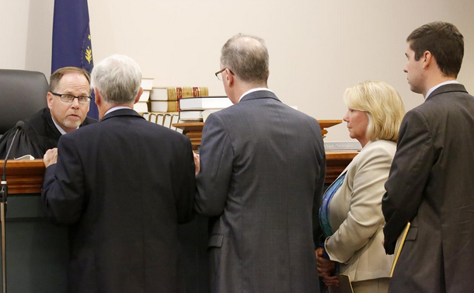
Worldly Standing Means Nothing in God’s Kingdom
Sidebar!!!
James 2:6,7
But you have dishonored the poor man. Is it not the rich who oppress you and personally drag you into court? Do they not blaspheme the fair name by which you have been called?
James 1:9–10 (NASB95)
But the brother of humble circumstances is to glory in his high position; and the rich man is to glory in his humiliation, because like flowering grass he will pass away.

Slide 9
Worldly Standing Means Nothing in God’s Kingdom
A Measure of Our Heart- Ignore God’s Order
“…did not God choose the poor of this world to be rich in faith and heirs of the kingdom which He promised to those who love Him?”
1 Corinthians 1:26–29 (NASB95)
For consider your calling, brethren, that there were not many wise according to the flesh, not many mighty, not many noble; but God has chosen the foolish things of the world to shame the wise, and God has chosen the weak things of the world to shame the things which are strong,
and the base things of the world and the despised God has chosen, the things that are not, so that He may nullify the things that are, so that no man may boast before God.

Slide 10
Worldly Standing Means Nothing in God’s Kingdom
A Measure of Our Heart- Ignore God’s Order
“…did not God choose the poor of this world to be rich in faith and heirs of the kingdom which He promised to those who love Him?”
Matthew 11:25–27 (NASB95)
At that time Jesus said, “I praise You, Father, Lord of heaven and earth, that You have hidden these things from the wise and intelligent and have revealed them to infants. Yes, Father, for this way was well-pleasing in Your sight.
“All things have been handed over to Me by My Father; and no one knows the Son except the Father; nor does anyone know the Father except the Son, and anyone to whom the Son wills to reveal Him.

Slide 11
Worldly Standing Means Nothing in God’s Kingdom
A Measure of Our Heart- Reflect our Lord
Matt. 20:30-34
And behold, two blind men sitting by the road, hearing that Jesus was passing by, cried out, saying, "Lord, have mercy on us, Son of David!" And the multitude sternly told them to be quiet; but they cried out all the more, saying, "Lord, have mercy on us, Son of David!" And Jesus stopped and called them, and said, "What do you want Me to do for you?" They said to Him, "Lord, {we want} our eyes to be opened." And moved with compassion, Jesus touched their eyes; and immediately they regained their sight and followed Him.

