Slide 1
The Book of James
Lesson 26
Chapter 4 vss. 13-17

Slide 2
James 4:13–17 (NASB95)
Come now, you who say, “Today or tomorrow we will go to such and such a city, and spend a year there and engage in business and make a profit.”
Yet you do not know what your life will be like tomorrow. You are just a vapor that appears for a little while and then vanishes away. Instead, you ought to say, “If the Lord wills, we will live and also do this or that.”
But as it is, you boast in your arrogance; all such boasting is evil.
Therefore, to one who knows the right thing to do and does not do it, to him it is sin.

Slide 3
Sovereignty; not Fatalism
Fatalism; “It is what it is” and we are powerless to change anything; even if we want to.
Biblical Sovereignty; Nothing can successfully stop any act or any event or design or purpose that God intends to certainly bring about.

Slide 4
Sovereignty; is not Fatalism
Isaiah 46:9–10 (NASB95)
“Remember the former things long past,
For I am God, and there is no other;
I am God, and there is no one like Me,
Declaring the end from the beginning,
And from ancient times things which have not been done,
Saying, ‘My purpose will be established,
And I will accomplish all My good pleasure’;

Slide 5
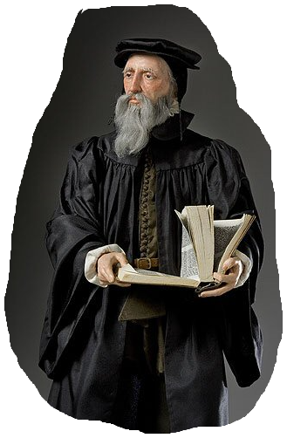
Sovereignty; is not Fatalism
God declared that the sun does not daily rise and set by a blind instinct of nature, but is governed by him in its course, that he may renew the remembrance of his paternal favor toward us.... John Calvin

Slide 6
Sovereignty; is not Fatalism
Matthew 11:28–29 (NASB95)
“Come to Me, all who are weary and heavy-laden, and I will give you rest.Take My yoke upon you and learn from Me, for I am gentle and humble in heart, and YOU WILL FIND REST FOR YOUR SOULS.”
Luke 15:7 (NASB95)
“I tell you that in the same way, there will be more joy in heaven over one sinner who repents than over ninety-nine righteous persons who need no repentance.

Slide 7
There is More Than the Visible
2 Kings 6:15–17 (NASB95)
Now when the attendant of the man of God had risen early and gone out, behold, an army with horses and chariots was circling the city. And his servant said to him, “Alas, my master! What shall we do?”
So he answered, “Do not fear, for those who are with us are more than those who are with them.”
Then Elisha prayed and said, “O LORD, I pray, open his eyes that he may see.” And the LORD opened the servant’s eyes and he saw; and behold, the mountain was full of horses and chariots of fire all around Elisha.

Slide 8
The Most Important is NOT the Visible
Matthew 10:28 (NASB95)
“Do not fear those who kill the body but are unable to kill the soul; but rather fear Him who is able to destroy both soul and body in hell.

Slide 9
Hubris
The Greek word for sin, hamartia (ἁμαρτία), originally meant "error" in the ancient dialect, and so poets used the word "hubris" to describe transgressions against the gods.
A common way that hubris was committed was when a mortal claimed to be better than a god in a particular skill or attribute.(courtesy Wikipedia)

Slide 10
Sin is not always 'commited'
James 4:17 (NASB95)
Therefore, to one who knows the right thing to do and does not do it, to him it is sin.
Matthew 25:41–43 (NASB95)
“Then He will also say to those on His left, ‘Depart from Me, accursed ones, into the eternal fire which has been prepared for the devil and his angels; for I was hungry, and you gave Me nothing to eat; I was thirsty, and you gave Me nothing to drink;
I was a stranger, and you did not invite Me in; naked, and you did not clothe Me; sick, and in prison, and you did not visit Me.’

Slide 11
Learn to Live in 'Real Time'
Ephesians 5:15–16 (NASB95)
Therefore be careful how you walk, not as unwise men but as wise, making the most of your time, because the days are evil.
And so here 'redeeming the time' does not merely mean making the most of moments, but means laying hold of, and understanding the special significance of, life as a whole, and of each succeeding instant of it as the season for some specific duty. It is not merely 'time,' it is 'the time';- Alexander Maclaren

