Slide 1
The Book of James
Lesson 29
Chapter 5 vss. 7,8

Slide 2
(Context); You have lived luxuriously on the earth and led a life of wanton pleasure; you have fattened your hearts in a day of slaughter. You have condemned and put to death the righteous man; he does not resist you.
James 5:7–8 (NASB95)
Therefore be patient, brethren, until the coming of the Lord. The farmer waits for the precious produce of the soil, being patient about it, until it gets the early and late rains. You too be patient; strengthen your hearts, for the coming of the Lord is near.

Slide 3
Patience
Greek- Patience
μακροθυμία makrothumia; to delay for a considerable time an exhibit of passion (ie; he does not resist you)
Peter 3:8–9 (NASB95)
But do not let this one fact escape your notice, beloved, that with the Lord one day is like a thousand years, and a thousand years like one day. The Lord is not slow about His promise, as some count slowness, but is patient toward you, not wishing for any to perish but for all to come to repentance.

Slide 4
Patience sees the Big Picture
Revelation 6:9–11 (NASB95)
When the Lamb broke the fifth seal, I saw underneath the altar the souls of those who had been slain because of the word of God, and because of the testimony which they had maintained; and they cried out with a loud voice, saying, “How long, O Lord, holy and true, will You refrain from judging and avenging our blood on those who dwell on the earth?”
And there was given to each of them a white robe; and they were told that they should rest for a little while longer, until the number of their fellow servants and their brethren who were to be killed even as they had been, would be completed also.

Slide 5
Patience sees the Big Picture
2 Thessalonians 1:4–10 (NASB95)
therefore, we ourselves speak proudly of you among the churches of God for your perseverance and faith in the midst of all your persecutions and afflictions which you endure.
This is a plain indication of God’s righteous judgment so that you will be considered worthy of the kingdom of God, for which indeed you are suffering. For after all it is only just for God to repay with affliction those who afflict you, and to give relief to you who are afflicted and to us as well when the Lord Jesus will be revealed from heaven with His mighty angels in flaming fire,

Slide 6
Patience sees the Big Picture
2 Thessalonians 1:4–10 (NASB95)
dealing out retribution to those who do not know God and to those who do not obey the gospel of our Lord Jesus.
These will pay the penalty of eternal destruction, away from the presence of the Lord and from the glory of His power, when He comes to be glorified in His saints on that day, and to be marveled at among all who have believed—for our testimony to you was believed.

Slide 7
Big Picture Reveals Each Person's Importance
Hebrews 12:11–15 (NASB95)
All discipline for the moment seems not to be joyful, but sorrowful; yet to those who have been trained by it, afterwards it yields the peaceful fruit of righteousness.
Therefore, strengthen the hands that are weak and the knees that are feeble, and make straight paths for your feet, so that the limb which is lame may not be put out of joint, but rather be healed.
Pursue peace with all men, and the sanctification without which no one will see the Lord. See to it that no one comes short of the grace of God; that no root of bitterness springing up causes trouble, and by it many be defiled;

Slide 8
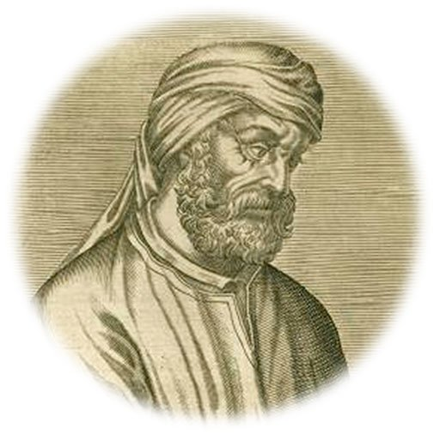
Big Picture Reveals Each Person's Importance
John 13:34–35 (NASB95)
“A new commandment I give to you, that you love one another, even as I have loved you, that you also love one another. By this all men will know that you are My disciples, if you have love for one another.”
“Look . . . how they love one another
(for they themselves [pagans] hate one another);
and how they are ready to die for each other
(for they themselves are readier to kill each other).”
Tertullian (Apologist and Theologian of Carthage(ca. 160–220).

Slide 9
Overcoming Impatience through Truth
Timothy 3:10–15 (NASB95)
Now you followed my teaching, conduct, purpose, faith, patience, love, perseverance, persecutions, and sufferings, such as happened to me at Antioch, at Iconium and at Lystra; what persecutions I endured, and out of them all the Lord rescued me!
Indeed, all who desire to live godly in Christ Jesus WILL BE persecuted. But evil men and impostors will proceed from bad to worse, deceiving and being deceived.
You, however, continue in the things you have learned and become convinced of, knowing from whom you have learned them, and that from childhood you have known the sacred writings which are able to give you the wisdom that leads to salvation through faith which is in Christ Jesus.

Slide 10
Overcoming Impatience through Truth
James 4:12 (NASB95)
There is only one Lawgiver and Judge, the One who is able to save and to destroy; but who are you who judge your neighbor?

Slide 11
Overcoming Impatience through Truth
Hebrews 12:1–7 (NASB95)
Therefore, since we have so great a cloud of witnesses surrounding us, let us also lay aside every encumbrance and the sin which so easily entangles us, and let us run with endurance the race that is set before us, fixing our eyes on Jesus, the author and perfecter of faith, who for the joy set before Him endured the cross, despising the shame, and has sat down at the right hand of the throne of God.
For consider Him who has endured such hostility by sinners against Himself, so that you will not grow weary and lose heart.

Slide 12
Overcoming Impatience through Truth
Hebrews 12:1–7 (NASB95)
You have not yet resisted to the point of shedding blood in your striving against sin; and you have forgotten the exhortation which is addressed to you as sons,
“MY SON, DO NOT REGARD LIGHTLY THE DISCIPLINE OF THE LORD, NOR FAINT WHEN YOU ARE REPROVED BY HIM; FOR THOSE WHOM THE LORD LOVES HE DISCIPLINES, AND HE SCOURGES EVERY SON WHOM HE RECEIVES.”
It is for discipline that you endure; God deals with you as with sons; for what son is there whom his father does not discipline?

