Slide 1
THE BOOK OF JAMES
Lesson 7
Chapter 1 vss. 14-17

Slide 2
Our Journey is Toward the Light
James 1:14–17 (NASB95)
But each one is tempted when he is carried away and enticed by his own lust. Then when lust has conceived, it gives birth to sin; and when sin is accomplished, it brings forth death.
Do not be deceived, my beloved brethren. Every good thing given and every perfect gift is from above, coming down from the Father of lights, with whom there is no variation or shifting shadow.

Slide 3
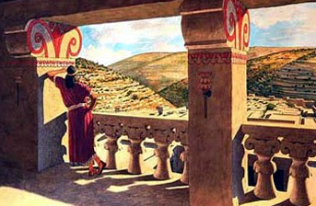
Do NOT be Deceived
We note that James does not say; Each one is tempted by the devil or by wicked men who act as the devil’s tools”. That would only go half way in refuting the charge against God. It would also fail to put the blame where it must eventually be put,
namely ourselves. – R.C.H. Lenski
2 Samuel 11:1–4 (NASB95)
Then it happened in the
spring, at the time when kings go out
to battle, that David sent Joab and his servants with him and all Israel, and they destroyed the sons of Ammon and besieged Rabbah. But David stayed at Jerusalem.

Slide 4
Do NOT Be Deceived
Now when evening came David arose from his bed and walked around on the roof of the king’s house, and from the roof he saw a woman bathing; and the woman was very beautiful in appearance.
So David sent and inquired about the woman. And one said, “Is this not Bathsheba, the daughter of Eliam, the wife of Uriah the Hittite?”
David sent messengers and took her, and when she came to him, he lay with her; and when she had purified herself from her uncleanness, she returned to her house.
2 Samuel 12:10–12 (NASB95)
‘Now therefore, the sword shall never depart from your house, because you have despised Me and have taken the wife of Uriah the Hittite to be your wife.’
“Thus says the Lord, ‘Behold, I will raise up evil against you from your own household; I will even take your wives before your eyes and give them to your companion and he will lay with them in broad daylight.

Slide 5
One has Gone Before Us
Every Good and Perfect Gift…
James 1:5 (NASB95)
But if any of you lacks wisdom, let him ask of God, who gives to all generously and without reproach, and it will be given to him.
Romans 8:28–29 (NASB95)
And we know that God causes all things to work together for good to those who love God, to those who are called according to His purpose. For those whom He foreknew, He also predestined to become conformed to the image of His Son, so that He would be the firstborn among many brethren;

Slide 6
Our Journey’s travels will be tough
Revelation 3:2–6 (NASB95)
‘Wake up, and strengthen the things that remain, which were about to die; for I have not found your deeds completed in the sight of My God.
‘So remember what you have received and heard; and keep it, and repent. Therefore if you do not wake up, I will come like a thief, and you will not know at what hour I will come to you. ‘But you have a few people in Sardis who have not soiled their garments; and they will walk with Me in white, for they are worthy.
‘He who overcomes will thus be clothed in white garments; and I will not erase his name from the book of life, and I will confess his name before My Father and before His angels.
‘He who has an ear, let him hear what the Spirit says to the churches.’

Slide 7
Our Journey’s Outcome is Assured
…coming down from the Father of lights, with whom there is no variation or shifting shadow.
Assurance is backed by God’s own character;
Father- Ownership, Age; Of Lights- Constancy, Direction, Illumination
Genesis 1:14–15 (NASB95)
14 Then God said, “Let there be lights in the expanse of the heavens to separate the day from the night, and let them be for signs and for seasons and for days and years; and let them be for lights in the expanse of the heavens to give light on the earth”; and it was so.

Slide 8
Our Journey’s Outcome is Assured
…coming down from the Father of lights, with whom there is no variation or shifting shadow.
2 Corinthians 1:20–22 (NASB95)
For as many as are the promises of God, in Him they are yes; therefore also through Him is our Amen to the glory of God through us.
Now He who establishes us with you in Christ and anointed us is God,
who also sealed us and gave us the Spirit in our hearts as a pledge.

Slide 9
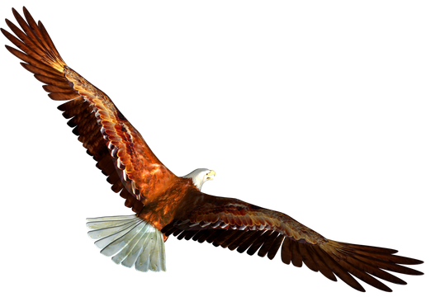
Our Journey’s travels are Overseen
Isaiah 41:8–10 (NASB95)
“But you, Israel, My servant,
Jacob whom I have chosen,
Descendant of Abraham My friend,
You whom I have taken from the ends of the earth,
And called from its remotest parts
And said to you, ‘You are My servant,
I have chosen you and not rejected you.
‘Do not fear, for I am with you;
Do not anxiously look about you, for I am your God.
I will strengthen you, surely I will help you,
Surely I will uphold you with My righteous right hand.’

