Slide 1
The Book of James
Lesson 8
Chapter 1 vss. 18-21

Slide 2
God’s Will accomplished through God’s Word
James 1:18–21 (NASB95)
In the exercise of His will He brought us forth by the word of truth, so that we would be a kind of first fruits among His creatures.
This you know, my beloved brethren. But everyone must be quick to hear, slow to speak and slow to anger; for the anger of man does not achieve the righteousness of God.
Therefore, putting aside all filthiness and all that remains of wickedness, in humility receive the word implanted, which is able to save your souls.

Slide 3
God’s Will accomplished through God’s Word
Brought us forth by the word of truth
Isaiah 55:10–11 (NASB95)
“For as the rain and the snow come down from heaven,
And do not return there without watering the earth
And making it bear and sprout,
And furnishing seed to the sower and bread to the eater;
So will My word be which goes forth from My mouth;
It will not return to Me empty,
Without accomplishing what I desire,
And without succeeding in the matter for which I sent it.

Slide 4
God’s Will accomplished through God’s Word
Brought us forth by the word of truth
Romans 10:13–14 (NASB95)
for “Whoever will call on the name of the Lord will be saved.”
How then will they call on Him in whom they have not believed? How will they believe in Him whom they have not heard? And how will they hear without a preacher?
.

Slide 5
God’s Will accomplished through God’s Word
Brought us forth by the word of truth
1 Peter 1:23–25 (NASB95)
for you have been born again not of seed which is perishable but imperishable, that is, through the living and enduring word of God.
For, “All flesh is like grass,
And all its glory like the flower of grass.
The grass withers,
And the flower falls off,
But the word of the Lord endures forever.”
And this is the word which was preached to you.

Slide 6
God’s Will accomplished through God’s Word
In Humility accept the word
Isaiah 66:1–3 (NASB95)
Thus says the Lord,
“Heaven is My throne and the earth is My footstool.
Where then is a house you could build for Me?
And where is a place that I may rest?
“For My hand made all these things,
Thus all these things came into being,” declares the Lord.
“But to this one I will look,
To him who is humble and contrite of spirit, and who trembles at My word.
needy
poor
wretched
stricken
crippled

Slide 7
God’s Will accomplished through God’s Word
In Humility accept the word
James 1:19–21(a) (NASB95)
This you know, my beloved brethren. But everyone must be quick to hear, slow to speak and slow to anger; for the anger of man does not achieve the righteousness of God. Therefore, putting aside
all filthiness and all that remains of wickedness…
Impediments to humility

Slide 8
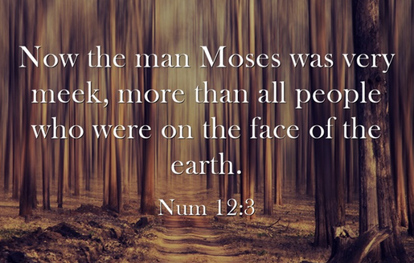
God’s Will accomplished through God’s Word
Humility looks like;
Being quick to hear
Being slow to speak
Being slow to anger (for the anger of man
does not achieve the righteousness of God)
Putting aside all filthiness and
all that remains of wickedness…

Slide 9
God’s Will accomplished through God’s Word
In Humility accept the word implanted in you
Jeremiah 15:16 (NASB95)
Your words were found and I ate them,
And Your words became for me a joy and the delight of my heart;
For I have been called by Your name,
O Lord God of hosts.
.

Slide 10
God’s Will accomplished through God’s Word
In Humility accept the word implanted in you
In other words, our souls depend on the implanted word, and our souls depend on receiving the word. If you decide that you don’t need to receive the external word, you are like a person who decides he doesn’t need to breathe. If you are spiritually dead, you can carry through that decision. You can choose not to breathe. But if you are spiritually alive, you can’t. The implanted word is powerful; it produces life and breathing. It takes over the spiritual diaphragm and demands oxygen. It demands the life-giving external word. If the word is implanted in you, you can’t hold your breath forever. The implanted word will sooner or later conquer and be replenished. You will receive the word again. And you will love it.- J Piper

Slide 11
God’s Will accomplished through God’s Word
In Humility accept the word implanted in you which is able to save your souls
1 Thessalonians 2:13 (NASB95)
For this reason we also constantly thank God that when you received the word of God which you heard from us, you accepted it not as the word of men, but for what it really is, the word of God, which also performs its work in you who believe.
And now….we are teed up for James 1:22 +

