Slide 1
The Book of James
Lesson 9
Chapter 1 vss. 22-25

Slide 2
The Proof is in the Pudding
James 1:22–25 (NASB95)
But prove yourselves doers of the word, and not merely hearers who delude themselves. For if anyone is a hearer of the word and not a doer, he is like a man who looks at his natural face in a mirror; for once he has looked at himself and gone away, he has immediately forgotten what kind of person he was.
But one who looks intently at the perfect law, the law of liberty, and abides by it, not having become a forgetful hearer but an effectual doer, this man will be blessed in what he does.

Slide 3
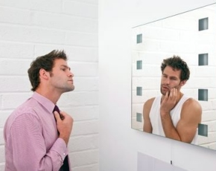
The Proof is in the Pudding

Slide 4
The Proof is in the Pudding
Matthew 23:23–26 (NASB95)
“Woe to you, scribes and Pharisees, hypocrites! For you tithe mint and dill and cummin, and have neglected the weightier provisions of the law: justice and mercy and faithfulness; but these are the things you should have done without neglecting the others.
“You blind guides, who strain out a gnat and swallow a camel! “Woe to you, scribes and Pharisees, hypocrites! For you clean the outside of the cup and of the dish, but inside they are full of robbery and self-indulgence. “You blind Pharisee, first clean the inside of the cup and of the dish, so that the outside of it may become clean also.

Slide 5
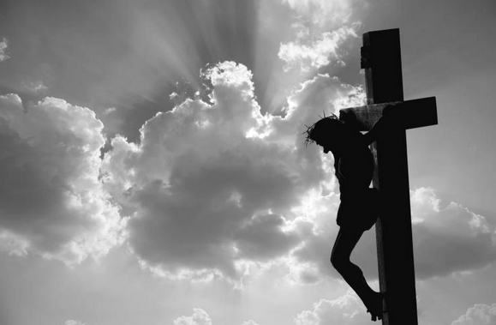
The Law is the Key
Jeremiah 31:31-34(NASB95)
“Behold, days are coming,” declares the Lord, “when I will make a new covenant with the house of Israel and with the house of Judah, not like the covenant which I made with their fathers in the day I took them by the hand to bring them out of the land of Egypt, My covenant which they broke, although I was a husband to them,” declares the Lord. “But this is the covenant which I will make with the house of Israel after those days,” declares the Lord, “I will put My law within them and on their heart I will write it; and I will be their God, and they shall be My people. They will not teach again, each man his neighbor and each man his brother, saying, ‘Know the Lord,’ for they will all know Me, from the least of them to the greatest of them,” declares the Lord, “for I will forgive their iniquity, and their sin I will remember no more.”

Slide 6
The Law is the Key
Galatians 3:10–13 (NASB95)
For as many as are of the works of the Law are under a curse; for it is written, “Cursed is everyone who does not abide by all things written in the book of the law, to perform them.”
Now that no one is justified by the Law before God is evident; for, “The righteous man shall live by faith.”
However, the Law is not of faith; on the contrary, “He who practices them shall live by them.”
Christ redeemed us from the curse of the Law, having become a curse for us—for it is written, “Cursed is everyone who hangs on a tree”—

Slide 7
The Law is the Key
Romans 8:2–4 (NASB95)
For the law of the Spirit of life in Christ Jesus has set you free from the law of sin and of death. For what the Law could not do, weak as it was through the flesh, God did: sending His own Son in the likeness of sinful flesh and as an offering for sin, He condemned sin in the flesh,
so that the requirement of the Law might be fulfilled in us, who do not walk according to the flesh but according to the Spirit.

Slide 8
The Law is the Key
2 Corinthians 3:7–10 (NASB95)
But if the ministry of death, in letters engraved on stones, came with glory, so that the sons of Israel could not look intently at the face of Moses because of the glory of his face, fading as it was, how will the ministry of the Spirit fail to be even more with glory?
For if the ministry of condemnation has glory, much more does the ministry of righteousness abound in glory. For indeed what had glory, in this case has no glory because of the glory that surpasses it.

Slide 9
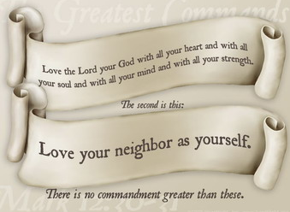
The Law is the Key
Mark 12:28–31 (NASB95)
One of the scribes came and heard them arguing, and recognizing that He had answered them well, asked Him, “What commandment is the foremost of all?”
Jesus answered, “The foremost is, ‘Hear, O Israel! The Lord our God is one Lord; and you shall love the Lord your God with all your heart, and with all your soul, and with all your mind, and with all your strength.’
“The second is this, ‘You shall love your neighbor as yourself.’ There is no other commandment greater than these.”

Slide 10
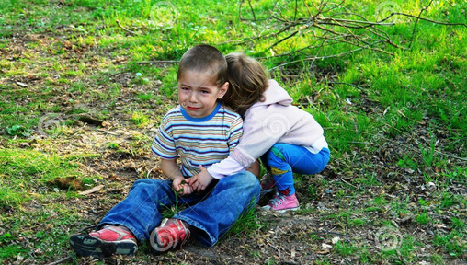
The Law is the Key
Galatians 6:2 (NASB95)
Bear one another’s burdens, and thereby fulfill the law of Christ.

Slide 11
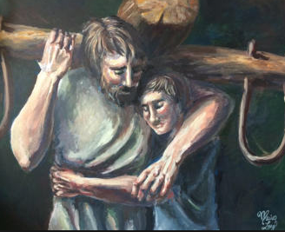
The Law is the Key
Have we been freed from the curse and burden of the Mosaic law just to be burdened down with a more radical law of Christ? No. The difference is that Moses gave us a law but could not change our hearts so that we would freely obey. Our pride and rebellion was not conquered by Moses. But when Christ summons us to obey his law of love, he offers us himself to slay the dragon of our pride, change our hearts, empower us by his Spirit, and fulfill his law.
That is why, even though Christ's law is more radical than the righteousness of the scribes and Pharisees, he can say, "Come to me, all who labor and are heavy-laden, and I will give you rest. Take my yoke upon you and learn from me; for I am gentle and lowly in heart, and you will find rest for your souls. For my yoke is easy, and my burden is light“ -J. Piper

