Slide 1
The Book of James
Lesson 15
Chapter 2 vss. 14-20

Slide 2
James 2:14–20 (NASB95)
What use is it, my brethren, if someone says he has faith but he has no works? Can that faith save him?
If a brother or sister is without clothing and in need of daily food, and one of you says to them, “Go in peace, be warmed and be filled,” and yet you do not give them what is necessary for their body, what use is that?
Even so faith, if it has no works, is dead, being by itself.
But someone may well say, “You have faith and I have works; show me your faith without the works, and I will show you my faith by my works.”
You believe that God is one. You do well; the demons also believe, and shudder. But are you willing to recognize, you foolish fellow, that faith without works is useless?

Slide 3
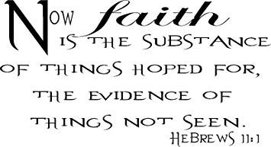
Defining Faith

Slide 4
Defining James’ Faith-nature
Intellectual-Emotional-Practical
James 2:19 (NASB95)
You believe that God is one. You do well; the demons also believe, and shudder.
John 6:68–69 (NASB95)
Simon Peter answered Him, “Lord, to whom shall we go? You have words of eternal life. We have believed and have come to know that You are the Holy One of God.”

Slide 5
Defining James’ Faith-nature
Intellectual-Emotional-Practical
1 Kings 18:28–29 (NASB95)
So they cried with a loud voice and cut themselves according to their custom with swords and lances until the blood gushed out on them. When midday was past, they raved until the time of the offering of the evening sacrifice; but there was no voice, no one answered, and no one paid attention.
Matthew 14:30 (NASB95)
But seeing the wind, he became frightened, and beginning to sink, he cried out, “Lord, save me!”

Slide 6
Defining James’ Faith-nature
Intellectual-Emotional-Practical
1 Corinthians 10:1–4 (NASB95)
For I do not want you to be unaware, brethren, that our fathers were all under the cloud and all passed through the sea; and all were baptized into Moses in the cloud and in the sea; and all ate the same spiritual food;
and all drank the same spiritual drink, for they were drinking from a spiritual rock which followed them; and the rock was Christ.
1 Corinthians 10:5 (NASB95)
Nevertheless, with most of them God was not well-pleased; for they were laid low in the wilderness.

Slide 7
Defining James’ Faith-nature
Intellectual-Emotional-Practical together
James 1:2–3 (NASB95)
Consider it all joy(E), my brethren, when you encounter various trials, knowing(I) that the testing of your faith produces endurance(P).

Slide 8
Defining James’ Faith-Object
Availability- Nearness
Colossians 1:25–27 (NASB95)
Of this church I was made a minister according to the stewardship from God bestowed on me for your benefit, so that I might fully carry out the 25preaching of the word of God, that is, the mystery which has been hidden from the past ages and generations, but has now been manifested to His saints,
to whom God willed to make known what is the riches of the glory of this mystery among the Gentiles, which is Christ in you, the hope of glory.

Slide 9
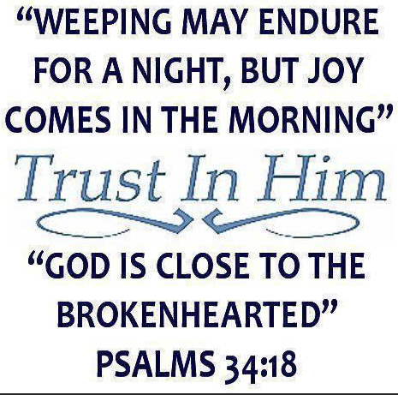
Defining James’ Faith-Object
Availability- Nearness
James 4:8 (NASB95)
Draw near to God and
He will draw near to you.
Cleanse your hands, you sinners;
and purify your hearts,
you double-minded.

Slide 10
Defining James’ Faith-Object
Availability- Desire
John 10:27–29 (NASB95)
“My sheep hear My voice, and I know them, and they follow Me;
and I give eternal life to them, and they will never perish; and no one will snatch them out of My hand. My Father, who has given them to Me, is greater than all; and no one is able to snatch them out of the Father’s hand.”

Slide 11
Defining James’ Faith-Object
Ability- Power
Colossians 1:15–19 (NASB95)
He is the image of the invisible God, the firstborn of all creation. For by Him all things were created, both in the heavens and on earth, visible and invisible, whether thrones or dominions or rulers or authorities—all things have been created through Him and for Him.
He is before all things, and in Him all things hold together.
He is also head of the body, the church; and He is the beginning, the firstborn from the dead, so that He Himself will come to have first place in everything. For it was the Father’s good pleasure for all the fullness to dwell in Him,

Slide 12
Defining James’ Faith-Object
Ability- Application
Colossians 1:20–22 (NASB95)
and through Him to reconcile all things to Himself, having made peace through the blood of His cross; through Him, I say, whether things on earth or things in heaven.
And although you were formerly alienated and hostile in mind, engaged in evil deeds, yet He has now reconciled you in His fleshly body through death, in order to present you before Him holy and blameless and beyond reproach—

Slide 13
Defining James’ Faith-Action
We know what our faith looks like...
We know where our faith lies...
James 2:20 (NASB95)
But are you willing to recognize, you foolish (empty or hard-headed) fellow, that faith without works is useless?
(of no value)
(a negative-doing harm)
(gives no assurance to you)
(provides no proof to the world)

