Slide 1
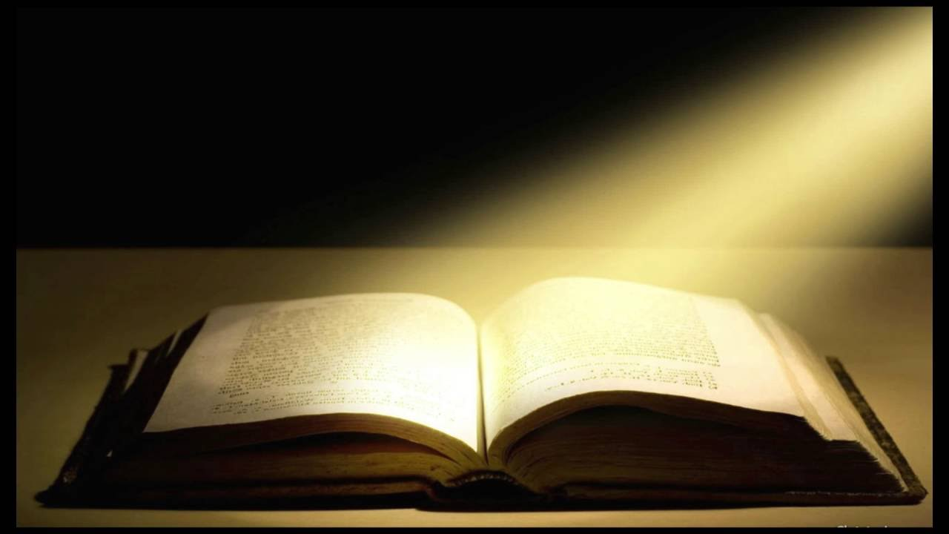
The Book of Revelation
PART 1

Slide 2
“One of the most prevalent and yet subtle problems with biblical interpretation is the way in which people read their own views INTO the bible. Instead of allowing the Bible to impose its views on them, people impose their views on it. All sorts of ideas and presuppositions that ought themselves to be examined in the light of the Bible without serious reflection are imposed upon it. These views and ideas become the unexamined framework within which everything in the Bible is understood. These folks read their bibles, but always through the spectacles of their unquestioned assumptions. They never consider taking these glasses off. They probably are not even aware that they are wearing them. They never think of testing these spectacles themselves in the light of scripture.” Samuel E. Waldron- Eschatology Made Simple

Slide 3
Revelation 1:1-3 The Revelation of Jesus Christ, which God gave Him to show to His bond-servants, the things which must soon take place; and He sent and communicated it by His angel to His bond-servant John, who testified to the word of God and to the testimony of Jesus Christ, even to all that he saw. Blessed is he who reads and those who hear the words of the prophecy, and heed the things which are written in it; for the time is near.

Slide 4
The Revelation of Jesus Christ 2 Cor. 12:1-7 Boasting is necessary, though it is not profitable; but I will go on to visions and revelations of the Lord. I know a man in Christ who fourteen years ago--whether in the body I do not know, or out of the body I do not know, God knows--such a man was caught up to the third heaven. And I know how such a man--whether in the body or apart from the body I do not know, God knows-- was caught up into Paradise and heard inexpressible words, which a man is not permitted to speak. On behalf of such a man I will boast; but on my own behalf I will not boast, except in regard to my weaknesses. 6 For if I do wish to boast I will not be foolish, for I will be speaking the truth; but I refrain from this, so that no one will credit me with more than he sees in me or hears from me. Because of the surpassing greatness of the revelations, for this reason, to keep me from exalting myself, there was given me a thorn in the flesh, a messenger of Satan to torment me--to keep me from exalting myself!

Slide 5
The Revelation of Jesus Christ Rom. 11:34-36 For WHO HAS KNOWN THE MIND OF THE LORD, OR WHO BECAME HIS COUNSELOR? 35 Or WHO HAS FIRST GIVEN TO HIM THAT IT MIGHT BE PAID BACK TO HIM AGAIN? For from Him and through Him and to Him are all things. To Him be the glory forever. Amen Col. 1:15-17 He is the image of the invisible God, the firstborn of all creation. For by Him all things were created, both in the heavens and on earth, visible and invisible, whether thrones or dominions or rulers or authorities--all things have been created through Him and for Him. He is before all things and in Him, all things hold together all things, and in

Slide 6
The Revelation of Jesus Christ Eph. 1:7-10 In Him we have redemption through His blood, the forgiveness of our trespasses, according to the riches of His grace which He lavished on us. In all wisdom and insight He made known to us the mystery of His will, according to His kind intention which He purposed in Him with a view to an administration suitable to the fullness of the times, that is, the summing up of all things in Christ, things in the heavens and things on the earth.

Slide 7
Revelation 1:1-3 …the things which must soon take place; … for the time is near. 1 Tim 3:14 I am writing these things to you, hoping to come to you before long; (Paul’s journeys/ life) Rom. 16:20 The God of peace will soon crush Satan under your feet. ( The actions of some in the church) Lk. 18:8 I tell you that He will bring about justice for them quickly. However, when the Son of Man comes, will He find faith on the earth?”

Slide 8
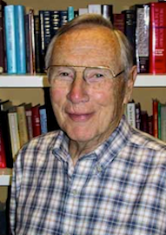
Robert Mounce; NT Greek Scholar-"one of our generation's most able expositors." He was involved in translation of the NIV, the NLT, the NIrV, and especially the ESV. “One solution is to understand “soon” in the sense of suddenly or without delay once the appointed time arrives. Another approach is to interpret it in terms of the certainty of the events in question. The suggestion that John may be employing the same formula of 2 Peter 3…..” mocking,

Slide 9
Revelation 1:1-3 …the things which must soon take place; … for the time is near. 2 Peter 3:3-9 Know this first of all, that in the last days mockers will come with their mocking, following after their own lusts, and saying, “Where is the promise of His coming? For ever since the fathers fell asleep, all continues just as it was from the beginning of creation.” For when they maintain this, it escapes their notice that by the word of God the heavens existed long ago and the earth was formed out of water and by water, 6 through which the world at that time was destroyed, being flooded with water. 7 But by His word the present heavens and earth are being reserved for fire, kept for the day of judgment and destruction of ungodly men. But do not let this one fact escape your notice, beloved, that with the Lord one day is like a thousand years, and a thousand years like one day. The Lord is not slow about His promise, as some count slowness, but is patient toward you, not wishing for any to perish but for all to come to repentance.

Slide 10
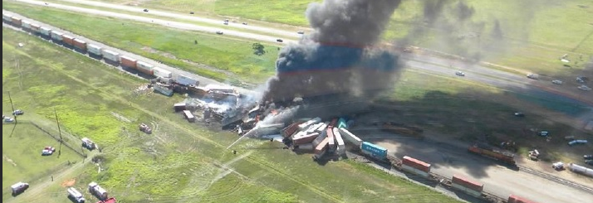
“One solution is to understand “soon” in the sense of suddenly or without delay once the appointed time arrives. Another approach is to interpret it in terms of the certainty of the events in question. The suggestion that John may be employing the same formula of 2 Peter 3….. Involves the Seer (John) in a verbal scam….The most satisfying solution is to take the expression “must soon take place” in a straightforward sense, remembering that in the prophetic outlook the end is always imminent” – (Rule#2 context, context, context)

Slide 11
The first Beatitude of Revelation “Blessed is he who reads and those who hear the words of the prophecy, and heed the things which are written in it; for the time is near.”
Reading it to others should be a welcome experience
Hearing it had moral implications as it was also instructional; “heed”
“The time is near” points to there being something ‘time sensitive’ and ‘critical’

