Slide 1
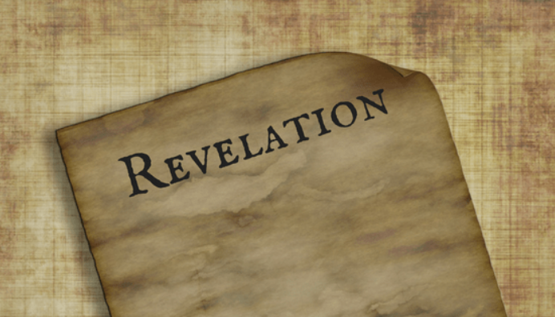
PART 12

Slide 2
Revelation 5:1–14 (NASB95) I saw in the right hand of Him who sat on the throne a book written inside and on the back, sealed up with seven seals. And I saw a strong angel proclaiming with a loud voice, “Who is worthy to open the book and to break its seals?” And no one in heaven or on the earth or under the earth was able to open the book or to look into it. Then I began to weep greatly because no one was found worthy to open the book or to look into it; and one of the elders said to me, “Stop weeping; behold, the Lion that is from the tribe of Judah, the Root of David, has overcome so as to open the book and its seven seals.” And I saw between the throne (with the four living creatures) and the elders a Lamb standing, as if slain, having seven horns and seven eyes, which are the seven Spirits of God, sent out into all the earth. And He came and took the book out of the right hand of Him who sat on the throne.

Slide 3
Revelation 5:1–14 (NASB95) When He had taken the book, the four living creatures and the twenty-four elders fell down before the Lamb, each one holding a harp and golden bowls full of incense, which are the prayers of the saints. And they sang a new song, saying, “Worthy are You to take the book and to break its seals; for You were slain, and purchased for God with Your blood men from every tribe and tongue and people and nation. “You have made them to be a kingdom and priests to our God; and they will reign upon the earth.” Then I looked, and I heard the voice of many angels around the throne and the living creatures and the elders; and the number of them was myriads of myriads, and thousands of thousands, saying with a loud voice,

Slide 4
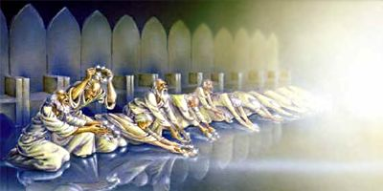
Revelation 5:1–14 (NASB95) “Worthy is the Lamb that was slain to receive power and riches and wisdom and might and honor and glory and blessing.” And every created thing which is in heaven and on the earth and under the earth and on the sea, and all things in them, I heard saying, “To Him who sits on the throne, and to the Lamb, be blessing and honor and glory and dominion forever and ever.” 14 And the four living creatures kept saying, “Amen.” And the elders fell down and worshiped.

Slide 5
The Scroll (Book) Daniel 12:1–4 (NASB95) “Now at that time Michael, the great prince who stands guard over the sons of your people, will arise. And there will be a time of distress such as never occurred since there was a nation until that time; and at that time your people, everyone who is found written in the book, will be rescued. Many of those who sleep in the dust of the ground will awake, these to everlasting life, but the others to disgrace and everlasting contempt. Those who have insight will shine brightly like the brightness of the expanse of heaven, and those who lead the many to righteousness, like the stars forever and ever.” “But as for you, Daniel, conceal these words and seal up the book until the end of time; many will go back and forth, and knowledge will increase.”

Slide 6
The Scroll (Book) Ezekiel 2:9–10 (NASB95) Then I looked, and behold, a hand was extended to me; and lo, a scroll was in it. When He spread it out before me, it was written on the front and back, and written on it were lamentations, mourning and woe. Zechariah 5:2–3 (NASB95) And he said to me, “What do you see?” And I answered, “I see a flying scroll; its length is twenty cubits and its width ten cubits.” Then he said to me, “This is the curse that is going forth over the face of the whole land; surely everyone who steals will be purged away according to the writing on one side, and everyone who swears will be purged away according to the writing on the other side.

Slide 7
The Weeping “no one in heaven or on earth or under the earth was able to open the scroll or to look into it” Daniel 7:13–14 (NASB95) “I kept looking in the night visions, and behold, with the clouds of heaven One like a Son of Man was coming, and He came up to the Ancient of Days And was presented before Him. “And to Him was given dominion, Glory and a kingdom, that all the peoples, nations and men of every language might serve Him. His dominion is an everlasting dominion which will not pass away; And His kingdom is one which will not be destroyed. John 5:22 (NASB95) “For not even the Father judges anyone, but He has given all judgment to the Son,

Slide 8
Weeping Stops With the Introduction of Jesus by the Elder Lion Genesis 49:8–10 (NASB95) “Judah, your brothers shall praise you; Your hand shall be on the neck of your enemies; Your father’s sons shall bow down to you. “Judah is a lion’s whelp; From the prey, my son, you have gone up. He couches, he lies down as a lion, and as a lion, who dares rouse him up? “The scepter shall not depart from Judah, nor the ruler’s staff from between his feet, until Shiloh comes, and to him shall be the obedience of the peoples.

Slide 9
Weeping Stops With the Introduction of Jesus by the Elder Root Isaiah 11:1–4 (NASB95) Then a shoot will spring from the stem of Jesse, and a branch from his roots will bear fruit. The Spirit of the LORD will rest on Him, the spirit of wisdom and understanding, the spirit of counsel and strength, the spirit of knowledge and the fear of the LORD. And He will delight in the fear of the LORD, and He will not judge by what His eyes see, nor make a decision by what His ears hear; But with righteousness He will judge the poor, and decide with fairness for the afflicted of the earth; and He will strike the earth with the rod of His mouth, and with the breath of His lips He will slay the wicked.

Slide 10
That is NOT what John sees. “I saw a Lamb standing, as though it had been slain” Isaiah 53:7–11 (NASB95) He was oppressed and He was afflicted, yet He did not open His mouth; Like a lamb that is led to slaughter, and like a sheep that is silent before its shearers, so He did not open His mouth. By oppression and judgment He was taken away; and as for His generation, who considered that He was cut off out of the land of the living for the transgression of my people, to whom the stroke was due? His grave was assigned with wicked men, yet He was with a rich man in His death, because He had done no violence, nor was there any deceit in His mouth. But the LORD was pleased to crush Him, putting Him to grief; If He would render Himself as a guilt offering, He will see His offspring, He will prolong His days, and the good pleasure of the LORD will prosper in His hand. As a result of the anguish of His soul, He will see it and be satisfied; By His knowledge the Righteous One, My Servant, will justify the many, as He will bear their iniquities.

Slide 11
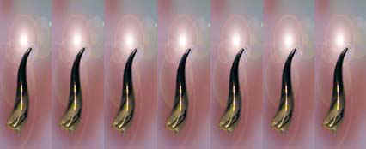
That is NOT what John sees. “I saw a Lamb standing, as though it had been slain” Seven Horns= Power, Authority Seven Spirits= Holy Spirit, Knowledge John 10:17–18 (NASB95) “For this reason the Father loves Me, because I lay down My life so that I may take it again. No one has taken it away from Me, but I lay it down on My own initiative. I have authority to lay it down, and I have authority to take it up again. This commandment I received from My Father.”

Slide 12
The Transfer of the Scroll (book) brings Praise of Music and Prayer He alone is worthy; Because he was Slain- His obedience on the cross exhalted him (Phil. 2:7) He Ransomed his People- Silver and gold fail, Jesus precious blood prevails (2 Peter 2:18) He gave them a Kingdom- A giant 'do over' (Gen.1:28) He made them Priests- Direct access to God (Eph. 2:18, Gen. 3:8) He made them Rulers- 'in all these things, we overwhelmingly conquer through Him...' (Rom. 8:37)

Slide 13
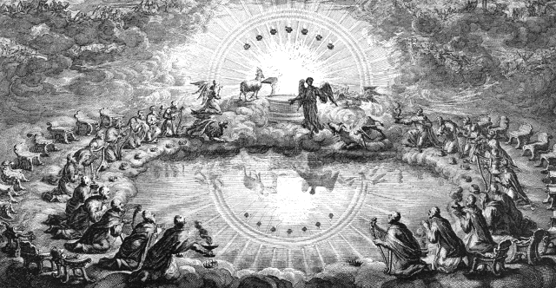
The Transfer of the Scroll (book) brings Praise From the Living Creatures- All created things From The Elders- The Church Universal From Innumerable Angels- His Heavenly Servants

Slide 14
The Transfer of the Scroll (book) brings Praise Worthy is the Lamb to Receive Power Wealth Wisdom Might Honor Glory Blessing
Romans 13:7 (NASB95)
Render to all what is due them: tax to whom tax is due; custom to whom custom; fear to whom fear; honor to whom honor.

Slide 15
The Transfer of the Scroll (book) brings Praise
No Human institution or individual has created all things or reconciled rebels, making them God's priests and kings. Therefore none is worthy of the adoration that belongs to the Enthroned One and to the Lamb.
John would not mislead us into dismissing the threats of this world as illusory. But he points us to a reality more deeply real; the eternal rule of God amid his awesome, adoring courtiers in heaven and the authority of the Lamb to carry out on earth the divine plan for the rescue and restoration of creation to it's chief end, the glorification and enjoyment of God-
Dennis Johnson, “Triumph of the Lamb”, p.113

