Slide 1
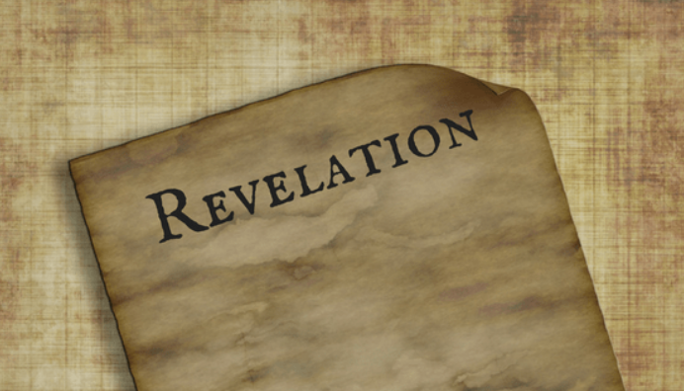
PART 16

Slide 2
Revelation 8:1–13 (NASB95) When the Lamb broke the seventh seal, there was silence in heaven for about half an hour. And I saw the seven angels who stand before God, and seven trumpets were given to them. Another angel came and stood at the altar, holding a golden censer; and much incense was given to him, so that he might add it to the prayers of all the saints on the golden altar which was before the throne. And the smoke of the incense, with the prayers of the saints, went up before God out of the angel’s hand. Then the angel took the censer and filled it with the fire of the altar, and threw it to the earth; and there followed peals of thunder and sounds and flashes of lightning and an earthquake. And the seven angels who had the seven trumpets prepared themselves to sound them. The first sounded, and there came hail and fire, mixed with blood, and they were thrown to the earth; and a third of the earth was burned up, and a third of the trees were burned up, and all the green grass was burned up.

Slide 3
The second angel sounded, and something like a great mountain burning with fire was thrown into the sea; and a third of the sea became blood, and a third of the creatures which were in the sea and had life, died; and a third of the ships were destroyed. The third angel sounded, and a great star fell from heaven, burning like a torch, and it fell on a third of the rivers and on the springs of waters. The name of the star is called Wormwood; and a third of the waters became wormwood, and many men died from the waters, because they were made bitter. The fourth angel sounded, and a third of the sun and a third of the moon and a third of the stars were struck, so that a third of them would be darkened and the day would not shine for a third of it, and the night in the same way. Then I looked, and I heard an eagle flying in midheaven, saying with a loud voice, “Woe, woe, woe to those who dwell on the earth, because of the remaining blasts of the trumpet of the three angels who are about to sound!”

Slide 4
7th seal isn't an end but a beginning. “When the Lamb broke the seventh seal, there was silence in heaven for about half an hour.” Habakkuk 2:18–20 (NASB95) “What profit is the idol when its maker has carved it, or an image, a teacher of falsehood? For its maker trusts in his own handiwork when he fashions speechless idols. “Woe to him who says to a piece of wood, ‘Awake!’ to a mute stone, ‘Arise!’ and that is your teacher? Behold, it is overlaid with gold and silver, and there is no breath at all inside it. “But the LORD is in His holy temple. Let all the earth be silent before Him.”

Slide 5
The Hearts of the Saints PRAY for thes trumpets Revelation 8:4–5 (NASB95) And the smoke of the incense, with the prayers of the saints, went up before God out of the angel’s hand. Then the angel took the censer and filled it with the fire of the altar, and threw it to the earth;... Psalm 68:1–2 (NASB95) Let God arise, let His enemies be scattered, And let those who hate Him flee before Him. As smoke is driven away, so drive them away; As wax melts before the fire, So let the wicked perish before God. 1 Corinthians 16:22 (NASB95) 22 If anyone does not love the Lord, he is to be accursed. Maranatha.

Slide 6
The Trumpets announce Gods answering of prayer. Revelation 8:4–5 (NASB95) ...and there followed peals of thunder and sounds and flashes of lightning and an earthquake. Psalm 68:7–8 (NASB95) O God, when You went forth before Your people, When You marched through the wilderness, Selah. The earth quaked; The heavens also dropped rain at the presence of God; Sinai itself quaked at the presence of God, the God of Israel.

Slide 7
Moving from Proclamation to Warning and a Call for Action Joel 2:1 (NASB95) Blow a trumpet in Zion, and sound an alarm on My holy mountain! Let all the inhabitants of the land tremble, for the day of the LORD is coming; Surely it is near, Ezekiel 33:1–5 (NASB95) And the word of the LORD came to me, saying, “Son of man, speak to the sons of your people and say to them, ‘If I bring a sword upon a land, and the people of the land take one man from among them and make him their watchman, and he sees the sword coming upon the land and blows on the trumpet and warns the people, then he who hears the sound of the trumpet and does not take warning, and a sword comes and takes him away, his blood will be on his own head. ‘He heard the sound of the trumpet but did not take warning; his blood will be on himself. But had he taken warning, he would have delivered his life.

Slide 8
These Trumpets announce Gods final answering of prayer. Zephaniah 1:2–8 (NASB95) “I will completely remove all things from the face of the earth,” declares the LORD. “I will remove man and beast; I will remove the birds of the sky And the fish of the sea, and the ruins along with the wicked; and I will cut off man from the face of the earth,” declares the LORD “So I will stretch out My hand against Judah and against all the inhabitants of Jerusalem. And I will cut off the remnant of Baal from this place, and the names of the idolatrous priests along with the priests. “And those who bow down on the housetops to the host of heaven, and those who bow down and swear to the LORD and yet swear by Milcom,and those who have turned back from following the LORD, and those who have not sought the LORD or inquired of Him.” 7 Be silent before the Lord GOD! For the day of the LORD is near, for the LORD has prepared a sacrifice, He has consecrated His guests. 8 “Then it will come about on the day of the LORD’S sacrifice that I will punish the princes, the king’s sons and all who clothe themselves with foreign garments.

Slide 9
4 Horses (seals)=Judgment as seen on earth (introduced by the 4LC) White horse; conquering Red horse; war/ murder Black horse; famine/ inequality Ashen horse; suffering/ unnatural death
4 Trumpets*= Judgment as seen in Heaven (initiated by angels)
1st trumpet; judgment on earth
2nd trumpet; judgment on oceans
3rd trumpet; judgment on life
4th trumpet; judgment on sky/ heavens
* 'a third' is a common theme for the trumpets; seemingly meant to convey 'partial'

Slide 10
The Eagle has definitely NOT landed (woe, woe, woe) Hosea 8:1 (NASB95) Put the trumpet to your lips! Like an eagle the enemy comes against the house of the LORD, Because they have transgressed My covenant And rebelled against My law. Habakkuk 1:8 (NASB95) “Their horses are swifter than leopards And keener than wolves in the evening. Their horsemen come galloping, Their horsemen come from afar; They fly like an eagle swooping down to devour.

Slide 11
Isaiah 26:7–12 (NASB95) The way of the righteous is smooth; O Upright One, make the path of the righteous level. Indeed, while following the way of Your judgments, O LORD, we have waited for You eagerly; Your name, even Your memory, is the desire of our souls. At night my soul longs for You, indeed, my spirit within me seeks You diligently; For when the earth experiences Your judgments the inhabitants of the world learn righteousness. Though the wicked is shown favor, he does not learn righteousness; He deals unjustly in the land of uprightness, and does not perceive the majesty of the LORD. O LORD, Your hand is lifted up yet they do not see it. They see Your zeal for the people and are put to shame; Indeed, fire will devour Your enemies. LORD, You will establish peace for us, since You have also performed for us all our works.

