Slide 1
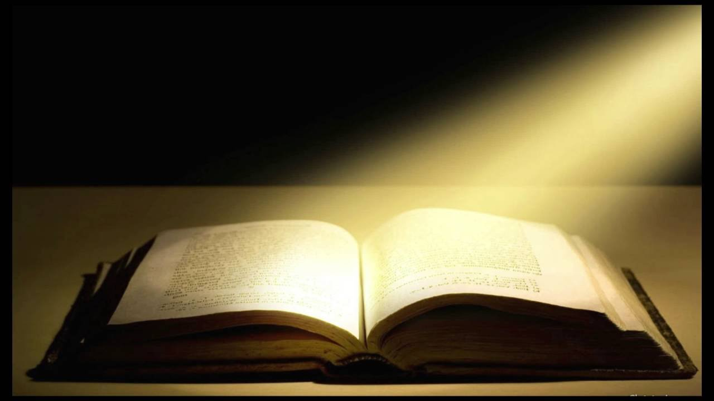
The Book of Revelation
PART 3

Slide 2
Revelation 1:9–20 (NASB95) I, John, your brother and fellow partaker in the tribulation and kingdom and perseverance which are in Jesus, was on the island called Patmos because of the word of God and the testimony of Jesus. I was in the Spirit on the Lord’s day, and I heard behind me a loud voice like the sound of a trumpet, saying, “Write in a book what you see, and send it to the seven churches: to Ephesus and to Smyrna and to Pergamum and to Thyatira and to Sardis and to Philadelphia and to Laodicea.” Then I turned to see the voice that was speaking with me. And having turned I saw seven golden lampstands; and in the middle of the lampstands I saw one like a son of man, clothed in a robe reaching to the feet, and girded across His chest with a golden sash. His head and His hair were white like white wool, like snow; and His eyes were like a flame of fire. His feet were like burnished bronze, when it has been made to glow in a furnace, and His voice was like the sound of many waters.

Slide 3
In His right hand He held seven stars, and out of His mouth came a sharp two-edged sword; and His face was like the sun shining in its strength. When I saw Him, I fell at His feet like a dead man. And He placed His right hand on me, saying, “Do not be afraid; I am the first and the last, and the living One; and I was dead, and behold, I am alive forevermore, and I have the keys of death and of Hades. Therefore write the things which you have seen, and the things which are, and the things which will take place after these things. As for the mystery of the seven stars which you saw in My right hand, and the seven golden lampstands: the seven stars are the angels of the seven churches, and the seven lampstands are the seven churches.

Slide 4
The Commission to Write- Given to; I, John -Brother (vs. “Elder in 1&2 John) -Fellow partaker in; -tribulation John 16:33 (NASB95) “These things I have spoken to you, so that in Me you may have peace. In the world you have tribulation, but take courage; I have overcome the world.”

Slide 5
The Commission to Write- Given to; I, John -Brother (vs. “Elder in 1&2 John) -Fellow partaker in; -tribulation -the Kingdom Revelation 1:6 (NASB95) and He has made us to be a kingdom, priests to His God and Father—to Him be the glory and the dominion forever and ever. Amen.

Slide 6
The Commission to Write- Given to; I, John -Brother (vs. “Elder in 1&2 John) -Fellow partaker in; -tribulation -the Kingdom -perseverence Romans 5:3–5 (NASB95) And not only this, but we also exult in our tribulations, knowing that tribulation brings about perseverance; and perseverance, proven character; and proven character, hope; and hope does not disappoint, because the love of God has been poured out within our hearts through the Holy Spirit who was given to us.

Slide 7
The Commission to Write- Given for; R “As for the mystery of the seven stars which you saw in My right hand, and the seven golden lampstands: - the seven stars are the angels of the seven churches, Revelation 22:9 (NASB95) But he said to me, “Do not do that. I am a fellow servant of yours and of your brethren the prophets and of those who heed the words of this book. Worship God.”

Slide 8
The Commission to Write- Given for; R “As for the mystery of the seven stars which you saw in My right hand, and the seven golden lampstands: - the seven lampstands are the seven churches. Matthew 5:15 (NASB95) nor does anyone light a lamp and put it under a basket, but on the lampstand, and it gives light to all who are in the house.

Slide 9
The Commission to Write- Given by; ROne like a son of man; - clothed in a robe reaching to the feet - girded across His chest with a golden sash. - His head and His hair were white like white wool, like snow - His eyes were like a flame of fire. - His feet were like burnished bronze, when it has been made to glow in a furnace - His voice was like the sound of many waters. - out of His mouth came a sharp two-edged sword - His face was like the sun shining in its strength. “I fell at His feet like a dead man”

Slide 10
Daniel 10:5–9 (NASB95) I lifted my eyes and looked, and behold, there was a certain man dressed in linen, whose waist was girded with a belt of pure gold of Uphaz. His body also was like beryl, his face had the appearance of lightning, his eyes were like flaming torches, his arms and feet like the gleam of polished bronze, and the sound of his words like the sound of a tumult. Now I, Daniel, alone saw the vision, while the men who were with me did not see the vision; nevertheless, a great dread fell on them, and they ran away to hide themselves. So I was left alone and saw this great vision; yet no strength was left in me, for my natural color turned to a deathly pallor, and I retained no strength. But I heard the sound of his words; and as soon as I heard the sound of his words, I fell into a deep sleep on my face, with my face to the ground.

Slide 11
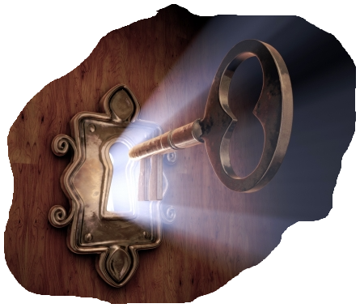
The Commission to Write- Given by; R - I am the first and the last - and the living One; and I was dead, and behold, I am alive forevermore, - I have the keys of death and of Hades.

Slide 12
The Commission to Write; R Revelation 1:19 (NASB95) “Therefore write the things which you have seen, and the things which are, and the things which will take place after these things.

