Slide 1
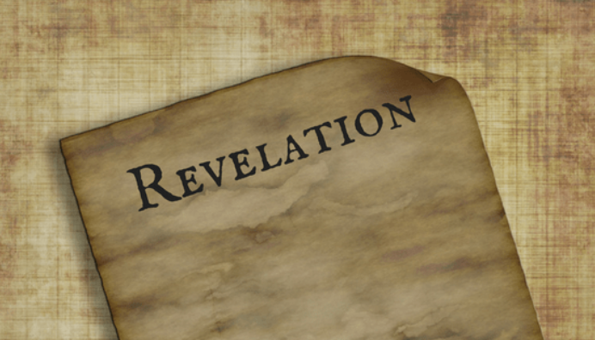
PART 33

Slide 2
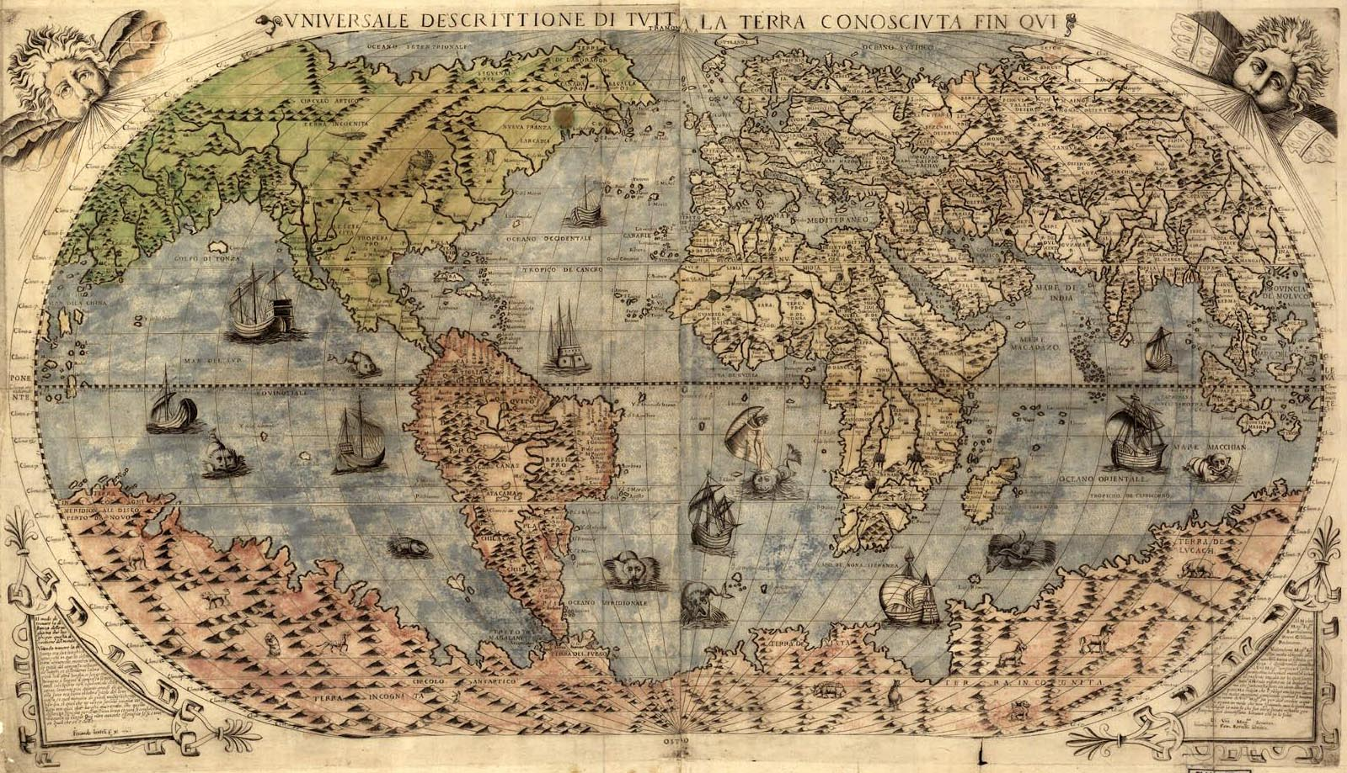

Slide 3
Revelation 21:1–27 (NASB95) Then I saw a new heaven and a new earth; for the first heaven and the first earth passed away, and there is no longer any sea. And I saw the holy city, new Jerusalem, coming down out of heaven from God, made ready as a bride adorned for her husband. And I heard a loud voice from the throne, saying, “Behold, the tabernacle of God is among men, and He will dwell among them, and they shall be His people, and God Himself will be among them, and He will wipe away every tear from their eyes; and there will no longer be any death; there will no longer be any mourning, or crying, or pain; the first things have passed away.” And He who sits on the throne said, “Behold, I am making all things new.” And He said, “Write, for these words are faithful and true.” Then He said to me, “It is done. I am the Alpha and the Omega, the beginning and the end. I will give to the one who thirsts from the spring of the water of life without cost. “He who overcomes will inherit these things, and I will be his God and he will be My son.

Slide 4
Revelation 21:1–27 (NASB95) “But for the cowardly and unbelieving and abominable and murderers and immoral persons and sorcerers and idolaters and all liars, their part will be in the lake that burns with fire and brimstone, which is the second death.” Then one of the seven angels who had the seven bowls full of the seven last plagues came and spoke with me, saying, “Come here, I will show you the bride, the wife of the Lamb.” And he carried me away in the Spirit to a great and high mountain, and showed me the holy city, Jerusalem, coming down out of heaven from God, having the glory of God. Her brilliance was like a very costly stone, as a stone of crystal-clear jasper. It had a great and high wall, with twelve gates, and at the gates twelve angels; and names were written on them, which are the names of the twelve tribes of the sons of Israel. There were three gates on the east and three gates on the north and three gates on the south and three gates on the west.

Slide 5
Revelation 21:1–27 (NASB95) And the wall of the city had twelve foundation stones, and on them were the twelve names of the twelve apostles of the Lamb. The one who spoke with me had a gold measuring rod to measure the city, and its gates and its wall. The city is laid out as a square, and its length is as great as the width; and he measured the city with the rod, fifteen hundred miles; its length and width and height are equal. And he measured its wall, seventy-two yards, according to human measurements, which are also angelic measurements. The material of the wall was jasper; and the city was pure gold, like clear glass. The foundation stones of the city wall were adorned with every kind of precious stone. The first foundation stone was jasper; the second, sapphire; the third, chalcedony; the fourth, emerald; the fifth, sardonyx; the sixth, sardius; the seventh, chrysolite; the eighth, beryl; the ninth, topaz; the tenth, chrysoprase; the eleventh, jacinth; the twelfth, amethyst.

Slide 6
Revelation 21:1–27 (NASB95) And the twelve gates were twelve pearls; each one of the gates was a single pearl. And the street of the city was pure gold, like transparent glass. I saw no temple in it, for the Lord God the Almighty and the Lamb are its temple. And the city has no need of the sun or of the moon to shine on it, for the glory of God has illumined it, and its lamp is the Lamb. The nations will walk by its light, and the kings of the earth will bring their glory into it. In the daytime (for there will be no night there) its gates will never be closed; and they will bring the glory and the honor of the nations into it; and nothing unclean, and no one who practices abomination and lying, shall ever come into it, but only those whose names are written in the Lamb’s book of life.s.

Slide 7
New Heavens and New Earth Isaiah 65:17–19 (NASB95) “For behold, I create new heavens and a new earth; and the former things will not be remembered or come to mind. But be glad and rejoice forever in what I create; For behold, I create Jerusalem for rejoicing and her people for gladness. “I will also rejoice in Jerusalem and be glad in My people; and there will no longer be heard in her the voice of weeping and the sound of crying. Romans 8:22–23 (NASB95) For we know that the whole creation groans and suffers the pains of childbirth together until now. And not only this, but also we ourselves, having the first fruits of the Spirit, even we ourselves groan within ourselves, waiting eagerly for our adoption as sons, the redemption of our body.

Slide 8
New Heavens and New Earth 2 Peter 3:10–13 (NASB95) But the day of the Lord will come like a thief, in which the heavens will pass away with a roar and the elements will be destroyed with intense heat, and the earth and its works will be burned up. Since all these things are to be destroyed in this way, what sort of people ought you to be in holy conduct and godliness, looking for and hastening the coming of the day of God, because of which the heavens will be destroyed by burning, and the elements will melt with intense heat! But according to His promise we are looking for new heavens and a new earth, in which righteousness dwells.

Slide 9
The sea was no more Daniel 7:2–3 (NASB95) Daniel said, “I was looking in my vision by night, and behold, the four winds of heaven were stirring up the great sea. And four great beasts were coming up from the sea, different from one another.” Revelation 13:1 (NASB95) And the dragon stood on the sand of the seashore. Then I saw a beast coming up out of the sea, having ten horns and seven heads, and on his horns were ten diadems, and on his heads were blasphemous names.
James 1:6 (NASB95)
But he must ask in faith without any doubting, for the one who doubts is like the surf of the sea, driven and tossed by the wind.
Jude 12,13 (NASB95)
These are the men who are hidden reefs in your love feasts when they feast with you without fear, caring for themselves; clouds without water, carried along by winds; autumn trees without fruit, doubly dead, uprooted; wild waves of the sea, casting up their own shame like foam;

Slide 10
The Holy City; the New Jerusalem & God's people Genesis 3:7–9 (NASB95) Then the eyes of both of them were opened, and they knew that they were naked; and they sewed fig leaves together and made themselves loin coverings. They heard the sound of the LORD God walking in the garden in the cool of the day, and the man and his wife hid themselves from the presence of the LORD God among the trees of the garden. Then the LORD God called to the man, and said to him, “Where are you?” Genesis 3:22–23 (NASB95) Then the LORD God said, “Behold, the man has become like one of Us, knowing good and evil; and now, he might stretch out his hand, and take also from the tree of life, and eat, and live forever”— therefore the LORD God sent him out from the garden of Eden, to cultivate the ground from which he was taken.

Slide 11
The Holy City; the New Jerusalem & God's people Genesis 17:7 (NASB95) “I will establish My covenant between Me and you and your descendants after you throughout their generations for an everlasting covenant, to be God to you and to your descendants after you. Romans 4:13 (NASB95) For the promise to Abraham or to his descendants that he would be heir of the world was not through the Law, but through the righteousness of faith.

Slide 12
The Holy City; the New Jerusalem & God's people Exodus 40:34–35 (NASB95) Then the cloud covered the tent of meeting, and the glory of the LORD filled the tabernacle. Moses was not able to enter the tent of meeting because the cloud had settled on it, and the glory of the LORD filled the tabernacle. 1 Kings 8:27 (NASB95) 27 “But will God indeed dwell on the earth? Behold, heaven and the highest heaven cannot contain You, how much less this house which I have built! Ezekiel 10:18 (NASB95) Then the glory of the LORD departed from the threshold of the temple and stood over the cherubim.

Slide 13
The Holy City; the New Jerusalem & God's people John 1:14 (NASB95) And the Word became flesh, and dwelt (lit. 'spread His tabernacle') among us, and we saw His glory, glory as of the only begotten from the Father, full of grace and truth. John 2:19–21 (NASB95) Jesus answered them, “Destroy this temple, and in three days I will raise it up.” The Jews then said, “It took forty-six years to build this temple, and will You raise it up in three days?” But He was speaking of the temple of His body..

Slide 14
The Holy City; the New Jerusalem & God's people 1 Corinthians 3:16 (NASB95) Do you not know that you are a temple of God and that the Spirit of God dwells in you? Ephesians 2:19–22 (NASB95) So then you are no longer strangers and aliens, but you are fellow citizens with the saints, and are of God’s household, having been built on the foundation of the apostles and prophets, Christ Jesus Himself being the corner stone, in whom the whole building, being fitted together, is growing into a holy temple in the Lord, in whom you also are being built together into a dwelling of God in the Spirit.

Slide 15
The Holy City; the New Jerusalem & God's people Revelation 21:3 (NASB95) And I heard a loud voice from the throne, saying, “Behold, the tabernacle of God is among men, and He will dwell among them, and they shall be His people, and God Himself will be among them, Revelation 21:9–10 (NASB95) Then one of the seven angels who had the seven bowls full of the seven last plagues came and spoke with me, saying, “Come here, I will show you the bride, the wife of the Lamb.” And he carried me away in the Spirit to a great and high mountain, and showed me the holy city, Jerusalem, coming down out of heaven from God, Revelation 21:22 (NASB95) I saw no temple in it, for the Lord God the Almighty and the Lamb are its temple.

Slide 16
What about Ezekiel's Temple Vision? 1. Figurative Ezekiel 40-48 measures it out as big as entire city of Jerusalem 2. Built as the people of God 2 Corinthians 6:16 (NASB95) Or what agreement has the temple of God with idols? For we are the temple of the living God; just as God said, “I WILL DWELL IN THEM AND WALK AMONG THEM; AND I WILL BE THEIR GOD, AND THEY SHALL BE MY PEOPLE. Ezekiel 37:27 (NASB95) “My dwelling place also will be with them; and I will be their God, and they will be My people.

Slide 17
The Promises to the Residents Revelation 21:4 (NASB95) 4 and He will wipe away every tear from their eyes; and there will no longer be any death; there will no longer be any mourning, or crying, or pain; the first things have passed away.” Revelation 21:27 (NASB95) and nothing unclean, and no one who practices abomination and lying, shall ever come into it, but only those whose names are written in the Lamb’s book of life.

