Slide 1
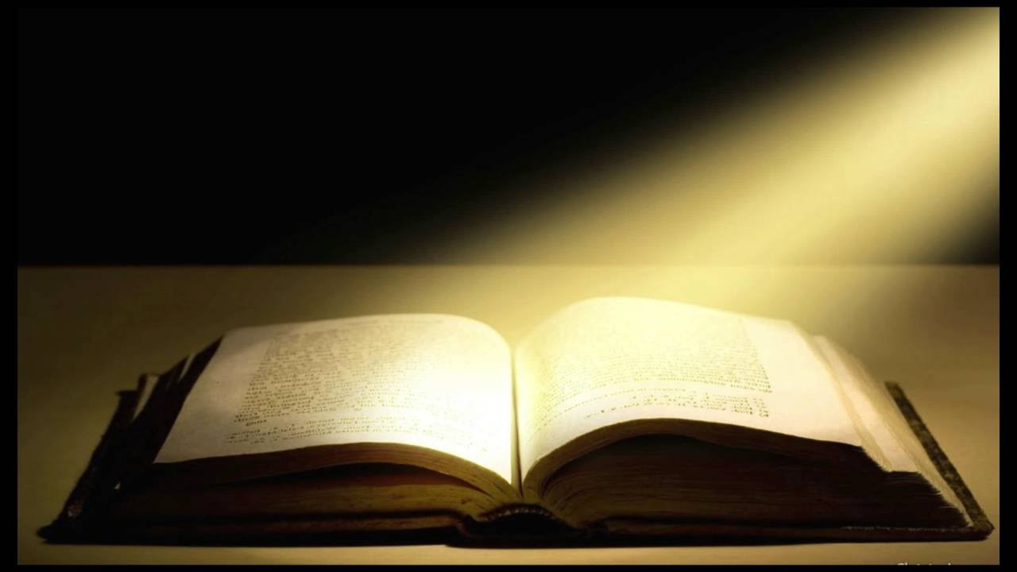
The Book of Revelation
PART 5

Slide 2
Revelation 2:8–11 (NASB95) “And to the angel of the church in Smyrna write: The first and the last, who was dead, and has come to life, says this: ‘I know your tribulation and your poverty (but you are rich), and the blasphemy by those who say they are Jews and are not, but are a synagogue of Satan. Do not fear what you are about to suffer. Behold, the devil is about to cast some of you into prison, so that you will be tested, and you will have tribulation for ten days. Be faithful until death, and I will give you the crown of life. He who has an ear, let him hear what the Spirit says to the churches. He who overcomes will not be hurt by the second death.’

Slide 3
Paradoxical Christianity exposed @ Smyrna -The first and the last, who was dead, and has come to life, says this -I know your tribulation and your poverty (but you are rich) -Those who say they are Jews and are not, but are a synagogue of Satan. -Be faithful until death, and I will give you the crown of life.

Slide 4
Paradox 1 -The first and the last, who was dead, and has come to life, says this Jesus Christ- The Paradox God- Man Hebrews 1:8–12 (NASB95) But of the Son He says, “YOUR THRONE, O GOD, IS FOREVER AND EVER, AND THE RIGHTEOUS SCEPTER IS THE SCEPTER OF HIS KINGDOM…. …“YOU, LORD, IN THE BEGINNING LAID THE FOUNDATION OF THE EARTH, AND THE HEAVENS ARE THE WORKS OF YOUR HANDS; THEY WILL PERISH, BUT YOU REMAIN; AND THEY ALL WILL BECOME OLD LIKE A GARMENT, AND LIKE A MANTLE YOU WILL ROLL THEM UP; LIKE A GARMENT THEY WILL ALSO BE CHANGED. BUT YOU ARE THE SAME, AND YOUR YEARS WILL NOT COME TO AN END.”

Slide 5
Paradox 1 -The first and the last, who was dead, and has come to life, says this Jesus Christ- The Paradox Slain Lamb-Conquering Ruler Isaiah 53:10–12 (NASB95) But the LORD was pleased to crush Him, putting Him to grief; If He would render Himself as a guilt offering, He will see His offspring, He will prolong His days, and the good pleasure of the LORD will prosper in His hand. As a result of the anguish of His soul, He will see it and be satisfied; By His knowledge the Righteous One, my Servant, will justify the many, as He will bear their iniquities. Therefore, I will allot Him a portion with the great, and He will divide the booty with the strong; because He poured out Himself to death, and was numbered with the transgressors; Yet He Himself bore the sin of many, and interceded for the transgressors.

Slide 6
Paradox 2 -I know your tribulation and your poverty (but you are rich) Moving focus from picture to reality Psalm 135:15–18 (NASB95) The idols of the nations are but silver and gold, The work of man’s hands. They have mouths, but they do not speak; They have eyes, but they do not see; They have ears, but they do not hear, Nor is there any breath at all in their mouths. Those who make them will be like them, Yes, everyone who trusts in them.

Slide 7
Paradox 2 -I know your tribulation and your poverty (but you are rich) Moving focus from picture to reality 2 Corinthians 4:16–18 (NASB95) Therefore we do not lose heart, but though our outer man is decaying, yet our inner man is being renewed day by day. For momentary, light affliction is producing for us an eternal weight of glory far beyond all comparison, while we look not at the things which are seen, but at the things which are not seen; for the things which are seen are temporal, but the things which are not seen are eternal.

Slide 8
Paradox 3 -Those who say they are Jews and are not, but are a synagogue of Satan. Kingdom membership is not geographical or genealogical. Romans 2:28–29 (NASB95) For he is not a Jew who is one outwardly, nor is circumcision that which is outward in the flesh. But he is a Jew who is one inwardly; and circumcision is that which is of the heart, by the Spirit, not by the letter; and his praise is not from men, but from God.

Slide 9
Paradox 4 -Be faithful until death, and I will give you the crown of life. James was the perfect ‘Set-Up’ book! -How to/ why handle persecution, suffering, -Recognizing false Christians -Rightly evaluating mankind and riches James 1:12 (NASB95) Blessed is a man who perseveres under trial; for once he has been approved, he will receive the crown of life which the Lord has promised to those who love Him.

Slide 10
Paradox 4 -Be faithful until death, and I will give you the crown of life. Be Faithful- Not fearful Matthew 10:25–29 (NASB95) “It is enough for the disciple that he become like his teacher, and the slave like his master. If they have called the head of the house Beelzebul, how much more will they malign the members of his household! “Therefore do not fear them, for there is nothing concealed that will not be revealed, or hidden that will not be known. What I tell you in the darkness, speak in the light; and what you hear whispered in your ear, proclaim upon the housetops. “Do not fear those who kill the body but are unable to kill the soul; but rather fear Him who is able to destroy both soul and body in hell. “Are not two sparrows sold for a cent? And yet not one of them will fall to the ground apart from your Father.

Slide 11
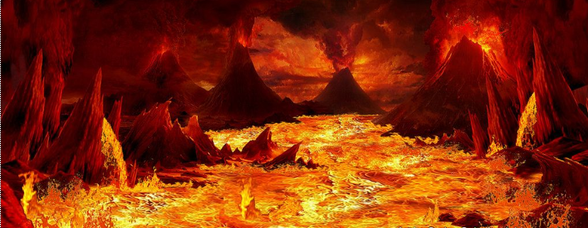
Successful Paradoxical Living “He who overcomes will not be hurt by the second death.” Revelation 20:6, 14-15 (NASB95) Blessed and holy is the one who has a part in the first resurrection; over these the second death has no power, but they will be priests of God and of Christ and will reign with Him for a thousand years. Revelation 20:14-15 (NASB95) Then death and Hades were thrown into the lake of fire. This is the second death, the lake of fire. And if anyone’s name was not found written in the book of life, he was thrown into the lake of fire.

