Slide 1
The Book of Revelation
PART 7

Slide 2
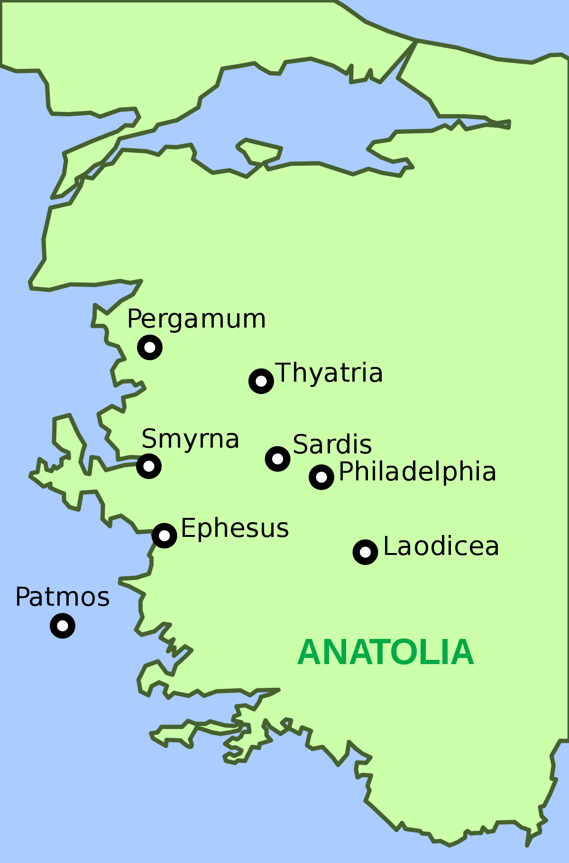
Where we have been- What we have been taught Ephesus- Lost their 1st love (lack of worship) Smyrna- Carefully living in the light of (paradoxical) Christian truth Pergamum- Watching within the church Thyatira- ..... .

Slide 3
Revelation 2:18–29 (NASB95) Message to Thyatira “And to the angel of the church in Thyatira write: The Son of God, who has eyes like a flame of fire, and His feet are like burnished bronze, says this: ‘I know your deeds, and your love and faith and service and perseverance, and that your deeds of late are greater than at first. But I have this against you, that you tolerate the woman Jezebel, who calls herself a prophetess, and she teaches and leads My bond-servants astray so that they commit acts of immorality and eat things sacrificed to idols. ‘I gave her time to repent, and she does not want to repent of her immorality. Behold, I will throw her on a bed of sickness, and those who commit adultery with her into great tribulation, unless they repent of her deeds.

Slide 4
Revelation 2:18–29 (NASB95) Message to Thyatira ‘And I will kill her children with pestilence, and all the churches will know that I am He who searches the minds and hearts; and I will give to each one of you according to your deeds. ‘But I say to you, the rest who are in Thyatira, who do not hold this teaching, who have not known the deep things of Satan, as they call them—I place no other burden on you. Nevertheless what you have, hold fast until I come. He who overcomes, and he who keeps My deeds until the end, TO HIM I WILL GIVE AUTHORITY OVER THE NATIONS; AND HE SHALL RULE THEM WITH A ROD OF IRON, AS THE VESSELS OF THE POTTER ARE BROKEN TO PIECES, as I also have received authority from My Father; and I will give him the morning star. ‘He who has an ear, let him hear what the Spirit says to the churches.’”

Slide 5
The 1st Clue is Christ's self description Ephesus- Lost their 1st love (Holds the 7 stars, Walks among the lampstands) Smyrna- Paradoxical christian truth (1st and the last, Was dead and is alive) Pergamum- Watching within the church (has sharp 2 edged sword) Thyatira- Spiritual growth (Eyes like a flame of fire, feet like burnished bronze)

Slide 6
Spiritual Growth to be in Evidence by; Increase in love and faith exhibited in service 2 Peter 1:5–9 (NASB95) Now for this very reason also, applying all diligence, in your faith supply moral excellence, and in your moral excellence, knowledge, and in your knowledge, self-control, and in your self-control, perseverance, and in your perseverance, godliness, and in your godliness, brotherly kindness, and in your brotherly kindness, love. For if these qualities are yours and are increasing, they render you neither useless nor unfruitful in the true knowledge of our Lord Jesus Christ. For he who lacks these qualities is blind or short-sighted, having forgotten his purification from his former sins.

Slide 7
Spiritual Growth to be in Evidence by; Intolerence of false teachers Galatians 1:6–10 (NASB95) I am amazed that you are so quickly deserting Him who called you by the grace of Christ, for a different gospel; which is really not another; only there are some who are disturbing you and want to distort the gospel of Christ. But even if we, or an angel from heaven, should preach to you a gospel contrary to what we have preached to you, he is to be accursed! As we have said before, so I say again now, if any man is preaching to you a gospel contrary to what you received, he is to be accursed! For am I now seeking the favor of men, or of God? Or am I striving to please men? If I were still trying to please men, I would not be a bond-servant of Christ.

Slide 8
Spiritual Growth to be in Evidence by; Immersed in Gods Word Psalm 119:10–14 (NASB95) With all my heart I have sought You; Do not let me wander from Your commandments. Your word I have treasured in my heart, That I may not sin against You. Blessed are You, O LORD; Teach me Your statutes. With my lips I have told of All the ordinances of Your mouth. I have rejoiced in the way of Your testimonies, As much as in all riches.

Slide 9
Spiritual Growth to be in Evidence by; Impacted by God's Mercy Romans 2:4–5 (NASB95) Or do you think lightly of the riches of His kindness and tolerance and patience, not knowing that the kindness of God leads you to repentance? But because of your stubbornness and unrepentant heart you are storing up wrath for yourself in the day of wrath and revelation of the righteous judgment of God,

Slide 10
Spiritual Growth to be in Evidence by; Increased Fear of God Revelation 15:3–4 (NASB95) And they sang the song of Moses, the bond-servant of God, and the song of the Lamb, saying, “Great and marvelous are Your works, O Lord God, the Almighty; Righteous and true are Your ways, King of the nations! “Who will not fear, O Lord, and glorify Your name? For You alone are holy; For ALL THE NATIONS WILL COME AND WORSHIP BEFORE YOU, FOR YOUR RIGHTEOUS ACTS HAVE BEEN REVEALED.”

Slide 11
Spiritual Growth to be in Evidence by; Intimate with God John 5:39–40 (NASB95) “You search the Scriptures because you think that in them you have eternal life; it is these that testify about Me; and you are unwilling to come to Me so that you may have life.

Slide 12
Spiritual Growth to be in Evidence by; Intimate with God Hebrews 4:14–16 (NASB95) Therefore, since we have a great high priest who has passed through the heavens, Jesus the Son of God, let us hold fast our confession. For we do not have a high priest who cannot sympathize with our weaknesses, but One who has been tempted in all things as we are, yet without sin. Therefore let us draw near with confidence to the throne of grace, so that we may receive mercy and find grace to help in time of need.

