Slide 1
Isaiah
Only God is God
Chapter 34
Notes:
Definnition of insanity is?
This is why knowing history is SO important. To learn from the past and not duplicate failure
things that have proven themselves to NOT be worth our trust should be abandoned. This is one of the reasons why God was so against Israel striking a deal with Egypt. They have proven themselves to be untrustworthy.
Most people will gravitate to the familiar and not necessariy the trustworthy.
Case in point. as a kid when I was scared at night, I didn't get out of bed and look for something to defend myself, I hid under my covers because they were familiar. They didn't offwer any protection but I knew them.
Humans do this all the time in their lives- voting- many times it is 'name recognition' not any policy.
Many people are attracted to a certain 'type' of people. Not because they are necessarily 'good' for them, but because they are 'familiar'.
But by choosing familiar, we can be sacrificing ALOT.
These next chapters detaill the result of choice.
For the last five weeks; chapters have been aimed toward a nation
Israel- 3 weeks
Egypt- 1 week
Assyria- 1 week
Next 2 weeks, Audience is broadened. Focus is NOT on what God will do to the nation but what He will do in the WORLD.
These chapters bring a section of Isaiah to a close that really started back in Ch. 13 when Isaiah records a prophecy concerning Babylon's judgment as well as the promise of destruction on a more global scale.
Ch. 34 portrays a productive land being turned desolate because of choice; specifically choosing the familiar
Ch. 35 presents a desert turning into a garden again because of choice; by letting go of the familiar and putting and submitting to the trustworthy
Ps.33:6-11
6 By the word of the LORD the heavens were made,
And by the breath of His mouth all their host.
7 He gathers the waters of the sea together as a heap;
He lays up the deeps in storehouses.
8 Let all the earth fear the LORD;
Let all the inhabitants of the world stand in awe of Him.
9 For He spoke, and it was done;
He commanded, and it stood fast.
10 The LORD nullifies the counsel of the nations;
He frustrates the plans of the peoples.
11 The counsel of the LORD stands forever,
The plans of His heart from generation to generation.
These verses expose the reality of choice.
As an unbeliever, these verses would bring fear. As a person who is TRUSTING in God, these verses can be soothing.
Let's look at the 'price of familiarity'

Slide 2
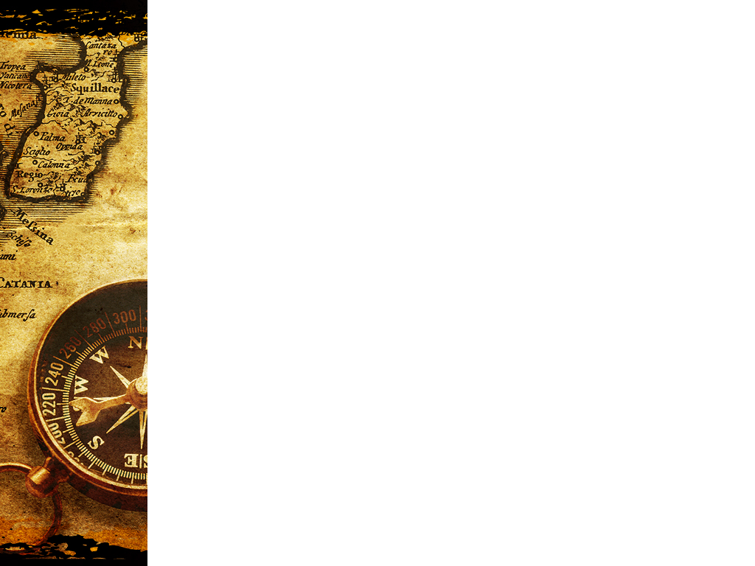
Isaiah 34
“Draw near, O nations, to hear; and listen, O peoples! Let the earth and all it contains hear, and the world and all that springs from it. For the LORD’S indignation is against all the nations, And His wrath against all their armies; He has utterly destroyed them, He has given them over to slaughter. So their slain will be thrown out, And their corpses will give off their stench, And the mountains will be drenched with their blood. And all the host of heaven will wear away, And the sky will be rolled up like a scroll; All their hosts will also wither away As a leaf withers from the vine, Or as one withers from the fig tree.” (Isaiah 34:1–4, NASB95)
Notes:
READ:
Although this is written to Israel, it definitely has a 'global' perspective.
Notice the repeated use of ALL
All it contains
All that springs from it
All the nations
All their armies
even ALL the host of heaven. Isaiah is including not just the inhabitants of this earth but God's 'indignation'-all his “angry wrath”will fall on ALL of creation including the stars in heaven.
Notice also how no one or any thing can stand before his anger. the mountains will be erroded by blood, the stars will be worn out and the very sky from end to end will be laid out and rolled up for destruction.
John uses the same language of Isaiah in describing the return of Christ and the final judgment.
“The sky was split apart like a scroll when it is rolled up, and every mountain and island were moved out of their places. Then the kings of the earth and the great men and the commanders and the rich and the strong and every slave and free man hid themselves in the caves and among the rocks of the mountains; and they said to the mountains and to the rocks, “Fall on us and hide us from the presence of Him who sits on the throne, and from the wrath of the Lamb; for the great day of their wrath has come, and who is able to stand?”” (Revelation 6:14–17, NASB95)

Slide 3
Isaiah 34
“For My sword is satiated in heaven, Behold it shall descend for judgment upon Edom And upon the people whom I have devoted to destruction. The sword of the LORD is filled with blood, It is sated with fat, with the blood of lambs and goats, With the fat of the kidneys of rams. For the LORD has a sacrifice in Bozrah And a great slaughter in the land of Edom. Wild oxen will also fall with them And young bulls with strong ones; Thus their land will be soaked with blood, And their dust become greasy with fat.” (Isaiah 34:5–7, NASB95)
Notes:
Since it is written primarily to Israel, it takes on a jewish flavor by casting the nation of EDOM as the symbol for God's global enemy
READ:
An Israelite reading this would immediately have visions of the alter in the Temple of God and the blood sacrifices made on it. He would have also made a note of the implement used in the slaughter. A sword...making it personal.
Here, God is saying CITIES and NATIONS will fall in judgmnent- in payment for their rebellion.
This is personal for God. It flies in the face of HIS CHARACTER
He uses Edom as the poster-child because Edom has been Israels leading antagonist for a Millenium beginning with the reign of Saul shortly after Israel has inherited their 'Promised Land'.
Amos makes note of a continual antagonism between Israel and Edom in ch. 1 vs.11.
“Thus says the LORD, “For three transgressions of Edom and for four I will not revoke its punishment, Because he pursued his brother with the sword, While he stifled his compassion; His anger also tore continually, And he maintained his fury forever. “So I will send fire upon Teman And it will consume the citadels of Bozrah.”” (Amos 1:11–12, NASB95)
So this relationship between Edom and Israel is held up as a picture of the relationship God has with the WORLD.

Slide 4
Isaiah 34
“For the LORD has a day of vengeance, A year of recompense for the cause of Zion. Its streams will be turned into pitch, And its loose earth into brimstone, And its land will become burning pitch. It will not be quenched night or day; Its smoke will go up forever. From generation to generation it will be desolate; None will pass through it forever and ever.” (Isaiah 34:8–10, NASB95)
Notes:
This coming destruction is NOT just about God's character though.
Notice what Isaiah refers to as the reason for the coming day of vengeance
READ:
The destruction of God's enemies by His hand is necessary for His character.
“For we must all appear before the judgment seat of Christ, so that each one may be recompensed for his deeds in the body, according to what he has done, whether good or bad.” (2 Corinthians 5:10, NASB95)
But it ALSO is payback for the ill treatment of God's people!
This is reminescent of God's judgment falling on Sodom and Gommorrah.
Again, if we look at Revelation, this same thought is expressed in the destruction of 'Babylon and all the “kings of the earth in Rev. 18.
(Revelation 18:3–10, NASB95)
““For all the nations have drunk of the wine of the passion of her immorality, and the kings of the earth have committed acts of immorality with her, and the merchants of the earth have become rich by the wealth of her sensuality.” I heard another voice from heaven, saying, “Come out of her, my people, so that you will not participate in her sins and receive of her plagues; for her sins have piled up as high as heaven, and God has remembered her iniquities. “Pay her back even as she has paid, and give back to her double according to her deeds; in the cup which she has mixed, mix twice as much for her. “To the degree that she glorified herself and lived sensuously, to the same degree give her torment and mourning; for she says in her heart, ‘I SIT as A QUEEN AND I AM NOT A WIDOW, and will never see mourning.’ “For this reason in one day her plagues will come, pestilence and mourning and famine, and she will be burned up with fire; for the Lord God who judges her is strong. “And the kings of the earth, who committed acts of immorality and lived sensuously with her, will weep and lament over her when they see the smoke of her burning, standing at a distance because of the fear of her torment, saying, ‘Woe, woe, the great city, Babylon, the strong city! For in one hour your judgment has come.’”
in Vs. 20 of this same chapter we have a call going out to the People of God;
““Rejoice over her, O heaven, and you saints and apostles and prophets, because God has pronounced judgment for you against her.”” (Revelation 18:20, NASB95)
So Isaiah writes this to the Jews of His time and both Assyria and Babylon do fall by the hands of a nation more agressive than them but the more complete fulfillment comes as God starts closing the book on time. “None will pass through it forever and ever.”

Slide 5
Isaiah 34
“But pelican and hedgehog will possess it, And owl and raven will dwell in it; And He will stretch over it the line of desolation And the plumb line of emptiness. Its nobles—there is no one there Whom they may proclaim king— And all its princes will be nothing. Thorns will come up in its fortified towers, Nettles and thistles in its fortified cities; It will also be a haunt of jackals And an abode of ostriches.” (Isaiah 34:11–13, NASB95)
Notes:
Then we come to this weird section.
READ:
We need not get bogged down into the details of the names of the animals...fact is, these are 'best guesses' .
Pelicans and hedgehogs don't really come to mind when we think of animals that would inherit a place of burning pitch a land of continual smoke.
The translation for owl really is 'unclean bird'. In some translations it is used in the place of pelican denoting another 'unclean bird'
Some translations will seperate the birds by Horned owl and Screech owl vs. pelican and owl.
And hedgehog- porcupine literally translates'rolled up one'.
We don't want to loose the forest for the trees though.
The pronouncement is that this destruction is going to turn a thrivinf nation into a desoltae desert- fit only for unclean animals.
There will be no human rule or human protection.
it will be over run by weeds, briars and animals (jackels comes from another un-used Hebrew word, and ostriches represent not only an unclean bird but along with jackals were considered untamable.
Total, unrecoverable destruction lies in wait for those who have chosen to ignore God and continue to trust in the things of man. Those who put their trust in human intellect, ambitioin, power or wisdom will come up short AND have to answer for squandering their time here on the earth

Slide 6
Isaiah 34
“The desert creatures will meet with the wolves, The hairy goat also will cry to its kind; Yes, the night monster will settle there And will find herself a resting place. The tree snake will make its nest and lay eggs there, And it will hatch and gather them under its protection. Yes, the hawks will be gathered there, Every one with its kind.” (Isaiah 34:14–15, NASB95)
Notes:
Humankind will be destroyed and Isaiah seems to paint a picture of fantastic un-named creatures that are at least unusual that will take over the deserted landscape;
Desert creatures
Night monster
along with the tree snake and hawks
As he makes not of specific and generic-fantastic animals inheriting the evacuated and ruined cities, he is actually drawing attention to the REALITY that this is going to happen. The very fact that Isaiah can be so specific in naming what will replace mankind is also reinforcing the reality of the judgment and dismissal of mankind

Slide 7
Isaiah 34
“Seek from the book of the LORD, and read: Not one of these will be missing; None will lack its mate. For His mouth has commanded, And His Spirit has gathered them. He has cast the lot for them, And His hand has divided it to them by line. They shall possess it forever; From generation to generation they will dwell in it.” (Isaiah 34:16–17, NASB95)
Notes:
This poem closes with that 'stamp of certainty' that began in the last verses.
READ:
The watchcare that was ususally reserved for people is now fixed on the animals.
God is thoroughly done with mankind.
The Book of the LORD is a bit of a mystery;
1. compare what he is writing to what they are seeing...is what was written taking place
2. a possible earlier prophecy (possibly Isaiah 13:21,22
“But desert creatures will lie down there, And their houses will be full of owls; Ostriches also will live there, and shaggy goats will frolic there. Hyenas will howl in their fortified towers And jackals in their luxurious palaces. Her fateful time also will soon come And her days will not be prolonged.” (Isaiah 13:21–22, NASB95)
3. This actually may have been added to the book after the Babylonian exile
4. Some sort of allusion to a heavenly book of destiny. There ARE references to books we do not have available such as Ps. 40:7, Ps. 56:8 and Ps. 139:16 as well as Mal. 3:16 and Dan. 7:10 LSO references books to be opened at the end..
Without going too far afied, each possibility has it's difficulties but again, the POINT of the matter is not so much the book OR the animals but what God is warning the people.
You keep on choosing mankind- You keep on listening to them, trusting them-what they say- what they build- what they do...Your end is destruction. As sure as you are here today destruction will overtake you.
Next week We will look at the flip side of the coin. The future for those who have put their trust in God.
1 John 2:15-18 are words that have more immediate meaning now than at any time in humankind history.
“Do not love the world nor the things in the world. If anyone loves the world, the love of the Father is not in him. For all that is in the world, the lust of the flesh and the lust of the eyes and the boastful pride of life, is not from the Father, but is from the world. The world is passing away, and also its lusts; but the one who does the will of God lives forever. Children, it is the last hour; and just as you heard that antichrist is coming, even now many antichrists have appeared; from this we know that it is the last hour.” (1 John 2:15–18, NASB95)

