Slide 1
Isaiah
Only God is God
Chapter 49
Notes:
About 4 years ago, I was given the job of “Director of Operations” at one of our locations. My job was to get it assembled, staffed and running for this great influx of cars that we were going to purchase to refurbish and resell.
I set up the building, staffed it, put in processes, policies, KPIs and a reporting structure.
The company, overall, could not keep us busy so they decided to 're-structure' and my position was going away.
I had 2 questions;
1. What were they going to do with the people, building and equipment and
2. What was going to happen to me?
We had talked earlier about God's servants. We saw that the job of the servant was to make God's glory known. God used people from the very beginning of time in peculiar fashions as His servants.
Abraham was God's servant,
Isaac was called God's servant,
Jacob recognizes himself as God's servant to Esau.
Moses, Caleb, Joshua,
Saul, David, Hezekiah, the Prophets obviously...
Even Gentiles were called by God to in some way reveal God. Cyrus is our most recent example as he was to honor God and reveal God in the RELEASE of the nation of Israel from captivity.
God's servants and their job was to, in some fashion, make God known to Israel and the world.
Israel was ALSO called God's servant and, as a nation, It was supposed to glorify God and show him to the nations in all His splendor. We know from our readings, that that Israel was an unfaithful, stiff-necked, hard-headed people and did not perform their duties as God had commanded. So, like most masters, after God had given them ample opportunity to repent and seek him, putting their trust in him, he judged them and was about to send them into exile, relieving them from their duty.
So, in this chapter, there are 2 questions that are waiting to be answered;
1. Identification of God's servant
2. What happens to Israel if they are not needed?

Slide 2

Isaiah 49
“Listen to Me, O islands, And pay attention, you peoples from afar. The LORD called Me from the womb; From the body of My mother He named Me. He has made My mouth like a sharp sword, In the shadow of His hand He has concealed Me; And He has also made Me a select arrow, He has hidden Me in His quiver.
He said to Me, “You are My Servant, Israel, In Whom I will show My glory.” But I said, “I have toiled in vain, I have spent My strength for nothing and vanity; Yet surely the justice due to Me is with the LORD, And My reward with My God.”” (Isaiah 49:1–4, NASB95)
Notes:
Brevard S. Childs in his commentary of Isaiah says “Isaiah 49:1–6 is quite clearly an intentional literary continuation of 42:1–4(5–9) as shown by the obvious parallels. Yet much has happened in prophetic history between chapters 42 and 49. Cyrus has come to liberate Israel according to the divine promise (44:24ff.). The deities of Babylon have been shown powerless before the will of the one creator God (cf. chapters 46–47). Israel, the servant of Yahweh, has been called to its mission of establishing justice in the earth and being a light to the nations (42:1ff.). Yet Israel remains blind and will not see (42:19). It continues to believe that its right has been disregarded by God (40:27).
Then in chapter 48, unfaithful, obstinate Israel is called to account: “You had never heard, you had never known” (v. 8). A new direction is now signaled by God. A new voice is introduced in 48:16: “And now the Lord GOD has sent me,” who delivers a message in vs. 17ff. God renews his promise as Redeemer to Israel in spite of the nation’s failure (v. 18). The chapter ends with a summons for those who believe to depart from Babylon and to participate in the new exodus (vs. 20–21), leaving behind those who persist in evil (v. 22).
Chapter 49 then picks up the voice of the messenger sent in 48:16, and interprets in great detail the new strategy of God for his servant”
Isaiah opens up with a call from God's servant.
READ
The call is to listen- echoed from the last chapter. Then, the voice was identified as God's-
Listen to Me, O Jacob, even Israel whom I called;
I am He, I am the first, I am also the last.
Surely My hand founded the earth,
And My right hand spread out the heavens;
When I call to them, they stand together.
Assemble, all of you, and listen!
Who among them has declared these things?
Then later in the chapter, the next time, Israel is called to listen, they are called by Isaiah to remember their God;
Come near to Me, listen to this:
From the first I have not spoken in secret,
From the time it took place, I was there.
And now the Lord GOD has sent Me, and His Spirit.”
Thus says the LORD, your Redeemer, the Holy One of Israel,
“I am the LORD your God, who teaches you to profit,
Who leads you in the way you should go.
Now the call goes out again...Listen.
This time it is NOT the Lord because it is the Lord that has told the speaker to speak
The caller is identified as a person...using language similar to God's call to Jeremiah in Jeremiah 1:5
““Before I formed you in the womb I knew you, And before you were born I consecrated you; I have appointed you a prophet to the nations.””
The calling one is identified with a sharp sword in his mouth and a 'select arrow' yet he is still being concealed after a fashion by God,'hidden in His quiver'.
He then continues on to identify Himself as Israel; “Israel In Whom I Will Show My Glory”.
The servant continues on' I am called yet concealed by God but the mission I am on is fruitless. (You would think this Servant would come in Triumph?) He is exhausted for nothing. He has spent himself for no purpose.
This servant does not come arrogantly but in humility and gentleness. Isaiah introduced us to the servant and this aspect in Ch. 42.
“Behold, My Servant, whom I uphold;
My chosen one in whom My soul delights.
I have put My Spirit upon Him;
He will bring forth justice to the nations.
He will not cry out or raise His voice,
Nor make His voice heard in the street.
A bruised reed He will not break
And a dimly burning wick He will not extinguish;
He will faithfully bring forth justice.
“He will not be disheartened or crushed
Until He has established justice in the earth;
And the coastlands will wait expectantly for His law.”
The servant doesn't yet see it but Justice is coming. It is certain because it is coming from God who in Himself is the servant's reward.

Slide 3
Isaiah 49
“And now says the LORD, who formed Me from the womb to be His Servant, To bring Jacob back to Him, so that Israel might be gathered to Him (For I am honored in the sight of the LORD, And My God is My strength), He says, “It is too small a thing that You should be My Servant To raise up the tribes of Jacob and to restore the preserved ones of Israel; I will also make You a light of the nations So that My salvation may reach to the end of the earth.”. Thus says the LORD, the Redeemer of Israel and its Holy One, To the despised One, To the One abhorred by the nation, To the Servant of rulers, “Kings will see and arise, Princes will also bow down, Because of the LORD who is faithful, the Holy One of Israel who has chosen You.”” (Isaiah 49:5–7, NASB95)
Notes:
The servant's message continues and within the message is his mission and maybe more clarity to His identity.
READ
His mission is to gather Israel. To restore the 'Preserved Ones' but his mission is LARGER than to Israel alone. He is called to be a servant for God's glory a servant that brings light- salvation to the ends of the earth.
Within his mission are identifiers/ clarifiers of who the servant could (could NOT) be.
It seems unlikely that the servant in question is NATIONAL Israel since it would be hard for Israel to bring Jacob back to him. They are in some fashion, the same group.
It seems unlikely that it is Isaiah since he would never bear the title “Israel”He was a prophet. One who declared God to men. To wear the title Israel would be more of a Priest's function as he would be a representative to God for the nation.
The The LORD speaks to His servant- understanding the position He is in. The servant says his mission is fruitless, the LORD recognizes that Israel has NOT embraced and run with the message. In fact few ON THE EARTH have responded postively.
He is actually despised and abhorred by the the nations.
This chapter is setting Isaiah up for his later writings concerning God's servant in Chapter 53;
3 He was despised and forsaken of men,
A man of sorrows and acquainted with grief;
And like one from whom men hide their face
He was despised, and we did not esteem Him
God reassures Him that this reaction is short-lived. Kings will see him and stand at attention. princes will bow, honoring God's servant because God has chosen him.
We can see this string in Isaiah 53 as well;
12 Therefore, I will allot Him a portion with the great,
And He will divide the booty with the strong;
Because He poured out Himself to death,
And was numbered with the transgressors;
God tells him BECAUSE he endured the shame, he will receive the glory.
This servant will reveal God to the world successfully and completely yet his lot is to endure the shame of the world. being despised and rejected yet holding firmly to the knowledge that justice will come and that God is his reward.

Slide 4
Isaiah 49
“Thus says the LORD, “In a favorable time I have answered You, And in a day of salvation I have helped You; And I will keep You and give You for a covenant of the people, To restore the land, to make them inherit the desolate heritages; Saying to those who are bound, ‘Go forth,’ To those who are in darkness, ‘Show yourselves.’ Along the roads they will feed, And their pasture will be on all bare heights. “They will not hunger or thirst, Nor will the scorching heat or sun strike them down; For He who has compassion on them will lead them And will guide them to springs of water.” (Isaiah 49:8–10, NASB95)
Notes:
READ
God declares that He called and helped his servant in a 'favorable time...the day of salvation.
When is the favorable time? Isaiah uses this term a bit later in the 61st chapter. It carries connotations of the 'favorable year of the Lord or the year of jubilee...When all debts were canceled and all slaves set free.
He promises to help AND keep His servant. His servant will accomplish God's mission. The favorable time is not just a removal of physical debt but is now a day of salvation.
The servant is then identified again as the covenant for God's people. This was introduced to us in Chapter 42
6 I am the LORD, I have called You in righteousness,
I will also hold You by the hand and watch over You,
And I will appoint You as a covenant to the people,
As a light to the nations,
7 To open blind eyes,
To bring out prisoners from the dungeon
And those who dwell in darkness from the prison
Using imagery from the garden of Eden, Jubilee year AND the new covenant blessing, he tells them what they can expect from embracing this new servant... the new COVENANT sent by God.
Restore land
Apportion inheritances
Free the people
They will find food by the road- this is the roadway, highway the righteous walk referenced in Is.35. the Highway of Holiness
There will be relief from the scorching sun
Refreshing springs of water
All images of restoration- a making of all things right.
Above and surrounding all of this we find God.
He will be their leader, guiding them to streams of water.
Using imagery from the exodus of Israel, God declares, just as I was faithful in leading Israel then, even more now as I lead the people who are WILLINGLY following me because they have believed my Servant

Slide 5
Isaiah 49
““I will make all My mountains a road, And My highways will be raised up. “Behold, these will come from afar; And lo, these will come from the north and from the west, And these from the land of Sinim.” Shout for joy, O heavens! And rejoice, O earth! Break forth into joyful shouting, O mountains! For the LORD has comforted His people And will have compassion on His afflicted.” (Isaiah 49:11–13, NASB95)
Notes:
READ
The message continues.
Recalling what he had written earlier in Isaiah 40 3-5;
A voice is calling,
“Clear the way for the LORD in the wilderness;
Make smooth in the desert a highway for our God.
4 “Let every valley be lifted up,
And every mountain and hill be made low;
And let the rough ground become a plain,
And the rugged terrain a broad valley;
5 Then the glory of the LORD will be revealed,
And all flesh will see it together;
For the mouth of the LORD has spoken.”
God confirms his intentions. God will make it EASY to find, follow him.
And there WILL be followers. Not just from Israel but from all 4 corners of the world. (Sinim was a land south of Egypt).
Going back to creation language God emphasizes the Joy of all creation in the redemption, the freeing of His people. Paul speaks similarly using opposite language as HE declares the BURDEN of sin not just on humankind but how it has burdened ALL of creation and how the consummation of God's redemption will free his people and creation from the weight of sin;
“For we know that the whole creation groans and suffers the pains of childbirth together until now. And not only this, but also we ourselves, having the first fruits of the Spirit, even we ourselves groan within ourselves, waiting eagerly for our adoption as sons, the redemption of our body.” (Romans 8:22–23, NASB95)

Slide 6
Isaiah 49
“But Zion said, “The LORD has forsaken me, And the Lord has forgotten me.” “Can a woman forget her nursing child And have no compassion on the son of her womb? Even these may forget, but I will not forget you. “Behold, I have inscribed you on the palms of My hands; Your walls are continually before Me. “Your builders hurry; Your destroyers and devastators Will depart from you.” (Isaiah 49:14–17, NASB95)
Notes:
It seems like we have a pretty good handle on the servant's identity as well as his mission.
We still need to answer the second question that came up.
READ
What happens to Israel now?. The judgment on Israel and the prophetic coming of a better servant seems to leave Israel in limbo. Is God just going to dissolve the nation...let it collapse or destroy it?
We know from God's previous words to Israel that He is absolutely ABLE to deliver his people. In fact He is the only one in all creation ABLE to deliver Israel. The question is; Does he want to?
The answer is...Yes. He DOES want to deliver them. They still have purpose. They are not forgotten.
Paul confirms the necessity of Israel in Romans 9
I am speaking the truth in Christ—I am not lying; my conscience bears me witness in the Holy Spirit— 2 that I have great sorrow and unceasing anguish in my heart. 3 For I could wish that I myself were accursed and cut off from Christ for the sake of my brothers, my kinsmen according to the flesh. 4 They are Israelites, and to them belong the adoption, the glory, the covenants, the giving of the law, the worship, and the promises. 5 To them belong the patriarchs, and from their race, according to the flesh, is the Christ, who is God over all, blessed forever. Amen.
God Will continue to care for them, watch over them, use them for through Israel will come His Servant.
Later Paul asks the same question Israel seems to be asking; “Is God rejecting Israel?”in chapter 11 of Romans;
“I say then, God has not rejected His people, has He? May it never be! For I too am an Israelite, a descendant of Abraham, of the tribe of Benjamin. God has not rejected His people whom He foreknew. Or do you not know what the Scripture says in the passage about Elijah, how he pleads with God against Israel?” (Romans 11:1–2, NASB95)
God says in effect; “I will not allow you to be destroyed because my servant will come through you. I will not dissolve you because there will come a people from you, whom I have foreknown that will respond to the message of my servant.
T

Slide 7
Isaiah 49
““Lift up your eyes and look around; All of them gather together, they come to you. As I live,” declares the LORD, “You will surely put on all of them as jewels and bind them on as a bride. “For your waste and desolate places and your destroyed land— Surely now you will be too cramped for the inhabitants, And those who swallowed you will be far away. “The children of whom you were bereaved will yet say in your ears, ‘The place is too cramped for me; Make room for me that I may live here.’” (Isaiah 49:18–20, NASB95)
Notes:
God, through Isaiah casts a vision for this new people, the Israel that embraces His servant and covenant.
READ
His people gathering around the servant.
They are a variety all different and all valuable to the servant. Adorning him like a necklace around the neck of a bride...The showpiece!
It is not just Israel but it is people from ALL nations coming to him.
Isaiah comes back to this in Isaiah 54;
““Shout for joy, O barren one, you who have borne no child; Break forth into joyful shouting and cry aloud, you who have not travailed; For the sons of the desolate one will be more numerous Than the sons of the married woman,” says the LORD. “Enlarge the place of your tent; Stretch out the curtains of your dwellings, spare not; Lengthen your cords And strengthen your pegs. “For you will spread abroad to the right and to the left. And your descendants will possess nations And will resettle the desolate cities.” (Isaiah 54:1–3, NASB95)
Paul helps us understand that “The children of the barren one” are children of the promise in Galatians 4. as Paul identifies national Israel as children born into slavery, numerous but enslaved under the Jewish law.
The people the servant is seeing are the people of the Promise. People who have the faith of Abraham People who are in agreement with God's promise to Abraham; “I will be your God and you will be My people”. They are coming from all over the world. More than could be imagined. The servant may have not seen many followers at his time but there is an effect of AMAZING growth over time.

Slide 8
Isaiah 49
““Then you will say in your heart, ‘Who has begotten these for me, Since I have been bereaved of my children And am barren, an exile and a wanderer? And who has reared these? Behold, I was left alone; From where did these come?”
Thus says the Lord GOD, “Behold, I will lift up My hand to the nations And set up My standard to the peoples; And they will bring your sons in their bosom, And your daughters will be carried on their shoulders. “Kings will be your guardians, And their princesses your nurses. They will bow down to you with their faces to the earth And lick the dust of your feet; And you will know that I am the LORD; Those who hopefully wait for Me will not be put to shame.” (Isaiah 49:21–23, NASB95)
Notes:
Then the Servant speaks up. The true servant Israel...almost in astonishment declares!
READ
Israel, the nation, as God's people left the servant desolate. They were rebellious and unrepentant.
yet the servant sees children where there shouldn't be any and asks ;'how did this happen?”.
God's response?
I did it.
I called people from every nation.
Isaiah had mentioned it earlier in Chapter 11
11 Then it will happen on that day that the Lord
Will again recover the second time with His hand
The remnant of His people, who will remain,
From Assyria, Egypt, Pathros, Cush, Elam, Shinar, Hamath,
And from the islands of the sea.
Then he goes back to the original complaint of the servant...'I feel my mission was in vain', His mission to display God in all his glory would bear fruit and he re-iterates that Kings and Princes will submit to the RULE of the servant as God's servant, His missionary His covenant with the people.
Those who wait for me in joyous expectation will not be disappointed.

Slide 9
Isaiah 49
““Can the prey be taken from the mighty man, Or the captives of a tyrant be rescued?” Surely, thus says the LORD, “Even the captives of the mighty man will be taken away, And the prey of the tyrant will be rescued; For I will contend with the one who contends with you, And I will save your sons. “I will feed your oppressors with their own flesh, And they will become drunk with their own blood as with sweet wine; And all flesh will know that I, the LORD, am your Savior And your Redeemer, the Mighty One of Jacob.”” (Isaiah 49:24–26, NASB95)
Notes:
The chapter closes with God's reminder that it is HE behind these new things and that what he declares WILL come to pass.
Powers that APPEAR formidable are impotent against God and His designs for His people.
READ
Typically the answer to the question of 'Can you take something away from a strong or ruthless man? is answered in the negative.
But God declares that this in fact WILL happen. It happens when Cyrus, God's servant as king of Persia, takes over Babylon. He separates Israel from the strong man, Babylon, and frees them.
The Perfect servant Jesus Christ comes and does the same thing.
He comes and separates His people from the power of sin...setting them free.
Not only that but this chapter closes with God's wrath being poured out on those who lived in opposition to God's people. It seems like they will destroy themselves warring and fighting..
Saving his people out of the grasp of the strong, tyrannical man will again culminate in glory and honor to God.

Slide 10
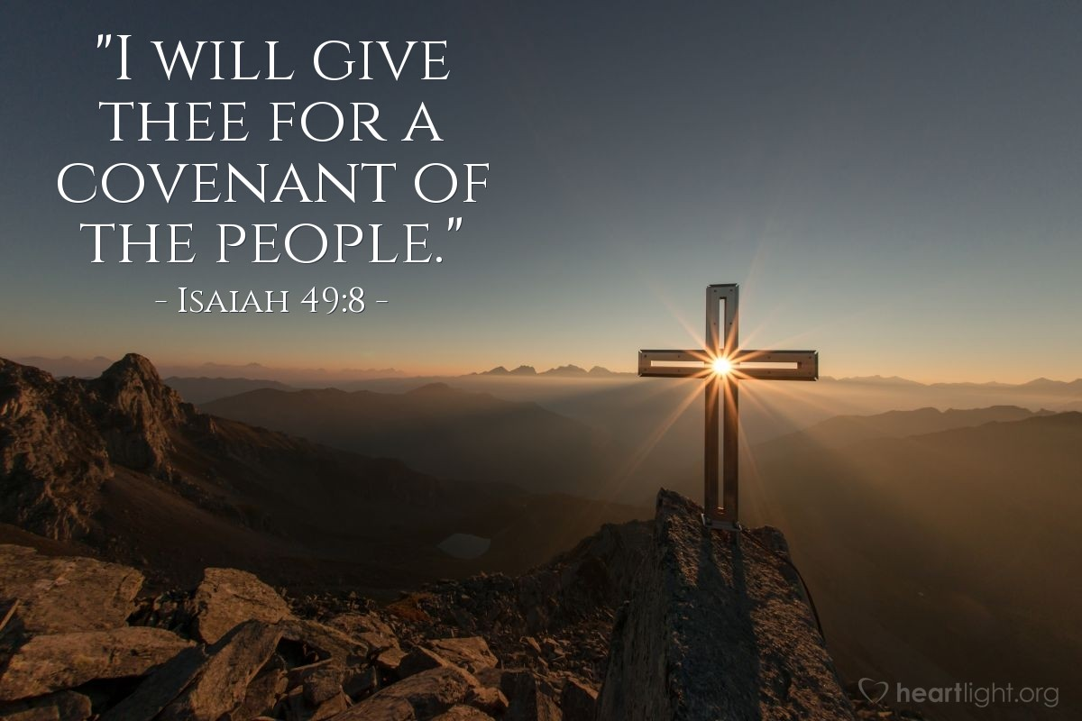
Notes:
Our salvation is guaranteed by the power of God and the perfect work of the Servant who not only fulfills the Old Covenant but Is the new covenant. Our salvation depends on Jesus Christ and on Him alone.
Hebrews 12:1-3 says; “Therefore, since we have so great a cloud of witnesses surrounding us, let us also lay aside every encumbrance and the sin which so easily entangles us, and let us run with endurance the race that is set before us, fixing our eyes on Jesus, the author and perfecter of faith, who for the joy set before Him endured the cross, despising the shame, and has sat down at the right hand of the throne of God. For consider Him who has endured such hostility by sinners against Himself, so that you will not grow weary and lose heart.” (Hebrews 12:1–3, NASB95)
We have Christ as the author and perfecter of our faith but we also have a call to remember his suffering, bearing our shame, was a joy for him BECAUSE his suffering gave him the necklace Isaiah mentioned earlier.
We have Christ as our surety. As our protector and as God's servant for our sake.
Armed with this, how should we live?

