Slide 1
Isaiah
Only God is God
Chapter 55
Notes:
Kirby vaccuum- How many of you have purchased one?
They spend time thoroughly discussing its features and advantages
even if we ask the price they do not reveal it
...More time helping us see the superiority of it over any other,
Finally....the PRICE. By then, it doesn't even seem unreasonable!
They have convinced us...won us over, “Honey, give me the chckbook!!”
But then they say...you don't need a check, We don't even need payment today.
Let us set you up with some great financing.
In Chapter 54, God had described the benefits of being made righteous through the work of His Humble, Suffering Servant.
We will part of a numerous family who's father is no less than the God of all creation.
We have NO reason to carry guilt or shame as the Servant took ours on Him and suffered in our place
We have as a Mighty Redeemer, Not the king of Persia OR Babylon. We have as our Redeemer the Holy one of Israel-God of all the Earth.
We have no reason for fear. There is no opression or terror from God to be concerned with
We need only experience his Hesed-Love
We have this all as a sure an certain promise. The earth will disolve before these promises fail.
We have comfort for today and a future filled with joy and well-being
Lastly, we have the promise that even our enemies will not prevail over us.
No weapon formed against us will stand. We are invincible until God calls us to His side.
This is now, our heritage.
Now as we come to the next chapter (55), We are going to be given the cost for all these benefits.

Slide 2
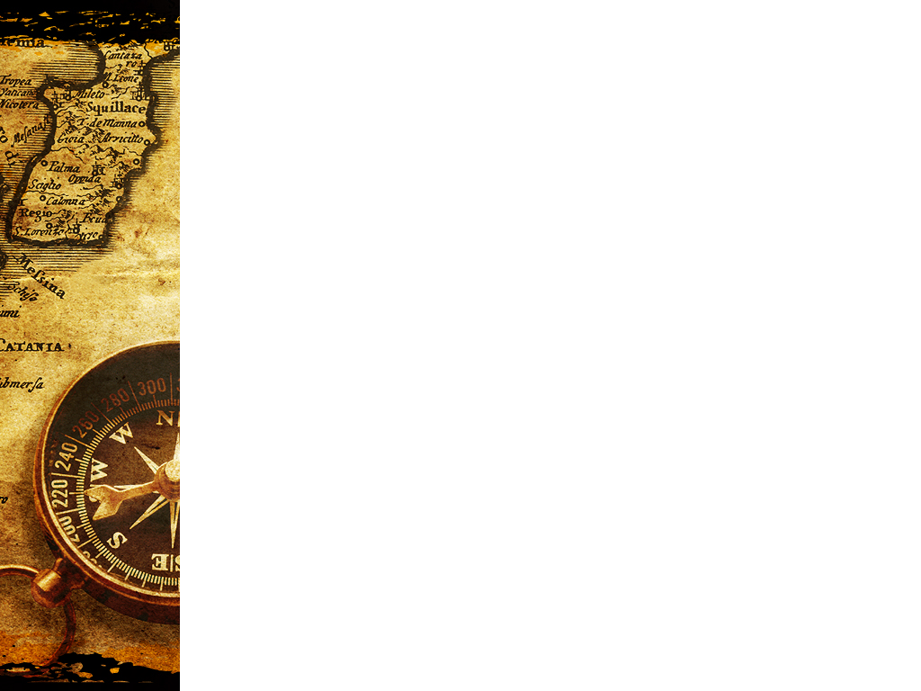
Isaiah 55
Isaiah 55:1–2
“Ho! Every one who thirsts, come to the waters; And you who have no money come, buy and eat. Come, buy wine and milk Without money and without cost. “Why do you spend money for what is not bread, And your wages for what does not satisfy? Listen carefully to Me, and eat what is good, And delight yourself in abundance.” (NASB95)
Notes:
After having gone through the last section, We should be licking our lips, hungry to hear how we can get these. Thirsty for the information we need to 'close this deal'.
READ
This section really closes the door on the use of the Law to establish our own righteousness.
The call goes out as MORE than an 'invitation'. This is more than a sugestion or possibility.
This call comes from the Holy one of Israel, the God of all creation.
He is not recommending. He is insisting.
Are you thirsty?
Are you hungry? Come!!
(Response) But I have no money, How do I pay for this?
You that have no money Come, BUY and eat.
(Response) But I said I have no money!
Come Buy...Not just daily sustenance but come get food from the KINGS table. Wine, Milk and Honey.
(Response) But...I still have no money!
Come Buy WITHOUT money. Without cost! Come buy...freely!!!
No money...No 'payment plan', No debt that will come due at a later date
In FACT....Why do you spend money/ effort/ time on what is NOT Bread and things that will NOT satisfy?
What are you doing with your money and your efforts now? Trying to BUY favor? Purchase righteousness. Buy your sacrifices...toil after law obedience...sweat to be seen righteous in each others eyes?
What value is there in that? Were is your nourishment in 'looking good in the neighborhood?' Are THEY the one's with whom you will have to do?
Listen...Eat what is GOOD...Delight yourself in abundance!!!
There should be no need fo further explaination.
All these things described in Ch. 54 are available to you freely. Why?

Slide 3
Isaiah 55
Isaiah 55:3–5
“Incline your ear and come to Me. Listen, that you may live; And I will make an everlasting covenant with you, According to the faithful mercies shown to David. “Behold, I have made him a witness to the peoples, A leader and commander for the peoples. “Behold, you will call a nation you do not know, And a nation which knows you not will run to you, Because of the LORD your God, even the Holy One of Israel; For He has glorified you.”” (NASB95)
Notes:
Well Listen!
READ
How do we inherit these amazing blessings? How do we get a set at the table full of the delicacies from the King?
Listen...and Come.
Listen, I will make an everlasting covenant with YOU according to the faithful mercies shown to David.
What were those mercies?
2 Samuel 7:12–16
“When your days are complete and you lie down with your fathers, I will raise up your descendant after you, who will come forth from you, and I will establish his kingdom. “He shall build a house for My name, and I will establish the throne of his kingdom forever. “I will be a father to him and he will be a son to Me; when he commits iniquity, I will correct him with the rod of men and the strokes of the sons of men, but My lovingkindness shall not depart from him, as I took it away from Saul, whom I removed from before you. “Your house and your kingdom shall endure before Me forever; your throne shall be established forever.” ’ ”” (NASB95)
Paul Certifies that the promise to David reaches it's fulfillment in Jesus Christ. David's body definitely saw the grave but Jesus, God's own King of kings has risen and sits on the throne currently...eternally. The throne of David will NEVER lack for a king.
Because of this, David then becomes the witness to the peoples.
His throne- is established forever in Christ The nation come together under the kingship of Christ is the nation that does draw people...calling nations through the message of the gospel of reconcilliation.
The life, death resurrection ascension and glorification of God's servant (Who ALSO is currently sitting on the throne of David as king) calls people
John 12:32
“And I, if I am lifted up from the earth, will draw all men to Myself.”” (NASB95)
Here is something interesting though. Most of us know the covenant that David and God entered into but earlier in David's life, there was a VERY interesting discussion David had with his best friend, Johnathan.
David was unsure of his standing before the then current king, Saul. Johnathan's father.
Johnathan tells David that he will sound him out and let David know what Sauls intentions were for him.
1 Samuel 20:12–16
Then Jonathan said to David, “The LORD, the God of Israel, be witness! When I have sounded out my father about this time tomorrow, or the third day, behold, if there is good feeling toward David, shall I not then send to you and make it known to you? “If it please my father to do you harm, may the LORD do so to Jonathan and more also, if I do not make it known to you and send you away, that you may go in safety. And may the LORD be with you as He has been with my father. “If I am still alive, will you not show me the lovingkindness of the LORD, that I may not die? “You shall not cut off your lovingkindness from my house forever, not even when the LORD cuts off every one of the enemies of David from the face of the earth.” So Jonathan made a covenant with the house of David, saying, “May the LORD require it at the hands of David’s enemies.”” (NASB95)
Johnathan has a deeper understanding of the kingship of David that we might at first glance, think.
See how he appeals to David but NOT JUST for himself but also for HIS family. Not just through David's reign but FOREVER.
He looks at David and sees glimpses of David's eternal throne AND that same throne cutting off ALL David's enemies.
Again, we see Jesus, absolutely fulfilling this covenant David makes with Johnathan.
1 Corinthians 15:22–26
For as in Adam all die, so also in Christ all will be made alive. But each in his own order: Christ the first fruits, after that those who are Christ’s at His coming, then comes the end, when He hands over the kingdom to the God and Father, when He has abolished all rule and all authority and power. For He must reign until He has put all His enemies under His feet. The last enemy that will be abolished is death.” (NASB95)

Slide 4
Isaiah 55
Isaiah 55:6–7
Seek the LORD while He may be found; Call upon Him while He is near. Let the wicked forsake his way And the unrighteous man his thoughts; And let him return to the LORD, And He will have compassion on him, And to our God, For He will abundantly pardon.” (NASB95)
Notes:
Listen, Come and now SEEK and CALL
READ
David, more than once in his psalms has confirmed this. For example;
Psalm 9:9–10
The LORD also will be a stronghold for the oppressed, A stronghold in times of trouble; And those who know Your name will put their trust in You, For You, O LORD, have not forsaken those who seek You.” (NASB95)
And in Psalm 24;
Psalm 24:3–6
Who may ascend into the hill of the LORD? And who may stand in His holy place? He who has clean hands and a pure heart, Who has not lifted up his soul to falsehood And has not sworn deceitfully. He shall receive a blessing from the LORD And righteousness from the God of his salvation. This is the generation of those who seek Him, Who seek Your face—even Jacob. Selah.” (NASB95)
And Asaph in Psalm 105
Psalm 105:3–7
Glory in His holy name; Let the heart of those who seek the LORD be glad. Seek the LORD and His strength; Seek His face continually. Remember His wonders which He has done, His marvels and the judgments uttered by His mouth, O seed of Abraham, His servant, O sons of Jacob, His chosen ones! He is the LORD our God; His judgments are in all the earth.” (NASB95)
The writer of Hebrews ALSO promises that those who seek him earnestly will certainly be rewarded.
The seeking, calling must be combined with a letting go, releasing, REPENTING of the things that have caused or maintained the separation.
Effective and earnest calling on God is accompanied with a turning or RE-turning to the Lord.
Forsaking, abandoning wicked ways and unrighteous thoughts.
Ezekiel 18:27–32
“Again, when a wicked man turns away from his wickedness which he has committed and practices justice and righteousness, he will save his life. “Because he considered and turned away from all his transgressions which he had committed, he shall surely live; he shall not die. “But the house of Israel says, ‘The way of the Lord is not right.’ Are My ways not right, O house of Israel? Is it not your ways that are not right? “Therefore I will judge you, O house of Israel, each according to his conduct,” declares the Lord GOD. “Repent and turn away from all your transgressions, so that iniquity may not become a stumbling block to you. “Cast away from you all your transgressions which you have committed and make yourselves a new heart and a new spirit! For why will you die, O house of Israel? “For I have no pleasure in the death of anyone who dies,” declares the Lord GOD. “Therefore, repent and live.”” (NASB95)
The work of God's servant are met with faith and repentance to bring LIFE
Acts 3:18–19
“But the things which God announced beforehand by the mouth of all the prophets, that His Christ would suffer, He has thus fulfilled. “Therefore repent and return, so that your sins may be wiped away, in order that times of refreshing may come from the presence of the Lord;” (NASB95)
In contrast to the promise of reward for earnestly seeking, There is also the warning tied into these promises...Seek, WHILE HE MAY BE FOUND. Call WHILE HE IS NEAR.
There IS an end to his patience. and there is a time when he allows or hardens hearts and 'calling out to God' is not even a consideration in the lives of unbelievers.

Slide 5
Isaiah 55
Isaiah 55:8–9
“For My thoughts are not your thoughts, Nor are your ways My ways,” declares the LORD. “For as the heavens are higher than the earth, So are My ways higher than your ways And My thoughts than your thoughts.” (NASB95)
Notes:
READ
We quote this often when we don't understand why God has done or allowed certain things, people or circumstances to affect our lives.
The context though is within the context of Salvation.
How are God's thoughts not my thoughts?
Because in MY thoughts, the only way I can be made righteous is through self effort. Works, law-keeping.
That is what guilt does...It makes us think that We have to fix what we have broken.
GOD's thought are knowing we CAN'T fix what we have broken but purchasing what is required and GIVING it to us can.
GODs thoughts are that righteousness is freely given through faith...the same faith that makes itself manifest in obedience.
Our thoughts= righteousness throu works
God's thoughts= righteousness through faith PROVEN by works

Slide 6
Isaiah 55
Isaiah 55:10–11
“For as the rain and the snow come down from heaven, And do not return there without watering the earth And making it bear and sprout, And furnishing seed to the sower and bread to the eater; So will My word be which goes forth from My mouth; It will not return to Me empty, Without accomplishing what I desire, And without succeeding in the matter for which I sent it.” (NASB95)
Notes:
READ
Isaiah records attributes concerning what God has spoken; His words, His promises.
He likens God's word to rain;
Restorative
Refreshing
Necessary for nourishment and for Life.
The Word of God is efficient and certain;
Unlike the Kirby Vacuum salesperson, God's word ALWAYS accomplishes exactly what was intended. “Suceeding in whatever it was meant to accomplish.
We just need to go back to Isaiah 53...recognize that Isaiah writing about the person and mission of the Servant yet to come in the PAST tense.
Isaiah 53:10–11
But the LORD was pleased To crush Him, putting Him to grief; If He would render Himself as a guilt offering, He will see His offspring, He will prolong His days, And the good pleasure of the LORD will prosper in His hand. As a result of the anguish of His soul, He will see it and be satisfied; By His knowledge the Righteous One, My Servant, will justify the many, As He will bear their iniquities.” (NASB95)
God declares the reality of his Righteous, Suffering servant.
God's word declares the task to be completed as if it has happened.
Or see God declaring to Moses his plan for Egypt that certainly took place.
Exodus 14:17
“As for Me, behold, I will harden the hearts of the Egyptians so that they will go in after them; and I will be honored through Pharaoh and all his army, through his chariots and his horsemen.” (NASB95)
The Word of God is absolutely dependable.
Isaiah 40:8
The grass withers, the flower fades, But the word of our God stands forever.” (NASB95)
Joshua 21:45
Not one of the good promises which the LORD had made to the house of Israel failed; all came to pass.” (NASB95)
Because of the power, certainty and dependability of Gods word;
Hebrews 10:23
Let us hold fast the confession of our hope without wavering, for He who promised is faithful;” (NASB95)

Slide 7
Isaiah 55
Isaiah 55:12–13
“For you will go out with joy And be led forth with peace; The mountains and the hills will break forth into shouts of joy before you, And all the trees of the field will clap their hands. “Instead of the thorn bush the cypress will come up, And instead of the nettle the myrtle will come up, And it will be a memorial to the LORD, For an everlasting sign which will not be cut off.”” (NASB95)
Notes:
Chapter 55 closes a section of Isaiah and it closes with a literal BANG... The clapping of hands of all the trees in worship. A personification of Nature rising up in worship to the God of all nature.
Declaring worship as the only real response required or even available.
READ
Worship and praise should be natural for God's people.
In David's Psalm 95, Just prior to the warning he gives the Jews about hardening their hearts now like they did in the wilderness, he calls all God's people to:
Come, let us worship and bow down, Let us kneel before the LORD our Maker. For He is our God, And we are the people of His pasture and the sheep of His hand. Today, if you would hear His voice,” (NASB95)
This act of redemption; The repurchasing of a people will act as a memorial- a witness to God's power and promises.
The return of the Jews to the city of Jerusalem was a witness to the world about his promises and power.
The turning or hearts from idols to serve the true and living God is a memorial- a witness to the world of God's promises and power.
An everlasting memorial.
We are that memorial today. We are the cyprus that came from the thornbush and rejoicing should characterize us.
The call of God should be ever on our lips; “Come, Everyone who thirsts!”

Slide 8
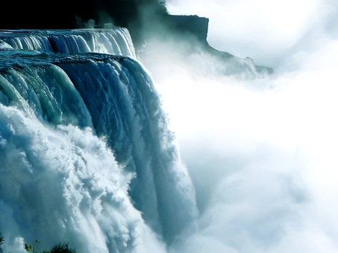
“ Every one who thirsts, come to the waters; And you who have no money come, buy and eat. Come, buy wine and milk Without money and without cost.”

