Slide 1
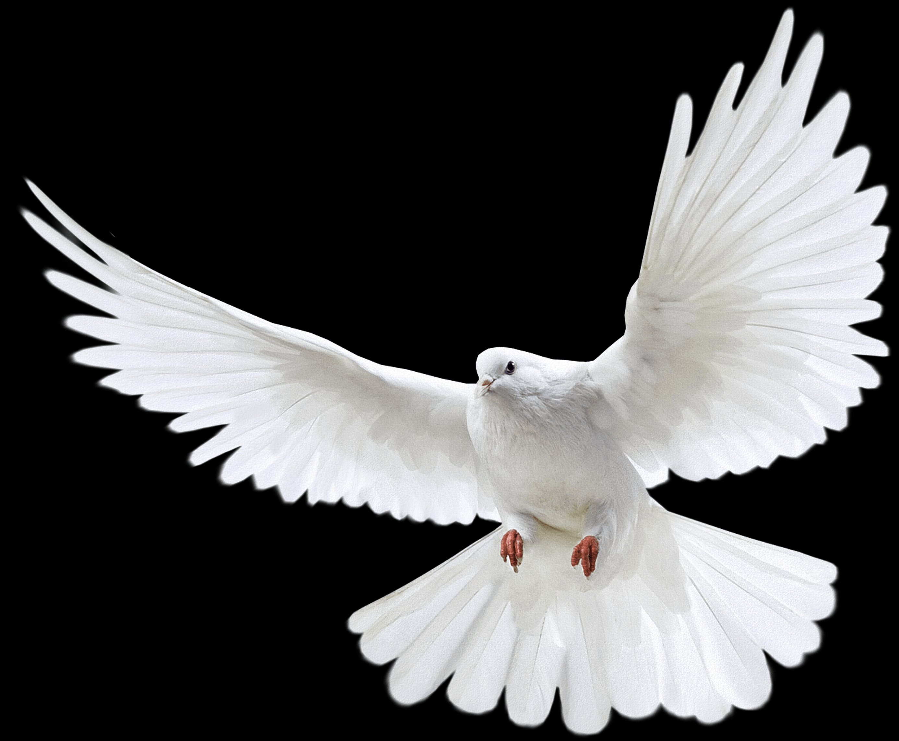
Notes:
Anniversary present...tip to GC (supposed to make a grandchild
Problem...Anita was already pregnant
We were waiting for a special time to tell them. We waited too long
When we came back we told the grandparents and had a celebration.
Happy Unveiling day...Happy Revelation Day!!
Just made it up...But I think it is amazingly appropriate for what we are going to discuss
Something revealed=
Long hidden- now publically displayed

Slide 2
Matthew 3:13–17
Then Jesus arrived from Galilee at the Jordan coming to John, to be baptized by him. But John tried to prevent Him, saying, “I have need to be baptized by You, and do You come to me?” But Jesus answering said to him, “Permit it at this time; for in this way it is fitting for us to fulfill all righteousness.” Then he permitted Him. After being baptized, Jesus came up immediately from the water; and behold, the heavens were opened, and he saw the Spirit of God descending as a dove and lighting on Him, and behold, a voice out of the heavens said, “This is My beloved Son, in whom I am well-pleased.”” (NASB95)
Notes:
READ
The incarnation.
An obedient servant
cessation of sacrifices
Perfect acceptance
Shrouded in secrecy for hundreds of years.
Hinted at
explained but never revealed...
1 Peter 1:10–12
As to this salvation, the prophets who prophesied of the grace that would come to you made careful searches and inquiries, seeking to know what person or time the Spirit of Christ within them was indicating as He predicted the sufferings of Christ and the glories to follow. It was revealed to them that they were not serving themselves, but you, in these things which now have been announced to you through those who preached the gospel to you by the Holy Spirit sent from heaven—things into which angels long to look.” (NASB95)
The baptism of Jesus is God's public declaration of Jesus being the fulfilment of all the promises he had made up until this time.
Peace
Justice
Righteousness
Glory
FINALLY!!!!Salvation is reevealed EXPOSED. The culmination of all things from time immemorial.....
What is there left?
Before we go to chapter 4, i want to look at a couple of things surrounding the encounter with John and jesus baptism.
Just why did Jesus need to be Baptized to be announced?

Slide 3
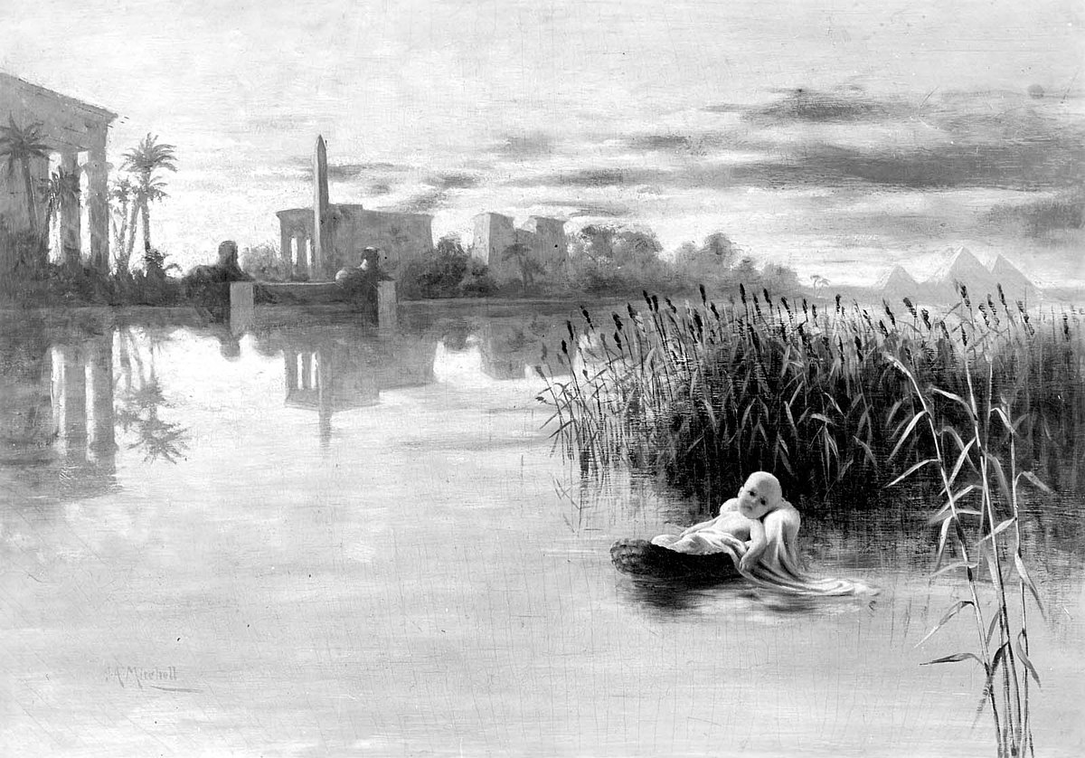
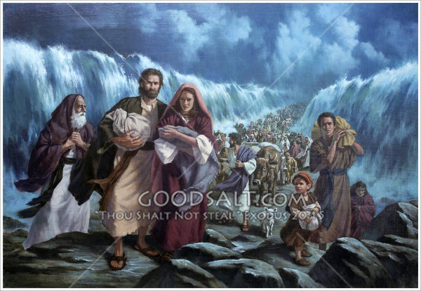
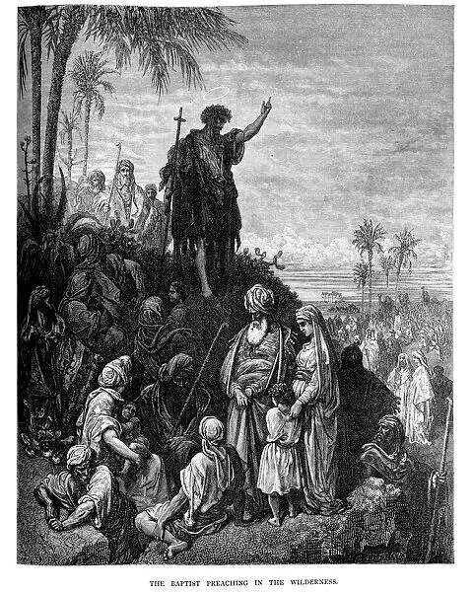
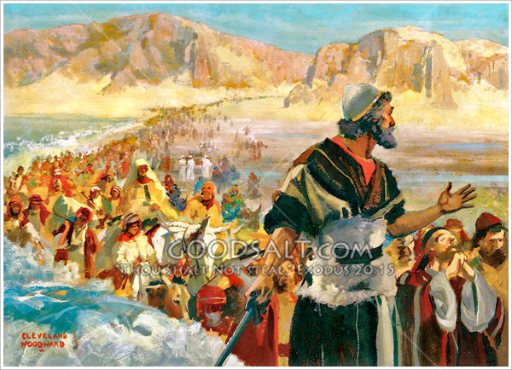
The significance of water
1 Peter 3:20
who once were disobedient, when the patience of God kept waiting in the days of Noah, during the construction of the ark, in which a few, that is, eight persons, were brought safely through the water.” (NASB95)
Notes:
Water.... Drawing out of His people
Creation is drawn...out of water
He kept Noah safe, His remnant, through waters
He draws Moses out of the water as Israels representative and spokesperson.
Exodus 2:10
The child grew, and she brought him to Pharaoh’s daughter and he became her son. And she named him Moses, and said, “Because I drew him out of the water.”” (NASB95)
He draws Israel out of Egypt through the Red Sea and again through the wilderness into the Promised land through the Jordan.
Then we come to Babylon. Israels exile- They return to the land but no 'drawing. There is only a return to the world as it were.
God brings a remnant back but there is no...water.
Nehemiah 2:7
And I said to the king, “If it please the king, let letters be given me for the governors of the provinces beyond the River, that they may allow me to pass through until I come to Judah,” (NASB95)
Israel goes up and OVER the jordan and Nehemiah needs letters for the gings that are on the East side.
It would appear
God is done with Israel as a nation.
They have broken the covenant so their return is NOT to God but to the land only. There is no 'water crossing or drawing.
The next time we have water is John...Baptism of repentance. A baptism of confession- committing to God.

Slide 4
Jesus to be baptized
I have not hidden Your righteousness within my heart; I have spoken of Your faithfulness and Your salvation; I have not concealed Your lovingkindness and Your truth from the great congregation.” (NASB95)
Psalm 40:6–10
Sacrifice and meal offering You have not desired; My ears You have opened; Burnt offering and sin offering You have not required. Then I said, “Behold, I come; In the scroll of the book it is written of me. I delight to do Your will, O my God; Your Law is within my heart.” I have proclaimed glad tidings of righteousness in the great congregation; Behold, I will not restrain my lips, O LORD, You know.”
Notes:
Jesus is baptized. Identified as the Obedient servant, the obedient Israel, in contrast to the DIS-obedient 1st Adam, Noah and nation of Israel.
READ
The Remnant. The son , the servant in Isaiah who desires and accomplishes God's will
Isaiah 49:6
He says, “It is too small a thing that You should be My Servant To raise up the tribes of Jacob and to restore the preserved ones of Israel; I will also make You a light of the nations So that My salvation may reach to the end of the earth.”” (NASB95)
Adam fails in His mission to be God's obedient servant.
Noah fails...having been drawn through the water. He come out the other side a sinner
Moses fails...He is NOT allowed into the promised land because of his disobedience
Israel, Gods corporate servant fails. even having God's laws laid out to them plainly

Slide 5
Jesus to be baptized
Nevertheless, with most of them God was not well-pleased; for they were laid low in the wilderness. Now these things happened as examples for us, so that we would not crave evil things as they also craved.” (NASB95)
1 Corinthians 10:1–6
For I do not want you to be unaware, brethren, that our fathers were all under the cloud and all passed through the sea; and all were baptized into Moses in the cloud and in the sea; and all ate the same spiritual food; and all drank the same spiritual drink, for they were drinking from a spiritual rock which followed them; and the rock was Christ.
Notes:
READ
Israel, tramping through the sea...being drawn out , as it were, to God through Moses in the OC, proved their disobedience and the hardness of their hearts by 40 years of rebellion in the wilderness
They became a object lesson. Displaying their hostility and in turn, suffering for it.
Until now God has not had a real servant, a real son. All had failed UNTIL
Jesus, God incarnate. Takes the place of all who have gone before...Adam, Noah, Moses, Israel, doing all the things they were unable to.
Doing all the things the 1st Adam was unwilling to do.
Superman....in a battle using his fists only later does he break out his lazer or just throw the offender off the planet. Always having the power, chosing when to use it.
His coming too- like Noah, like Israel- is revealed to the nations as He also is drawn through water.
He comes to be revealed as God's son, Israel
He comes through to be identified as man

Slide 6
It is fitting for us to fulfill all righteousness
1 2 Chronicles 36:20–23
Those who had escaped from the sword he carried away to Babylon; and they were servants to him and to his sons until the rule of the kingdom of Persia, to fulfill the word of the LORD by the mouth of Jeremiah, until the land had enjoyed its sabbaths. All the days of its desolation it kept sabbath until seventy years were complete. Now in the first year of Cyrus king of Persia—in order to fulfill the word of the LORD by the mouth of Jeremiah—the LORD stirred up the spirit of Cyrus king of Persia, so that he sent a proclamation throughout his kingdom, and also put it in writing, saying, “Thus says Cyrus king of Persia, ‘The LORD, the God of heaven, has given me all the kingdoms of the earth, and He has appointed me to build Him a house in Jerusalem, which is in Judah. Whoever there is among you of all His people, may the LORD his God be with him, and let him go up!’ ”” (NASB95)
Notes:
John, seeing Jesus approach, does not understand why Jesus comes to him to be baptized?
According to John's gospel- John did not KNOW who Jesus was until the descent of the dove
John 1:30–34
“This is He on behalf of whom I said, ‘After me comes a Man who has a higher rank than I, for He existed before me.’ “I did not recognize Him, but so that He might be manifested to Israel, I came baptizing in water.” John testified saying, “I have seen the Spirit descending as a dove out of heaven, and He remained upon Him. “I did not recognize Him, but He who sent me to baptize in water said to me, ‘He upon whom you see the Spirit descending and remaining upon Him, this is the One who baptizes in the Holy Spirit.’ “I myself have seen, and have testified that this is the Son of God.”” (NASB95)
So his question is NOT about why he is coming as God's annointed (because he did not have that information) but more probably, why is He coming to be baptized for repentance? John had never witnessed him doing anything to deserve this.
Jesus' response is “Permit it at this time; for in this way it is fitting for us to fulfill all righteousness.”
Meaning?
righteousness= right, correct, self evident or established; decided
'Permit this because this is God's chosen path for me.
It has been foretold and we need to make it happen.
ALL Righteousness is fulfilled as Gods prophetic words are brought to pass
READ
Was God righteous in making the decrees recorded for us from Jeremiah's mouth?
Absolutely
Fulfilled prophecy is God's righteousness being revealed and completed.
For Jesus to come to John to be baptized may not have been prophecied but his revealing himself to the Jews and to the nations has;
Psalm 40:7
Then I said, “Behold, I come; In the scroll of the book it is written of me.” (NASB95)

Slide 7
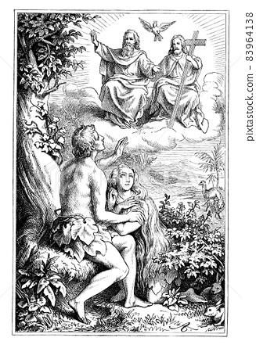
It is fitting for us to fulfill all righteousness
1Hosea 6:6–7
For I delight in loyalty rather than sacrifice, And in the knowledge of God rather than burnt offerings. But like Adam they have transgressed the covenant; There they have dealt treacherously against Me.” (NASB95)
Notes:
READ
Now, it is not so much the ACT of baptism that has been foretold. It is that Jesus has come on a mission from God and that mission is beginning today.
Jesus has arrived to replace the offerings. He is coming as the second Adam and the Obedient Servant. He comes to replace sacrifice with His loyalty.
The baptism is the declaration.
THIS DAY,
Jesus is being revealed to earth AND to the spiritual forces. Evil was OK with animasl sacrifices since they did nothing to keep people out of hell.
BUT NOW, Jesus has arrived. He is announced as the one to not just fix a broken system but to throw the ineffective one out and build a pathway to God that does not depend on mankind at all

Slide 8
It is fitting for us to fulfill all righteousness
1Romans 5:14
Nevertheless death reigned from Adam until Moses, even over those who had not sinned in the likeness of the offense of Adam, who is a type of Him who was to come.” (NASB95)
Notes:
READ
This is the day...chosen before creation. That God would reveal his salvation. His response to the failure of Adam, Noah, Moses, Israel and us.
Our necessity is proven by our deaths. Christ is being revealed today as the one that will replace the animal sacrifices and coverings that mankind has used since the days of Adam.
Noah, Moses, Israel...All sacrificed animals, pouring out blood. Here we have now the 2nd Adam that is coming to fulfill ALL righteousness. Something NO ONE has been able to do.
Today, at the Jordan, Jesus is fulfilling all righteousness by fulfilling God's plan to bring salvation to all mankind through the death of His Son, the Suffering servant and chosen one of God, the suffering has begun.

Slide 9
The Spirit of God descending like a dove
IIIsaiah 63:11–14
Then His people remembered the days of old, of Moses. Where is He who brought them up out of the sea with the shepherds of His flock? Where is He who put His Holy Spirit in the midst of them, Who caused His glorious arm to go at the right hand of Moses, Who divided the waters before them to make for Himself an everlasting name, Who led them through the depths? Like the horse in the wilderness, they did not stumble; As the cattle which go down into the valley, The Spirit of the LORD gave them rest. So You led Your people, To make for Yourself a glorious name.” (NASB95)
Notes:
Jesus is baptized and as he comes through the water, the form of a dve descends upon him.
Beyond the obvious 'peace' symbolism, we have other things going on as well.
We have the fulfillment of Isaiah 63.
READ
Israel was looking for the Spirit of God to come upon their nation. to rescue them....
They say'”He brought his people through the sea...where is his presence?”
Or in the vernacular;”He brought us back from captivity, where is His presence?”
They are looking for the Spirit...Isaiah says;The Spirit of the LORD gave them rest. So You led Your people, To make for Yourself a glorious name.”
Israel was still waiting for the peace
Now, in the baptism and revelation of Jesus Christ and Gods chosen servant, His Israel of God, they see the coming of the Spirit and know that peace is available.peace.
Only in coming to God through Christ will they have the peace that rested visibly upon him.
Isaiah 64:1
Oh, that You would rend the heavens and come down, That the mountains might quake at Your presence—” (NASB95)
The Holy Spirit comes to;
Brings peace
Provides confirmation of identity
Leads him to His mission
provides capacity

Slide 10
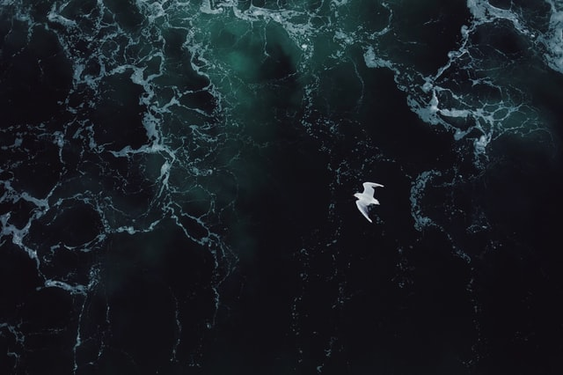
The Spirit of God descending like a dove
Genesis 1:1–3
In the beginning God created the heavens and the earth. The earth was formless and void, and darkness was over the surface of the deep, and the Spirit of God was moving over the surface of the waters. Then God said, “Let there be light”; and there was light.” (NASB95)
Notes:
But there is also another aspect of this that I don't want us to miss
That comes from the very beginning of creation. We have Christ rising out of the waters in Matt. 3 and the Holy Spirit ministering to him
In Genesis we have the Holy Spirit'moving' over the surface of the waters....building creation.
We have a Dove, instrumental in letting Noah know the re-creation is available
Go back to Matthew's baptism. The Holy Spirit comes to Build the NEW CREATION.
God's Kingdom is being established on earth through the same creative Holy Spirit that was in power over the creation of heaven and earth and the rebuilding of creation after the flood.

Slide 11
A voice out of the heavens
Psalm 2:6–9
“But as for Me, I have installed My King Upon Zion, My holy mountain.” “I will surely tell of the decree of the LORD: He said to Me, ‘You are My Son, Today I have begotten You. ‘Ask of Me, and I will surely give the nations as Your inheritance, And the very ends of the earth as Your possession. ‘You shall break them with a rod of iron, You shall shatter them like earthenware.’ ”” (NASB95)
Notes:
The descent of the Spirit, as amazing as that was, is not all that happened.
God himself spoke...audibly (some understood, some didn't)
God says, “This is My beloved Son, in whom I am well-pleased.”
A mash up of two scripture.references; Ps.2 and Is. 42.
Ps 2 reveals the Son to be powerful, mighty, awesome and worthy of honor and submission.
He comes in opposition to the world and laughs at its powers and it's designs of rebellion
He looks at all their dealings and laughs (Takes us to Pilate)
He laughs because they are ineffective
He laughs because they are no surprise
(My certainty in dodgeball)
Psalm 2:7–9
“I will surely tell of the decree of the LORD: He said to Me, ‘You are My Son, Today I have begotten You. ‘Ask of Me, and I will surely give the nations as Your inheritance, And the very ends of the earth as Your possession. ‘You shall break them with a rod of iron, You shall shatter them like earthenware.’ ”” (NASB95)God the Father says,
This IS the king. Anointed not with oil but with the Holy Spirit.
The nations are his (Very important fact to remember for the next chapter)
Jesus WILL have his way with them.

Slide 12
A voice out of the heavens
Isaiah 42:1–3
“Behold, My Servant, whom I uphold; My chosen one in whom My soul delights. I have put My Spirit upon Him; He will bring forth justice to the nations. “He will not cry out or raise His voice, Nor make His voice heard in the street. “A bruised reed He will not break And a dimly burning wick He will not extinguish; He will faithfully bring forth justice.” (NASB95)
Notes:
The second section is reflective of isaiah 42.
Servant= faithful- caring, careful. Knows our frailties and will will preserve His people in justice.
I really like picture of bruised reed.
A reed once bent over will break the very next time.
He does NOT bring justice by Defeating the Roman empire. he brings justice through submission and humility.
Today the grand announcement was made. Jeus Christ begins his mission..He begins establishing His kingdom. He begins putting Satan in check.
He begins comforting the sick and needy AND he begins warning the Rebels
going further in Psalm 2, there are 2 outcomes to the inauguration of the king
having his wrath kindled against us or making himour refuge. His baptism draws the line in the sand.

Slide 13
Notes:
The baptism of Jesus is a glorious event.
Words don't do justice to what wasa happening.
Salvation...promise for thousands of years is revealed, confirmed.
Outside of the theologigal implications this has brought out...So what?
A couple of things...not in any order...
We are face to face with an unchangeable God. EVERYTHING has happened as he willed...Is that a truth you need to hear. He is in absolute control and doesn't need you steering or worring?
We are face to face with a God who does ALL things perfectly. Jesus comes to fulfill, not just the prophesies but the very will of God. Something NO ONE ELSE has done or could do.
We are face to face with LOVE. This is HIS SON. He is sending HIS SON to death...UNJUSTLY. For you and me. Is he NOT going to take care of us with the care of a mother and strength of Father?
We are face to face with COMPASSION. A SON who has experienced fully the onslaught of Satan and comes to our defense daily.

