Slide 1
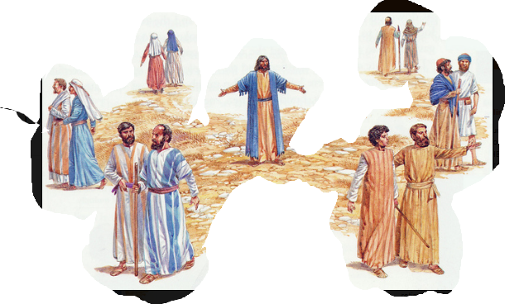
Notes:
Wedding proposals....
They are one of the more important questions and have life altering implications.
My proposal (if you can call it that) was done on a Saturday morning at our local Bob's Big Boy.
We were there for brunch and discussing things and the question just kinda came out.
It wasn't even much of a proposal because after I asked her, she said she didn't understand the question!
In a normal world and not in the wild mind of David, most guys make a big deal out of the proposal.
They want the perfect setting.
They want the perfect ambiance
They want the question to go off without a hitch and the whole thing to be very memorable BECAUSE it is an important question and decision.
Last time; We spent some time discussing the 12 disciples Jesus chose.
They were seperated out...chosen to be Apostles....messengers and now we have Jesus outfitting them and giving them the message.
and noticed a few things about the group;
They were mostly local
They were not all the same
They WERE all ordinary.
This week we have Jesus deputizing and empowering them to deliver Jesus’message about the coming of the Kingdom of God.
...the proposal.
We are going to take a look at the HOWS of the sending out of the 12.

Slide 2
Matthew 10:5–10
These twelve Jesus sent out after instructing them: “Do not go in the way of the Gentiles, and do not enter any city of the Samaritans; but rather go to the lost sheep of the house of Israel. “And as you go, preach, saying, ‘The kingdom of heaven is at hand.’ “Heal the sick, raise the dead, cleanse the lepers, cast out demons. Freely you received, freely give. “Do not acquire gold, or silver, or copper for your money belts, or a bag for your journey, or even two coats, or sandals, or a staff; for the worker is worthy of his support.
Notes:
READ

Slide 3
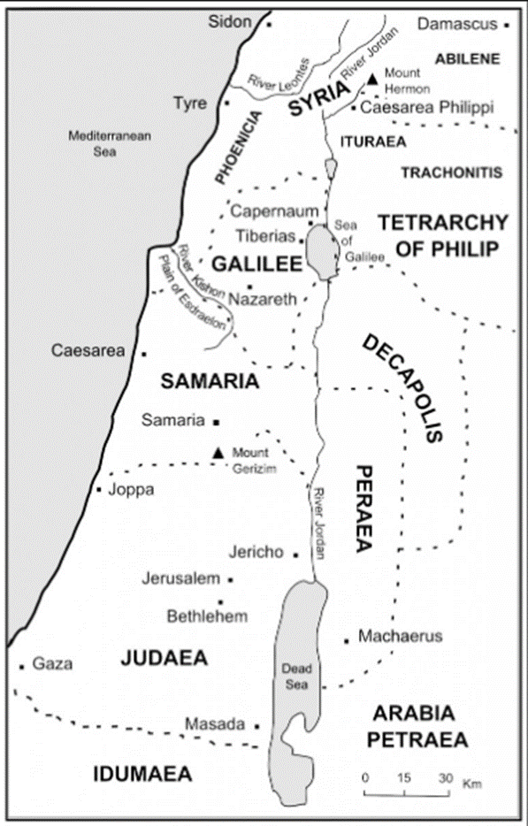
Restricting.
Not to Gentiles. Avoid Samaritans
(for now)
Notes:
The first HOW is... Specifically. Jesus did not send them out to everyone. He had a distinct plan in mind.
The gameplan for the kingdom was gradual expansion.
Jesus initially came to address and offer entrance into the kingdom to the Jews and almost bypassing completely the gentiles and Samaritans
Notice the map.....do NOT go to the Gentiles and do NOT enter into a Samaritan city.
Matthew 15:21–24
Jesus went away from there, and withdrew into the district of Tyre and Sidon. And a Canaanite woman from that region came out and began to cry out, saying, “Have mercy on me, Lord, Son of David; my daughter is cruelly demon-possessed.” But He did not answer her a word. And His disciples came and implored Him, saying, “Send her away, because she keeps shouting at us.” But He answered and said, “I was sent only to the lost sheep of the house of Israel.”” (NASB95)
Sometimes at work I bring snacks for the team. I put them out on our table but I make sure that they take what they want before i offer them up to others who may wander into the office. I do not force the snacks on them...I give them the 'right of first refusal This is what jesus is doing. Making sure the jews are exposed to the message first.
He has a particular and very tender concern for the house of Israel; they were beloved for the fathers’sakes,
Romans 9:3–5
For I could wish that I myself were accursed, separated from Christ for the sake of my brethren, my kinsmen according to the flesh, who are Israelites, to whom belongs the adoption as sons, and the glory and the covenants and the giving of the Law and the temple service and the promises, whose are the fathers, and from whom is the Christ according to the flesh, who is over all, God blessed forever. Amen.” (NASB95)
Romans 11:28
From the standpoint of the gospel they are enemies for your sake, but from the standpoint of God’s choice they are beloved for the sake of the fathers;” (NASB95)
The growth of the kingdom, like the unfolding of the knowledge of the kingdom is ORGANIC.
As the ministry of Jesus draws to a close, the boundaries for their preaching are removed.
Matthew 28:19
“Go therefore and make disciples of all the nations, baptizing them in the name of the Father and the Son and the Holy Spirit,” (NASB95)
God, through the HS equips them exactly as God sees (and knows) best.
Acts 1:8
but you will receive power when the Holy Spirit has come upon you; and you shall be My witnesses both in Jerusalem, and in all Judea and Samaria, and even to the remotest part of the earth.”” (NASB95)
Later on The Holy Spirit will be rightly identified as the one who gives the disciples their healing power.

Slide 4
Messaging
The Kingdom of Heaven is at hand
1 Corinthians 15:3–4
For I delivered to you as of first importance what I also received, that Christ died for our sins according to the Scriptures, and that He was buried, and that He was raised on the third day according to the Scriptures,” (NASB95)
Notes:
The second Specific is WHAT.
There was a specific message and it was concerning the Kingdom of Heaven.
This 'kingdom of Heaven' picture is first mentioned in Daniel 2 to Nebuchadnezzar
Daniel 2:36–44
“This was the dream; now we will tell its interpretation before the king. “You, O king, are the king of kings, to whom the God of heaven has given the kingdom, the power, the strength and the glory; and wherever the sons of men dwell, or the beasts of the field, or the birds of the sky, He has given them into your hand and has caused you to rule over them all. You are the head of gold. “After you there will arise another kingdom inferior to you, then another third kingdom of bronze, which will rule over all the earth. “Then there will be a fourth kingdom as strong as iron; inasmuch as iron crushes and shatters all things, so, like iron that breaks in pieces, it will crush and break all these in pieces. “In that you saw the feet and toes, partly of potter’s clay and partly of iron, it will be a divided kingdom; but it will have in it the toughness of iron, inasmuch as you saw the iron mixed with common clay. “As the toes of the feet were partly of iron and partly of pottery, so some of the kingdom will be strong and part of it will be brittle. “And in that you saw the iron mixed with common clay, they will combine with one another in the seed of men; but they will not adhere to one another, even as iron does not combine with pottery. “In the days of those kings the God of heaven will set up a kingdom which will never be destroyed, and that kingdom will not be left for another people; it will crush and put an end to all these kingdoms, but it will itself endure forever.”
Everyone wants to know whick each kingdom corresponds to which part of the statue, but there may be a different perspective.... I stumbled upon it while studying.
This perspective looks at things from a general national goodness perspective. from the standpoint of rightousness or pursuit of morality a type of spiritual sensitivity and not necessaily a direct correlation between kingdom and element.
Notice first one is Gold- single element, pure and extremely valuable.
(There is no way I am saying that Nebuchadnezzer was a believer but he certainly DID recognize the reality and power of God in the end.)
Second is silver, another pure element, yet less costly and maybe loosing a bt of a moral standard
Third is bronze- a combining of to semi precious materials, copper and zinc that need to be combined through fire
Forth is made of iron- a combination of worthless ironstone, limestone and again, FIRE.
FIRE is what gives it it's unique properties...it HAS to go through a fire to even BE…even to Exist while silver and gold are naturally found.
Lastly you have iron and clay- a mixture that does not even stay together. they are opposites. to make iron strong, you use fire which makes clay brittle.
We can look at the statue this way,
not so much of a seperating out of specific kingdom ages or dividing history by king or kingdom (although kings and kingdoms are used as placeholders).
It is the disintegration of kingdoms and with it, many times a reduction in morality and spiritual pursuit.
The statue represents the growing of godlessness until God steps in and establishes His kingdom.
THIS kingdom, Daniel says, is an eternal kingdom. It will not disintegrate or be destroyed.
Fastforwarding now to Matthew, it is NOW the fullness of time and the Kingdom of God is at hand.
God is beginning to establish His kingdom in earnest.
To have a kingdom, the first thing you need is the King and now Jesus is ON THE EARTH.
The kingdom is AT HAND
The message of God's kingdom and the installation of God's king is THE most important message to ever be delivered
(NASB95)1 Corinthians 15:3–8
For I delivered to you as of first importance what I also received, that Christ died for our sins according to the Scriptures, and that He was buried, and that He was raised on the third day according to the Scriptures, and that He appeared to Cephas, then to the twelve. After that He appeared to more than five hundred brethren at one time, most of whom remain until now, but some have fallen asleep; then He appeared to James, then to all the apostles; and last of all, as to one untimely born, He appeared to me also.” (NASB95)
The message was given and testimony is available from eye-witnesses.
The repercussions of each person's decision is summed up in Psalm 2;
David is looking forward.
He sees that God the Father has installed His hand-picked king in Zion (His Son). and The Father turns toward the Son and says;
Psalm 2:8–12
‘Ask of Me, and I will surely give the nations as Your inheritance, And the very ends of the earth as Your possession. ‘You shall break them with a rod of iron, You shall shatter them like earthenware.’ ” Now therefore, O kings, show discernment; Take warning, O judges of the earth. Worship the LORD with reverence And rejoice with trembling. Do homage to the Son, that He not become angry, and you perish in the way, For His wrath may soon be kindled. How blessed are all who take refuge in Him!” (NASB95)
God's wrath or Gods blessing hang in the balance of what each person does with the information that The Apostles are proclaiming.
What each person does with “The Kingdom of Heaven”shapes not just their life, like a wedding commitment or office politics but it shapes their eternity.

Slide 5
Authenticating
Miracles (bringing healing instead of accusation or punishment)
John 3:17–18
“For God did not send the Son into the world to judge the world, but that the world might be saved through Him. “He who believes in Him is not judged; he who does not believe has been judged already, because he has not believed in the name of the only begotten Son of God.” (NASB95)
Notes:
The messae of the coming Kingdom is not new then,
From Daniel through John, there is an undercurrent of the coming Kingdom.
Yet the message many times came wrapped in calling out failure and judgement because they had been found unfit.
For example;
Jonah 3:4
Then Jonah began to go through the city one day’s walk; and he cried out and said, “Yet forty days and Nineveh will be overthrown.”” (NASB95)
Isaiah 3:13–15
The LORD arises to contend, And stands to judge the people. The LORD enters into judgment with the elders and princes of His people, “It is you who have devoured the vineyard; The plunder of the poor is in your houses. “What do you mean by crushing My people And grinding the face of the poor?” Declares the Lord GOD of hosts.” (NASB95)
Ezekiel 7:3–4
‘Now the end is upon you, and I will send My anger against you; I will judge you according to your ways and bring all your abominations upon you. ‘For My eye will have no pity on you, nor will I spare you, but I will bring your ways upon you, and your abominations will be among you; then you will know that I am the LORD!’” (NASB95)
Jeremiah 11:20
But, O LORD of hosts, who judges righteously, Who tries the feelings and the heart, Let me see Your vengeance on them, For to You have I committed my cause.” (NASB95)
BUT NOW We have Jesus arriving on the scene with the same message but VERY different approach.
HE even points out the difference when he contrasts HIS ministry with John;
Luke 7:31–35
“To what then shall I compare the men of this generation, and what are they like? “They are like children who sit in the market place and call to one another, and they say, ‘We played the flute for you, and you did not dance; we sang a dirge, and you did not weep.’ “For John the Baptist has come eating no bread and drinking no wine, and you say, ‘He has a demon!’ “The Son of Man has come eating and drinking, and you say, ‘Behold, a gluttonous man and a drunkard, a friend of tax collectors and sinners!’
“Yet wisdom is vindicated by all her children.”” (NASB95)
Jesus comes as King of the coming kingdom
He comes to DESTROY sin and it's effects He does NOT come to inflame it. Much like the message we have in the Old Covenant.
Paul confirms the Old Covenant message as inflammatory when he explains it’s effects in Romans 7
Romans 7:7–8
What shall we say then? Is the Law sin? May it never be! On the contrary, I would not have come to know sin except through the Law; for I would not have known about coveting if the Law had not said, “You shall not covet.” But sin, taking opportunity through the commandment, produced in me coveting of every kind; for apart from the Law sin is dead.” (NASB95)
The third specific is Authentication
READ
He came to heal and forgive and not to act as judge
The one who rejects the king is self condemned..he has judged himself already.
So His message came in power but not power to punish.
He extends this power to his Apostles.
Their ability to perform the miracles needed to fall in line with Jesus way.
Their performance proved the veracity of their message and that they were authentic apostles.
When he sent them to preach the same doctrine that he had preached, he empowered them to confirm it, by the same divine seals, which could never be set to a lie. This is not necessary now the kingdom of God is come; to call for miracles now is to lay again the foundation when the building is reared. The point being settled, and the doctrine of Christ sufficiently attested, by the miracles which Christ and his apostles wrought, it is tempting God to ask for more signs. Matthew Henry

Slide 6
Providing
Giving without receiving, authentication via God’s provision
2 Corinthians 11:12
But what I am doing I will continue to do, so that I may cut off opportunity from those who desire an opportunity to be regarded just as we are in the matter about which they are boasting.” (NASB95)
Notes:
Lastly we look at God's provision
What we notice right away is that they were sent without anything.
No food
No money
No defense
This is VERY different than what we recognize as normal or 'approved' today.
We look at things 180 degrees differently.
Many of us believe that God will provide BEFOREHAND if he wants us to do 'missions'.
The entire 'Missions Societies' were built on this premise.
They would send evangelists out after they had enough (or close to enough) support.
Valerie , Ryan and Gabe....mission to SD...Raise support
What does Paul say.
2 Corinthians 11:7–15
Or did I commit a sin in humbling myself so that you might be exalted, because I preached the gospel of God to you without charge? I robbed other churches by taking wages from them to serve you; and when I was present with you and was in need, I was not a burden to anyone; for when the brethren came from Macedonia they fully supplied my need, and in everything I kept myself from being a burden to you, and will continue to do so. As the truth of Christ is in me, this boasting of mine will not be stopped in the regions of Achaia. Why? Because I do not love you? God knows I do! But what I am doing I will continue to do, so that I may cut off opportunity from those who desire an opportunity to be regarded just as we are in the matter about which they are boasting. For such men are false apostles, deceitful workers, disguising themselves as apostles of Christ. No wonder, for even Satan disguises himself as an angel of light. Therefore it is not surprising if his servants also disguise themselves as servants of righteousness, whose end will be according to their deeds.” (NASB95)
I am not advocating for irresponsible missions activity but I am advocating for a greater degree of allowing God to work out the details in a mission whether it be backed by a organization or just yourself thinking about ministering to your neighbor. Everything does NOT need to be worked out prior to your stepping out!
Jesus addresses their concern when he admonishes his disciples to remember that the worker is worth his wages. Your work in the Lord never goes unnoticed.
They were to find a place locally to stay at while they were in town and God would certainly provide that for the Apostles.
John Calvin;
no man will be a sincere minister of his word or dispenser of his grace, till he is prepared to bestow his labour gratuitously, and that all hirelings basely corrupt and profane the sacred office of teaching. Yet it is not inconsistent with this gratuitous dispensation, that the teachers of the church receive public salaries, provided that they willingly and generously serve Christ and his church, and that their support is, in some sort, an accessory of their labour.
Whereas the Apostles were to find a place locally to retire at night during their stay in a city, Paul counted on God delivering suport to him from places EVEN BEYOND where he was currently ministering!
He chose to not take any money from the Corinthian believers to cut the ground out from beneath the false teachers who would teach fof money.
Again, I am not advocating this but I AM reminding us all that God accomplishes his goals in ways we would not have figured out on our own.
God's promise in Galatians confirms the reward for our efforts.
Galatians 6:9
Let us not lose heart in doing good, for in due time we will reap if we do not grow weary.” (NASB95)
Peter tells the Elders, those teaching and guiding the local churches;
1 Peter 5:1–3
Therefore, I exhort the elders among you, as your fellow elder and witness of the sufferings of Christ, and a partaker also of the glory that is to be revealed, shepherd the flock of God among you, exercising oversight not under compulsion, but voluntarily, according to the will of God; and not for sordid gain, but with eagerness; nor yet as lording it over those allotted to your charge, but proving to be examples to the flock.” (NASB95)
The Apostles were given their message and accompanying powers for free, they should freely share both of them with the people they visit.
The message of the appearance of the King and His establishing His kingdom on earth through his followers should eclipse their miracles in importance.
The Kingdom of God is truly at Hand now more than ever!
The crumbling of societies and nations does not affect the ETERNAL Kingdom of Christ one bit and we have the rest of our time here as well as eternity to show our gratitude for his sharing the message with us as well as being the conduit of rescue for others.

Slide 7
Notes:
The message that was given to the twelve is the same message we have to deliver today.
The Kingdom of Heaven is at Hand.
The ministry of reconcilliation has been passed down from generation to generation.
The message they had in seed form, we have as full grown yet not yet ready for Harvest.
The Kingdom is at hand, the King is ready to return in power glory and this time, in judgment.

