Slide 1
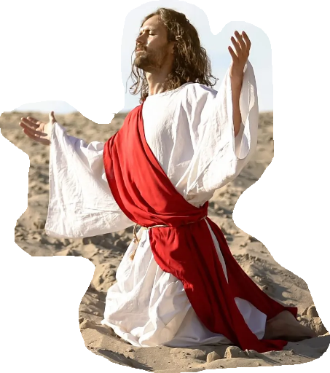
Notes:
Most of us learned the ‘Lord’s Prayer’ before we learned any other scripture verses and probably much at all about God.
In our confirmation classes as a Lutheran, One of the subjects we studied WAS The Lord’s Prayer.
I can remember being very excited to listen to our pastor teach through it and give us some things to consider about each petition that Jesus was providing His followers.
I can recall him taking each statement and fleshing it out, helping us realize that it was NOT JUST a prayer but it was a model for prayer. It served as a framework and if we prayed with this framework in mind, we were using it as intended.
I also remember early on, Sunday School. Even as we were learning to read, the Flannel Board would come out and week by week and line by line we would learn it like the pledge of allegiance. It felt much the same.
Pledge Monday through Friday, Lords Prayer on Sunday…
We would be given work sheets that mimicked the flannel board that we started during class but were supposed to finish at home (I always did it before class let out because I didn’t weant to be bothered doing it later, during cartoons or “Voyage to the Bottom of the Sea”, “Lost in Space” or “Mr. Ed”.
I recognize, though, that not everyone had that opportunity as they grew up. To really interact with the ‘Lord’s Prayer’ so I thought, in the spirit of inclusivism, I would share it with you.

Slide 2
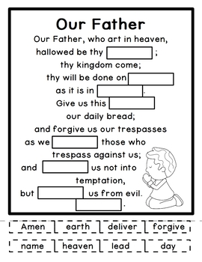
Matthew 6:9-15
“Pray, then, in this way:‘
Notes:
Now, class, We will be reading this out loud.
What we want to do is to fill in each box using one of the words below.

Slide 3
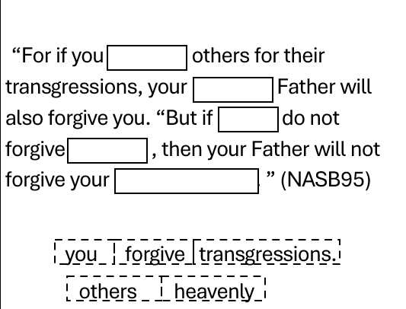
Notes:
I want to want to close out this section in Matthew so let's finish up our exercise.

Slide 4
‘Our Father who is in heaven, Hallowed be Your name.
I find it striking that when Jesus taught the church how to pray, the first thing He chose to tell us to pray about is that the name of God might be regarded as sacred. Very few people today would list the hallowing of the name of God as a top priority for the supplications of the people of God. It almost seems foreign to our environment to place so much emphasis on proper treatment of a name.
I don’t think that anything reveals the state of a person’s soul more clearly than the words that come out of his mouth. I understand that Christians are capable of all kinds of sin, but I can’t understand how a regenerate person could ever use the name of Jesus in a blasphemous way. How can you worship Someone whom you routinely blaspheme? I don’t see how it’s possible.- R.C. Sproul
Notes:
If we look at the prayer as a whole, It’s main objective it to hasten the Kingdom.
We accomlish thi by the way we relate to the king. His kingdom DOES progress when we are
Rrevering the king
Reconciling to the king
Relying on the king
Reflecting the king
R.C. Sproul-The attention at the beginning of this petition is on the exaltation of God and His concerns. In the initial phrases of the Lord's Prayer, Jesus fixes our gaze not on ourselves but on God.
R.C also is quoted as saying....READ
Solomon directs his prayer the same way at the dedication of the Temple. His prayer is for the future of God's people and God's kingdom at the dedication of the temple. He begins his address this way;
1 Kings 8:23–28
He said, “O Lord, the God of Israel, there is no God like You in heaven above or on earth beneath, keeping covenant and showing lovingkindness to Your servants who walk before You with all their heart, who have kept with Your servant, my father David, that which You have promised him; indeed, You have spoken with Your mouth and have fulfilled it with Your hand as it is this day. “Now therefore, O Lord, the God of Israel, keep with Your servant David my father that which You have promised him, saying, ‘You shall not lack a man to sit on the throne of Israel, if only your sons take heed to their way to walk before Me as you have walked.’ “Now therefore, O God of Israel, let Your word, I pray, be confirmed which You have spoken to Your servant, my father David. “But will God indeed dwell on the earth? Behold, heaven and the highest heaven cannot contain You, how much less this house which I have built! “Yet have regard to the prayer of Your servant and to his supplication, O Lord my God, to listen to the cry and to the prayer which Your servant prays before You today;” (NASB95)
His entire prayer up to this point, revolves around who God is and What he promised.
He later on, petitions God for mercy and forgiveness for the people because he knows Israel will stray.
David, even more so, lives in the centrality of God as first importance and as his own heavenly father in Psalm 73:25 “Whom have I in heaven but you? And beside you, I desire nothing on earth.
Andrew Murray“… the knowledge of the Fatherhood of God, the revelation of His infinite Fatherliness in our hearts; the faith in the infinite love that gives us His Son and His Spirit to make us children, is indeed the secret of prayer in spirit and truth. This is the new and living way Christ opened up for us. To have Christ the Son, and The Spirit of the Son, dwelling within us, and revealing the Father, this makes us true, spiritual worshippers”
I like to think about God as my father…important to do so.
When we bring that mindset to this prayer, we find the entirety of the prayer is relational
Along side of that, I ALSO must remember that He alone is holy. He is above all, separate. Not like us and there will always be a UNfamiliarity with Him.
As a holy God and my creator, I need to ALSO realize and respect Him.
Not unlike some of our earthly fathers... They were Dad, our protector, provider, helper and teacher but also, you didn't want to cross him and you gave him a wide berth when he came around.
Listen to God’s explanation to Aaron the high priest after he witnesses God working out an issue amongst His people.
Leviticus 10:1–3
Now Nadab and Abihu, the sons of Aaron, took their respective firepans, and after putting fire in them, placed incense on it and offered strange fire before the LORD, which He had not commanded them. And fire came out from the presence of the LORD and consumed them, and they died before the LORD. Then Moses said to Aaron, “It is what the LORD spoke, saying, ‘By those who come near Me I will be treated as holy, And before all the people I will be honored.’ ” So Aaron, therefore, kept silent.” (NASB95)
Jesus gives us this balance.
God is our father. A relationship we can understand. yet he is NOT COMPLETELY understandable since He is our HEAVENLY FATHER and to be given His due.

Slide 5
‘Your kingdom come. Your will be done, On earth as it is in heaven.
"Thy will be done" is what we are saying. That is the climax of the first half of the prayer. We are asking God to be God. We are asking God to do not what we want, but what God wants. We are asking God to make manifest the holiness that is now mostly hidden, to set free in all its terrible splendor the devastating power that is now mostly under restraint. "Thy kingdom come . . . on earth" is what we are saying. And if that were suddenly to happen, what then? What would stand and what would fall? Who would be welcomed in and who would be thrown the hell out? Which if any of our most precious visions of what God is and of what human beings are would prove to be more or less on the mark and which would turn out to be phony as three-dollar bills?- Fredrick Buechner
Notes:
When we pause long enough to reflect on God, His mission becomes more important than ours as well.
Jesus makes plain the importance of God's mission by taking us there next.
The fulfilling of God's will in the coming of His kingdom.
READ
This is a very thoughtful quote.
Have you ever stopped to think about the immediate ramifications of the return of the Lord?
Absolutely, we should join in with the saints gathered underneath the alter. But with that is the finality of the thing. Those who are lost are lost eternally.
Revelation 6:9–10
When the Lamb broke the fifth seal, I saw underneath the altar the souls of those who had been slain because of the word of God, and because of the testimony which they had maintained; and they cried out with a loud voice, saying, “How long, O Lord, holy and true, will You refrain from judging and avenging our blood on those who dwell on the earth?”” (NASB95)
Once Jesus bares his arm and brandishes his sword, time is up. Everything changes and there is no re-do.
BUT, like the saints under the alter, There should be no greater joy than for us to see KING JESUS, finally destroy even death itself and reign in his consummated kingdom.
We should be longing for release from sin and to worship with our WHOLE BEING and unreservedly.
Our hearts should be moved to do all we can to see more people become the subjects of his kingdom.

Slide 6
‘Give us this day our daily bread.
It is perfectly proper then that we pray about the need of the body. Bread here is a symbol of all the necessities of physical life. It includes more than mere bread; it stands for all that our physical life demands -- shelter, drink, clothing -- anything that the body requires. The vital concern in this area is that there be available to us an immediate unbroken supply. So, this prayer moves right at the issue when it says; "Give us this day each day our daily bread." The only limit in this prayer is that we are never to pray for a warehouse full supply for a year ahead. There are no giant economy packages available to us in this area of life. We are to pray for one day's supply.- Ray Stedman
Hey were in the wilderness 16 “In the wilderness He fed you manna which your fathers did not know, that He might humble you and that He might test you, to do good for you in the end.
17 “Otherwise, you may say in your heart, ‘My power and the strength of my hand made me this wealth.’
Notes:
After we have had our eyes and hearts adjusted and filled with awe, wonder and joy in the contemplation of God and His coming kingdom, our own needs seem to be a bit less important.
We have been invited to participate in the expansion of Jesus kingdom, but, right, now...I am kinda hungry!
It is as if we were asked to sit on a counsel to bring world peace but all we can think about is those bologna sandwiches on the table in the corner.
The beauty is that Jesus knows that bologna is important too!!
Through the ages, Men have tried to spiritualize this phrase…turning this request into an invitation to the Lord’s Wedding Feast. Others have felt that the bread in question is actually Jesus Christ, and it is a plea to find acceptance at the communion table and all that means..
Now this may be true in other ‘bread’ references but this here, Jesus is simply explaining that God is concerned for our daily needs. He IS our daily provider.
Daily bread recalls God’s gracious provision for his people as they were in the wilderness;
Moses reminds Israel of it in Deut. 8.
Deuteronomy 8:16–17
“In the wilderness He fed you manna which your fathers did not know, that He might humble you and that He might test you, to do good for you in the end. “Otherwise, you may say in your heart, ‘My power and the strength of my hand made me this wealth.’” (NASB95)
Jesus confirms the goodness of God in answering our petitions for bodily needs in the next chapter of Matthew. Chapter 7.;
Matt. 7:9-11
Or what man is there among you who, when his son asks for a loaf, will give him a stone? Or if he asks for a fish, he will not give him a snake, will he? If you then, being evil, know how to give good gifts to your children, how much more will your Father who is in heaven give what is good to those who ask Him!
READ
Mr. Stedman cautions us though, as with everything else, motive plays a big part. Or accecptable request is to ask for daily bread daily.
It keeps us close to Him
It keeps us dependent on Him
It keeps us satisfied in Him
When we move further into the future, we are moving past the thing’s God wants us to be concerned about.
Proverbs 30:8,9 give us a proper perspective on not just food but ALL our daily necessities.
Proverbs 30:8–9
Keep deception and lies far from me, Give me neither poverty nor riches; Feed me with the food that is my portion, That I not be full and deny You and say, “Who is the Lord?” Or that I not be in want and steal, And profane the name of my God.” (NASB95)
The writer expresses how EASY it is to derail our affections.
- Give us too much and we forget our God.
Give us to little and we become malcontents.
Israel give us a very clear example of the ‘temptation to have more’ when the walls of Jericho fell down.
Joshua 6-8. The story begins with the city being ‘shut tight’ because Israels’ reputation had preceded them...
Their leaving Egypt in spectacular fashion,
The destruction of kingdoms of Bashan and Og on the west side of the Jordan. The entire nation walking through the river on dry land to the east and now camping outside the city.
God reminds them when they settle there. He says; ““See, I have given Jericho into your hand, with its king and the valiant warriors.
He gives them very specific instruction…They follow them…the city falls.
A guy named Achan does NOT follow God’s command. Instead, he sees this as an opportunity to pad his bank account so he DOESN”T need to rely on God.
God tells them to go to a much smaller city with a much smaller name Ai.
The shift in Achan seems to infect the entire Israelite population because THEY start deciding their battle strategy
God tells Joshua that;
Israel has sinned, and they have also transgressed My covenant which I commanded them. And they have even taken some of the things under the ban and have both stolen and deceived. Moreover, they have also put them among their own things.
Because of the victory@ Jericho, they may have become confident in and among themselves and Achan is the posterboy.
The nation is called out.
They repent
They get rid of Achan
God then tells them there is no longer a reason to fear.
He gives them their battle plan and the overtake Ai.
Contentment is a slippery thing but Paul say’ Godliness with contentment is great gain!
Later on in this same chapter 6 of Matthew, Jesus commands that we maintain a proper focus.
Matthew 6:31–33
“Do not worry then, saying, ‘What will we eat?’ or ‘What will we drink?’ or ‘What will we wear for clothing?’ “For the Gentiles eagerly seek all these things; for your heavenly Father knows that you need all these things. “But seek first His kingdom and His righteousness, and all these things will be added to you.” (NASB95)

Slide 7
‘And forgive us our debts, as we also have forgiven our debtors.
Our real problem at this point is not theological. Our real problem is personal. We don’t see ourselves as very great sinners; therefore, we do not appreciate how greatly God has forgiven us. But when your own sins seem small, the sins of others against you will seem big indeed. The reverse is also true. The greater you see the depth of your sin before God, the less the sins of other people against you will bother you. Don’t talk about repentance unless you are willing to forgive your brothers and sisters. Unless you are willing to forgive, your repentance is just so much hot air and empty talk. True repentance always starts with a change of mind that leads to a change of heart that leads to a change (in this case) in the way we view those who have sinned against us. -Ray Pritchard
Notes:
Moving from physical necessity , Jesus turns toward relational necessity. The necessity of forgiveness in His kingdom.
Fogiveness by God is a pre-requisite to the kingdom.
God's forgiveness is reuired for entrance. So forgiveness for one another is the hallmark of its subjects.
READ
Proverbs 28:13–14
He who conceals his transgressions will not prosper, But he who confesses and forsakes them will find compassion. How blessed is the man who fears always, But he who hardens his heart will fall into calamity.” (NASB95)
Now, we know that Jesus Christ’s death on the cross has effectively saved us from all sins, and from a legal standpoint, our relationship does not depend on our daily asking for forgiveness.
Above all, though, forgiveness is relational.
My children will never stop being my children. They are mine. Nothing they do will stop us from loving them.
BUT there can be roadblocks to a healthy relationship such as stubbornly holding onto a bad behavior, personal pride or a spirit of unforgiveness.
In these cases, our relationship is not a joyful one and when we would meet, my desire as the parent would be to exercise my power to bring them back in line. Until then, I am not going to continue to act like everything is OK.
Having a TEMPORARY spirit of unforgiveness gets in the way. Having a PERMANENT ONE would reflect we never were part of His family in the first place.
Philip Schaff- Commentary on Matthew-We feel assurance in Thy forgiveness, perceiving within ourselves a readiness to forgive others, which Thou hast implanted;
Matthew helps us see this in Matthew 18.
Peter asks a relational question concerning forgiveness and Jesus gives him a hard response.
Matthew 18:21–35
Then Peter came and said to Him, “Lord, how often shall my brother sin against me and I forgive him? Up to seven times?” Jesus said to him, “I do not say to you, up to seven times, but up to seventy times seven. “For this reason the kingdom of heaven may be compared to a king who wished to settle accounts with his slaves. “When he had begun to settle them, one who owed him ten thousand talents was brought to him. “But since he did not have the means to repay, his lord commanded him to be sold, along with his wife and children and all that he had, and repayment to be made. “So the slave fell to the ground and prostrated himself before him, saying, ‘Have patience with me and I will repay you everything.’ “And the lord of that slave felt compassion and released him and forgave him the debt. “But that slave went out and found one of his fellow slaves who owed him a hundred denarii; and he seized him and began to choke him, saying, ‘Pay back what you owe.’ “So his fellow slave fell to the ground and began to plead with him, saying, ‘Have patience with me and I will repay you.’ “But he was unwilling and went and threw him in prison until he should pay back what was owed. “So when his fellow slaves saw what had happened, they were deeply grieved and came and reported to their lord all that had happened. “Then summoning him, his lord said to him, ‘You wicked slave, I forgave you all that debt because you pleaded with me. ‘Should you not also have had mercy on your fellow slave, in the same way that I had mercy on you?’ “And his lord, moved with anger, handed him over to the torturers until he should repay all that was owed him. “My heavenly Father will also do the same to you, if each of you does not forgive his brother from your heart.”” (NASB95)
This is not meant to be a treatise on salvation but on the importance of relationships and motives of the heart.
The first, forgiven slave was not so interested in restoring a broken relationship as he was in getting out from under the punishment of a debt. We see this because of the way he treated his fellow slave. Gratitude begats gratitude. Compassion should generate compassion and Being forgiven begats forgiving others. If we find we are NOT in a place of forgiveness, we need to get it fixed or Jesus will fix it for us.

Slide 8
‘And do not lead us into temptation but deliver us from evil.
In the course of providence, the Lord tests our graces and the sincerity of our profession; and for this purpose he does “lead us into temptation. ” We entreat him not to try us too severely. ‘Lord, let not my joys or my sorrows become temptations to me. As I would not run into temptation of myself, I pray thee, do not lead me where I must inevitably meet it.
But if I must be tried, Lord, deliver me from falling into evil, and specially preserve me from that evil one, who, above all, seeks my soul, to destroy it. Temptation or trial may be for my good, if I am delivered from evil.
Lord, do this for me, for I cannot preserve myself.’ C.H. Spurgeon
Notes:
The prayer closes with a plea to be spared.
It forces us to recognize that GOD controls our circumstances…ALL my circumstances.
It comforts me to know that GOD relents at our request. My prayers have effect or God is a liar.
It strengthens me to know that GOD is my deliverer and I will not spend one more SECOND in the furnace of affliction than is necessary to fulfill God’s good plan for my life.
there is no one more capable of wise in bringing about sure deliverance.
One may say, ‘How does God lead us into temptation in light of James 1:13?
James 1; 13 does not say We are tempted by God but simply we are led to a point of temptation by god. What we do with it comes from our own heart.
James 1:13–18
Let no one say when he is tempted, “I am being tempted by God”; for God cannot be tempted by evil, and He Himself does not tempt anyone. But each one is tempted when he is carried away and enticed by his own lust. Then when lust has conceived, it gives birth to sin; and when sin is accomplished, it brings forth death. Do not be deceived, my beloved brethren.
Every good thing given and every perfect gift is from above, coming down from the Father of lights, with whom there is no variation or shifting shadow. In the exercise of His will He brought us forth by the word of truth, so that we would be a kind of first fruits among His creatures.” (NASB95)
James is saying the opposite, we may be led to a place of temptation. We may have a wilderness experience Like Jesus had done, but the Lord is not our temptor anymore than the Father was the temptor of Jesus in the wilderness. What James is actually saying is that we bring our falling into temptation on ourselves.
James is making the case that even the temptation (not the sin if we fall) is a good and perfect gift. It is a gift from God that we get to use to reflect His glory in our choices and actions as his “First fruits”.
READ
What Jesus is telling us we should be asking for is gentleness. It comes from a place of understood inadequacy. The sense is, that God may preserve us from such temptations as might lead us into sin; or else that God would, with the temptation, give a way of escape as promised in first Corinthians.
Also, let me see it for what it is and do not allow me to become bitter through the trial. Do not let my heart grow cold as you work to fashion it. Keep me from falling, bring me success. Do not allow the temptation to give birth to evil.
As Job works to make sense of the trials that overtook him, he makes this declaration. Reminding himself as much as his 3 friends;
Job 16:19
“Even now, behold, my witness is in heaven, And my advocate is on high.” (NASB95)
He knew all his troubles were overseen by God. That was his issue!!!
Yet, in the middle of the struggle, he confesses what he ALSO knows to be true.
God is my biggest fan!
In keeping with this petition, our prayers should include such things as these…
Allow me to share joy without envy.
Keep the look from turning to lust.
Help me practice giving without it becoming a source of pride,
We are to be asking for mercy and grace.
This is similar to Jesus own request in John 17.
John 17:15–17
“I do not ask You to take them out of the world, but to keep them from the evil one. “They are not of the world, even as I am not of the world. “Sanctify them in the truth; Your word is truth.” (NASB95)
Our means of sanctification is through trial and temptation. We ask that our most powerful and merciful heavenly Father overshadow our wilderness experiences as he did with Jesus.

Slide 9
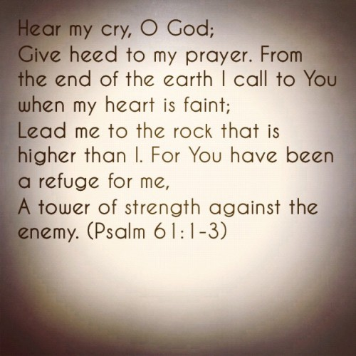
Notes:
So this is Lord’s Prayer, The useful template for our own prayer opens with a long look at God and ends with a long look at our need.
It touches on those things most important in prayer and is founded in our relationship as a dependent on our Holy Father
Beginning with motives followed by relational reality check. God is God and not us.
MY prayer is that you found this template extremely relational. It is more than just words on a page it is our father’s hearts desire in communication.
It is ONLY because of our relation to The Heavenly Father that any request is heard and acted on
Yet though we are reminded with his ‘otherness’, He has a real, earnest concern for us and our well being at our most basic levels…food.
We are to recognize our daily dependence on Him and to cultivate contentment for all he does.
Our relationship can be damaged by unforgiveness.
It can ALSO be quickly restored by correcting our hearts and asking God himself to heal us through His own forgiveness.
and it closes with the reality that God is in sovereign control but he hears our prayers he acts in mercy and gentleness even when we are pressed and tried.
We are to rely on Him for protection AND strength as we live’ behind enemy lines.
Work @ Boeing…One of the biggest issues we were told that the battlefield presented was communication.
Clear
Quick
Accurate.
We too are in a battle BUT we have, because of Jesus, IMMEDIATE, DIRECT, ACTIONABLE access to our Heavenly Father.
We have his ear. His attention
In closing… To recite the Lord’s Prayer as the Lord’s Prayer is a bit like eating the wrapper of a candy bar. It is better than starving. It may even have some of the taste but it is not nearly as satisfying as eating the bar that the wrapper displayed.

