Slide 1
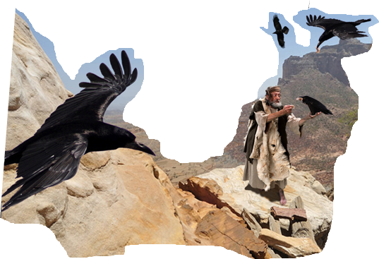
Notes:
For the last number of weeks we have been learning about the importance of MOTIVE.
I have been trying to understand my motives better and I am finding that I struggle with being transactional.
I do this- I should get this in return. Life is a vending machine. You get out of it what you put into it.
We know that is not true because we serve a gracious and merciful God but many times I find myself falling into that behavior.
Recently we have had impressed upon us the relational aspect of Christianity and how our relationship with Jesus Christ should be the driver for what we do and not a transaction.
It was brought up a couple of weeks ago that Christianity IS transactional. We obey…we are rewarded. I agree but I would like to shift the focus not on being rewarded (Because we are) but ON the reward.
If we pray/ give…whatever for a reward…even heaven, are we not missing the best blessing. Shouldn’t we be ‘doing’ not for things or for future blessing but for PRESENT RELATIONSHIP?
When we give (and we should be giving) What is our motive?
Are we more interested in what kind of impression we make on those we see around us or are we doing it to honor our unseen Heavenly Father?
When we pray, why are we praying?
Do we pray in a way that attracts attention to ourselves? Do we launch out in grand prayers full of flowery language and theology or do we come as a child would come to their guardian? Do we pray out of love and childlike devotion or are we really praying to call attention to ourselves and how righteous we are?
Because prayer is so important to our relationship to our Lord, Jesus gave us a template. A list of things that should be considered when addressing God in prayer and the template begins with a clear understanding of who we are speaking to.
A Heavenly Father who spared no expense to redeem us but also a Father whose glorious robes fill the heavenly temple in unapproachable splendor?
This week we will look at another practice that was popularized by the Pharisees and it was made popular for all the wrong reasons.

Slide 2
Matthew 6:16–18
“Whenever you fast, do not put on a gloomy face as the hypocrites do, for they neglect their appearance so that they will be noticed by men when they are fasting. Truly I say to you, they have their reward in full. “But you, when you fast, anoint your head and wash your face so that your fasting will not be noticed by men, but by your Father who is in secret; and your Father who sees what is done in secret will reward you.” (NASB95)
Notes:
The Pharisees had taken a relatively unused practice and made it into something it was never intended to be…a show!
In God’s Old Covenant economy, He had prescribed that his people fast.
That doesn’t seem to be so amazing but what I do find unusual (given the Pharisee’s penchant to fast) is the background.
READ

Slide 3
Fasting
Leviticus 23:26–32
The LORD spoke to Moses, saying, “On exactly the tenth day of this seventh month is the day of atonement; it shall be a holy convocation for you, and you shall humble your souls and present an offering by fire to the LORD. “You shall not do any work on this same day, for it is a day of atonement, to make atonement on your behalf before the LORD your God.

Slide 4
Fasting
“If there is any person who will not humble himself on this same day, he shall be cut off from his people. “As for any person who does any work on this same day, that person I will destroy from among his people. “You shall do no work at all. It is to be a perpetual statute throughout your generations in all your dwelling places. “It is to be a sabbath of complete rest to you, and you shall humble your souls; on the ninth of the month at evening, from evening until evening you shall keep your sabbath.”” (NASB95)
Notes:
The Israelites were commanded by God to fast a single day out of the year…That is the Day of Atonement.
The reason behind their fasting was…what? To humble themselves. It was to be a day that centered around gratitude for the Atonement sacrifice but ALSO a day that was to be used for self reflection. Why was this day even necessary? Should there be some sorrow mixed in to understand that a life had to be taken to spare my own?

Slide 5
Fasting
1 Samuel 7:6
They gathered to Mizpah, and drew water and poured it out before the LORD, and fasted on that day and said there, “We have sinned against the LORD.” And Samuel judged the sons of Israel at Mizpah.” (NASB95)
Notes:
The first time AFTER God had proclaimed the Day of Atonement a fasting day, we find 1 Samuel 7
Israel had LOST the ark of their covenant to the Philistine for presuming
God infected the philistines with boils and mice. The Philistines were wise enough to make the connection. so they decide to send the ark back and confirm their theory.
The ark returns and Samuel calls on the nation to repent; “If you return to the Lord with all your heart, remove the foreign gods and the Ashtaroth from among you and direct your hearts to the Lord and serve Him alone; and He will deliver you from the hand of the Philistines.”
The nation does indeed recognize their sin as Samuel reminds them. They remove the false idols from their midst and fast as an expression of the genuineness of their actions.
While they are gathered at Mizpah fasting, The Philistines see it as an opportunity to attack Israel but God steps in to stop them
The ark is put on a cart being pulled by two cows who had just given birth and although they should have rather decided to stay and nurse their calves, they pull ‘straight-away’ back to Israel.
Next time we see fasting it AGAIN is done on a national level and this is because of the desecration of Saul and his son’s bodies.
Saul and Johnathan and his brothers had died in battle. Saul dies by the hand of his own armor bearer as a ‘mercy-killing’ that is unappreciated by David.
The Philistines come back to the battle ground to loot the bodies. When the come upon Saul, they use his body as a trophy and decide to decapitate him and hang his body on the wall of the city.
Outside of this being humiliating because the city that they hung Saul’s body on was WITHIN the Border of Manessah, God had declared earlier that those who WERE hung were to be removed before nightfall. The Philistines certainly did not care. His body was a trophy that should be on display. BUT some of the valiant warriors DO walk all night to remove his body and give it a proper burial.
1 Samuel 31:11-13
Now when the inhabitants of Jabesh-gilead heard what the Philistines had done to Saul, all the valiant men rose and walked all night, and took the body of Saul and the bodies of his sons from the wall of Beth-shan, and they came to Jabesh and burned them there. They took their bones and buried them under the tamarisk tree at Jabesh, and fasted seven days.” (NASB95)
The last example I want to look at comes from the life of David and certainly is more well known.
David had fallen into sin with Bathsheba and her husband Uriah, killing him and impregnating her.
After she gives birth, God brings illness on the infant boy. David’s response is to fast for the life of the boy
2 Samuel 12:23
“But now he has died; why should I fast? Can I bring him back again? I will go to him, but he will not return to me.”” (NASB95)
So…Although God commanded fasting for a single occasion, it seems that God’s people understood what was behind it and it became part of their faith and practice. Exercised on special, specific occasions to underscore their hearts toward their circumstances.

Slide 6
Fasting
Isaiah 58:3
‘Why have we fasted and You do not see? Why have we humbled ourselves and You do not notice?’ Behold, on the day of your fast you find your desire, And drive hard all your workers.” (NASB95)
Notes:
Within a few hundred years we see that fasting has become more accepted and more of a standard practice AND more of a transaction
Isaiah 58:1–7
“Cry loudly, do not hold back; Raise your voice like a trumpet, And declare to My people their transgression And to the house of Jacob their sins. “Yet they seek Me day by day and delight to know My ways, As a nation that has done righteousness And has not forsaken the ordinance of their God. They ask Me for just decisions, They delight in the nearness of God. ‘Why have we fasted and You do not see? Why have we humbled ourselves and You do not notice?’ Behold, on the day of your fast you find your desire, And drive hard all your workers. “Behold, you fast for contention and strife and to strike with a wicked fist. You do not fast like you do today to make your voice heard on high. “Is it a fast like this which I choose, a day for a man to humble himself? Is it for bowing one’s head like a reed And for spreading out sackcloth and ashes as a bed? Will you call this a fast, even an acceptable day to the Lord? “Is this not the fast which I choose, To loosen the bonds of wickedness, To undo the bands of the yoke, And to let the oppressed go free And break every yoke? “Is it not to divide your bread with the hungry And bring the homeless poor into the house; When you see the naked, to cover him; And not to hide yourself from your own flesh?” (NASB95)
The relational aspect of fasting has diminished and has been taken over.
Their hearts are not into fasting for relational reasons but for ‘what can I get for it reasons’
They DO all the right things but there is no heart behind it. They put on sack cloth and bow their heads in humility but God is looking deeper. He is looking for fasting from a broken heart…a repentant heart, a heart that is seeking to be made whole in their relationship with God. He is pointing out to THEM the fallacy of their fast. They fast but their hearts are still hard toward their fellow Israelites…How can that be?
There is no earnestness or honesty behind their observing of their fasts.

Slide 7
Fasting
Zechariah 7:4–6
Then the word of the LORD of hosts came to me, saying, “Say to all the people of the land and to the priests, ‘When you fasted and mourned in the fifth and seventh months these seventy years, was it actually for Me that you fasted? ‘When you eat and drink, do you not eat for yourselves and do you not drink for yourselves?... (NASB95)
Notes:
To see God’s final direction on Fasting, we can look at Zechariah.
Written during the Babylonian exile.
It would seem that when Judah was exiled, fasting became even more prominent and ritualistic. Having specific months of fasting in an effort to get God to return them to their land.
Here God’s response to their fasting
Zechariah 7:4–13
Then the word of the Lord of hosts came to me, saying, “Say to all the people of the land and to the priests, ‘When you fasted and mourned in the fifth and seventh months these seventy years, was it actually for Me that you fasted? ‘When you eat and drink, do you not eat for yourselves and do you not drink for yourselves? ‘Are not these the words which the Lord proclaimed by the former prophets, when Jerusalem was inhabited and prosperous along with its cities around it, and the Negev and the foothills were inhabited?’ ” Then the word of the Lord came to Zechariah saying, “Thus has the Lord of hosts said, ‘Dispense true justice and practice kindness and compassion each to his brother; and do not oppress the widow or the orphan, the stranger or the poor; and do not devise evil in your hearts against one another.’ “But they refused to pay attention and turned a stubborn shoulder and stopped their ears from hearing. “They made their hearts like flint so that they could not hear the law and the words which the Lord of hosts had sent by His Spirit through the former prophets; therefore great wrath came from the Lord of hosts. “And just as He called and they would not listen, so they called and I would not listen,” says the Lord of hosts;” (NASB95)

Slide 8
Fasting
Acts 13:2–3
While they were ministering to the Lord and fasting, the Holy Spirit said, “Set apart for Me Barnabas and Saul for the work to which I have called them.” Then, when they had fasted and prayed and laid their hands on them, they sent them away.” (NASB95)
Notes:
Now, we know that the Pharisees fasted in the similar fashion and similarly missing the main point . But we DO have record of the Christian church exercising this as well.
The church, in their fasting, received direction from the Lord on what mission Paul and Barnabas were to undertake. Now we do NOT know if they were fasting for that in particular or not but what we DO know is that God honored their devotion as represented by their fasting AND service.
That really is the sole clear passage in the NT that discusses fasting. (There is another in Acts 27 but the fast that is being discussed there is the fast associated with the Day of Atonement)
What are we supposed to do with fasting?
Why was this a big concern for Jesus?
Is fasting necessary for Believers in the NT?
What is the purpose?
Are there any prerequisites?
Because it was not JUST fasting he was dealing with, was it?
What was it…motive? Relationship?

Slide 9
Fasting
Luke 5:34–35
And Jesus said to them, “You cannot make the attendants of the bridegroom fast while the bridegroom is with them, can you? “But the days will come; and when the bridegroom is taken away from them, then they will fast in those days.”” (NASB95)
Notes:
When we read Jesus response to the Pharisees when they ask why His disciples are NOT observing times of fasting, it becomes much clearer that fasting is all about relationship.
READ
It seems it is actually one of the most intimate forms of relationship because an acceptable fast comes from a heart that is unencumbered by self and full of devotion toward God. Jesus, when he talks to the followers about fasting makes it very clear that this act is JUST between the one who is fasting and the Lord.

Slide 10
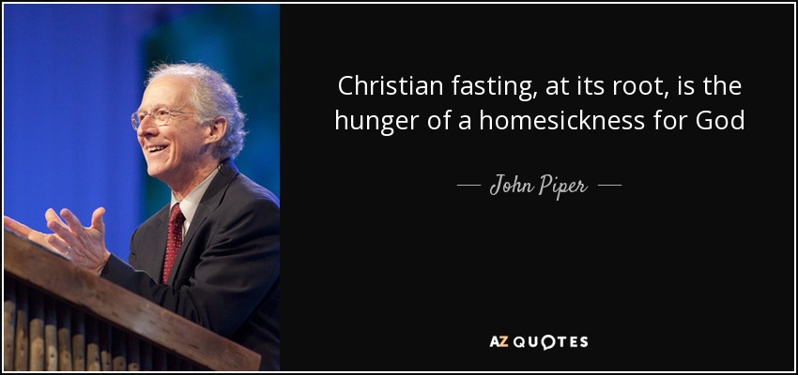
“Scripture does not command Christians to fast. It is not something that God requires or demands of Christians. At the same time, the Bible presents fasting as something that is good and profitable. Fasting and prayer are often linked together.”- Unknown, but not me
Notes:
The book of Acts seems to underscore there is benefit to proper fasting. But there is a line we need to not cross.
If we make it a necessity, that is crossing the line. The ONLY commanded fast was for the day of Atonement and that has been fulfilled in Christ.
If we think we can get God to act because of our fast, that is crossing the line.
If we think (or want or need) to impress others by our fast, we have completely missed the point. Fasting is an intimate, individual expression
Many would recognize the need say, ‘fasting without prayer is simply dieting’.
If we fast as an act of worship… and a way to clear our minds from distraction…in a sincere pursuit to know him better…We are probably more close to the biblical intent.
There is nothing magical about fasting but fasting accompanied by prayer and service is effective in drawing us closer to our Lord.
As I mentioned earlier. Fasting is not required but fasting done properly can increase humility, increase awareness of dependence and increase self control in pursuing the Lord with your whole heart. It is not necessary. It is not commanded it IS an opportunity if done with right motives.
That is why this is something that registers with Jesus, they have taken a very personal thing and tried to make it a public showcase of holiness instead of actual humility.

