Slide 1
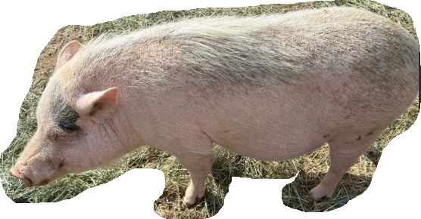
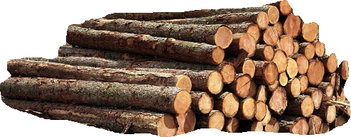
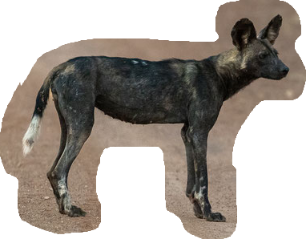
Notes:
Sinner…. Saved because of God’s mercy and not because of anything I did.
Today we are going to see what Jesus has to say to his gathereed crowd of followers and disciples.
Start with a story …No judging.
Younger…had a temper.
Grew up, grew out of it..sort of.
As Anita amd my wedding day drew near, some of the guys wanted to take me out…not much for that.
Spent time with them @ tennis.
Overheard them talking about their preparations for the night.
put stuff all over the car, blah blah.
I kindly asked them not to do that. Not a fan of calling attention to myself
Marriage night. Professed my love to Anita…everything was wonderful…birds are flitting around us and deer come out of the orange grove to wish us well.
My bride is absolutely stunning and everything is right with the world.
Late start out of the church...to honeymoon Had to wake up early for a physicl agility test for City of Tempe
Got to the vehicle….What do you think I saw?
Here I am in my white tux tearing off banners and popping balloons and Anita is standing there with here jaw dropped watching me.
The day my heart was filled with joy, I … Well you get the picture.
Talk about hypocrisy!
That is one of the issues Jesus deals with this week as we continue in Matthew.
Chapter 7, VS 1-6 or Logs, Hogs and Dogs.

Slide 2
Matthew 7:1–6
“Do not judge so that you will not be judged. “For in the way you judge, you will be judged; and by your standard of measure, it will be measured to you. “Why do you look at the speck that is in your brother’s eye, but do not notice the log that is in your own eye? “Or how can you say to your brother, ‘Let me take the speck out of your eye,’ and behold, the log is in your own eye?
Notes:
READ

Slide 3
Matthew 7:1–6
“You hypocrite, first take the log out of your own eye, and then you will see clearly to take the speck out of your brother’s eye. “Do not give what is holy to dogs, and do not throw your pearls before swine, or they will trample them under their feet, and turn and tear you to pieces.” (NASB95)
Notes:
READ
Jesus uses three object lessons to draw our attention to his truths surrounding hypocrisy and judgment
Logs, Hogs and Dogs.
Some of these vs. are most ABUSED in the bible.
vs,. 1 “Do not judge so that you will not be judged.”
Is Jesus really telling us, his followers to not judge at all?
Jesus has just given us a grocery list of things we should be pursuing as citizens of his kingdom. How can we know if we are unless we are weighing evidence and making judgments
He says we are supposed to emulate traits like;
Gentleness
Peacemaking
Merciful,
Pursuing righteousness
We are not to shy away from things like;
Persecution
Going the ‘extra mile’
Being salt and light in a wicked world
These ALL require that we form some sort of judgment.
Notice who we are judging though… All these things listed are meant to be measuring lines for our OWN growth.

Slide 4
Logs, Judging Others
1 Corinthians 6:1–2
Does any one of you, when he has a case against his neighbor, dare to go to law before the unrighteous and not before the saints? Or do you not know that the saints will judge the world? If the world is judged by you, are you not competent to constitute the smallest law courts?” (NASB95)
Notes:
Paul though, in his letter to the Corinthians DOES call for judgment of others.
As believers, God DOES call us to judge others, even within the body of Christ.
In Chapter 5 he has called out the church BECAUSE they had, until now, NOT brought judgment on people in the church who were decidedly acting in a way CONTRARY to God’s word.
Vs. 12 of Ch. 5 Paul says”; For what have I to do with judging outsiders? Do you not judge those who are within the church? “
As Believers, our judgment is NOT just for self evaluation but we a ARE supposed to exercise it in the body of Believers.
In Chapter 6 Paul reminds the believers of their heavenly office. How in the future, we are going to be judges of the entire world
READ
So There is definitely a place for judgment for self, others in the body and the world in general.
We cant dismiss or HIDE behind Matthew 7:1 so as to not proclaim the truth of God’s word in judgment to anyone.
I would dare say that the silence of the church in the world today, the ABSENCE of the church as a source of salt and light...a point of judgment, has contributed greatly to the disintegration of things like;
Human identity
The role of the family
Respecting authority
Getting back to Matthew 7.
What IS Jesus talking about?

Slide 5
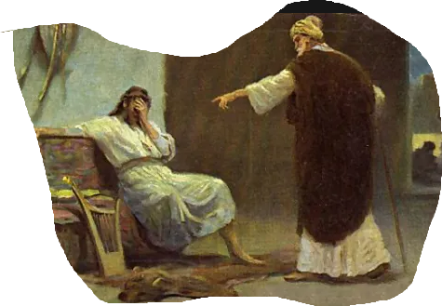
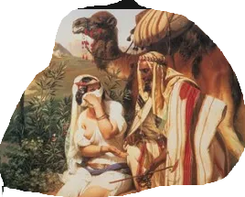
Logs, (Hypocrisy)
David and Nathan
Judah and Tamar
Notes:
The MAIN point Jesus is addressing is NOTjudging but How we are to judge.
Here are 2 prime examples found in Scripture of judging wrongly.
David- Taking Bathsheba yet denouncing the hypothetical man who stole a pet sheep from another man to feed his guests
And Judah and Tamar- Judah condemns tamar for unwed sex until he finds out that HE is the one she had sex with and it is only because he never fulfilled his promise to her to provide her a new husband.
Notice that the actual judgment is actually correct.
The man stealing the sheep should be punished and the woman found to have been an adulteress ALSO should have been punished
But one thing that our hypocritical judgments get us many time is an UNMERCIFUL response
David wanted to kill the man
Judah's anger BURNED against Tamar.
The sins we fall fr most often are usually the same sins we cannot toleragte when evidenced in others

Slide 6
Logs, Judging Others
John 7:24
“Do not judge according to appearance, but judge with righteous judgment.”” (NASB95)
Notes:
Jesus is NOT telling his followers to refrain from judgment but to do it correctly.
READ
The 1st step in judging correctly is to have clear vision. (Removing the log)
In Matthew 7, Jesus has separated judgment into two different spheres.
The 1st section has to do with our judgment of others in the faith…brothers and sisters.
““Why do you look at the speck that is in your brother’s eye”.
What we need to get away from is critical AND hypocritical judgments.
Gal. 6:1 Brethren, even if anyone is caught in any trespass, you who are spiritual, restore such a one in a spirit of gentleness; each one looking to yourself, so that you too will not be tempted.
Judgment certainly is not done as a way to make SELF look good, judgment is triage so we can determine how to BEST step in and HELP.
This can ONLY be done if we have no log or if, in Paul’s words, we are keeping one eye on ourselves so we do not stumble
1 Cor. 13:(Love) does not act unbecomingly; it does not seek its own, is not provoked, does not take into account a wrong suffered,
6 does not rejoice in unrighteousness, but rejoices with the truth;
7 bears all things, believes all things, hopes all things, endures all things.
Judgment is patient and hopeful. It does not write people off.
We need 1st remove the log out of our eye to STEP IN AND ASSIST with any speck in someone elses eye.
Loving someone does NOT mean withholding judgment but it means that benefit of the doubt is given..it means that there is a recognition that we are all on the same team…after the same goals. It means seeing something wrong and helping someone correct it
When John says don’t judge according to appearance…what does that mean?
Don’t judge a brother or sister solely on results.
Righteous judgment INCLUDES a consideration of motives.
This leaves very little room for assumption when it comes to assigning judgment or placing blame.
We are on shakey ground when we assume motives of others. Only God know our hearts.
Jamieson, Faust Brown commentary on Matthew 7;
“The context makes it clear that the thing here condemned is that disposition to look unfavorably on the character and actions of others, which leads invariably to the pronouncing of rash, unjust, and unlovely judgments upon them. No doubt it is the judgments so pronounced which are here spoken of; but what our Lord aims at is the spirit out of which they spring. Provided we eschew this unlovely spirit, we are not only warranted to sit in judgment upon a brother’s character and actions, but in the exercise of a necessary discrimination are often constrained to do so for our own guidance. It is the violation of the law of love involved in the exercise of a censorious disposition which alone is here condemned”
It is not that judging in and of itself is bad..It is WHY you are judging…what kind of heart do you have IN judging…What are YOUR motives behind judging.
This can take a bit of self reflection.
The great thing about all of this, though, is that there IS a Great judge.
He is unflappable
Unbuy-able
He cannot be fooled, conned or swayed. His jugdgments are always just.
He is ALWAYS able to judge in righteousness and there will be a time that he WILL set everything on order.

Slide 7
Logs, Judging Others
Romans 14:10
But you, why do you judge your brother? Or you again, why do you regard your brother with contempt? For we will all stand before the judgment seat of God.” (NASB95)
Notes:
READ
Are we to exercise judgment?
YES. To not do so would be foolish (see an example later).
We are to judge rightly though and that does NOT include assumption, pride or hypocrisy.
If you need further convincing of the importance of rightly judging someone, we need look no further than the next verse.
“For in the way you judge, you will be judged; and by your standard of measure, it will be measured to you.”
Carefulness should be exercised
Patience should be extended
Mercy and endurance should be incorporated when we are exercising judgment within the Body of Christ.
How seldom we weigh our neighbor in the same balance with ourselves.
- Thomas a Kempis
It is true all our sins have been purchased by the blood of Jesus Christ
(Thanks be to God!)
But as God’s children and spokespeople, we will give an account for what we have done here and that includes our willingness to step into others lives.
It ALSO includes a willingness to forgive prior offenses and not hold earlier judgments in concrete…writing people off forever.
This is a dismissal of the work of the Holy Spirit and a denial of His power in the lives of His children.
Jesus answers Peters hard question (that we were all thinking) about the place of forgiveness in the arena of judgment …how many times..3, maybe 4…maybe even 7??
Jesus response is full of mercy and grace…70 times 7.
Every man should keep a fair-sized cemetery in which to bury the faults of his friends.
- Henry Ward Beecher
Before we leave this topic, I want to spend a little time on an aspect of judging we don’t often think about but is absolutely heinous
The sneer at the godly man for his imperfections is ill-judged. A blade is a small thing. At first it grows very near the earth. It is often soiled and crushed and downtrodden. But it is a living thing,... and "it doth not yet appear what it shall be."
- Henry Drummond

Slide 8
Judging God
Job 36:21–23
“Be careful, do not turn to evil, For you have preferred this to affliction. “Behold, God is exalted in His power; Who is a teacher like Him? “Who has appointed Him His way, And who has said, ‘You have done wrong’?” (NASB95)
Notes:
We judge ourselves AND others often enough but do you ever realize how often we judge God?
We doubt his love for us in affliction
We doubt his provision in the loss of a job
We doubt his promises when things are rough
Dare I say that these doubts are all a form of judging God.
Job is a classic case of one who doubted God and literally wanted God to go to court to either justify his actions or to be judged in Job’s trail.
We all know how the book ends….Job confronted by God himself and is reminded of God’s place in Jobs life.
Prior to that, one of job’s counselors, the only one to NOT receive discipline from God had this to say to Job.
READ
These are profound words spoken by a man who has proved them in his life.
Be careful not to turn to evil because you do not like the station God has placed you in
Elihu reminded Job that this entire life was fitting him for something even grander…the afflictions Job endured were a training aid. They were things God used to re-direct Jobs eyes, mind and heart BACK to God.
Beside that, What court can you appeal to? God IS the Supreme Court. He takes orders from no one and his ways are ONLY his. He is incapable of doing wrong.
When we doubt, complain, we are placing ourselves above God just as we place ourselves above anyone else when we judge with a bad heart.

Slide 9
Hogs and Dogs (Wisdom)
Matthew 10:14–15
“Whoever does not receive you, nor heed your words, as you go out of that house or that city, shake the dust off your feet. “Truly I say to you, it will be more tolerable for the land of Sodom and Gomorrah in the day of judgment than for that city.” (NASB95)
Notes:
Jesus does NOT want his people to be absolute fools concerning judgment AND he wants them to grasp the importance of the message He will be entrusting them with so he does declare that there is a time to pronounce radical judgment on those OUTSIDE the body of Christ.
Dog- not domesticated, they were largely half-wild mongrels that acted as scavengers. They were dirty, greedy, snarling, and often vicious and diseased. They were dangerous and despised.
Hogs (pigs)- were considered by Jews to be the epitome of uncleanness.
Neither of these animals would have found any welcome in a Jewish home let alone being offered holy food or Precious pearls
These animals would not have understood the value of either of these things
READ
Jesus when he sent his disciples out gave them orders to not waste their time with people who were not interested and whose hearts were not at least receptive.
Paul in Corinth.
Finding time on the Sabbath to break away from work and teach @ the synagogue. When he had Silas and Timothy come to him, he was able to teach wholeheartedly
He taught in the synagogue for some time …We pick it up in Acts 18:6–7
But when they resisted and blasphemed, he shook out his garments and said to them, “Your blood be on your own heads! I am clean. From now on I will go to the Gentiles.” Then he left there and went to the house of a man named Titius Justus, a worshiper of God, whose house was next to the synagogue.” (NASB95)
John McArthur-” When people not only reject the gospel, but insist on mocking and reviling it, we are not to waste God’s holy Word and the precious pearls of His truth in a futile and frustrating attempt to win them. We are to leave them to the Lord, trusting that somehow His Spirit can penetrate their hearts-as He apparently did with some of those who at first rejected the preaching of Paul and the other apostles-or leaving them to the just judgment of God.”
It is not only OK but it is actually commanded by God to stop giving the gospel to an uninterested or antagonistic unbeliever!
In Matthew 18 he actually calls out the CHURCH to stop ministering to someone IN the church because of their unrepentant behavior.
In 2 Cor. Paul reminded the church that their willingness to bring judgment on another church goer actually brought repentance and reconciliation.
There is power in the gospel AND there is power in witholding the gospel.
There IS a time to STOP our work and commit the person to the Holy Spirit Who takes no pleasure in the punishment of the wicked, and intercede for their sould before God’s throne.

Slide 10
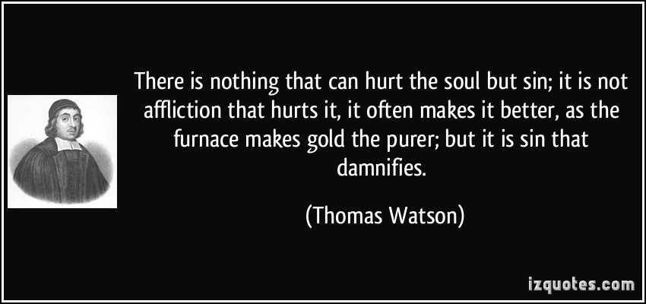
Notes:
Judgment, like anything else God gives us, is beautiful, empowering and restoring when used rightly.
But sin, taking the opportunity can twist it into something hateful, prideful and dis-honoring to God.
We see the results of wicked judgment all the time and we may be at a place where righteous judgment will no longer be tolerated in our society but that does not allow us an escape.
We are called… and commanded to judge…rightly, lovingly, patiently and wisely for the glory of God and the furtherance of His kingdom.

