Slide 1
Notes:
Wife helping with gratitude….
Funny to say it out loud.
One of the things she says (rightly so), ‘It could be much worse, at least you have (or don’t have or didn’t get or____________________
As Believers gratitude seems to be a much harder commodity to hold onto than it should be
I want to take today and our time together to encourage gratitude in these verses.
Remember context.
Talking to disciples about living in the kingdom of the King of Kings
Change in behavior- understand self, recognize need, living ‘behind enemy lines= No hiding actively engaging out of love
Change in attitude- I am more than what I do. My heart and thoughts are MORE important than what I do
Change in ability- know that the source of this change comes from God stepping into their lives. They need only to ask, seek, knock.
Then Jesus gives them more explicit instructions about what to expect as they Pursue the King and his kingdom.
He gives them direction and warning…I want to say he gives them Reason for Celebration and warning

Slide 2
Matthew 7:13–14
“Enter through the narrow gate; for the gate is wide and the way is broad that leads to destruction, and there are many who enter through it. “For the gate is small and the way is narrow that leads to life, and there are few who find it.” (NASB95)
Notes:
READ

Slide 3
Genesis 3:22–24
Then the LORD God said, “Behold, the man has become like one of Us, knowing good and evil; and now, he might stretch out his hand, and take also from the tree of life, and eat, and live forever”— therefore the LORD God sent him out from the garden of Eden, to cultivate the ground from which he was taken. So He drove the man out; and at the east of the garden of Eden He stationed the cherubim and the flaming sword which turned every direction to guard the way to the tree of life.”
Notes:
With his introduction of a gate and path,Jesus had, with this example taken them back to the;
Beginning
Creation Beauty and excellence
It was good…It was VERY good.
Adam and God had unbroken fellowship.
Recorded for us like this;
“They heard the sound of the LORD God walking in the garden in the cool of the day”
A stroll…with God;
Can you even imagine what was discussed?
Shortly, though, Adam’s sin damaged the relationship a bit (?)
Breaks the relationship;
Destroys the intimate Fellowship between he and the Lord…Already we see a lack of gratitude!
READ
God’s response was to cast them out of Eden and then do what?
Bar the Way!
Make return impossible. The clothing saved their lives but it did not take the sting of separation away.
We know the blood of goats and bulls (or bears or even lions)
Does nothing to take away sin and THAT is what separated them (and us) from God.
God gives us a stunning illustration of an impossible return;
God stationed Cherubim outside the garden with drawn/ flaming swords.
These were not the cheribum of Valentines day…soft, pudgy angels with baby faces and little hummingbird wings.
These were angels whose sworn and ONLY obligation was to keep mankind OUT of the garden.
Wielding weapons of defense not just swords but FLAMING swords…Holy swords…dedicated swords.
These are the same type of angels that were a reminder to Israel of the gravity of and Holiness of God
They were built into the structure of the mercy seat; stationed on the top of the ark of the covenant
Beautiful yet awesome reminders of their now having access to God ONLY because God decided to show them mercy.
,

Slide 4
Hebrews 10:19–22
Therefore, brethren, since we have confidence to enter the holy place by the blood of Jesus, by a new and living way which He inaugurated for us through the veil, that is, His flesh, and since we have a great priest over the house of God, let us draw near with a sincere heart in full assurance of faith, having our hearts sprinkled clean from an evil conscience and our bodies washed with pure water.”
Notes:
The blood of bulls or lambs would never be sufficient to wash away the stain of our sin but God told his disciples to ask, seek and knock.
Why?
READ
Because He himself would provide the way.
Hebrews says; “A new and LIVING way”
Not the same way…Not the dead way of Law obedience but a New and living way.
All animals sacrificed…spilling their blood died.
JESUS, spilt His blood yet is alive He is our ever-living, living way.
This HAS given us access to God…Directly.
Moving us closer to a full restoration as in the garden,
We ask, seek and knock. He provides the way.
Notice the end of vs, 22 though.
God does not just 'offer a way”
Our hearts are ‘sprinkled clean’,
Our bodies are ‘washed with pure water’….This ALSO is Jesus doing.
He has given us the way both in providing the pathway AND fitting us for the journey.
We are made New Creatures in Christ and changed; outfitted for our new pathway to His Kingdom.
We are the ONLY ones fit, able and willing to follow the new Narrow Way.

Slide 5
Jude 5
Now I desire to remind you, though you know all things once for all, that the Lord, after saving a people out of the land of Egypt, subsequently destroyed those who did not believe.” (NASB95)
Jude 10
But these men revile the things which they do not understand; and the things which they know by instinct, like unreasoning animals, by these things they are destroyed.” (NASB95)
Notes:
Jesus talks about a narrow way AND a wide way.
The wide way does NOT lead to anywhere good BUT it is an easy pathway with plenty of company.
One commentator says this; “You will have abundance of liberty in that way; the gate is wide,
and stands wide open to tempt those that go right on their way.
You may go in at this gate with all your lusts about you;
it gives no check to your appetites, to your passions: you may walk in the way of your heart,
and in the sight of your eyes; that gives room enough.
” It is a broad way, for there is nothing to hedge in those that walk in it,
but they wander endlessly; a broad way, for there are many paths in it; there is choice of sinful ways,
contrary to each other, but all paths in this broad way.
Secondly, “You will have abundance of company in that way: many there be that go in at this gate, and walk in this way.
” If we follow the multitude, it will be to do evil: if we go with the crowd, it will be the wrong way.
It is natural for us to incline to go down the stream, and do as the most do; but it is too great a compliment,
to be willing to be damned for company, and to go to hell with them, because they will not go to heaven with us:
if many perish, we should be the more cautious”
As Believers though, we see people in the wide way prosper and enjoy their time on their path and we are not UNAFFECTED. We see evil prosper. Wickedness is unpunished and earthly desires are unchecked without consequence.
We may ask Why when we are facing trials.
David asked Why?
Psalm 73:13–20
Surely in vain I have kept my heart pure And washed my hands in innocence;
For I have been stricken all day long And chastened every morning.
If I had said, “I will speak thus,” Behold, I would have betrayed the generation of Your children.
When I pondered to understand this, It was troublesome in my sight Until I came into the sanctuary of God;
Then I perceived their end. Surely You set them in slippery places;
You cast them down to destruction. How they are destroyed in a moment!
They are utterly swept away by sudden terrors! Like a dream when one awakes, O Lord, when aroused, You will despise their form.” (NASB95)
The Why is answered forcefully. Irrefutably and finally.
Those whom you see prosper and get what they apparently want in the world today WILL get what God PROMISED in the coming future.
Jude 5 reminds us that God God has always and will always hold Unbelievers responsible.
Jude 10 reminds us that It is the natural decision of mankind to try to revolt.
Psalm two---they devise 'vain things' in an attempt to overthrow God.
He sits in the heavens and laughs...installs KingJesus on the throne and gives him an iron scepter.
He warns the nations to revere His Son the king and give him the homage he is due.
Those who are traveling down the broad way have lived their entire lives in rebellion to their creator and king
They have spurned any of his offers of peace and reconcilliation..
There is no hope for them at death. They will fae an eternity AWAY from God and in eternal punishment for their affront.
Weak Gratitude responds…Well, at least we aren’t getting THAT.
That is a hollow gratitude.
one dimensional gratitude.
blind gratitude...gratitude for being left out.

Slide 6
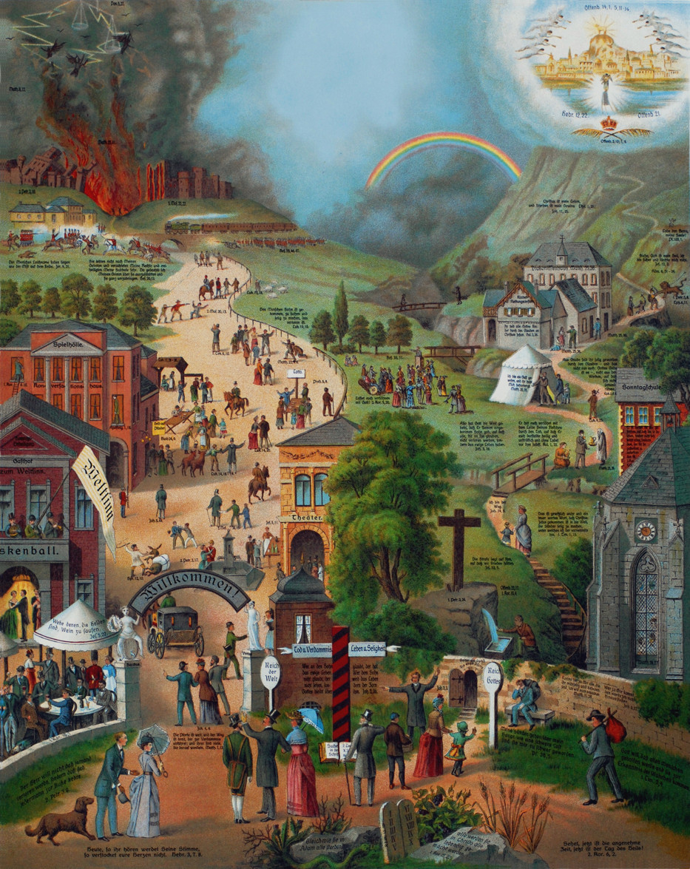
Every Pilgrims Progress
Notes:
I saw in my dream that one day, while he was walking and reading, greatly distressed, he burst out,
as before, “What shall I do to be saved?” He looked around wildly, as if looking to run, but he did
not know which way to go. As I watched, I saw a man named Evangelist come up to him ask, “Why do
you cry out?”
He answered, “Sir, I have seen in this book that I am condemned to die,
and after that to face judgment
. I do not want to do the first and am
unable to do the second.”
And Evangelist said, “Why are you not willing to die, since this life is so
hard and the world is filled with such evil?”, to which the man (whose
name was Christian) said, “Because I’m afraid that this burden which is
on my back will cause me to sink lower than the grave, and I shall descend into hell.
And sir, if I’m not equipped to go even to prison, I’m certainly not fit to go to judgment and from there to
execution. Even thinking of these things makes me cry.”
Evangelist said, “If such is your condition, why are you just standing there?”, and Christian
answered, “Because I don’t know where else to go.” Evangelist gave him a slip of paper, and on it
was written, “Flee the wrath that is to come.”
The man read it, and peering carefully at Evangelist, said, “Where must I go?
Evangelist, pointing across a very wide plain, said, “Do you see that wooden gate?”
and the man answered, “No.
Evangelist said, “Do you see that bright light?”
The man said, “I think so. Yes, I do.”
Then Evangelist said, “Keep that light in sight, and go directly to it. Then you will find the gate, and
when you are there, knock and you will be told what to do next.”
Now as Christian was walking alone, he saw another a long way off, coming across the field to meet
him. The gentleman’s name was Mr. Worldly Wiseman, who lived in the town of Carnality, a very
large city, very close to Christian’s own home town. This man, having heard of Christian – whose
flight from Destruction had been quite the topic of conversation in those parts – had guessed who he
was by observing his tortured labor, his sighs and groans and the like, and he began to converse with
Christian.
Worldly Wiseman: “Hello, my good man. Where are you going in this burdened manner?”
Christian: “As burdened a manner, I think, as any creature ever had! You ask me where I am going,
and I tell you that I am going to that gate that stands yonder. There I will be told how to rid myself of
this burden.”
Worldly Wiseman: “Do you have a wife? And children?
Christian: “Yes, but I am so loaded down with this burden on my back, I cannot take as much
pleasure in them as I formerly did. It’s as if I had no family.”
Worldly Wiseman: “Will you let me give you some advice?”
Christian: “If it’s good advice, I will. I need some good counsel.”
Worldly Wiseman: “I advise you, then, to quickly get rid of that burden, for you will never be
content until you do so, nor can you enjoy the blessings that God has given you until then.”
Christian: “That is what I want more than anything, to be rid of this heavy burden. But I cannot get
it off myself, nor is there any man in my country who can get it off my shoulders; that’s why I’m
going this way, as I said, to be rid of my burden.”
Worldly Wiseman: “Who told you to go this way to get rid of your burden?”
Christian: “A man who seemed to me to be a very great and honorable person, who goes by the
name of Evangelist.”
Worldly Wiseman: “I curse him for his counsel! There is not a more difficult and dangerous way in
the world than that which he has set for you – as you will discover, if you follow his directions.
You’ve already met with trouble, as I see from the mud all over you, for I can tell it is from the Bog
of Discouragement. That old swamp is the beginning of troubles for those who go that way. Listen to
me. If you go that way, you are likely to meet with weariness, pain, hunger, danger, nakedness,
battle, beasts, and demons. In a word: death! These things are true, having been confirmed by many
testimonies. And why should a man take a stranger’s advice, and in so doing, throw away his life?
Christian: “Why, sir, this burden on my back is more terrible to me than all these things you have
described. I don’t care what troubles I meet with in the way, if I can also meet with deliverance from
my burden.”
Worldly Wiseman: “How did you come by such a burden in the first place?”
Christian: “By reading this book in my hand.”
Worldly Wiseman: “Ah, I thought so. What has happened to you has happened to other weak men,
who meddle with things too high for them and become distracted. Those distractions not only
unnerve men, as I see they have done with you, but they lead them to go off on desperate ventures to
find what they are seeking, which they really do not know.”
Christian: “I know what I seek: relief from my heavy burden.”
Worldly Wiseman: “But why do you seek it in this way, seeing that so many dangers come with it?
Especially since, if you’ll hear me out, I can tell you how to get what you want with encountering the
dangers that you’ll run into if you continue in the way.
And besides, instead of those dangers, you will find safety, friendship, and contentment.”
Christian: “Please, sir, tell me this secret.”
Worldly Wiseman: “Why, in that village over there, which is called Morality, lives a gentleman
whose name is Legalism – a very judicious man, of good reputation, who has the skill to help men
discard such burdens as are on your shoulders. I have heard that he has helped a great deal of good in
this way, and he also has the skill to cure those who are going crazy over their burdens. And if he is
not at home, he has an assistant, a nephew named Civility, who can help you just as well as the old
man himself. There, you can be relieved from your burden, and if you do not wish to return to your
former home – as, indeed, I would wish for you – you can send for your wife and children and have
them come to this city, where there are many available homes. And there you can live, surrounded
by honest neighbors who make a good neighborhood.”
Now Christian had to stop and think, but eventually he concluded that, if everything this man had
said was true, it would be good to accept his advice, and so he spoke:
Christian: “Sir, how do I get to this honest man’s house?”
Worldly Wiseman: “Do you see that hill over there? Go up that hill, and the first house you come to
is his.”
So Christian left the way in order to go to Mr. Legalism’s place, but when he got to the hill, it
seemed so high, and it was so steep, that Christian was afraid to go any farther, lest the hill should
fall on his head. He stopped and pondered what he should do next, and his burden seemed heavier
than it ever had before. Then he noticed that flashes of fire would occasionally come out of the hill,
and Christian began to fear that he might be burned.
And he sweated and trembled with fear.
And now he began to be sorry that he had taken Mr. Worldly Wiseman’s counsel. Just then, he saw
Evangelist coming to meet him, and at the sight of him he began to blush with shame. Evangelist
came up to him with a scowl upon his face, and began to reason with Christian:
Evangelist: “What are you doing here, Christian?” Christian did not know how to answer, and stood
silently before him.
Evangelist: “Aren’t you the man whom I found crying in the city of Destruction?”
Christian: “Yes sir, I am that man.”
Evangelist: “And didn’t I direct you to the little wooden gate?”
Christian: “Yes, dear sir.”
Evangelist: “How is it, then, that you are so quickly turned aside? For you are now no longer in the
way.”
Christian: “I met a gentleman right after I had got out of the Bog of Discouragement, who
persuaded me that I might find a man in this village who could remove my burden.”
Evangelist: “Who was he?”
Christian: “He looked like an honest man, and he talked me into coming here, but when I saw this
hill, and how it hangs over the way, I decided not to go there lest it should fall on my head and crush
me……
Then Evangelist proceeded, saying, “Give heed to the things I am telling you. I will now show you
who it was who deceived you, and who it was to whom he sent you. The first is Mr. Worldly
Wiseman, who is named correctly – partly, because he enjoys only the doctrine of this world,
and partly because he loves that doctrine best because it saves him best from the responsibilities that
come with the cross.
Because he is so carnal, he seeks to pervert my ways, though they are right.
Now there are three things in his counsel that you must utterly abhor: (1) his turning you out of the
way; (2) his attempts to render the cross unnecessary and even repugnant to you; and (3) his leading
you into that way that leads to death.
“First, you must abhor his turning you out of the way, and your own compliance in the deed, because
this is to reject the counsel of God for the sake of the counsel of a man wise in the ways of the world.
The Lord says, ‘Strive to enter through the narrow gate’,which is the gate to which I sent you, for
‘narrow is the gate that leads to life, and few there are who find it.’
From this little gate, and from the way to it, this wicked man has turned you, and almost brought about your destruction. Hate,
therefore, his turning you out of the way, and abhor yourself for listening to him.
“Second, abhor his efforts to render the cross repugnant to you, for you are to prefer it to all the
treasures in Egypt.
Remember that the King of Glory has told you that he who will save his life
shall lose it,and that he who follows Him and does not hate his father and mother, and sisters and
brothers, and even his own wife and children, and his own life also, he cannot be His disciple.
I say, therefore, that if a man tries to persuade you that the cross will be your death (indeed, without
the cross you cannot have eternal life), you must abhor that doctrine.
“Third, you must hate his leading you into any way that leads to death. Consider to whom he sent
you, and also how unable that man was to deliver you from your burden…..
Now Christian wished that he could die right there, and he began crying out in sorrow, even cursing
the time in which he had met with Worldly Wiseman, calling himself a fool for listening to his
counsel. He was also ashamed to think that this man’s arguments, coming from the flesh, should
have prevailed with him and caused him to forsake the right way. Eventually, he spoke to
Evangelist:
Christian: “Sir, what do you think? Is there still hope? Can I go back and go up to the gate? Will I
be abandoned for what I’ve done, and sent back from the gate ashamed? I am sorry I listened to this
man’s advice. May my sin be forgiven?”
Evangelist: “Your sin is very great, for it has transgressed twice: you have forsaken the way, and
you have walked in forbidden paths. But the man at the gate will still receive you, for he has
goodwill for men. But take heed that you do not turn aside again, lest you perish from the way, when
His wrath is kindled but a little.
Then Christian resolved to go back, and Evangelist gave him a smile and bid him God-speed. So he
went on quickly, not speaking to anyone he encountered. He proceeded the whole time as though he
was walking on forbidden ground, and did not consider himself safe until he was again in the way
which he had left to follow Mr. Worldly Wiseman’s counsel. In due time, Christian made his way to
the gate, upon which he saw written, “Knock, and it shall be opened to you.”
I read this lenghty section;
So we can remember and be graful for;
How we came to the Lord and the circumstances surrounding our coming to Him.
Christian
Received a book
Recognized the burden on his back
'bumps into' Evangelist who sends him to the gate and cross
Bump into 'Obstinate and Pliable who serve to sharpen his focus and strengthen his resolve
falls into the swamp of Dispondence
a man named “Help' comes to his rescue by telling him there are actually steps to easliy get out.
Continuing on he meets another man who would take like to put him on the wide path.
Christian is again tripped up but Evangelist is able to re-align him.
Bunyan does a great jobunacking even God's involvement in the calling of His children.
For each of us it is wildly different but none the less each of us can now look back at 'circumstance', situations or discussions and say
without a doubt, God was with me every step of the way. His was the force behind everything required to bring me TO the gate.
I want us to remember that ever encounter, every word uttered to us, every opportunity,
every obstacle and finally even our willingness to embrace the Gospel are ALL from Him.
We need to remember that there was NOTHING special about any one of us, we all had our homes and lives, willingly established in the city of Destruction.
I want us to remember how many mis-steps...ESPECIALLY the mis-steps we took,
take and will take in our own unique experience. Coming to Christ, our journey until now and ALSO as we walk along the narrow way.
Note
In "The Pilgrim's Progress" by John Bunyan, Christian does not immediately lose his burden when he enters the Wicket Gate because the burden he carries symbolizes the weight of his sins and guilt. The Wicket Gate represents the entrance to the path of salvation, and Christian's journey is allegorical, reflecting the Christian experience of seeking salvation and deliverance from sin.
Christian's burden is a heavy load on his back that he has carried for a long time, burdened by the realization of his sinful nature and the fear of divine judgment. When he reaches the Wicket Gate, he is allowed entry into the narrow way that leads to the Celestial City (Heaven). However, his burden is not removed immediately because Bunyan intends to convey several important spiritual truths through this allegorical element of the story:
The Burden of Sin: Christian's burden symbolizes the weight of sin and guilt that all individuals carry before they come to faith. It illustrates the conviction of sin that leads people to seek salvation and forgiveness.
The Process of Sanctification: Christian's journey is not just about salvation but also about the ongoing process of sanctification, which is the transformation of the believer's character to become more Christlike. The removal of the burden is symbolic of the gradual process of becoming free from the power of sin and growing in spiritual maturity.
God's Timing: The timing of Christian's burden being removed signifies that God's grace and deliverance come at His appointed time. It's a reminder that people must trust in God's plan and timing for their spiritual growth and redemption.
Assurance of Salvation: By keeping the burden on Christian for a time, Bunyan emphasizes that salvation is not based on works but on faith in Christ. Christian's burden is ultimately removed when he reaches the Cross, representing the moment of genuine repentance and faith in Christ's atonement for sin.
So, Christian's burden is not removed immediately at the Wicket Gate to convey these deeper theological and allegorical messages about the Christian journey and the process of salvation. It is only after he reaches the Cross that his burden is lifted, signifying his redemption and forgiveness through faith in Christ.
Regenerate

Slide 7
Romans 8:31–32
What then shall we say to these things? If God is for us, who is against us? He who did not spare His own Son, but delivered Him over for us all, how will He not also with Him freely give us all things?” (NASB95)
Notes:
READ
In Romans, Paul TELLS us that as followers of Christ, although we are walking in the narrow way,
We need not fear falling away,
He uses argues the lesser from the greater.
If God has already spent His son's blood to redeem us, how will he not ensure our arrival at the goal.
David confirms this for us in Psalm 23...even though i walk through the valley of the shadow of death you are with me. and again in PS 139
Psalm 139:8–12
If I ascend to heaven, You are there; If I make my bed in Sheol, behold,
You are there. If I take the wings of the dawn,
If I dwell in the remotest part of the sea,
Even there Your hand will lead me, And Your right hand will lay hold of me.
If I say, “Surely the darkness will overwhelm me, And the light around me will be night,”
Even the darkness is not dark to You, And the night is as bright as the day.
Darkness and light are alike to You.” (NASB95)
Jesus says in John 6;
John 6:39–40
“This is the will of Him who sent Me, that of all that He has given Me I lose nothing, but raise it up on the last day.
“For this is the will of My Father, that everyone who beholds the Son and believes in Him will have eternal life,
and I Myself will raise him up on the last day.”” (NASB95)
Paul makes it legal and logical in Romans 8. John makes it relational and intimate.
John earlier records that Jesus sole mission was to accomplish His father's will.
His will is to not just purchase salvation (as amazing as that is) But he has also come to purchase safe passage to Journey's End at the Celestial City.
When we see salvation as a single act; transactional,logical, legal...as mind blowing as that is, that is NOT all that we have to be grateful for.
Our journey getting us TO the cross,
Our heart;s change to come to the cross and release our burden,
Our continued, day by day progress ON the narrow way are ALL designed to ellicit praise and gratitude from our hearts and minds.
How did we come into the way? By God's doing.
How did we pass through the gate? By God's doing
How have we made it this far through the way? God's protection, guidance and mercy How are we to continue on? Through the power of God having been fit for the journey by His Spirit.
Let us see what there is in this way, which, notwithstanding this, should invite us all to it; it leads to life, to present comfort in the favour of God, which is the life of the soul; to eternal bliss, the hope of which, at the end of our way, should reconcile us to all the difficulties and inconveniences of the road. Life and godliness are put together (2 Pt. 1:3); The gate is strait and the way narrow and up-hill, but one hour in heaven will make amends for it.

Slide 8
John 10:1–5
“Truly, truly, I say to you, he who does not enter by the door into the fold of the sheep, but climbs up some other way, he is a thief and a robber. “But he who enters by the door is a shepherd of the sheep. “To him the doorkeeper opens, and the sheep hear his voice, and he calls his own sheep by name and leads them out. “When he puts forth all his own, he goes ahead of them, and the sheep follow him because they know his voice. “A stranger they simply will not follow, but will flee from him, because they do not know the voice of strangers.”” (NASB95)
Notes:
.

