Slide 1
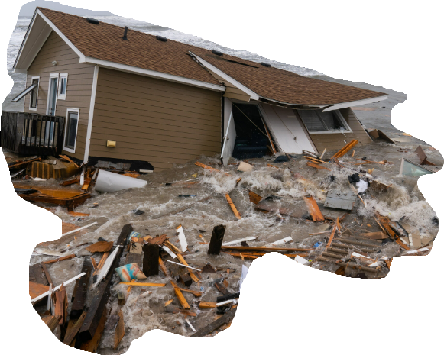
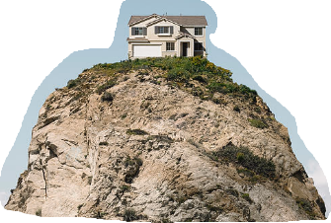
Notes:
There was a time in our marriage where I had lost my job and despite being faithful to look everyday and to try to start up a home business as well, we culdn't get any traction. As a matter of fact we went into significant debt. A feeling of hopelessness crept into my mind periodically as there was really noting I could do and everything I DID try met with failure. I was on this hamster wheel of money going out and nothing coming in.
My bet is that most of us have been there.
Anita had been much better prepared for this than I had been and her optimism and continuallyrefocusing me on Jesus is what Got us through but without that, I would have drown in despair.
In the section of scripture we have been going through (Sermon on the mount), my guess is that there were many listening to him because they felt the same way spiritually. The keep on DOING the OC law bu they see no progress in their own lives and they may even begin to question it's relevance.
Then Jesus come on the scene and starts talking and saying AMAZING THINGS about entering into the Kingdom of heaven that they had not heard before and they begin to listen closer and closer because , in Peter's words, He has the 'words of hope'

Slide 2
Matthew 7:24–29
“Therefore everyone who hears these words of Mine and acts on them, may be compared to a wise man who built his house on the rock. “And the rain fell, and the floods came, and the winds blew and slammed against that house; and yet it did not fall, for it had been founded on the rock. “Everyone who hears these words of Mine and does not act on them, will be like a foolish man who built his house on the sand.
Notes:
READ

Slide 3
“The rain fell, and the floods came, and the winds blew and slammed against that house; and it fell—and great was its fall.” When Jesus had finished these words, the crowds were amazed at His teaching; for He was teaching them as one having authority, and not as their scribes.” (NASB95)
Notes:
READ

Slide 4
2 Foundations- rooted in context
Therefore…
Notes:
The section begins with the connecting word; THEREFORE
Therefore; is a word used in scripture to move the argument along…to make a logical inference…to push us to take the next step.
But we need to ALSO keep in mind where we were.
Therefore; is ALWAYS rooted in context.
What IS the context?
The kingdom of Jesus is near. The kingdom of HEAVEN is at hand.
Jesus is establishing his nation in a similar fashion to the establishment of Israel @ Mt. Sinai. Standing on the mount and proclaiming the laws of the kingdom. (Instead of being an unapproacable mountain, this message is given to everyone who will listen
Jesus is declaring the laws , as the king, is the authoritative lawgiver…superseding the law of Moses and pushing the Old Covenant off the cliff of usefulness.
Jesus’ kingdom is NOT about outward ‘doing for doing sake’.
Jesus’ kingdom can be entered into ONLY by those who have a ‘right’ heart and has nothing to do with blood
A heart that begins with Jesus as the king. A heart that does things like show mercy, bring peace, hunger and thirst for righteousness, become salt and light in a failing world kingdom, love even your ‘enemies’, store up treasures in heaven by preparing now through PROPER prayer, PROPER giving and PROPER fasting. Rising ABOVE anxiety by pursuit of His kingdom and not our own, treating others as you would have them treat you. In conclusion, having a God given desire to “be perfect because your Heavenly father is perfect.”
Jesus’ kingdom is NOT available to those who follow the course of the world…entering in through the WIDE gate. They bear BAD fruit…rotten fruit of selfishness exhibited in greed, lust, control, fear, anger, pride, hypocrisy, arrogance and sowing disorder and chaos.
Therefore, Since the kingdom is here (AND it will not be entered into by very many)
AND entrance into it has nothing to do with what OTHER people think or even necessarily WHAT we do,
What ARE to be our next steps?
How is it that we gain entrance into the kingdom?
If this is the question rattling around in your head, The THEREFORE applies to you.
Jesus, in closing out his message to his followers, GIVES them their next steps

Slide 5
2 Foundations- different builders
The Foolish.
Psalm 14:1–3
The fool has said in his heart, “There is no God.” They are corrupt, they have committed abominable deeds; There is no one who does good. The LORD has looked down from heaven upon the sons of men To see if there are any who understand, Who seek after God. They have all turned aside, together they have become corrupt; There is no one who does good, not even one.” (NASB95)
Notes:
Here is your next step (and EVERYONE HAS a next step)
If you are wise; sensible, have understanding, are able to think, you will act on the words of the King and not continue to eat the bread of the Pharisees
If you are foolish; Scripture portrays fools as those who have rejected God.
Te have turned away from his ways and are unable or unwilling to appreciate the wisdom of knowing and obeying him.
(GK= moros) stupid, literally a MORON, you will NOT act on them.
Let’s spend some time on the ‘foolish’ builder, first.
David, in Ps 14 says this about the lot of the fool…
READ
The fool is someone whose HEART is not right with God.
David makes no mention of their heart but DOES confirm that from a wrong heart ONLY wrong can spring from it.
All their deeds are Abominable; loathsome, detestable, UNACCEPTABLE by a Holy God.
Abominable is the word of choice by God for idol worship…and for doing things like throwing your children into the fire to burn them as sacrifices
THEY… not just their deeds but they, themselves are corrupt; Unusable, destined for the trash…for destruction.
Jeremiah tells us what a corrupt person looks like.
Now; Jeremiah LOVED his countrymen and was jealous for their salvation and restoration but at every turn in the road, when they could have chosen to return to their God, they refused.
They depended on alliances with other nations, diplomacy, bribery but not in God.
God strengthens Jeremiah for his task to declare a message of certain destruction to the nation he loves so well.
He does this by exposing them for who they are and because of who they are... what their end is in Jeremiah 6
Jeremiah 6:28–30
All of them are stubbornly rebellious, Going about as a talebearer. They are bronze and iron; They, all of them, are corrupt. The bellows blow fiercely, The lead is consumed by the fire; In vain the refining goes on, But the wicked are not separated. They call them rejected silver, Because the Lord has rejected them.” (NASB95).
----Tried to melt lead to make lead for body repair....couldn't get impurities out so thrwe it all away
Fools are the unrepentant, the scoffers.
They are deny-ers and persecutors.
Fools are literally morons and unable to think clearly or see reality.
They are unbelievers…everyone of them.
Jeremiah is not the first one to declare the demise of the nation for their foolishness
Asaph, one of David’s worship leaders says this.
Psalm 81:10–13
“I, the Lord, am your God, Who brought you up from the land of Egypt; Open your mouth wide and I will fill it. “But My people did not listen to My voice, And Israel did not obey Me. “So, I gave them over to the stubbornness of their heart, To walk in their own devices. “Oh, that My people would listen to Me, That Israel would walk in My ways!” (NASB95)
The dividing line between foolish and wise is NOT IQ.
It is faith and Unbelievers do NOT have righteous faith.
They are irredeemable unless OR until God steps in.
1 Corinthians 6:9–11
Or do you not know that the unrighteous will not inherit the kingdom of God? Do not be deceived; neither fornicators, nor idolaters, nor adulterers, nor effeminate, nor homosexuals, nor thieves, nor the covetous, nor drunkards, nor revilers, nor swindlers, will inherit the kingdom of God. Such were some of you; but you were washed, but you were sanctified, but you were justified in the name of the Lord Jesus Christ and in the Spirit of our God.” (NASB95)

Slide 6
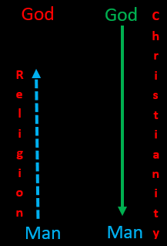
2 Foundations- different builders
The Wise
1 Corinthians 1:30–31
But by His doing you are in Christ Jesus, who became to us wisdom from God, and righteousness and sanctification, and redemption, so that, just as it is written, “LET HIM WHO BOASTS, BOAST IN THE LORD.”” (NASB95)
Notes:
READ
God gave us living object lesson in foolishness through the history of the nation of Israel’s interaction with God.
Borrowing from Paul in his documenting the ways of the world., “Professing to be wise, they became fools, and exchanged the glory of the incorruptible God for an image in the form of corruptible man and of birds and four-footed animals and crawling creatures”
We see the result of foolish behavior relating to God in the Old Covenant.
During the reign of Hezekiah, in the 6th year of his reign,he watched the kingdom of just north of his, Samaria, get dismantled and removed by the King of Assyria.
2 Kings 18:11–12
Then the king of Assyria carried Israel away into exile to Assyria, and put them in Halah and on the Habor, the river of Gozan, and in the cities of the Medes, because they did not obey the voice of the Lord their God, but transgressed His covenant, even all that Moses the servant of the Lord commanded; they would neither listen nor do it.” (NASB95)
They were cast OUT of the promised land; They were cast AWAY from God and allowed to live as they best felt.
But there IS a second type of builder, The WISE builder.
Care needs to be taken to identify who a wise builder is from the perspective of the king.
Isaiah paints a startling picture of wisdom that is really no wisdom at all;
Isaiah 5:20–21
Woe to those who call evil good, and good evil; Who substitute darkness for light and light for darkness; Who substitute bitter for sweet and sweet for bitter! Woe to those who are wise in their own eyes And clever in their own sight!” (NASB95)
If we want to know how the KING defines wisdom, we should go to 1 Cor.
1 Corinthians 1:20–25
Where is the wise man? Where is the scribe? Where is the debater of this age? Has not God made foolish the wisdom of the world? For since in the wisdom of God the world through its wisdom did not come to know God, God was well-pleased through the foolishness of the message preached to save those who believe. For indeed Jews ask for signs and Greeks search for wisdom; but we preach Christ crucified, to Jews a stumbling block and to Gentiles; foolishness, but to those who are the called, both Jews and Greeks, Christ the power of God and the wisdom of God. Because the foolishness of God is wiser than men, and the weakness of God is stronger than men.” (NASB95)
Paul says that there is wisdom that is recognized by the world that actually runs antithetical to the wisdom of God and his king, Jesus.
God has taken man’s wisdom and made it foolish.
God is the one who OWNS wisdom and he give it to whomever he desires.
God grants wisdom to ALL those whom He has called.
What IS the wisdom of God?
The wisdom of God IS THE GOSPEL, IT IS EMBODIED IN JESUS CHRIST.
CLICK
Man’s wisdom says I need to build a religion. A pathway to God, a way that I can ascend to His throne.
The tower of babel… manking wanted to climb up to God.
God declared this as foolish and confounded their languaget.
They could no longer share visions or thoughts. He made their wisdom (which was actually foolishness) un actionable for THEIR sake.
God’s wisdom On the other hand is to stoop DOWN to us and clear a pathway IN SPITE of ourselves, to God.
This he does in Christ Jesus
Jesus Christ is for us wisdom and righteousness (or right standing)
Jesus Christ is for us sanctification (purification or cleansing both legal and actual)
Jesus Christ is for us redemption. There is no other wisdom that will reconcile us to our creator.
Every other attempt made through the wisdom of man is foolishness

Slide 7
2 Foundations- different authorities
2 Peter 1:10,11
Therefore, brethren, be all the more diligent to make certain about His calling and choosing you; for as long as you practice these things, you will never stumble; for in this way the entrance into the eternal kingdom of our Lord and Savior Jesus Christ will be abundantly supplied to you.”
Notes:
The wise builder…where is His building instructions coming from?
Where does he get his blueprints for building correctly?
“everyone who hears these words of Mine and acts on them, may be compared to a wise man who built his house on the rock.”
His instructions come from the King.
The king is not Moses, the Pharisees and scribes or even the Old Covenant.
The foolish builder erects his house on his own foundation and builds his house as he thinks best.
You must understand the hopelessness of their predicament.
1St problem is that he cannot align anything with his foundation! Nothing fits!
He cannot build without knowing how any of the pieces fit together or even how they work together or what they are for.
He does not see his body as God’s temple so he does not honor God with it but instead uses it to feed his sin...destroying his body.
He doesn’t see relationships as something to cultivate for the kingdom but to use as he or she sees fit at the moment..alienating himself from his creator.
Following the king's instructions assures a strong and ready house.
2 Peter 1:2–11
Grace and peace be multiplied to you in the knowledge of God and of Jesus our Lord; seeing that His divine power has granted to us everything pertaining to life and godliness, through the true knowledge of Him who called us by His own glory and excellence. For by these He has granted to us His precious and magnificent promises, so that by them you may become partakers of the divine nature, having escaped the corruption that is in the world by lust. Now for this very reason also, applying all diligence, in your faith supply moral excellence, and in your moral excellence, knowledge, and in your knowledge, self-control, and in your self-control, perseverance, and in your perseverance, godliness, and in your godliness, brotherly kindness, and in your brotherly kindness, love. For if these qualities are yours and are increasing, they render you neither useless nor unfruitful in the true knowledge of our Lord Jesus Christ. For he who lacks these qualities is blind or short-sighted, having forgotten his purification from his former sins. Therefore, brethren, be all the more diligent to make certain about His calling and choosing you; for as long as you practice these things, you will never stumble; for in this way the entrance into the eternal kingdom of our Lord and Savior Jesus Christ will be abundantly supplied to you.” (NASB95)
God answers some outstanding questions in this section concerning these instructions.
He confirms for us that wisdom is found in the knowledge of God and in Jesus Christ.
This knowledge is found ONLY in His word. Literally in the scriptures and figuratively in the person of the Logos.
Jesus is the one who gives the tools and instructions AND abilities to build the house.
It is HIS divine power that grants us everything pertaining to life and godliness.
He is the one who took the power of sin and the sting of death OFF the table for His people thereby freeing them (and us) up and empowering us to live lives of obedience...and assembling our house correctly
A proper pursuit of holiness ensures direction keeping us from stumbling or fear.
Having God’s wisdom in Christ, established in His power, being obedient through His will actually works to confirm that the next steps we are making are in accordance with the Kings wishes and not for any other reason.

Slide 8
2 Foundations- different outcomes
Philippians 3:17–21
Brethren, join in following my example, and observe those who walk according to the pattern you have in us. For many walk, of whom I often told you, and now tell you even weeping, that they are enemies of the cross of Christ, whose end is destruction, whose god is their appetite, and whose glory is in their shame, who set their minds on earthly things…
Notes:
There IS a similarity in this parable of the very different houses.
The similarity is the storm… Rain…winds and flood.
As Christians, sometimes we (I) feel like I should not have to go ‘through’ the storm, Dr. Tackett would say our scripts call for 'clear sailing'.
But our lives are not our own. We are here are to be a testimony to our foundation and what better way to reveal the foundation than to test the strength of the building.
The foolish builder's house will crumble and crack in this life and in THAT DAY, The return of the king, the collapse of their house is certain.
Paul contrasts the two outcomes in almost every one of his writings. Romans, His letters to the Corinthians, His Thessalonian letters…but I think the best letter to understand the dichotomy is the epistle of the Philippians...written by Paul while in prision but identified by many as 'The Epistle of Joy”.
How can that be?
READ
Some things to address;
Remind yourself OFTEN of the outcome of the foolish.
There is no ‘safe haven’ There is no escape from the coming DESTRUCTION for the foolish, they are at constant war with the creator.
There is no place to flee to escape the gaze of His eye.
Every hidden thing will be exposed.
Evildoers are not getting away with anything.
God is not slow concerning his promise.
Do not confuse mercy with disregard.
The sure end of the wicked is destruction. To remind myself of that is a ready tool to escape temptation
2. The destruction of the wicked should be seen as a sorrowful thing.
If that is not the case, there is either a misunderstanding of God’s decree concerning hell and it’s eternity or a sinful attitude concerning self worth. We ALL, before Christ intervened, were merrily running headlong toward eternal judgment.
3. Importance of ‘Self’ is a pretty accurate barometer to identify what foundation you are building on and where you are in the building process.
Even as a Believer, my foundation may be sure enough but the building materials I use DO have an affect.
If I see myself following the path of the world, allowing the appetites of THIS world to control me…The reminder that the things the world glories in (wealth, prestige, power, notoriety, are all so much rubbish in relation to our pursuit of his kingdom.
1 Corinthians 3:12–15
Now if any man builds on the foundation with gold, silver, precious stones, wood, hay, straw, each man’s work will become evident; for the day will show it because it is to be revealed with fire, and the fire itself will test the quality of each man’s work. If any man’s work which he has built on it remains, he will receive a reward. If any man’s work is burned up, he will suffer loss; but he himself will be saved, yet so as through fire.” (NASB95)
Paul sets himself up as an example of escaping the judgment, building on the correct foundation and putting in effort to build and rebuild…daily.

Slide 9
2 Foundations- different outcomes
Philippians 3:17–21
…For our citizenship is in heaven, from which also we eagerly wait for a Savior, the Lord Jesus Christ; who will transform the body of our humble state into conformity with the body of His glory, by the exertion of the power that He has even to subject all things to Himself.” (NASB95)
Notes:
He knows that his foundation in Jesus Christ has come with a new location, new address and new citizenship.
He shares his understanding of who Jesus is and why he has fallen in love with His savior, His redeemer, His king and His God.
His is a waiting filled with EAGERNESS.
Literally a putting something down in order to get something very much better.
--I've given you movie tickets to watch a travelogue of Hawaii...You have all watched it.
The next time we meet, I tell you I have another set of movie tickets about Hawaii and give them to you.
I then tell you I will trade you your movie tickets for airline tickets to Hawaii flying out in March.
You take the airline tickets and then you “eagerly wait”
Paul shares that his (and our) current predicament is not worth the time it takes to describe it.
He looks forward…putting all things aside he presses on to the high calling.
Restoration to the king and bringing him (and us) into conformity with the body of his glory.
I don’t even know what all that means but it will be absolutely amazing.
How do I know?
Look at the power it takes to make it happen.
It take the same power to conform us as it does to bring EVERYTHING into subjection to Him.
Our conformity is going to be at least as amazing as his total re-creation of the sinless heavens and earth.
This is the certain future for those who enter through the narrow gate, do NOT get sidetracked by the flash of the world (Vanity Fair), bear proper fruit befitting His creation and have built on the Foundation of The Logos King.

Slide 10
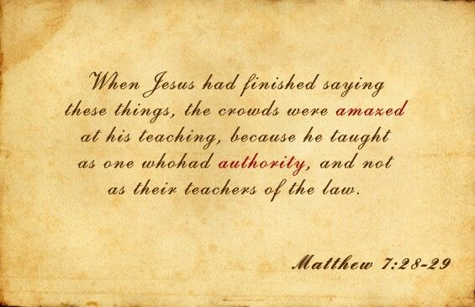
Notes:
With those words, Jesus brought his teaching to an end.
The result was that the people were amazed.
It was not human tradition or a re-hashing of legalities.
It was not human opinion it was God’s word
He had declared himself as the eternal king and rightful lawgiver
He declred Himself to BE the Holy God of Israel.
It was like nothing they had heard before because there was real hope…The king and his Kingdom had arrived!
By declaring himself as superior to the law, he has come with all the power and authority of God…Which we will begin to see as we enter into the next section of Matthew. That begins in Chapter 8

