Slide 1
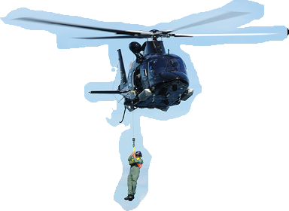
Notes:
Many of us have heard the saying;” When God closes one door He will open another (or a window)”.
There are some times in our lives (and we can all attest to this truth, That God closes a door an another avenue is not immediately apparent.
In fact I wish that it was as easy as just following the logical next step but many times that is NOT how God works. In fact, MOST times, God is very unpredictable. Even in the obvious He is unpredictable.
Only look as far as the birth of His Son.
very well prophesied about
He OBVIOUSLY fulfilled the prophecies and yet...Isaiah say “Seeing, they did not see and hearing, the did not understand”.
In our lives God usually is working on us on an entirely different level that we assume. We care SO MUCH about comfort, security and ease so we look to Him for that (and rightly so) But to God, those things are almost always less important. He is working on deeper things…Relational things like he did with Job.
Job wanted vindication and God was looking for contentment and satisfaction in Him.
We pray for health and ease but God is usually digging deeper.
Things like; giving up of self
Contentment
Faith
Perseverence.
These are things we don't look forward to usually but these are the things that really matter and what God is training us toward.
In this recounting of Jesus interacting with another paralytic, we see Jesus again going after something MUCH DEEPER than healing a may of paralysis and again, many miss it.

Slide 2
Matthew 9:1–8
Getting into a boat, Jesus crossed over the sea and came to His own city. And they brought to Him a paralytic lying on a bed. Seeing their faith, Jesus said to the paralytic, “Take courage, son; your sins are forgiven.” And some of the scribes said to themselves, “This fellow blasphemes.” And Jesus knowing their thoughts said, “Why are you thinking evil in your hearts?
Notes:
READ

Slide 3
“Which is easier, to say, ‘Your sins are forgiven,’ or to say, ‘Get up, and walk’? “But so that you may know that the Son of Man has authority on earth to forgive sins”—then He said to the paralytic, “Get up, pick up your bed and go home.” And he got up and went home. But when the crowds saw this, they were awestruck, and glorified God, who had given such authority to men.” (NASB95)
Notes:
After Jesus sails BACK across the sea of Galilee, he goes directly to his ‘home port'. His base of operations…Capernaum.
He moved from his actual hometown of Nazareth due to their ‘lack of faith’
Those living in Nazareth had lived too long around Jesus and were familiar with him in his childhood context.
They were unwilling and unable to shift their focus from their historical perspective to a proper perspective embracing the reality of Jesus for the day.
We may shake our heads at that thinking but it is a real thing and affects us more than we know.
How many of us take the MATERIAL blessings for granted or worse yet…attribute the blessing of God to our OWN ability?
My hard work put bread on the table or money in the bank.
It was MY diligent use of time that allowed me to accomplish this great feat or even this nagging, repetitive job.
It was my use of Elderberry or Vitamin C or Vitamin D or echinacea or whatever that kept the cold away from me.
It occurs in our lives so frequently. We give The Lord his due when extra-ordinary things happen (It’s a God thing) but we do not recognize him in his daily providence.
We are blinded by familiarity, just like the Nazarenes. Jesus grew up among them and they saw him ONLY that way. They cannot believe the extraordinary because they saw him in ordinary so often.
We cannot believe the ordinary because we look ONLY for extra-ordinary!
So, Jesus wastes no more time in Nazareth but operates from and frequently visits Capernaum.
We catch up with him here in this section.

Slide 4
Escalation continues
Authority over the physical
Authority over the natural
Authority over the spiritual
Notes:
Through out the last chapter, we have seen an escalation of sorts.
We have seen an escalation of Jesus authority and we have also seen a coinciding expansion in the borders of His kingdom.
We went from Physical kingdom and Israel as the border to physical kingdom with world-wide borders when he healed the Centurion’s slave.
He added the realm of nature into His kingdom with the calming of the storm. Expanding his kingship and kingdom to include ALL created things.
From there, Matthew introduces us into yet another realm of authority and that is the spiritual realm.
Jesus rules over the spirit realm, casting out demons, allowing them to inhabit the local pigs ONLY to make his authority known to the entire community when he shuffles the pigs into the sea.
The people, at some level caught the impact because they wanted…begged him to leave.

Slide 5
Escalation continues
Authority over the physical
Authority over the natural
Authority over the spiritual
Authority over the ETERNAL
Notes:
When we read on in Matthew’s account, we find that Jesus’ authority extends beyond the seen, to the unseen spiritual realm and it ALSO extends through time to eternity.
He is never in danger of loosing His kingdom. Time has no effect.
Unlike the kings of Israel or Babylon, Persia, Assyria, Egypt, or even today- the UAE, Jordan, Thailand all are overseen by kings who have or will loose their throne either by overthrow, destruction or death. Even dictators such as those we find in Russia, China, N. Korea or Venezuela will, in time, loose their power or authority.
Matthew opens our eyes so we CAN see.
In healing this man, the paralytic, we get a glimpse of Jesus kingdom extending BEYOND the curtains of TIME in that he is able to forgive sins and free them from their current eternal captivity. Something only the God who lives outside of time and space can do.
His Kingdom has NO Boundaries and His authority has no limit.
What should the truth of these statements provide for us his subjects?
How ought these realities shape our interactions with people within and outside of the kingdom?
How should we come to the King and of what things should we talk when we are engaging him in discussion? (prayer)

Slide 6
Seeing their faith…..
Ephesians 3:20
Now to Him who is able to do far more abundantly beyond all that we ask or think, according to the power that works within us,” (NASB95)
Notes:
One of the first things we come across is the recognition Jesus has of the men’s faith.
Based on the dialogue, I would include the man on the mat in this group.
He ‘SEES’ their faith.
How can he SEE faith?
Is it their aura?
Do people of faith have the halo above them or maybe he was able to see their 'guardian angels?
John 2:23–25
Now when He was in Jerusalem at the Passover, during the feast, many believed in His name, observing His signs which He was doing. But Jesus, on His part, was not entrusting Himself to them, for He knew all men, and because He did not need anyone to testify concerning man, for He Himself knew what was in man.” (NASB95)
Jesus KNOWS the hearts of all men.
Psalm 90:8
You have placed our iniquities before You, Our secret sins in the light of Your presence.” (NASB95)
Psalm 139:4
Even before there is a word on my tongue, Behold, O Lord, You know it all.” (NASB95)
There is NOTHING hidden from God or from His Son Jesus Christ.
Someones words or actions are in no way surprising to Him.
He alone is able to judge the hearts of Men.
Jesus knows the faith of these men.
But there is also another way Jesus AND EVERYONE ELSE ‘sees' their faith and it is explained better in Mark.
Mark 2:1–4
When He had come back to Capernaum several days afterward, it was heard that He was at home. And many were gathered together, so that there was no longer room, not even near the door; and He was speaking the word to them. And they came, bringing to Him a paralytic, carried by four men. Being unable to get to Him because of the crowd, they removed the roof above Him; and when they had dug an opening, they let down the pallet on which the paralytic was lying.” (NASB95)
Their faith was evidenced by their action.
This is a well knon though maybe sometimes inconvenient truth.
Our faith is revealed in what we say and do.
James= faith without works is dead
Jesus= For whoever is ashamed of Me and My words in this adulterous and sinful generation, the Son of Man will also be ashamed of him when He comes in the glory of His Father with the holy angels.”
But there is MORE to this story than just the faith that put the paralytic in front of Jesus.
Jesus goes BEYOND rewarding their faith in him being able to affect a cure.
He looks at the young man (he calls him ‘son’) and tells him His sins are forgiven!
He comes to Jesus to be cured of his paralysis and leaves…walking AND forgiven of his sin!
I do not know if that forgiveness extends to ALL his sins or possibly just the sins that may have caused the paralysis.
(Jn.8:1-11-adulterous woman, or Lk.23;34 forgiving those who nailed him to the cross are examples of Jesus forgiving specific sins))
The point is that Jesus is able to do it.
How is that possible? The Jews knew that all sin committed was committed against God (Psalm 51 Against you and you alone have I sinned) and he alone has the right and authority to forgive and restore.
We get a clue to his authority, believe it or not, from his name.

Slide 7
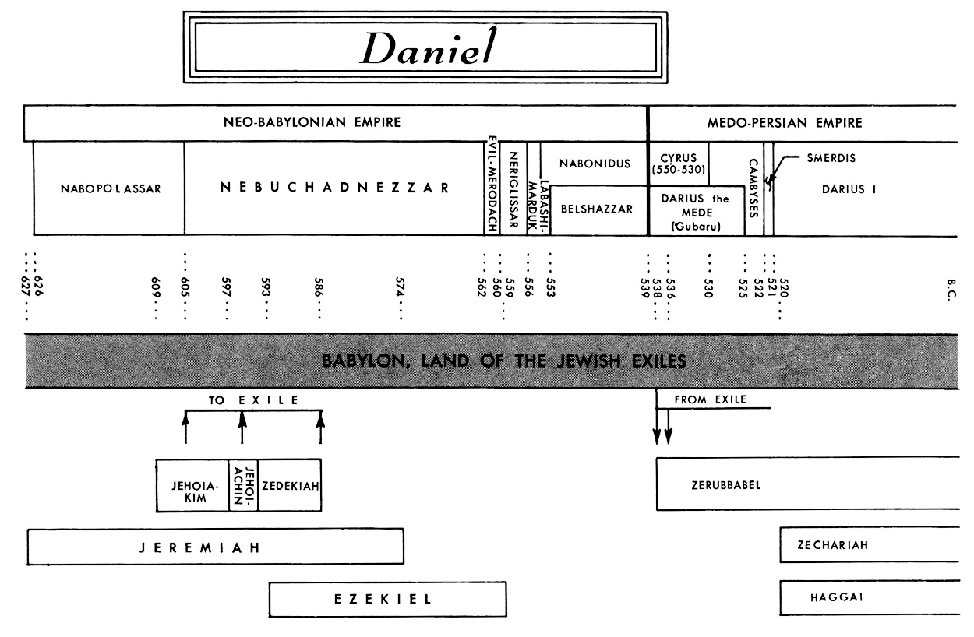
Authority to Determine sin- Daniel 7; Son of Man
Daniel 7
DANIEL 7 VISION
DANIEL 6
Notes:
Jesus calls himself the Son of man a number of times in the gospels and he does in this section. I think for a reason
Son of Man can be interpreted 1 of two way.
It can either be interpreted as in PS. 8;4 or Ps. 80:17 or Job 25:6 as a representative for mankind OR
It can be interpreted as in Daniel 7:13,14.
Daniel divides in Chapter 7.
Chapters 1-6 are written biographically but when you hit chapter 7 Daniel puts on his helmet pf prophecy and begins to discuss things in history more globally and covering time from sweeping through to the end of days.
Chapter 7 begins with a wild vision about 4 beasts, horns, The Ancient of Days, a throne, a court of judgment and the Son of Man. The vision of Daniel 7 took place BEFORE the things in Daniel 7 like the Lion’s den.
The Son of Man is presented to the Ancient of Days who is sitting on His throne;
“I kept looking in the night visions, And behold, with the clouds of heaven One like a Son of Man was coming, And He came up to the Ancient of Days And was presented before Him.” (NASB95)
Prior to any court action though, the Son of man has been given absolute authority over all mankind.
“And to Him was given dominion, Glory and a kingdom, That all the peoples, nations and men of every language Might serve Him. His dominion is an everlasting dominion Which will not pass away; And His kingdom is one Which will not be destroyed.” (NASB95)
He, along with the Ancient of Days, convene court
Daniel 7:25–26
‘He (The beast) will speak out against the Most High and wear down the saints of the Highest One, and he will intend to make alterations in times and in law; and they will be given into his hand for a time, times, and half a time. ‘But the court will sit for judgment, and his dominion will be taken away, annihilated and destroyed forever.” (NASB95)
The Son of Man and the Ancient of Days sit in judgment on the Beast, find him guilty and remove all His power and dominion.
Jesus’ mission IS to do just that…He goes to the cross to remove the power of sin that is identified by the court (He and His father) and the sting of death as the Son of Man.
And although it is not mentioned in scripture, I think you can make a case for a connecting the Son of Man’s duties all the way back to Adam.
Adam as man’s representative SHOULD have resisted Satan and destroyed the power of the devil in Eden but he does not.
Man falls under judgment. When Ezekiel is called the Son of man, it is primarily in the context of Ezekiel delivering a message of judgment or sitting in judgment on the people he was sent to. It is as if Ezekiel is confirming the sinfulness of Israel as their representative. He sees their sin, he knows it is sin and declares the consequences.
Jesus came as the second Adam, the second representative, the successful Son of man and accomplishes what Adam fails at.
When Jesus calls himself the ‘son of man’ is he representing all mankind…absolutely. but along with that, Jesus knows what sin is and agrees it is sin AND agrees with the consequences…pronouncing judgment in some cases. Frequently, when he assumes the title of the Son of Man, there is a backdrop of judgment.
Jesus, as the son of man- serves as representative, is given authority to identify and judge sin AND still as our representative...as the Son of Man, provides the sacrifice we are unable to that frees us from the same just condemnation.
All this to say that when Jesus refers to Himself as ‘The Son of man’ it goes BEYOND representation. It carries authority.
Ezekiel as the Son of Man pronounced Judgment but was helpless to fix it (Think valley of dry bones)
Ezekiel 37:3–6
He said to me, “Son of man, can these bones live?” And I answered, “O Lord God, You know.” Again He said to me, “Prophesy over these bones and say to them, ‘O dry bones, hear the word of the Lord.’ “Thus says the Lord God to these bones, ‘Behold, I will cause breath to enter you that you may come to life. ‘I will put sinews on you, make flesh grow back on you, cover you with skin and put breath in you that you may come alive; and you will know that I am the Lord.’ ”” (NASB95)
Jesus comes as the Perfect Son of Man.
He comes as our representative
He comes with authority to judge
He ALSO comes with authority to forgive, heal and restore

Slide 8
Seeing isn’t always Believing.
John 6:41–44
Therefore the Jews were grumbling about Him, because He said, “I am the bread that came down out of heaven.” They were saying, “Is not this Jesus, the son of Joseph, whose father and mother we know? How does He now say, ‘I have come down out of heaven’?” Jesus answered and said to them, “Do not grumble among yourselves. “No one can come to Me unless the Father who sent Me draws him; and I will raise him up on the last day.” (NASB95)
Notes:
Jesus was able to SEE the faith of the men..because he was able to see their hearts. Know their motives and desires.
The scribes were NOT able to SEE Jesus authority. They could not read his heart and refused to believe his words.
So like the men, Jesus provides eye-witness visible proof of his claim.
The men’s claim to faith was borne out by their removing the roof of the house and dropping the young man down right in front of Jesus so that he could not be missed.
Jesus claim to forgive could not be SEEN but by healing the young man, He was able to prove visibly that the man was no longer under the burden of sin that led to this.
His sin had been forgiven and no consequences remained.
But just like the disciples in the Boat, who said in response to Jesus calming the storm; What kind of a man is this, that even the winds and the sea obey Him?”
The on-lookers are absolutely amazed at the healing of the paralytic yet remain unconvinced.
Matthew 9:8
But when the crowds saw this, they were awestruck, and glorified God, who had given such authority to men.” (NASB95)
This is an example of the truth of John 6:44
John 6:44
“No one can come to Me unless the Father who sent Me draws him; and I will raise him up on the last day.” (NASB95)
The crowd in John 6 could not get past the fact that they SAW him growing up so they COULDN’T SEE him now as anything more than that guy.
It takes an intervention from God Himself to open the eyes and unstop the ears,
The people were not ready, so seeing was not believing for them but for the men, their faith was rewarded beyond what they had hopped for.

Slide 9
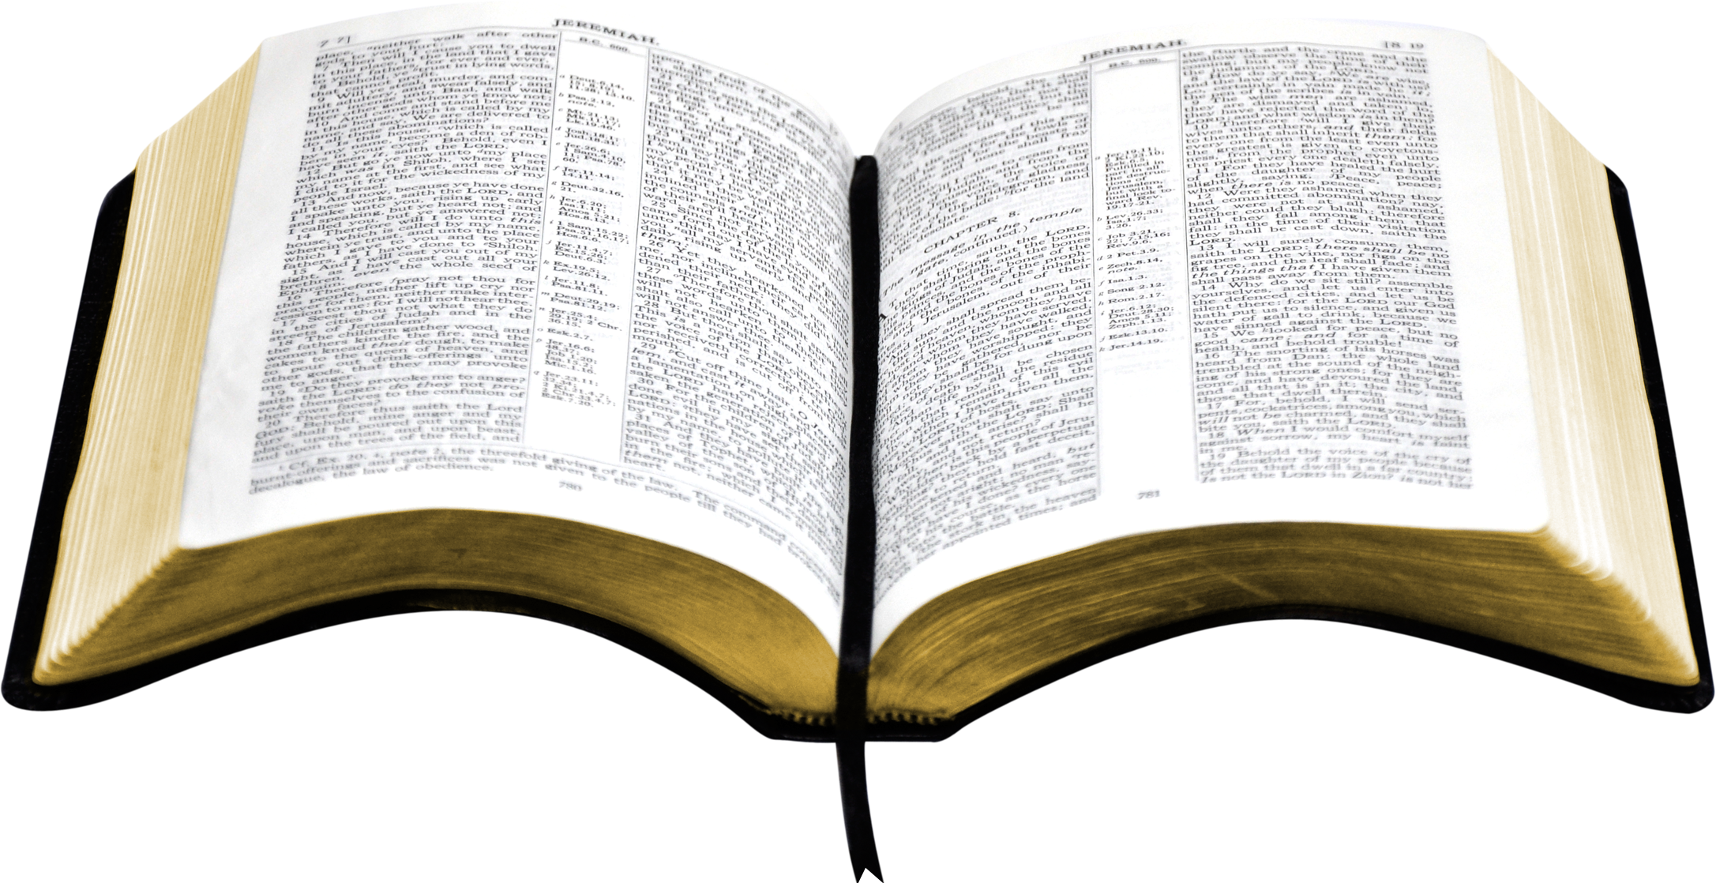
Consider these
1. Faith is evidenced in APPROVED action yet God’s word is the standard
2. It is Jesus alone who is qualified to recognize as well as
deal with sin in the eternal.
3. It is God who draws. To him alone belong the time, circumstance and result. Nothing can stop Him since He OWNS even providence, and his
reign is boundless
Notes:
So what?
Here are at least three things to think about. How do these truths impact your life?
Number 1; Action for the sake of action is not good and action for the wrong reason is not good either.
As Children of the King, He has called us to live a life of service to others in a way that Maginifies Him to the world. What does that look like?
We have our marching orders as well as examples (both good and bad) in His Word.
Number 2: While we all know by definition, what sin is, it is only Jesus, who knows the heart and is able to accurately call it out. He ALSO is the only one who HAS granted us freedom from paralysing slavery to sin.
He serves as jury in convicting, judge in sentencing AND lawyer in commuting the sentence by paying for it himself.
Number 3: Salvation is a gift from God that we have the responsibility and honor of offering to others. We have been given a gift that grows as it is shared BUT we are never responsible for the receiver. Growing up, I spent hours trying to find the 'best gift' (within my budget) for each of my family membrs and I waited anxoiusly to see their response because the gift was a reflection of me and if they 'loved it, they loved me. If they turned their nose up...it felt personal as well.
The gift God has given us to share is NOT ours. It did not come from us so acceptance or rejection has nothing to do with us.
These truths spill out beyond the gospel though.
James 1:17 says “Every good and perfect gift is from above, coming down from the Father of the heavenly lights, who does not change like shifting shadows”.
The ‘gift’ extends beyond the gospel to include everything he is and does through everyone and everything he brings into our lives.
God OWNS providence so there are no coincidences or mistakes. We meet who we are supposed to when we are supposed to. WE in that case become ONE of the gifts of God to those around us...how does THAT feel?
You are one of God's good and perfect gifts to us and we to you.The things we have and the things that happen to us are ALSO good and perfect gifts.
Including the promises we cling to.

