Slide 1
The Book of James
Lesson 17
Chapter 3 vss. 1-2

Slide 2
James 3:1–2 (NASB95)
Let not many of you become teachers, my brethren, knowing that as such we will incur a stricter judgment. For we all stumble in many ways. If anyone does not stumble in what he says, he is a perfect man, able to bridle the whole body as well.

Slide 3
Acceptable 'Circular Reasoning' (WEEK 5)
1:19- slow to speak
1:26- bridle your tongue
2:12- speak and act as those who will be judged by the Law of Liberty
2:14 saying you have faith isn't confirmation of it
3:1-12

Slide 4
Are James and Paul at Odds Again?
1 Timothy 3:1 (NASB95)
It is a trustworthy statement: if any man aspires to the office of overseer, it is a fine work he desires to do.
Hebrews 5:12 (NASB95)
For though by this time you ought to be teachers, you have need again for someone to teach you the elementary principles of the oracles of God, and you have come to need milk and not solid food.
1 Timothy 5:17 (NASB95)
The elders who rule well are to be considered worthy of double honor, especially those who work hard at preaching and teaching.

Slide 5
SO.. It is Not the Goal but the Motive
WARNING>>>THIS LETTER IS WRITTEN TO BELIEVERS
1 Corinthians 10:12 (NASB95)
Therefore let him who thinks he stands take heed that he does not fall.
James 3:2 (NASB95)
For we all stumble in many ways. If anyone does not stumble in what he says, he is a perfect man, able to bridle the whole body as well.

Slide 6
SO.. It is Not the Goal but the Motive
Wrong motive#1; To be honored by men
Matthew 23:5–8 (NASB95)
“But they do all their deeds to be noticed by men; for they broaden their phylacteries and lengthen the tassels of their garments. They love the place of honor at banquets and the chief seats in the synagogues, and respectful greetings in the market places, and being called Rabbi by men.
But do not be called Rabbi; for One is your Teacher, and you are all brothers.”

Slide 7
SO.. It is Not the Goal but the Motive
Wrong motive#1; To be honored by men
Galatians 1:9–10 (NASB95)
As we have said before, so I say again now, if any man is preaching to you a gospel contrary to what you received, he is to be accursed! For am I now seeking the favor of men, or of God? Or am I striving to please men? If I were still trying to please men, I would not be a bond-servant of Christ.

Slide 8
SO.. It is Not the Goal but the Motive
Wrong motive#2; Spin their own Doctrine
Acts 20:29–30 (NASB95)
“I know that after my departure savage wolves will come in among you, not sparing the flock; and from among your own selves men will arise, speaking perverse things, to draw away the disciples after them.

Slide 9
SO.. It is Not the Goal but the Motive
Wrong motive#2; Spin their own Doctrine
2 John 9 (NASB95)
Anyone who goes too far and does not abide in the teaching of Christ, does not have God; the one who abides in the teaching, he has both the Father and the Son.

Slide 10
SO.. It is Not the Goal but the Motive
Wrong motive#3; Material Gain
1 Peter 5:2 (NASB95)
shepherd the flock of God among you, exercising oversight not under compulsion, but voluntarily, according to the will of God; and not for sordid gain, but with eagerness;

Slide 11
SO.. It is Not the Goal but the Motive
Wrong motive#3; Material Gain
1 Timothy 1:5 (NASB95)
But the goal of our instruction is love from a pure heart and a good conscience and a sincere faith.

Slide 12
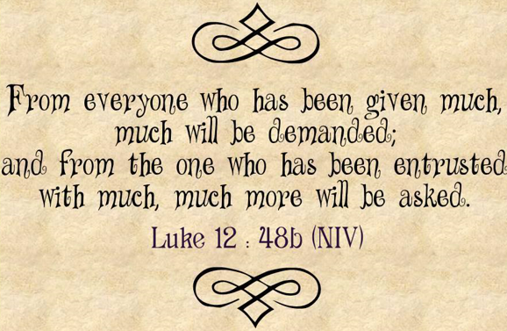
OR

Slide 13
